Slide 1

ECE 383 – Embedded Computer Systems II Lecture 1 – Intro to Digital System Design
Maj Jeffrey Falkinburg Room 2E46E 333-9193
1

Slide 2
Computer Engineering Courses
ECE 281:
Digital Design &
Comp Arch
ECE 382:
Embedded Comp
Systems I
ECE 383:
Embedded Comp
Systems II
ECE 484:
Adv Digital
System Design
ECE 485:
Adv Computer
Architecture
ECE 387:
Introduction to
Robotics

Slide 3
Lesson Outline
Why digital systems?
Instructor/Course Introduction
Methods of implementing digital systems
Custom digital device technologies
Abstraction
Digital System Design
Design Goals
Digital Design – Majority Circuit

Slide 4
Why Digital Systems?

Slide 5
Why Digital Systems?
Advantages
Reproducibility of information
Flexibility and functionality: easier to store, transmit and manipulate information
Economy: cheaper device and easier to design
Digital circuitry replaces many analog systems:
Audio recording: from tape to music CD to MP3 (MPEG Layer 3) player
Image processing: from silver-halide film to digital camera
Telephone switching networks
Control of mechanical system: e.g., “fly-by-wire”

Slide 6
Why Digital Systems?
Fly-By-Wire Digital System

Slide 7
Instructor/Course Intro

Slide 8
About me…
Education
BSCE, University of Nebraska Lincoln – Omaha Campus
MSCE, Air Force Institute of Technology (AFIT)
USAF Career (62E3C, T62E3E, 62E3A, 3CO31, 2E231)
Prior Enlisted 9.5 yrs
3rd Combat Communication Group – Tinker AFB, OK
Operation Southern Watch – Eskan Village, Saudi Arabia
55th Communications Group – Offutt AFB, NE
School/AFROTC/AECP – University of Nebraska
Air Force Research Labs (AFRL) – Munitions Directorate – Eglin AFB, FL
Operation Iraqi Freedom – Al Asad, Iraq
School – AFIT
711 Human Performance Wing (HPW) – Wright Patterson AFB, OH
Interests - Spending time with my Family, computers, watching movies, woodworking, getting outside

Slide 9

The Family
Britney, Dillon, and Brendan

Slide 10
Information Sheet
Name
Hometown
Hobbies / Interests
Course Goals?
Issues / Concerns about this course?
Anything else I should know?

Slide 11
Extra Instruction (EI)
Maj Jeffrey Falkinburg
2E46E
Office: 333-9193
M1
ECE 281 – 2F44
T1
M2
ECE 281 – 2F44
T2
M3
ECE 463 – 2G2
T3
ECE 383 – 2E48A
M4
ECE 463 – 2G2
T4
ECE 383 – 2E48A
Available
M5
T5
Sometimes Available
M6
ECE 383 – 2E48A
T6
Always Unavailable
M7
ECE 383 – 2E48A
T7

Slide 12
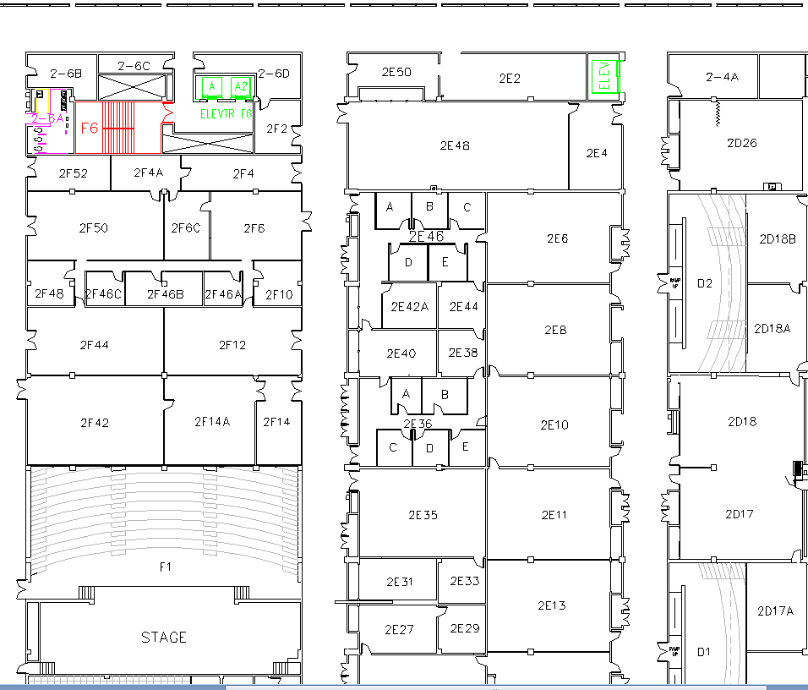
West (Terrazzo) Side

Slide 13

Why I do what I do

Slide 14
Rules
Be prepared for class (reading/homework)
Pay attention in lecture (1st hour)
Be productive during 2nd hour of application

Slide 15
Course Materials
Website:
http://ece.ninja/383/
Textbook:
RTL Hardware Design Using VHDL
Pong P. Chu

Slide 16
Methods of implementing digital systems

Slide 17
Digital Implementation Methods
General-purpose hardware with custom software
General purpose processor
Performance-oriented processor (e.g., Core i7)
Cost-oriented processor (e.g., PIC microcontroller)
Special purpose processor
DSP processor (multiplication-addition)
Network processor (buffering and routing)
Graphics engine (3D rendering)
Custom software on a custom processor (known as hardware-software co-design)
Custom hardware
Note: A complex project may use more than one of these!

Slide 18
Digital Implementation Methods
General Purpose Hardware
Custom Software
Custom Hardware
Custom Software
Custom Hardware
Increasing Development Time
Increasing Performance
Increasing Cost
Increasing Power Consumption

Slide 19
Custom digital device technologies

Slide 20
Custom Digital Device Technologies
Where customization is done:
In a fab (fabrication facility): ASIC (Application Specific IC)
In the “field”: non-ASIC
Six device technology classifications:
Full-custom ASIC
Standard cell ASIC
Gate array ASIC
Complex field programmable logic device
Simple field programmable logic device
Off-the-shelf SSI (Small Scaled IC)/MSI (Medium Scaled IC) components

Slide 21
Full-custom ASIC
All aspects (e.g., size of a transistor) of a circuit are tailored for a particular application.
Circuit fully optimized
Design extremely complex and involved
Only feasible for small components
Masks needed for all layers
Full-Custom ASIC
Standard-Cell ASIC
Gate-Array ASIC
Complex PLDs
Simple PLDs
SSI/MSI

Slide 22
Standard-Cell ASIC
Circuit made of a set of pre-defined logic, known as standard cells
Basic logic gates
1-bit adder,
D FF
etc.
Layout of a cell is pre-determined, but layout of the complete circuit is customized
Masks needed for all layers
Full-Custom ASIC
Standard-Cell ASIC
Gate-Array ASIC
Complex PLDs
Simple PLDs
SSI/MSI

Slide 23
Gate array ASIC
Circuit is built from an array of a single type of cell (known as base cell)
Base cells are pre-arranged and placed in fixed positions, aligned as one- or two-dimensional array
More sophisticated components (macro cells) can be constructed from base cells
Masks needed only for metal layers (connection wires)
Full-Custom ASIC
Standard-Cell ASIC
Gate-Array ASIC
Complex PLDs
Simple PLDs
SSI/MSI

Slide 24
Complex Field Programmable Device
Device consists of an array of generic logic cells and general interconnect structure
Logic cells and interconnect can be “programmed” by utilizing semiconductor fuses or switches
Customization is done “in the field” vs. fab
Two categories:
CPLD (Complex Programmable Logic Device)
FPGA (Field Programmable Gate Array)
No custom mask needed
Full-Custom ASIC
Standard-Cell ASIC
Gate-Array ASIC
Complex PLDs
Simple PLDs
SSI/MSI

Slide 25
Simple Field Programmable Device
Programmable device with simple internal structure
PROM (Programmable Read Only Memory)
PAL (Programmable Array Logic)
etc.
No custom mask needed
Replaced by CPLD/FPGA
Full-Custom ASIC
Standard-Cell ASIC
Gate-Array ASIC
Complex PLDs
Simple PLDs
SSI/MSI

Slide 26
SSI/MSI components
Small parts with fixed, limited functionality
7400 TTL series (more than 100 parts)
etc.
Resource is consumed by package but not silicon:
Power
Board area
Manufacturing cost
etc.
No longer a viable option
Full-Custom ASIC
Standard-Cell ASIC
Gate-Array ASIC
Complex PLDs
Simple PLDs
SSI/MSI

Slide 27
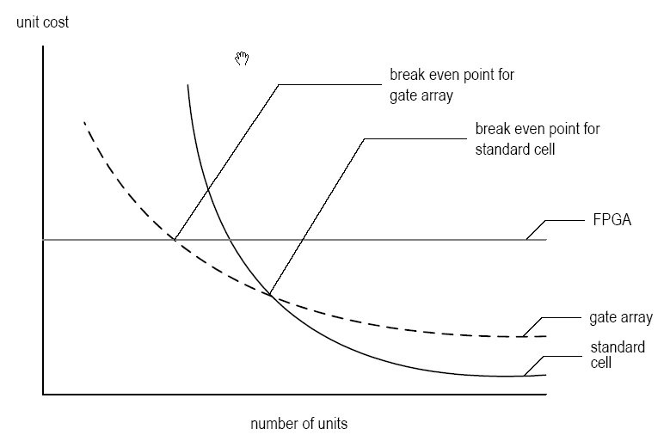
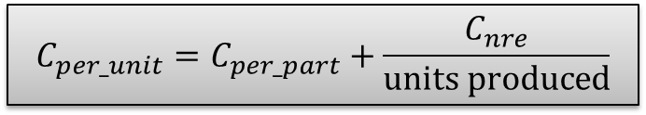
Types of Cost
NRE (Non-Recurrent Engineering) cost: one-time, per-design cost
Part cost: per-unit cost
Time-to-market cost: loss of revenue
$$C_{per_unit}=C_{per_part}+\frac{C_{nre}}{units produced}$$

Slide 28
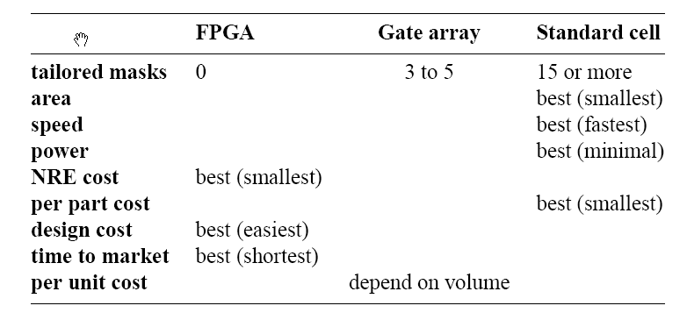
Technology Summary
Trade-off between optimal use of hardware resource and design effort/cost
No single best technology

Slide 29
Abstraction

Slide 30
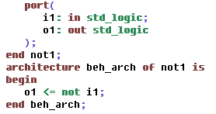
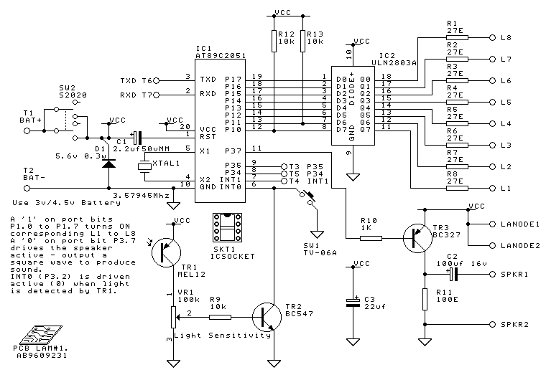
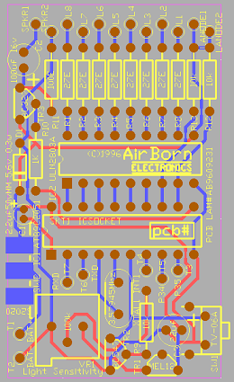
Digital System Views
Behavioral view:
Describe functionalities and I/O behavior
Treat the system as a black box
Structural view:
Describe the internal implementation (components and interconnections)
Essentially block diagram
Physical view:
Add more info to structural view: component size, component locations, routing wires
E.g., layout of a print circuit board

Slide 31
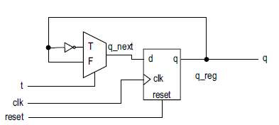
Register-Transfer Abstraction
Contains higher-level components (register, adder, mux, etc.) – think of datapaths in ECE 281/382
Based on clock “tick” event
Described as a finite state machine
Later on: a design methodology in which the system operation is described by how the data is manipulated and moved among registers

Slide 32
Digital system design

Slide 33
VHDL Design
VHDL is just a language which is used to describe hardware circuits.
A piece of hardware is described in VHDL in two separate ways.
Entity – Describes the inputs and outputs
Architecture – Describes what transformation the box performs.
There are two good reasons to realize a design in VHDL, you can simulate and synthesize hardware specified.

Slide 34
Digital System Simulation
Simulation
When a design is simulated you have complete control of time and the values of all the signals (wires) in the design.
Aids in Debugging
We will use Xilinx Vivado to perform our VHDL simulations.

Slide 35
Digital System Implementation
Synthesis
Maps a higher-level description to lower-level components (RT, gate, technology map levels)
Results in structural view
Physical Design
Generates netlist based on synthesis
Floor Plan – layout based on RT/processor level
Place & Route – gate level
Circuit Extraction – Compute propagation delays (Cp/R)
Power/Clock Networks
Etc.

Slide 36
Digital System Implementation
Verification – Checking whether a design meets the functional and timing goals
Simulation
Formal verification
Hardware emulation
Testing – Process of detecting physical defects of a die or package that occurred during manufacturing

Slide 37
Design goals

Slide 38
Design Goals
Design for Efficiency
Synthesis cannot convert bad designs into good ones
Know what hardware your HDL will create
Design for Large
Design a large module
Design to be incorporated into a larger system
Design to facilitate the overall development process
Design for Portability
Device independent
Software independent
Design reuse

Slide 39
Digital Design – Majority Circuit

Slide 40
Digital Design – Majority Circuit
Word Statement: Build a circuit (SOP min) with 3-bits of input and 1-bit of output. The output equals 1 when a majority of the three inputs equal 1.
Abstract word or statement
Truth
Table
Symbolic
Circuit Design Diagram
VHDL

Slide 41
Important Notes
You can use all the standard logic gates including:
AND
OR
XOR
NAND
NOR
XNOR
NOT

Slide 42
Important Notes
The "data type" std_logic can represent much more than just a logic 0 or 1.
'U', -- Uninitialized
'X', -- Forcing Unknown
'0', -- Forcing 0
'1', -- Forcing 1
'Z', -- High Impedance
'W', -- Weak Unknown
'L', -- Weak 0
'H', -- Weak 1
'-' -- Don't care

Slide 43
Lesson Outline
Why digital systems?
Instructor/Course Introduction
Methods of implementing digital systems
Custom digital device technologies
Abstraction
Digital System Design
Design Goals
Digital Design – Majority Circuit

