Slide 1

Chapter 12 – Oral Presentations

Slide 2
Upcoming
Tuesday Lesson 39
Project Functionality End of Class
Thursday Lesson 40
Project Presentation (10 minutes)
Course Evaluations (do these online)
Write-up on Git Lab

Slide 3
Oral Presentation
Technical presentation style
Goal
Efficient conveyance of information
Everyone is capable
Positive
Enthusiast
Prepared
Sharp

Slide 4
Determine Main Points
Identify the main points in that you want to get across.
If they learn nothing else, what do you want people to walk away with?
Emphasize main points in your talk.

Slide 5
Introduction, Problem Statement, and Needs
Title slide
Motivation
Anecdote
Story, news item
Need and Technical Objective
Video Demo
Audience may not be familiar with your project
12-year test
Notes:
Provide an overview of your project and address the need/motivation, goals, and objectives for the project.

Slide 6
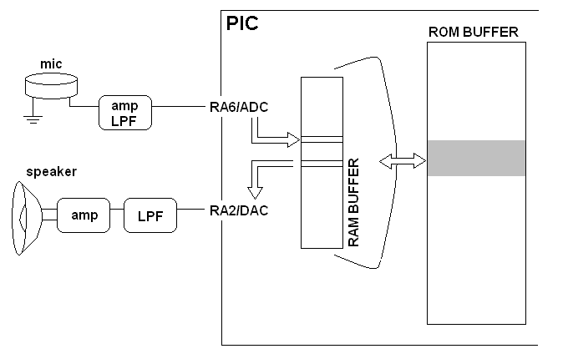
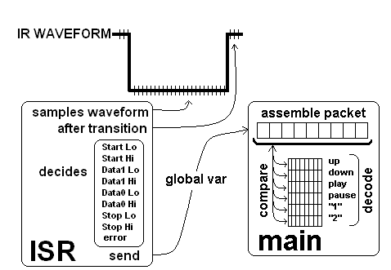
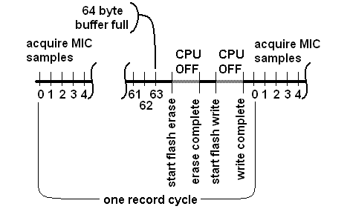
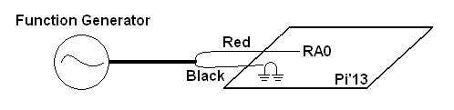
High level architecture

Slide 7
Detailed Design
For each major block
Explain role in overall architecture
Pictures or video of tests performed

