Slide 1

ECE 383 – Embedded Computer Systems II Lecture 13 – Lab 2 – Data Acquisition, Storage and Display
1

Slide 2
Feedback on HW#8 (GR?)
Don’t Cares
Okay for inputs; Normally bad for outputs
Mini-C → CU & DP
Missing “waits”?
Mutually exclusive transitions
Why do many MUXs?
Output Table
VHDL state machine style
Transitions in process (no outputs)
Outputs in CSA
state1
x
state0
y
x’
state3
state2

Slide 3
Lec11_cu
Lec11_dp
kbclk
cw
4
2
cw
cw
cw(1:0)
Counter
clearBusy
waitStart
kbclk’
setBusy
clear
6
33
key_cntr
6
compare
kbclk
sw
sw
Compare
sw
sw’
E
scan_out
wait1
DI
inc
cw(2)
cw
Shift Register
Kbclk’
kbclk’
8
shiftReg(8:1)
kbclk
wait0
shift
cw(4)
Register
(not needed for 2020)
cw
8
kbData
scan
Busy
kbData
scan

Slide 4
Lesson Outline
Time Logs!
Lab 2 – Data Acquisition, Storage and Display

Slide 5
Lab 2 – Data Acquisition, Storage and Display

Slide 6
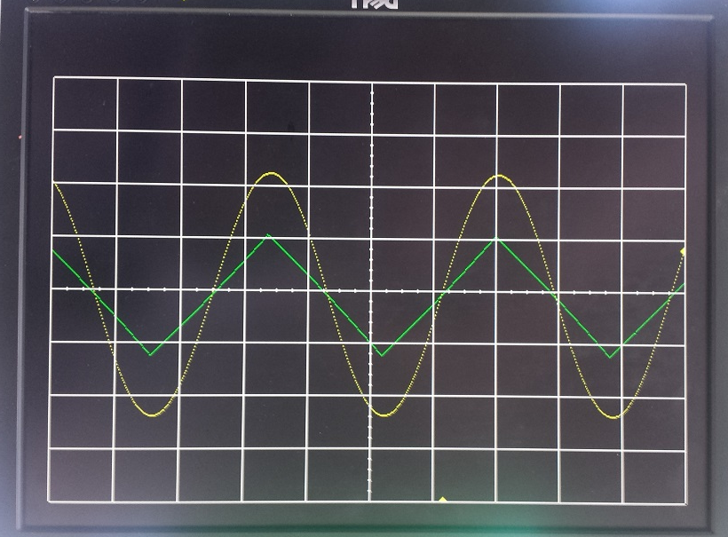
Lab 2 – Lab Overview
Lab Overview - Integrate the video display controller developed in Lab 1 with the audio codec on the Nexys Video board to build a basic 2-channel oscilloscope.

Slide 7
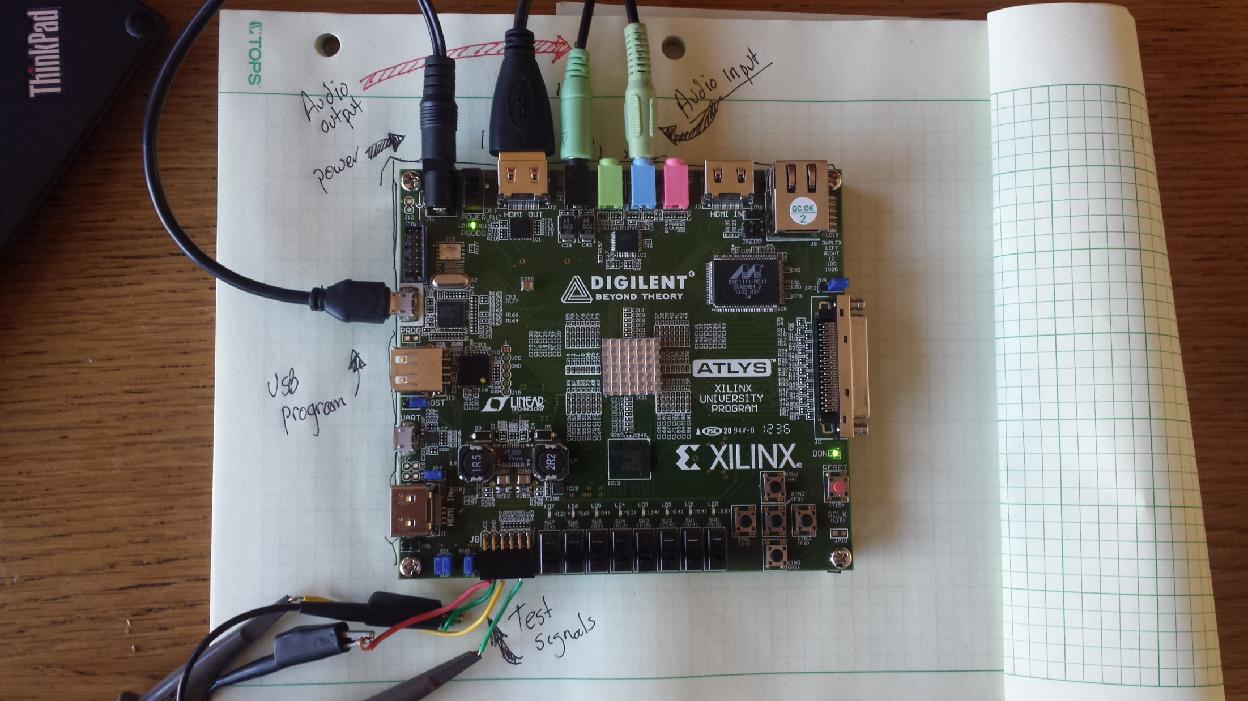
Lab 2 – Connections old board

Slide 8
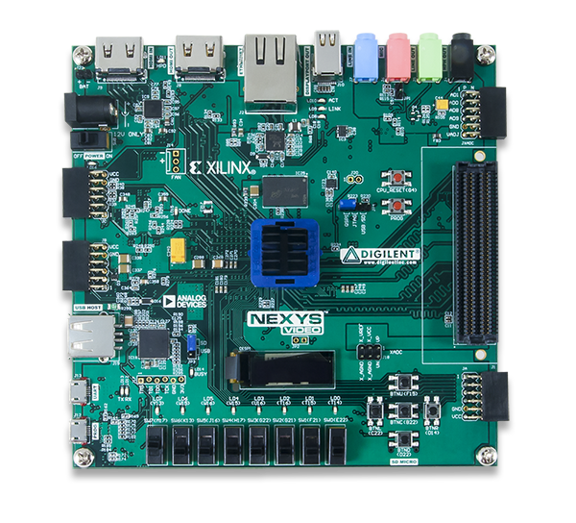
Lab 2 – Connections
HDMI Out
Audio
Input
Audio
Output
Power
CPU Reset
JB PMOD
Connector
For Test Signals
Buttons
USB Prog

Slide 9
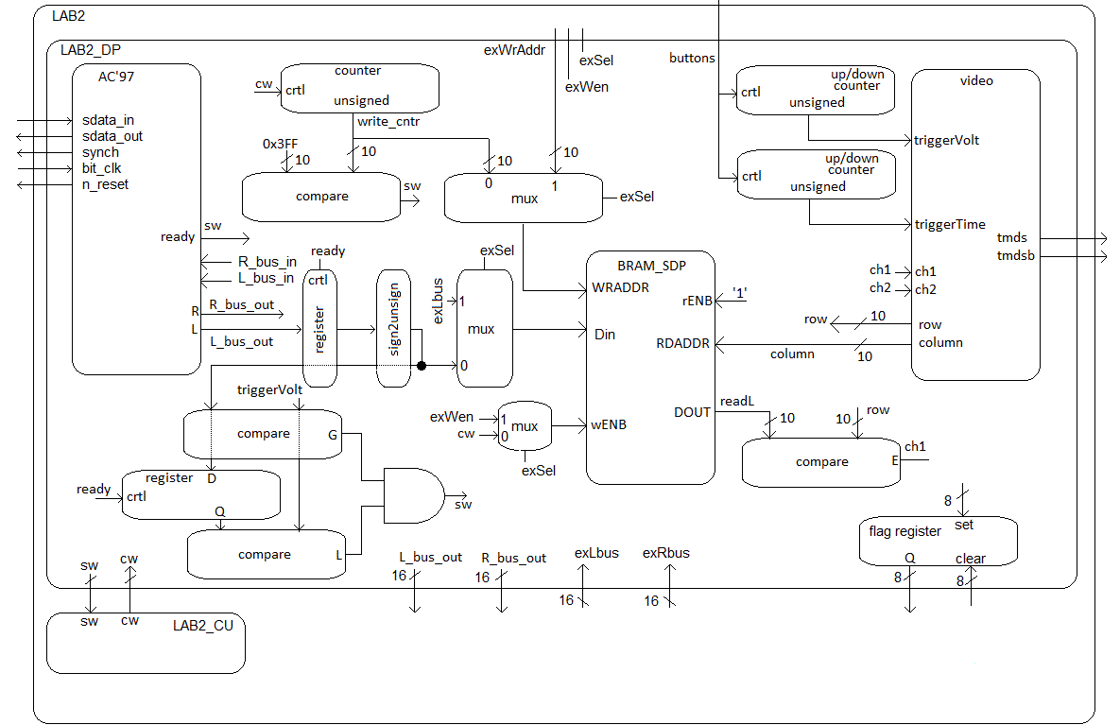
Lab 2 – Architecture

Slide 10
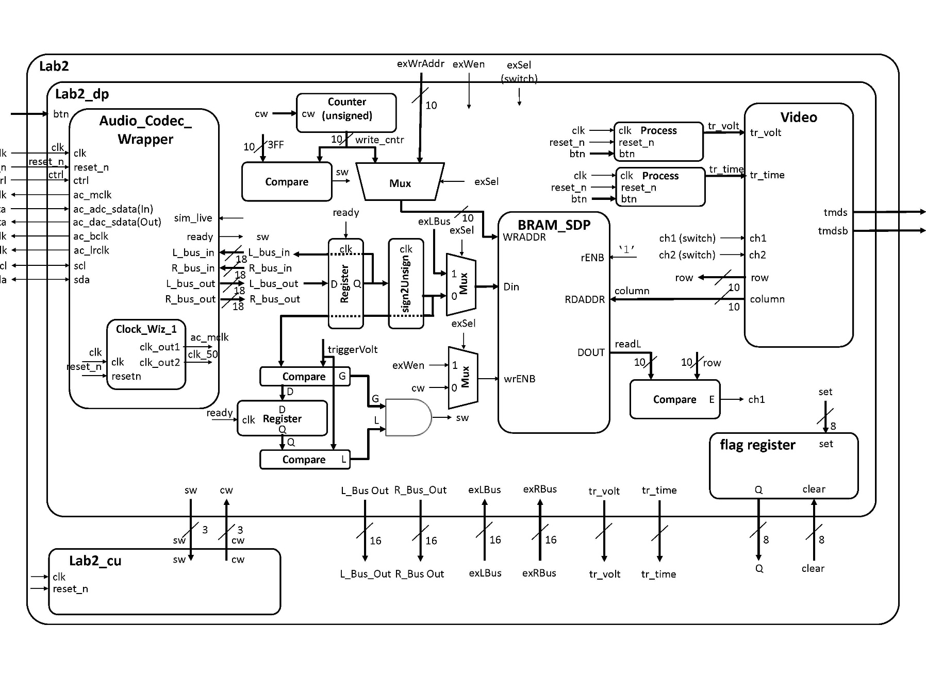
Lab 2 – Architecture

Slide 11
Lab 2 – ADAU1761 SigmaDSP Audio Codec
Analog Devices ADAU1761 SigmaDSP Audio Codec.
http://www.analog.com/media/en/technical-documentation/data-sheets/ADAU1761.pdf
1. Loop back L_bus_out and R_bus_out and listen on the HP_OUT Jack
process (clk)
begin
if (rising_edge(clk)) then
if reset_n = '0' then
L_bus_in <= (others => '0');
R_bus_in <= (others => '0');
elsif(ready = '1') then
L_bus_in <= L_bus_out;
R_bus_in <= R_bus_out;
end if;
end if;
end process;

Slide 12
Lab 2 – ADAU1761 SigmaDSP Audio Codec
2. Convert L_bus_out signal is to send it, in an unsigned format, to be stored in the block ram (BRAM).
Input Value |  | Ouput Value
2's complement | 2's value | unsigned | unsigned value
100...000 | -131072 | 000...000 | 0
111...111 | -1 | 011...111 | 131071
000...000 | 0 | 100...000 | 131072
000...001 | 1 | 100...001 | 131073
011...111 | 131071 | 111...111 | 262143

Slide 13
Lab 2 – Datapath
entity lab2_datapath is
Port( clk : in STD_LOGIC;
reset_n : in STD_LOGIC;
ac_mclk : out STD_LOGIC;
ac_adc_sdata : in STD_LOGIC;
ac_dac_sdata : out STD_LOGIC;
ac_bclk : out STD_LOGIC;
ac_lrclk : out STD_LOGIC;
scl : inout STD_LOGIC;
sda : inout STD_LOGIC;
tmds : out STD_LOGIC_VECTOR (3 downto 0);
tmdsb : out STD_LOGIC_VECTOR (3 downto 0);
sw: out std_logic_vector(2 downto 0);
cw: in std_logic_vector (2 downto 0);
btn: in STD_LOGIC_VECTOR(4 downto 0);
exWrAddr: in std_logic_vector(9 downto 0);
exWen, exSel: in std_logic;
Lbus_out, Rbus_out: out std_logic_vector(15 downto 0);
exLbus, exRbus: in std_logic_vector(15 downto 0);
flagQ: out std_logic_vector(7 downto 0);
flagClear: in std_logic_vector(7 downto 0));
end lab2_datapath;

Slide 14
Lab 2 – Flag Register
entity flagRegister is
Generic (N: integer := 8);
Port( clk: in STD_LOGIC;
reset_n : in STD_LOGIC;
set, clear: in std_logic_vector(N-1 downto 0);
Q: out std_logic_vector(N-1 downto 0));
end flagRegister;
reset_n | clk | set | clear | Q+
0 | X | X | X | 0
1 | 0,1,falling | X | X | Q
1 | rising | 0 | 0 | Q
1 | rising | 1 | 0 | 1
1 | rising | 0 | 1 | 0
1 | rising | 1 | 1 | X

Slide 15
VHDL Package file
Packages – Package for Lab 2
http://ece.ninja/383/lecture/code/lab2_pack.vhdl
This is where you will put all your component declarations
Include this at the top of your file:
use work.lab2Parts.all; -- all my components are declared here

Slide 16
VHDL Code
Overall Lab 2 File: lab2.vhd
Lab 2 Datapath: Lab2_datapath_tb.vhd
Audio Codec Wrapper: Audio_Codec_Wrapper.vhd (Audio Codec Wraper for Xilinx Vivado)
i2s_ctl.vhd (I2S Transmitter portion of Audio Codec Wraper for Xilinx Vivado)
audio_init.v (Audio Initializer portion of Audio Codec Wraper for Xilinx Vivado)
TWICtl.vhd (TWI Controller portion of Audio Codec Wraper for Xilinx Vivado)
You need to add a clocking wizard for the Audio Codec and set the output frequencies to what is required (see comments in the Audio Codec Wrapper file).
Constraint file: Lab2.xdc

Slide 17
Lab 2 – Generating Audio Waveforms
Since you need to use a 3.5mm jack to input signals to the Nexys Video board, your phone's audio output works quite well. However, make sure you get an app where you can control both the left and right audio channels individually (i.e. the green and yellow signals in the figure above). The Keuwl Dual Channel Function Generator (available on Google Play) works well for Android Phones, and is easy to use once you get the hang of it.

Slide 18
Lab 2 – Requirements Gate Check 1
Gate Checks for Required Functionality
There are 3 gate checks associated with this lab, each worth 5 points - see the rubric.
Gate Check 1
By COB Lesson 13, you must have started a Lab 2 Vivado project and downloaded the template files and drop in your Video, VGA, Scopeface, dvid, and tdms files from Lab 1 into your Lab 2 project in order to test your Lab 1 Scopeface works when you implement your BRAM using the two initialized signal examples in BRAM_example_init.vhd.
This does not require the audio or your control unit is working yet. Your Scopeface/Video should continuously be reading the left and right BRAM signals displaying them on the monitor.

Slide 19
Lab 2 – Requirements Gate Check 1
Gate Check 1
You must implement Video entity (from Lab 1) to take the channel output from the left and right BRAMs and send it to the Channel 1 and 2 inputs to be displayed when the readL and readR values equal the row value.
Sinvr there is no trigger, the waveform will be scrolling across the display and the scaling may be wrong
You will also have to re-implement the Lab 1 Clocking Wizard in you Lab 2 project.
Additionally your Scopeface and Button inputs from Lab 1 should be functional as well.

Slide 20
Gate Check 1

Slide 21
Lab 2 – Requirements Gate Check 2
Gate Check 2
NOTE: THIS IS THE HARDEST PART! By COB Lesson 15, you must have implemented and connected the BRAM Address Counter to left and right BRAMs, instantiated the Audio Codec Wrapper in Simulation mode (sim_live = '0'), and your control unit, such that your control unit writes the simulated audio data to the left and right BRAM and you can see the waveforms plotted on the monitor.
Since there is no trigger, the waveform will be scrolling across the display
convert the signed audio data from the Audio_Codec_Wrapper into unsigned data
implement another Clocking Wizard for the Audio Codec

Slide 22
Gate Check 2 Simulated Audio

Slide 23
Lab 2 – Requirements Gate Check 3
Gate Check 3
By COB Lesson 16, redo Gate Check 2, except with the Audio Codec Wrapper in Live mode (sim_live = '1').
since there is no trigger, the waveform will be scrolling across the display
Also make connections to loopback the serial ADC input back out to the DAC output (i.e. send the signal back into the Codec).
After you finish Gate Check 3, this is a good time to implement proper triggering on the trig_volt value.
If this does not work, you must create a Testbench to help debug why it is not working.

Slide 24
Gate Check 3 Live Audio

Slide 25
Lab 2 – Requirements Required Functionality
Required Functionality
Get a single channel of the oscilloscope to display with reliable triggering that holds the waveform at a single point on the left edge of the display. A 220Hz waveform should display something similar to what is shown in the screenshot at the top of this page. Additionally, you must have the following done:
Use a package file to contain all your component declarations.
Use separate datapath and control unit.

Slide 26
Lab 2 – Requirements Required Functionality Cont 1
Required Functionality
Your datapath must use processes which are similar to our basic building block (counter, register, mux, etc.). I do not want to see one massive process that attempts to do all the work in the datapath.
Testbench for the flagRegister.
Testbench for the control unit.

Slide 27
Lab 2 – Requirements Required Functionality Cont 2
Required Functionality
Testbench for the datapath unit showing data (different value than what is given in the testbench) coming out of the audio codec and being converted from signed to unsigned and then to std_logic_vector to go into your BRAM. Include calculations to back up what the waveform shows.

Slide 28
Lab 2 – Requirements Required Functionality Cont 3
Required Functionality
For Bonus Points: Testbench for the datapath unit showing that same data coming out of the BRAM. Make sure you show the read address and the data values coming out. This will require you to set your control words on the testbench. Additionally, you will have to drive the pixel_clock on the Video Module. Once you get the datapath testbench running you will notice that DCM module doesn't put out a clock in the Video Module.

Slide 29
Lab 2 – Requirements B-Level Functionality
B-level Functionality
Meet all the requirements of required functionality
Add a second channel (in green).
Integrate the button debouncing strategy in HW #7 (or another equivalent debouncing method) to debounce the buttons controlling the trigger time and trigger voltage.
Move the cursors on the screen.

Slide 30
Lab 2 – Requirements A-Level Functionality
A-level Functionality
Meet all the requirements of B-level functionality.
Use the trigger voltage marker to establish the actual trigger voltage used to capture the waveform. As the trigger is moved up and down, you should see the point at which the waveform intersects the left side of the screen change.

Slide 31
Lab 2 – Requirements Turn In
Turn In Requirements
All your work in this lab is to be submitted using Bitbucket. The main part of the lab is your README, documenting your design. Your README must include the following:
Introduction - Provide a brief overview of the problem.
Implementation - Provide block-diagram of your solution using the signal names in your code. The block diagram given above is somewhat incomplete, so make sure to include corrections to it. For each module that you built, explain its overall purpose, inputs, outputs, and behavior. Include all your vhdl files (code and testbench), wcfg file, and bit files. Put these in a folder called "code".

Slide 32
Lab 2 – Requirements Turn In Cont 1
Turn In Requirements
Test/Debug - Briefly describe the methods used to verify system functionality.
List the major problems you encountered and how you fixed them. This should cover all the problems you encountered in the lab and how you fixed them. Break each problem and solution into separate paragraphs.
Capability - Well you have built a oscilloscope, what are its capabilities?
The horizontal axis represents time. There are 10 major divisions on the display; how long does each major division represent?

Slide 33
Lab 2 – Requirements Turn In Cont 2
Turn In Requirements
Capability Continued -
Each major time division is split into 4 minor division, how long does each minor division represent?
Generate a sine wave that can be fully captured on your display (like the yellow channel in the image at the top of this web page). record its height in major and minor vertical divisions. Measure this same audio output using the break out audio cable. Record the peak-to-peak voltage. Compute the number of volts in each major and minor vertical division.

Slide 34
Lab 2 – Requirements Turn In Cont 3
Turn In Requirements
Capability Continued -
Starting at address 0, how long does it take to fill the entire memory with audio samples (coming in at 48kHz)?
How long does it take to completely draw the display once?
The question is likely relevant to Lab 3 - how long is the vsynch signal held low?
Conclusion - Explain what your learned from this lab and what changes you would recommend in future years to this lab or the lectures leading up to this lab.

