Slide 1

ECE 383 – Embedded Computer Systems II Lecture 2 – Combinational Element, unsigned, constraints file, synthesis
Maj Jeffrey Falkinburg Room 2E46E 333-9193
1

Slide 2
Lesson Outline
Synthesis
Constraints file
Combinational Element
Unsigned Numeric Standard
Combinations

Slide 3
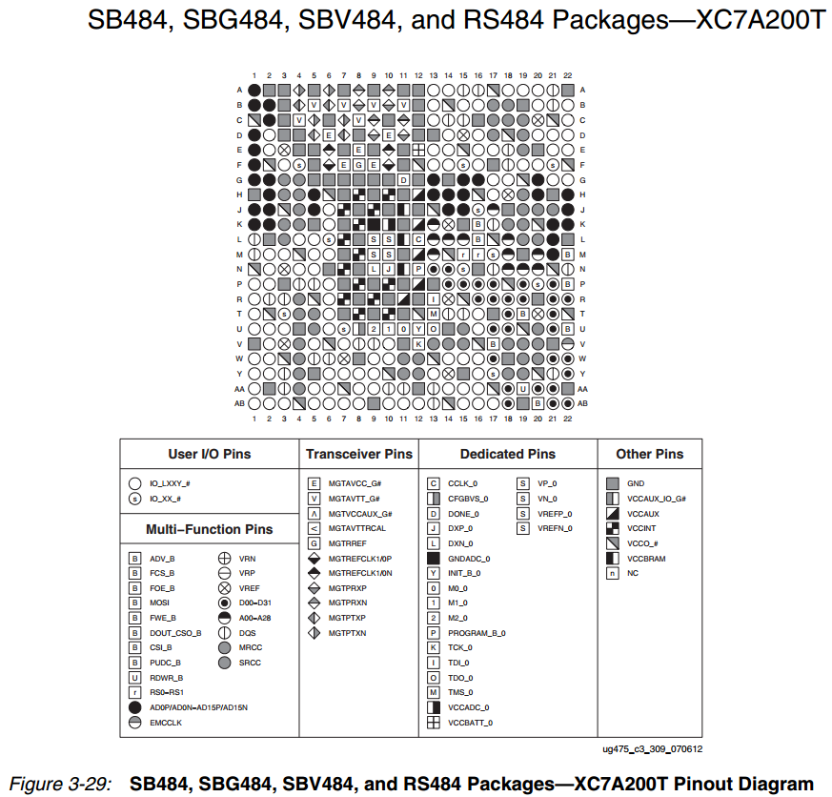
pp 80
https://www.xilinx.com/support/documentation/user_guides/ug475_7Series_Pkg_Pinout.pdf

Slide 4
Synthesis

Slide 5
Synthesis
Insert this code into your Majority.xdc file
Inputs from switches and outputs to LEDs
# This is slide switch SW0
set_property -dict { PACKAGE_PIN E22 IOSTANDARD LVCMOS12 } [get_ports { a }]; #IO_L22P_T3_16 Sch=sw[0]
# This is slide switch SW1
set_property -dict { PACKAGE_PIN F21 IOSTANDARD LVCMOS12 } [get_ports { b }]; #IO_25_16 Sch=sw[1]
# This is slide switch SW2
set_property -dict { PACKAGE_PIN G21 IOSTANDARD LVCMOS12 } [get_ports { c }]; #IO_L24P_T3_16 Sch=sw[2]
# This is LED Led(0)
set_property -dict { PACKAGE_PIN T14 IOSTANDARD LVCMOS25 } [get_ports { f }]; #IO_L15P_T2_DQS_13 Sch=led[0]
Xilix Chip
E22
UUT: Majority
a
T14
F21
b
f
G21
c

Slide 6
Constraints file

Slide 7
Constraints file
Nexyx Video Master XDC
http://ece.ninja/383/datasheets/NexysVideo_Master.xdc

Slide 8
Combinational Element

Slide 9
Combinational Element – Common error
Common error that may come up in your designs
You cannot use a variable listed on the entity as an out port, on the right hand side of a signal assignment statement.
entity circuit is
port (clk, data: in std_logic;
q, not_q: out std_logic);
end circuit;
architecture error of circuit is
begin
q <= some cool logical stuff using clk and data;
not_q <= not q;
end error;

Slide 10
Combinational Element – Solution
Solution
assign "some cool logical stuff using clk and data" to a temporary variable
entity circuit is
port (clk, data: in std_logic;
q, not_q: out std_logic);
end circuit;
architecture error of circuit is
signal temp std_logic;
begin
temp <= some cool logical stuf using clk and data;
q <= temp;
not_q <= not temp;
end error;

Slide 11
Combinational Element - Mux
Simplify muxes using conditional signal assignment statement
Example:
x <= y0 when S = "00" else
y1 when S = "01" else
y2 when S = "10" else
y3;
Draw this Circuit assuming 8-bit inputs
Now build 4-1 mux w/ 2-1 muxes

Slide 12
Unsigned Numeric Standard

Slide 13
Unsigned Numeric Standard
So far we mostly used STD_LOGIC_1164 library
library IEEE;
use IEEE.STD_LOGIC_1164.all;
Library Contents: http://www.csee.umbc.edu/portal/help/VHDL/packages/std_logic_1164.vhd

Slide 14
Unsigned Numeric Standard
Numeric_Std Library supports 2 main datatypes
Signed and Unsigned
Library Contents: http://www.csee.umbc.edu/portal/help/VHDL/packages/numeric_std.vhd
library IEEE;
use IEEE.std_logic_1164.all;
use IEEE.NUMERIC_STD.ALL;
entity lec3 is
port( au, bu: in unsigned(3 downto 0);
cu,du,su: out unsigned(3 downto 0);
as, bs: in signed(3 downto 0);
cs,ds,ss: out signed(3 downto 0));
end lec3;

Slide 15
Unsigned Numeric Standard
architecture structure of lec3 is
begin
cu <= "1000" when (au > bu) else
"0110" when (au = bu) else
"0001";
su <= au + bu;
du <= au - bu;
cs <= "1000" when (as > bs) else
"0110" when (as = bs) else
"0001";
ss <= as + bs;
ds <= as - bs;

Slide 16
Unsigned Numeric Standard
Unsigned
Signed
A | B | Value A | Value B | A >? B | A =? B | A <? B | A + B | A - B
0010 | 0100
1011 | 0001
0110 | 1010
0111 | 1000
A | B | Value A | Value B | A >? B | A =? B | A <? B | A + B | A - B
0010 | 0100
1011 | 0001
0110 | 1010
0111 | 1000

Slide 17
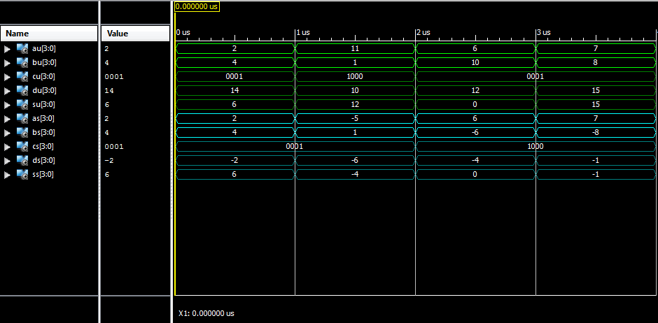
Unsigned Numeric Standard

Slide 18
Unsigned Numeric Standard
You will typically use STD_LOGIC_VECTOR and UNSIGNED
You may need to convert between the two
a: std_logic_vector(7 downto 0);
b: unsigned(7 downto 0);
c: std_logic_vector(7 downto 0);
b <= unsigned(a);
c <= std_logic_vector(b);
Lecture 4 – Sequential Element

Slide 19
Combinations

Slide 20
Combinations
Common Combinations if/then/else
All conditional statements consist of three parts:
the condition to be checked (the if clause)
the statement to be evaluated when the condition is true (the then clause)
the statement to be evaluated when the condition is false (the else clause)
Typically, the condition being evaluated seeks the relative magnitude of two unsigned binary numbers, requiring a comparator.
The then and else clauses will typically require some logic or arithmetic operation

Slide 21
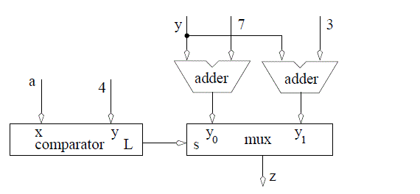
Combinations
In order to illustrate the hardware realization of a conditional statement, consider the following example:
C: if (a<4) then z=y+3 else z=y+7
VHDL: z <= y+3 when (a < 4) else y+7;

Slide 22
Combinations
However, this circuit is not minimal, one of the adders can be removed.
How?
Practice on Homework

Slide 23
Lesson Outline
Synthesis
Constraints file
Combinational Element
Unsigned Numeric Standard
Combinations

