Slide 1

ECE 383 – Embedded Computer Systems II Lecture 4 – Sequential Element
Maj Jeffrey Falkinburg Room 2E46E 333-9193
1

Slide 2
Using Unsigned and Decimal Numbers
Convert Decimal number to Unsigned Vector (7 downto 0)
to_unsigned(17, 8)
First argument is the decimal number
Second argument is the number of bits
Conditional with unsigned number
LED_Trigger <= '1' when (Binary_Input = to_unsigned(17, 8) ) else
‘0';

Slide 3
Lesson Outline
Sequential Elements
Mod 10 Counter Example
Truth Table
Timing Diagram
Circuit Diagram
VHDL
General VHDL Rules
Adding Signals to Isim

Slide 4
Sequential Elements

Slide 5
Sequential Elements
Goals:
basic sequential process and sensitivity list
register, counter in VHDL
Combination of sequential and combinational logic (counters)
Translate between schematic, truth table, and VHDL code

Slide 6
Mod 10 Counter Example

Slide 7
Mod 10 Counter Example
Truth Table
clk | reset | ctrl | D | Q+
0,1,falling | x | xx | x | Q
rising | 0 | xx | x | 0
rising | 1 | 00 | x | Q
rising | 1 | 01 | x | Q+1 mod 10
rising | 1 | 10 | D | D
rising | 1 | 11 | x | 0

Slide 8
Timing Diagram

Slide 9
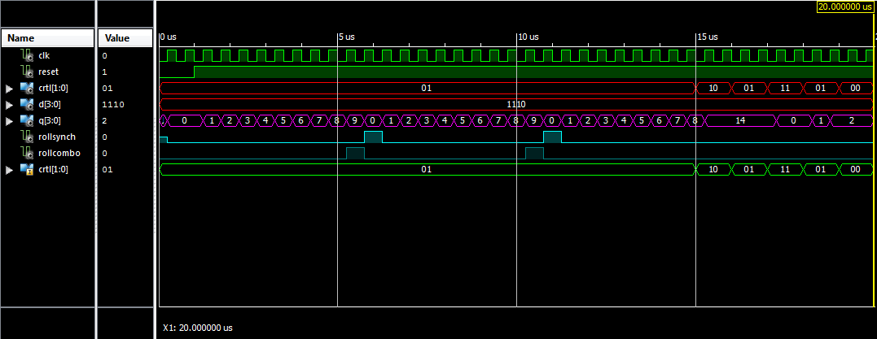
Mod 10 Counter - Timing Diagram

Slide 10
Mod 10 Counter - Timing Diagram

Slide 11
Mod 10 Counter - Timing Diagram

Slide 12
Circuit Diagram

Slide 13
Circuit Diagram
After completing the timing diagram, see if you can figure out how to construct the counter using the arrangement of devices show in the picture below.
You may assume that all these inputs are able to handle 4-bit values - to indicate this, draw a hash through the signal lines with a "4" next to it.
You should not draw additional lines in this picture. Instead, label the wires with names and use these names to create logical connections between signals with the same name.
Draw a border around your circuit. The only signals that should cross the boundary are those which are part of the entity description.

Slide 14
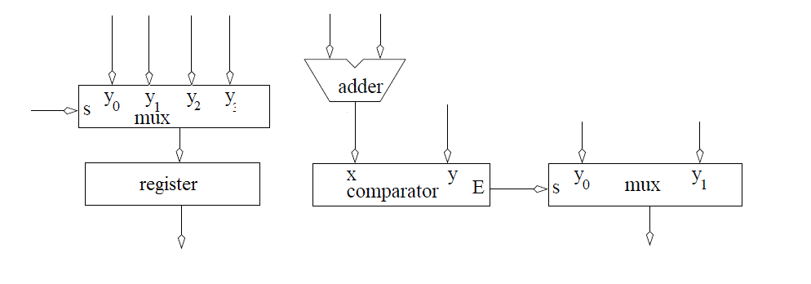
Circuit Diagram
Build the Architecture for the Mod 10 Counter

Slide 15
VHDL

Slide 16
Mod 10 Counter – VHDL Code Entity
entity lec4 is
Port( clk: in STD_LOGIC;
reset : in STD_LOGIC;
ctrl: in std_logic_vector(1 downto 0);
D: in unsigned (3 downto 0);
Q: out unsigned (3 downto 0));
end lec4;
1. architecture behavior of lec4 is
2. signal rollSynch, rollCombo: STD_LOGIC;
3. signal processQ: unsigned (3 downto 0);
4. begin

Slide 17
Mod 10 Counter – VHDL Code Architecture
process(clk)
begin
if (rising_edge(clk)) then
if (reset = '0') then
processQ <= (others => '0');
rollSynch <= '0';
elsif ((processQ < 9) and (ctrl = "01")) then
processQ <= processQ + 1;
rollSynch <= '0';
elsif ((processQ = 9) and (ctrl = "01")) then
processQ <= (others => '0');
rollSynch <= '1';
elsif (ctrl = "10") then
processQ <= unsigned(D);
elsif (ctrl = "11") then
processQ <= (others => '0');
end if;
end if;
end process;

Slide 18
Mod 10 Counter – VHDL Code Architecture
rollCombo <= '1' when (processQ = 9) else '0';
Q <= processQ;
end behavior;

Slide 19
General VHDL Rules

Slide 20
General VHDL Rules
Introduce the following rules for designing in VHDL in order to write code that can be synthesized.
Never use processes for combinational logic.
Only the clk should appear in the sensitivity list
The outermost structure should be "if (rising_edge(clk)) then"
Inside this structure should be "if (reset = '0') then" to reinitialize the state element used by the process
The else clause of the reset element (the body) should consist of a set of exclusive signal conditions in an if/then case structure.
Any signal on the left-hand side of an assignment statement (in the body) may not be put on the left-hand side of any assignment statement outside the process.

Slide 21
Adding Signals in Isim

Slide 22
Adding Signals in Isim
Sometimes it is necessary to examine signals not directly visible in a design. In the Instances and Process subwindow, reveal the instances inside the lec4_tb by clicking on the arrow to the left lec4_tb.
Reveal the signals inside the lec4 instance (called uut) by clicking on the label "uut".
In the Objects subwindow select the signal that you want to observe on the timing digram. In our case the ctrl signal.
Drag and drop the signal into the timing diagram.
In most cases you wil have to restart the simulation to get a complete trace of the newly added signal.
And the rerun it for the needed amount of time.

Slide 23
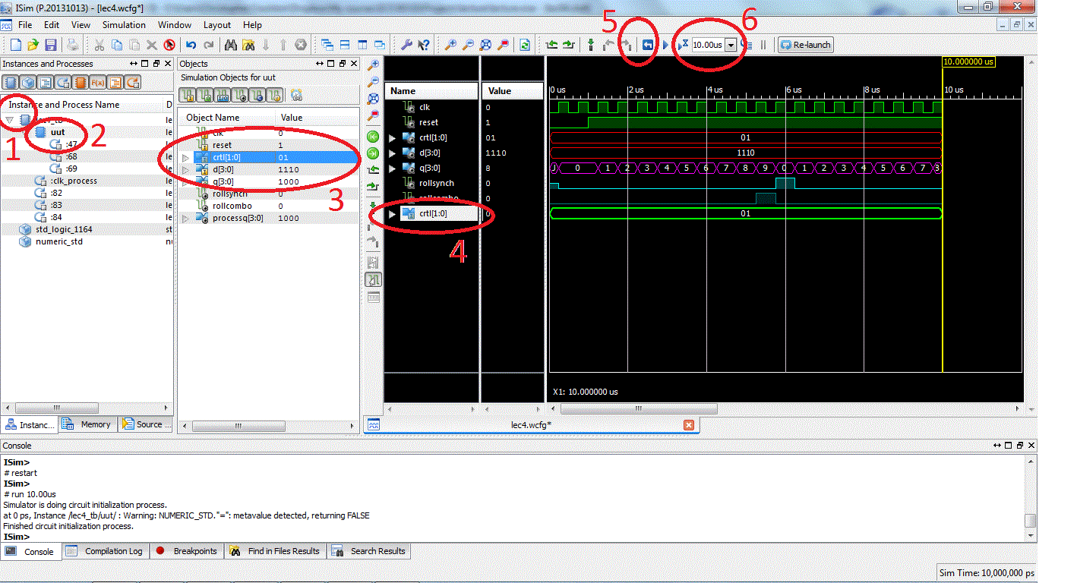
Adding Signals in Vivado Simulator

Slide 24
Lesson Outline
Sequential Elements
Mod 10 Counter Example
Truth Table
Timing Diagram
Circuit Diagram
VHDL
General VHDL Rules
Adding Signals to Isim

