Slide 1

ECE 383 – Embedded Computer Systems II Lecture 24 - Direct Digital Synthesis and Linear Interpolation
1

Slide 2
Lesson Outline
Time Logs!
Project Proposals Due BOC TODAY
Direct Digital Synthesis with Interpolation

Slide 3

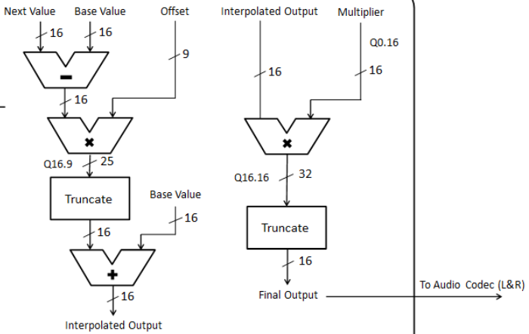
Interpolation Block Diagram
8
Switches
8
Phase Inc
Next
Base
Offset
Switches
Q4.4
8
8
8
4
8
8
delta
8
8
cw0
Index.Offset
Q4.4
Amplify
8
Q8.4
12
4
Index
4
Index
‘1’
4
Offset
delta*offset
truncate
Base
cw1
0
1
8
Mux
8
4
‘1’
Read
Addr
8
BRAM
Data
Do you need a register
To save the final answer,
With cw4?
8
= Base + (Next – Base) * Offset
cw2
Base Value
cw3
Next Value
8
Base
8
Next

Slide 4
LUT – Look Up Table

Slide 5
LUT – Look Up Table
Let's say that you wanted to compute the square root of an value using the microBlaze.
If you were lucky enough to have a compiler which provided this function you could just use the math library functions.
If on the other hand, you did not have the use of such a library, you would have to figure out a way to compute the square root.

Slide 6
LUT – Look Up Table
There are many ways to compute the SQRT Function:
Crack open a book to find a mathematical expression
Unfortunately this typically leads to timely computations
You could enumerate an every possible value of x and its square root.
We could then look-up a SQRT in the table, by going to the row corresponding to the x and retrieving its value.
This approach seems silly since it would use a lot of space
We could reduce this space by eliminating entries
We save space at the expense of introducing errors.
If you wanted the SQRT for x and its entry wasn’t in the table you would have to use the closest x in the table

Slide 7
LUT – Look Up Table
A good compromise among all three of these design constraints:
Space
Time
Error
Is to use Interpolation in a partial Look-Up-Table (LUT)

Slide 8
Interpolation
"Interpolation is a mathematical method of creating missing data. ... There are many methods of interpolation, but one simple method would be to generate a new value by using the average of the value of the two values on either side of the one to be created.“
This average is also referred to as linear interpolation.
For example if you have a value of x which is 1/2 way between 0 and 4 then you assume that the SQRT is 1/2 between 0 and 2.

Slide 9
Example Interpolation

Slide 10
Linear Interpolation
We know that if f(x)=y and f(x+4)=z then we estimate the intermediate values of f(x+1), f(x+2), and f(x+3) by drawing a straight line between y and z and using the points on this line to estimate the function between x and x+4.
For example, let: F(8)=2.8284 and F(12)=3.4641 then
F(9) = 2.8284 + 1/4(3.4641-2.8284) = 2.987
F(10) = 2.8284 + 2/4(3.4641-2.8284) = 3.146
F(11) = 2.8284 + 3/4(3.4641-2.8284) = 3.305
We understand that this is an approximation and consequently we will have error, but sometimes close is better than exact in embedded computing especially when time is of the essence.

Slide 11
Next 3.4641=
F(12)
F(11)
F(10)
Next - Base
F(9)
Base 2.8284 =
F(8)
8
9
10
11
12
Offset

Slide 12
Linear Interpolation
//----------------------------------------------
// A code chunk to perform linear
// interpolation of some unknown fnc at
// x+i where i is between 0 and 4
// inclusive. You are given that
// f(x)=y f(x+4)=z
// You are given i, please return f(x+i)
//----------------------------------------------
delta = (z-y)>>2;
f = y + delta*i;
It would be better to do the division by 4 (shift right by 2-bits) after the multiplication of delta*i because the difference (z-y) might be small and the division may result in a 0 value.

Slide 13
Square Root Interpolation 4 Point LUT
index | x | sqrt(x)
0 | 0 | 0
1 | 4 | 2
2 | 8 | 2.828427
3 | 12 | 3.464102
4 | 16 | 4

Slide 14
Square Root Interpolation Equation
Let's consider how to use interpolation to find a better value for the SQRT(9). Clearly, the SQRT will be between SQRT(8) and SQRT(12).
How much between?
Well 1/4 of the way because 9 is a 1/4 of the way between 9 and 12.
Have the class write an equation describing SQRT(9) in terms of SQRT(12) and SQRT(8).
SQRT(9) = SQRT(8) + 1/4*(SQRT(12)-SQRT(8))

Slide 15
Square Root Interpolation Equation
Now write the equation replacing the 1/4 by a statement using 9,8, and 12.
SQRT(9) = SQRT(8) + (9-8)/(12-8)*(SQRT(12)-SQRT(8))

Slide 16
Square Root Interpolation Spreadsheet
Now divide the class into 16 sections to compute all the values of SQRT for 0-15.
Compare these to the excel spreadsheet (4pt SQRT tab).
In this spreadsheet, I've broken the computation down so that you can see what the individual parts are doing…see next slide

Slide 17
Square Root Interpolation Spreadsheet
SQRT(9) = SQRT(8) + (9-8)/(12-8)*(SQRT(12)-SQRT(8))
base - this is the SQRT(8) term in the equation above. It represents the base value from which we will interpolate.
offset - this is the (9-8)/(12-8) term in the equation above. It represents how much offset you are into the interval.
delta - this is the SQRT(12)-SQRT(8) term in the equation above. Its how much range the function covers between the two values in the LUT.
base + offset*delta - this is the value of the SQRT function for the input given in the "x" column.
error(x) - this is the absolute values of the difference between the linear interpolation value and the true value of the SQRT function.

Slide 18
Square Root Interpolation Spreadsheet - 4 Point LUT
X | SQRT(X) | base | offset | delta | base + offset*delta | error(x)
0 | 0 | 0 | 0 | 2 | 0 | 0
1 | 1 | 0 | 0.25 | 2 | 0.5 | 0.5
2 | 1.414214 | 0 | 0.5 | 2 | 1 | 0.414214
3 | 1.732051 | 0 | 0.75 | 2 | 1.5 | 0.232051
4 | 2 | 2 | 0 | 0.828427 | 2 | 0
5 | 2.236068 | 2 | 0.25 | 0.828427 | 2.207106781 | 0.028961
6 | 2.44949 | 2 | 0.5 | 0.828427 | 2.414213562 | 0.035276
7 | 2.645751 | 2 | 0.75 | 0.828427 | 2.621320344 | 0.024431
8 | 2.828427 | 2.828427 | 0 | 0.635674 | 2.828427125 | 0
9 | 3 | 2.828427 | 0.25 | 0.635674 | 2.987345747 | 0.012654
10 | 3.162278 | 2.828427 | 0.5 | 0.635674 | 3.14626437 | 0.016013
11 | 3.316625 | 2.828427 | 0.75 | 0.635674 | 3.305182993 | 0.011442
12 | 3.464102 | 3.464102 | 0 | 0.535898 | 3.464101615 | 0
13 | 3.605551 | 3.464102 | 0.25 | 0.535898 | 3.598076211 | 0.007475
14 | 3.741657 | 3.464102 | 0.5 | 0.535898 | 3.732050808 | 0.009607
15 | 3.872983 | 3.464102 | 0.75 | 0.535898 | 3.866025404 | 0.006958

Slide 19
Square Root Interpolation 4 Point LUT

Slide 20
Square Root Interpolation 4 Point LUT
//----------------------------------------------
// Fnc SQRT
// In A 4-bit integer
// Out An approximate SQRT
// Pur This function computes a linear interpolated value for the SQRT
// function. There are some significant data type issues that will have to
// be resolved - note the use of "type" in the function is a place-holder.
//----------------------------------------------
fixed SQRT(int4 x) {
fixed lut[5] = {0, 2, 2.828427125, 3.464101615, 4};
int8 index;
fixed base;
index = x >> 2; // We are looking at sets of 4 points
base = lut[index]; // Get the base value to start interpolation
offset = (x & 0x03)>>2; // The proportion into the interval - PROBLEM
delta = lut[x+1] - lut[x]; // The difference between consecutive SQRTs
return(base + offset*delta);
} // end SQRT

Slide 21
Square Root Interpolation Data Type
//----------------------------------------------
// Fnc SQRT
// In A 4-bit integer
// Out An approximate SQRT 8-bit fixed point with decimal at 6th bit.
// Pur This function computes a linearly Interpolated value for the SQRT. The
// 5th entry in the lut is an approximation to 4.
//----------------------------------------------
int8 SQRT(int8 x) {
int8 lut[5] = {0x00, 0x80, 0xB5, 0xDE, 0xFF};
int8 index;
fixed base;
index = x >> 2;
base = lut[index];
offset = (x & 0x03)
delta = lut[index+1] - lut[index];
return(base + offset*delta)>>2;
} // end SQRT

Slide 22
Square Root Interpolation LUT
index | x | sqrt(x) | sqrt * 2^6 | Trunc Down | 2.6 Binary | 2.6 Hex
0 | 0 | 0 | 0 | 0 | 00.000000 | 00
1 | 4 | 2 | 128 | 128 | 10.000000 | 80
2 | 8 | 2.828427 | 181.0193 | 181 | 10.110101 | B5
3 | 12 | 3.464102 | 221.7025 | 221 | 11.011101 | DD
4 | 16 | 4 | 256 | 255 | 11.111111 | FF

Slide 23
Square Root Interpolation 8 Point LUT
LUT
 |  |  |  |  | 10.6 Binary
index | x | sqrt(x) | sqrt * 2^6 | Trunc down | Upper 10-Bits | Lower 6-Bits
0 | 0 | 0 | 0 | 0 | 0000000000 | 000000
1 | 16 | 4 | 256 | 256 | 0000000100 | 000000
2 | 32 | 5.656854 | 362.0387 | 362 | 0000000101 | 101010
3 | 48 | 6.928203 | 443.405 | 443 | 0000000110 | 111011
4 | 64 | 8 | 512 | 512 | 0000001000 | 000000
5 | 80 | 8.944272 | 572.4334 | 572 | 0000001000 | 111100
6 | 96 | 9.797959 | 627.0694 | 627 | 0000001001 | 110011
7 | 112 | 10.58301 | 677.3123 | 677 | 0000001010 | 100101
8 | 128 | 11.31371 | 724.0773 | 724 | 0000001011 | 010100

Slide 24
Square Root Interpolation 8 Point LUT

Slide 25
Square Root Interpolation LUT

Slide 26
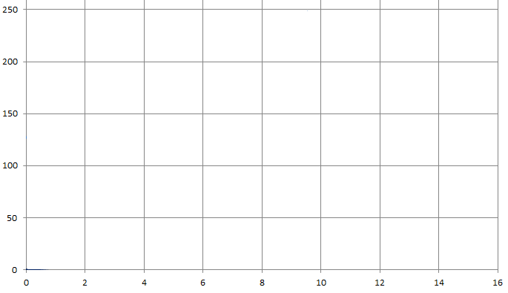
Practice
0 | 127
1 | 175
2 | 216
3 | 244
4 | 253
5 | 244
6 | 216
7 | 175
8 | 127
9 | 78
10 | 37
11 | 9
12 | 0
13 | 9
14 | 36
15 | 78
Time | Index | Base | Delta | Offset*Delta | Base + Offset*Delta
0 | 0000.0000 | 127 | 175-127 = 48 = 110000 | 0.0000*110000 = 00000.0000 | 127+0 = 127
1 | 0001.1011 | 175 | 216-175 = 41 = 101001 | 0.1011*101001 = 11100.0011 | 175+28 = 203
2
3
4
5
6
7
8
9
10
11
12
13
14

Slide 27
Solution
0 | 127
1 | 175
2 | 216
3 | 244
4 | 253
5 | 244
6 | 216
7 | 175
8 | 127
9 | 78
10 | 37
11 | 9
12 | 0
13 | 9
14 | 36
15 | 78

Slide 28
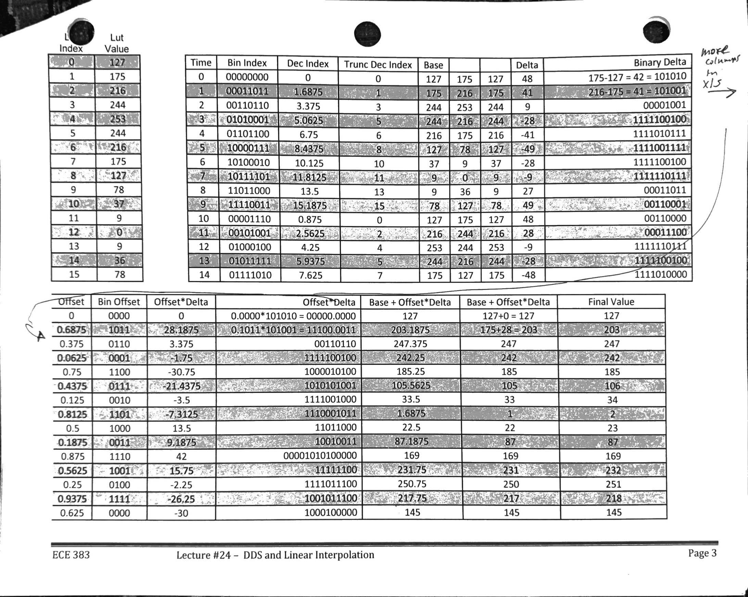
Solution with all spreadsheet columns

Slide 29
Solution
0 | 127
1 | 175
2 | 216
3 | 244
4 | 253
5 | 244
6 | 216
7 | 175
8 | 127
9 | 78
10 | 37
11 | 9
12 | 0
13 | 9
14 | 36
15 | 78

Slide 30
Solution with all spreadsheet columns

Slide 31
Interpolation Block Diagram
8
Switches
8
Phase Inc
Next
Base
Offset
Switches
Q4.4
8
8
8
4
8
8
delta
8
8
cw0
Index.Offset
Q4.4
Amplify
8
Q8.4
12
4
Index
4
Index
‘1’
4
Offset
delta*offset
truncate
Base
cw1
0
1
8
Mux
8
4
‘1’
Read
Addr
8
BRAM
Data
Do you need a register
To save the final answer,
With cw4?
8
= Base + (Next – Base) * Offset
cw2
Base Value
cw3
Next Value
8
Base
8
Next

Slide 32
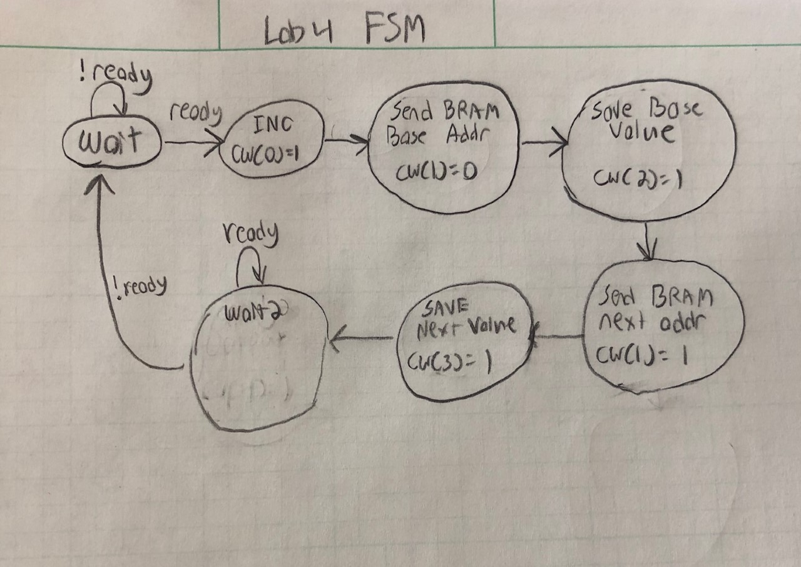
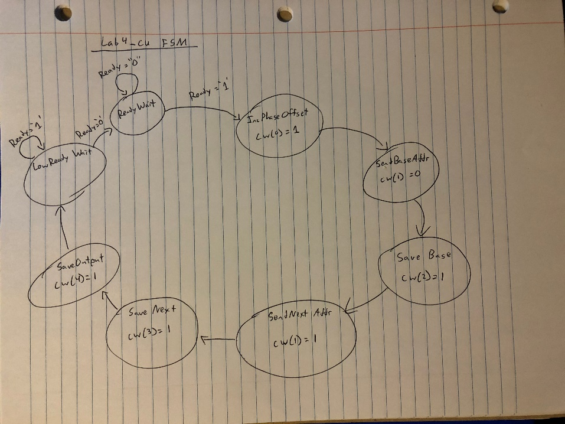
State Machine?

Slide 33
BRAM

Slide 34
See example spreadsheet for creating BRAM LUT (or use python, java, matlab…)
Block Diagram?
Intro to lab#4

Slide 35
Signed Multiply Issue with unsigned values
Our VHDL multiplier does signed multiplication, not unsigned multiplication. While the input/output signals from the Audio Codec are signed, in lab2 we converted them to unsigned (18-bits) by:
data_out_unsigned <= data_out_signed - x20000;
Your lab2 BRAM and Scopeface are designed based on unsigned values (And the sine wave you initialize in your BRAM for lab4 is most likely unsigned), so you will most likely want to do your interpolator math in unsigned values.

Slide 36
3 issues
1. We need to fool the signed multiplier to do unsigned multiplies. Signed numbers are only negative when the MSb is a "1". If the MSb is a '0', it is positive, it is unsigned. If both operands have a MSb that is '0', then it is basically doing unsigned multiplication with a signed multiplier. For example:
signal A, B : std_logic_vector(7 downto 0);
signal As, Bs : signed(8 downto 0);
signal Cs : signed(17 downto 0);
As <= signed('0' & A); -- add zero to ensure it is positive
Bs <= signed('0' & B);
Cs <= As * Bs; -- fool signed multiply to do unsigned multiply

Slide 37
3 issues
2. Our simple equation for interpolation:
Interpolated = Base + (Next - Base )* Offset
works great for signed numbers, but has an issue for unsigned numbers. If Next is greater than Base, the math works. What happens when Base is greater than Next? In this case, (Next - Base) would be negative, but unsigned signals cannot represent negative values. So here is pseudo-code for fixing this issue with unsigned numbers:
If Next > Base then
Interpolated = Base + (Next - Base ) * Offset;
else
Interpolated = Base - (Base - Next ) * Offset;
end if;

Slide 38
3 issues
3. The last issue is ensuring you align the binary points correctly for the math and grab the appropriate bits for the final answer, especially since we appended a '0' to our input values.
[notation below: o is a ‘0’ and X is a hex digit]
append a ‘0’ to the MSb of Base (oXXXX.), Next (oXXXX.), offset (o.XX) and amp (oX.X)
Delta = Next - Base; -- oXXXX. - oXXXX. = oXXXX.
Delta_Offset = Delta * Offset; -- oXXXX. * o.XX = ooXXXX.XX
For the next instruction, we need to add Base (oXXXX.) to Delta_Offset (ooXXXX.XX), and align their binary point and make them have the same number of bits, so for Delta_Offset, we will remove its first ‘0’, and its last two hex digits XX, leaving it in the form oXXXX.
Interp = Base + Delta_Offset; -- oXXXX. + oXXXX. = oXXXX.
Amp_Interp = Amp * Interp -- oX.X * oXXXX = ooXXXXX.X
Then to send the final output signal, depends on how many bits your want, like 18 for the codec. In this case, I delete the two MSb “00” on the left, and then send the next 18 MSbs to the Codec (since this value is unsigned, and the codec needs a signed value, I subtract x”20000” from these 18 bits first)

