Slide 1

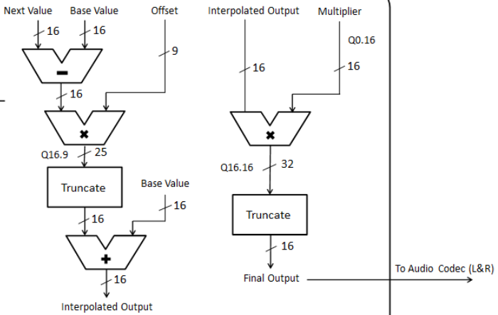
Interpolation Block Diagram
WARNING: This data flow is assumed for “signed” sine wave, not “unsigned”
8
Switches
8
Q8.0
Q0.4
Phase Inc
Next
Base
Offset
Switches
Q4.4
8
8
8
4
8
8
8
delta
8
Q4.4
8
cw0
Index.Offset
Q4.4
Amplify
8
Q8.4
12
4
‘1’
4
Q12.4
4
Index
Index
Offset
delta*offset
truncate
Base
cw1
0
1
8
Mux
Q8.0
8
4
16 MSBs
‘1’
Read
Addr
8
BRAM is assumed to be signed. If not, convert from unsigned to sign after reading value
BRAM
Data
8
Q8.0
= Base + (Next – Base) * Offset
cw2
Base Value
cw2
Next Value
WARNING: Our VHDL does signed multiplies, not unsigned multiplies
If a value is unsigned, like Offset and Amplify,
you will need to fool the multiply by appending a ‘0’ to the MSB,
And then remove the MSB from the answer. If both inputs are unsigned, you’ll need to remove two ‘00’s from the MSB of the answer
8
Base
8
Next

