Slide 1

ECE 383 – Embedded Computer Systems II Lecture 17 – Soft CPU – “MicroBlaze”
Maj Jeffrey Falkinburg Room 2E46E 333-9193
1

Slide 2
Lesson Outline
Time Logs!
HW# 9 BOC Next Lesson!
Soft CPU – MicroBlaze
MicroBlaze Intro
MicroBlaze Tutorial
Adding LEDs GPIO

Slide 3
MicroBlaze Intro

Slide 4
Microblaze Intro
The goal of today's class is to bring you up to speed on how to instantiate a microBlaze processor on our Artix 7, integrate a custom piece of VHDL code to the processor, and then to write some C code to run on the microBlaze to control the custom VHDL module. Here are some specifications on the microBlaze processor:It has thirty-two 32-bit general purpose registers.
It uses a 32-bit instruction word with three operands, and has two addressing modes.
It has a 32-bit address bus.
It uses a single issue (3 or 5)-stage pipeline.

Slide 5
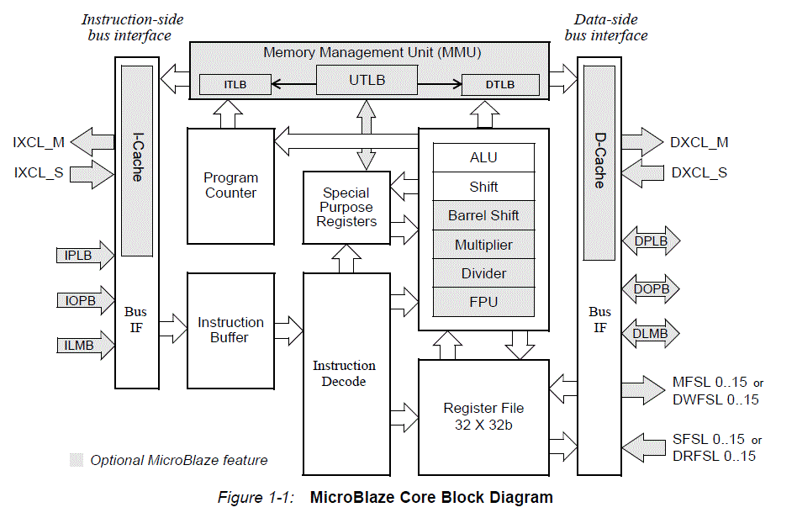
Microblaze Intro

Slide 6
MicroBlaze Tutorial

Slide 7
Microblaze – Tutorial Overview
In this tutorial, you will be introduced to the tool flow for simple MicroBlaze designs. Specifically, you will create a design that continuously reads the input from UART and writes that value to the LEDs. The UART will be connected from the FPGA to your computer via a micro USB cable.
You will follow the tutorial here step by step.

Slide 8
Microblaze – Tutorial Deviations
Deviations from the Tutorial
Call your project "L17" or "Lesson17".
Keep in mind that you can zoom in and out on your block diagram.
The AXI bus is the bus the Microblaze uses, similar to a PCI bus in normal PC's.
What does the UART actually do? Although you learned about it in ECE382, you can read more about UART's for a referesher.
UART Controller?
Ignore step 6.3 completely. When you do step 6.2, just check the "reset" box in the automatic connections dialogue under clock wizard. You do not need to make the connection manually.
The Memory Interface Generator (MIG) is used essentially add BRAM (it is SDRAM in this case).
Although you didn't need to make the first conneciton manually, you do need to make the 2nd connection manually (with the RAM).

Slide 9
Microblaze - Tutorial
https://reference.digilentinc.com/learn/programmable-logic/tutorials/nexys-video-getting-started-with-microblaze/start
https://reference.digilentinc.com/learn/programmable-logic/tutorials/pmod-ips/start
https://reference.digilentinc.com/nexys/nexysvideo/gsmb?s[]=ip&s[]=integrator
https://reference.digilentinc.com/learn/programmable-logic/tutorials/zedboard-creating-custom-ip-cores/start

Slide 10
Microblaze – Getting Started
What you need before proceeding with this guide
Software
Xilinx Vivado with the SDK package.
Follow this Wiki guide (Installing Vivado ) on how to install and activate Vivado 2014.3
Board Support Files
Board Support Files. These files will describe GPIO interfaces on your board and make it easier to select your FPGA board and add GPIO IP blocks.
Follow this Wiki guide (Vivado Board Files for Digilent 7-Series FPGA Boards ) on how to install Board Support Files for Vivado 2014.3
Hardware
Digilent Nexys Video FPGA Board and Micro USB Cable for UART communication and JTAG programming

Slide 11
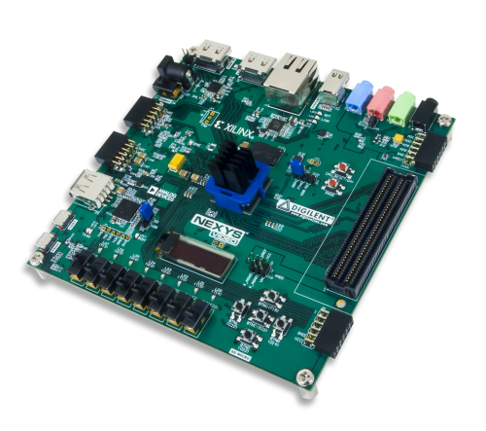
Microblaze
https://reference.digilentinc.com/learn/programmable-logic/tutorials/nexys-video-getting-started-with-microblaze/start

Slide 12
Microblaze - Introduction
Microblaze is a soft IP core from Xilinx that will implement a microprocessor entirely within the Xilinx FPGA general purpose memory and logic fabric. For this tutorial, we are going to add a Microblaze IP block using the Vivado IP Integrator tool.
In addition to the Microblaze IP block, we would also like to make use of the DDR3 SDRAM component on the Nexys Video. Therefore a MIG ( Memory Interface Generator ) IP block will be added to our design.
Finally, a UART ( Universal Asynchronous Receiver/Transmitter ) IP block will be added to communicate between the host PC and the soft processor core running on the Nexys Video.

Slide 13
Microblaze
General Design Flow - Vivado
Open Vivado and select Nexys Video board
Create an new Vivado Project
Create empty block design workspace inside the new project
Add required IP blocks using the IP integrator tool and build Hardware Design
Validate and save block design
Create HDL system wrapper
Run design Synthesis and Implementation
Generate Bit File
Export Hardware Design including the generated bit stream file to SDK tool
Launch SDK

Slide 14
Microblaze
Now the Hardware design is exported to the SDK tool. The Vivado to SDK hand-off is done internally through Vivado. We will use SDK to create a Software application that will use the customized board interface data and FPGA hardware configuration by importing the hardware design information from Vivado.
General Design Flow - SDK
Create new application project and select default Hello World template
Program FPGA
Run configuration by selecting the correct UART COM Port and Baud Rate

Slide 15
Microblaze

Slide 16
Microblaze - Issues
Ensure at this time don’t use the MicroBlaze Interrupt Controller on the MicroBlaze Block Automation.
Trouble with too many errors with MIG Block Automation. Should only have the error message [BD 41-1273]
Design won’t validate or build with more error messages.
Block Design name may need to start with “design”

Slide 17
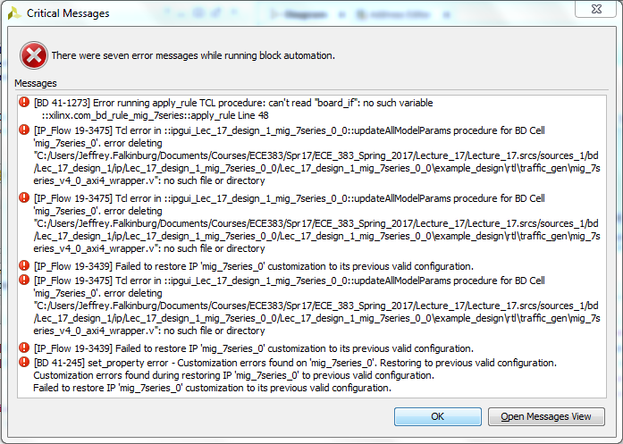
Microblaze
Errors after MIG Block Automation Run
can't read "board_if": no such variable
ERROR: [BD 41-1273] Error running apply_rule TCL procedure: can't read "board_if": no such variable
::xilinx.com_bd_rule_mig_7series::apply_rule Line 48
INFO: [BD 5-145] Automation rule xilinx.com:bd_rule:mig_7series was not applied to object mig_7series_0
apply_bd_automation: Time (s): cpu = 00:00:02 ; elapsed = 00:00:27 . Memory (MB): peak = 1280.910 ; gain = 0.000
INFO: [Common 17-17] undo 'apply_bd_automation -rule xilinx.com:bd_rule:mig_7series -config {Board_Interface "ddr3_sdram" } [get_bd_cells mig_7series_0]'
INFO: [Common 17-17] undo 'endgroup'
error deleting "C:/Users/Jeffrey.Falkinburg/Documents/Courses/ECE383/Spr17/ECE_383_Spring_2017/Lecture_17/Lecture_17.srcs/sources_1/bd/Lec_17_design_1/ip/Lec_17_design_1_mig_7series_0_0/Lec_17_design_1_mig_7series_0_0\example_design\rtl\traffic_gen\mig_7series_v4_0_axi4_wrapper.v": no such file or directory
ERROR: [IP_Flow 19-3475] Tcl error in ::ipgui_Lec_17_design_1_mig_7series_0_0::updateAllModelParams procedure for BD Cell 'mig_7series_0'. error deleting "C:/Users/Jeffrey.Falkinburg/Documents/Courses/ECE383/Spr17/ECE_383_Spring_2017/Lecture_17/Lecture_17.srcs/sources_1/bd/Lec_17_design_1/ip/Lec_17_design_1_mig_7series_0_0/Lec_17_design_1_mig_7series_0_0\example_design\rtl\traffic_gen\mig_7series_v4_0_axi4_wrapper.v": no such file or directory
error deleting "C:/Users/Jeffrey.Falkinburg/Documents/Courses/ECE383/Spr17/ECE_383_Spring_2017/Lecture_17/Lecture_17.srcs/sources_1/bd/Lec_17_design_1/ip/Lec_17_design_1_mig_7series_0_0/Lec_17_design_1_mig_7series_0_0\example_design\rtl\traffic_gen\mig_7series_v4_0_axi4_wrapper.v": no such file or directory
ERROR: [IP_Flow 19-3475] Tcl error in ::ipgui_Lec_17_design_1_mig_7series_0_0::updateAllModelParams procedure for BD Cell 'mig_7series_0'. error deleting "C:/Users/Jeffrey.Falkinburg/Documents/Courses/ECE383/Spr17/ECE_383_Spring_2017/Lecture_17/Lecture_17.srcs/sources_1/bd/Lec_17_design_1/ip/Lec_17_design_1_mig_7series_0_0/Lec_17_design_1_mig_7series_0_0\example_design\rtl\traffic_gen\mig_7series_v4_0_axi4_wrapper.v": no such file or directory
INFO: [IP_Flow 19-3438] Customization errors found on 'mig_7series_0'. Restoring to previous valid configuration.
INFO: [IP_Flow 19-3447] Customization errors found during restoring IP 'mig_7series_0' to previous valid configuration.
ERROR: [IP_Flow 19-3439] Failed to restore IP 'mig_7series_0' customization to its previous valid configuration.
error deleting "C:/Users/Jeffrey.Falkinburg/Documents/Courses/ECE383/Spr17/ECE_383_Spring_2017/Lecture_17/Lecture_17.srcs/sources_1/bd/Lec_17_design_1/ip/Lec_17_design_1_mig_7series_0_0/Lec_17_design_1_mig_7series_0_0\example_design\rtl\traffic_gen\mig_7series_v4_0_axi4_wrapper.v": no such file or directory
ERROR: [IP_Flow 19-3475] Tcl error in ::ipgui_Lec_17_design_1_mig_7series_0_0::updateAllModelParams procedure for BD Cell 'mig_7series_0'. error deleting "C:/Users/Jeffrey.Falkinburg/Documents/Courses/ECE383/Spr17/ECE_383_Spring_2017/Lecture_17/Lecture_17.srcs/sources_1/bd/Lec_17_design_1/ip/Lec_17_design_1_mig_7series_0_0/Lec_17_design_1_mig_7series_0_0\example_design\rtl\traffic_gen\mig_7series_v4_0_axi4_wrapper.v": no such file or directory
INFO: [IP_Flow 19-3438] Customization errors found on 'mig_7series_0'. Restoring to previous valid configuration.
INFO: [IP_Flow 19-3447] Customization errors found during restoring IP 'mig_7series_0' to previous valid configuration.
ERROR: [IP_Flow 19-3439] Failed to restore IP 'mig_7series_0' customization to its previous valid configuration.
ERROR: [BD 41-245] set_property error - Customization errors found on 'mig_7series_0'. Restoring to previous valid configuration.
Customization errors found during restoring IP 'mig_7series_0' to previous valid configuration.
Failed to restore IP 'mig_7series_0' customization to its previous valid configuration.

Slide 18
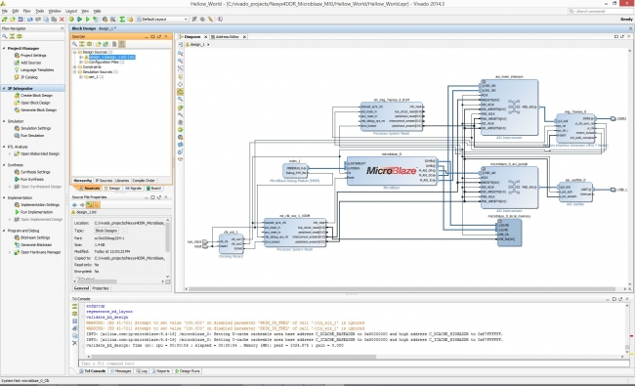
Microblaze - Tutorial
Microblaze based hardware ( HW ) design in Xilinx Vivado

Slide 19
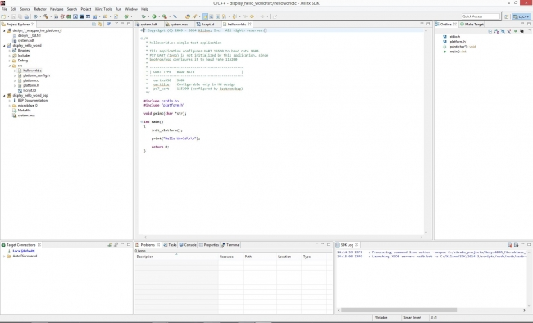
Microblaze - Xilinx Vivado SDK
.C Project in Xilinx Vivado SDK ( Software Development Kit) to display Hello World using the hardware design shown in the previous step

Slide 20
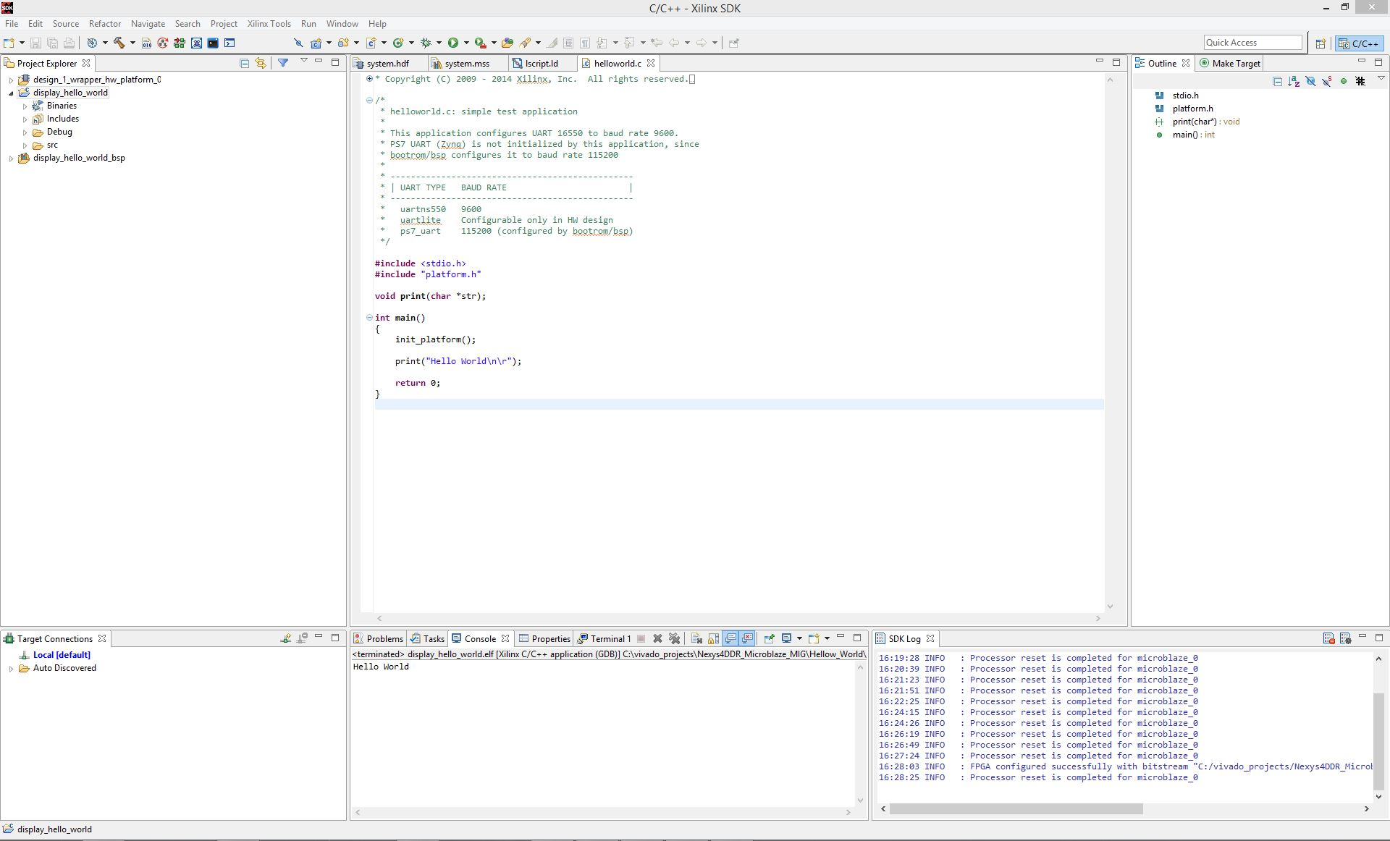
Microblaze - Xilinx Vivado SDK

Slide 21
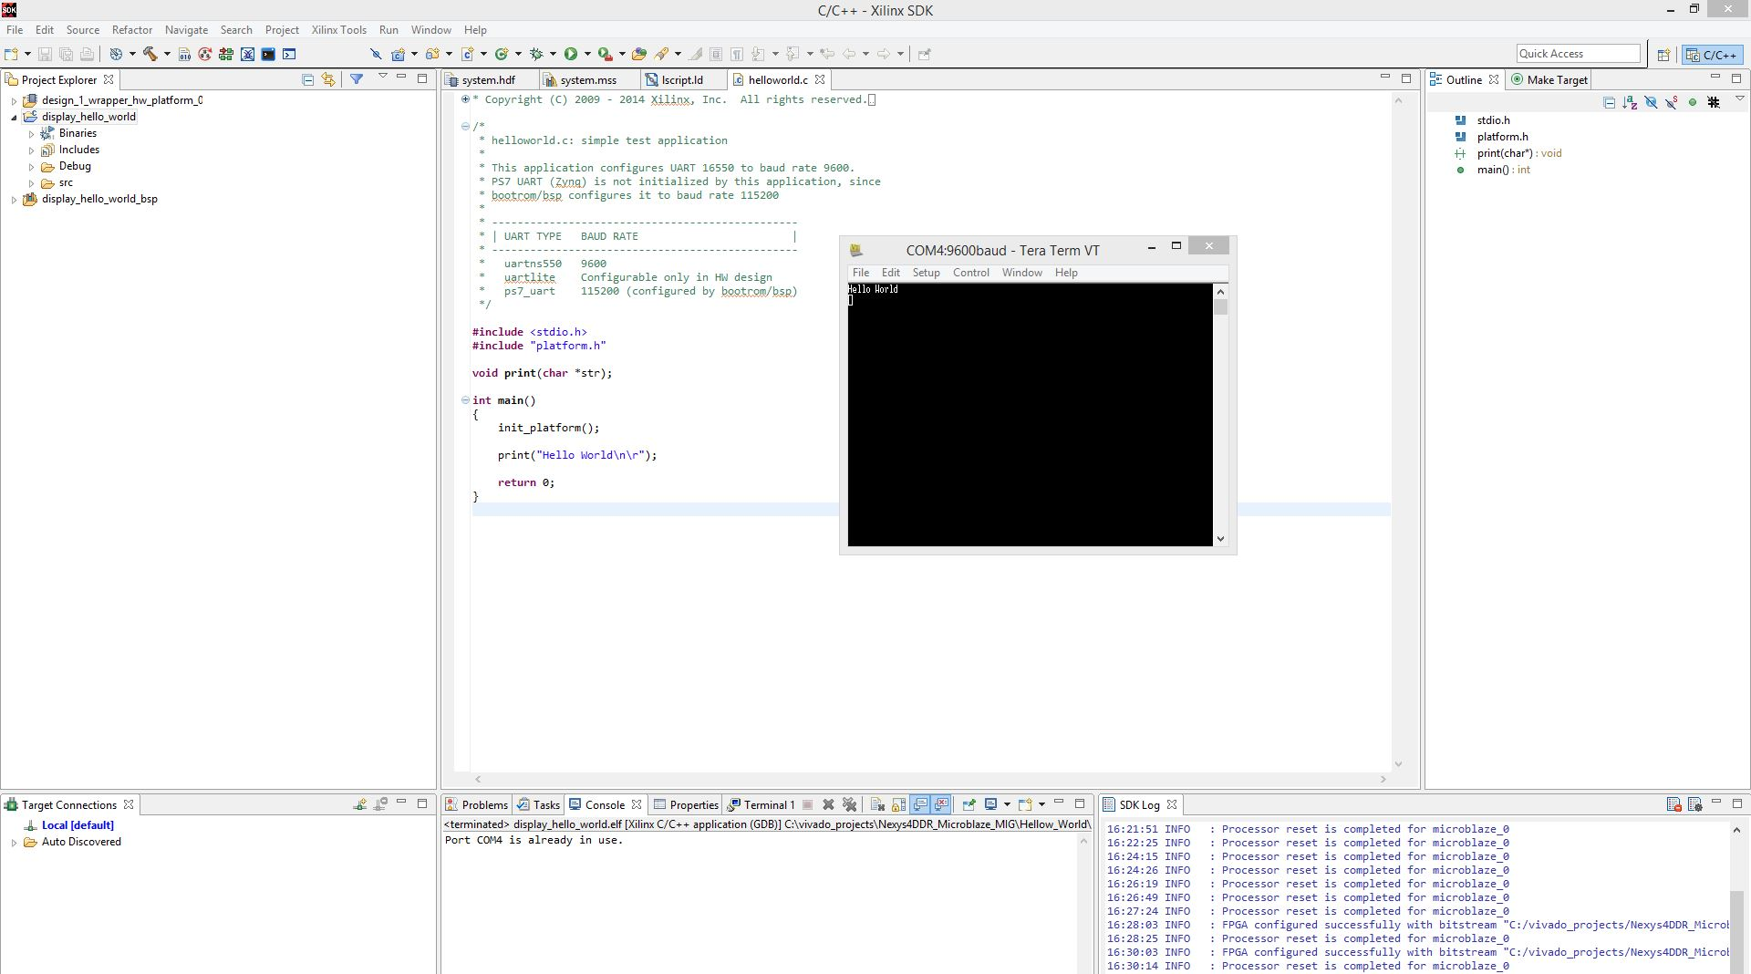
Microblaze - Xilinx Vivado SDK

Slide 22
Microblaze – Issues with SDK
ERROR: Specified device 'Digilent Nexys Video 210276723218B/1-xc7a200t' is not found on the board
This essentially means that the .bit file you created was for a different board and the Artix 7 is rejecting it.
Solution: Regenerate .bit file in Vivado and re-export to SDK

Slide 23
Adding LEDs GPIO

Slide 24
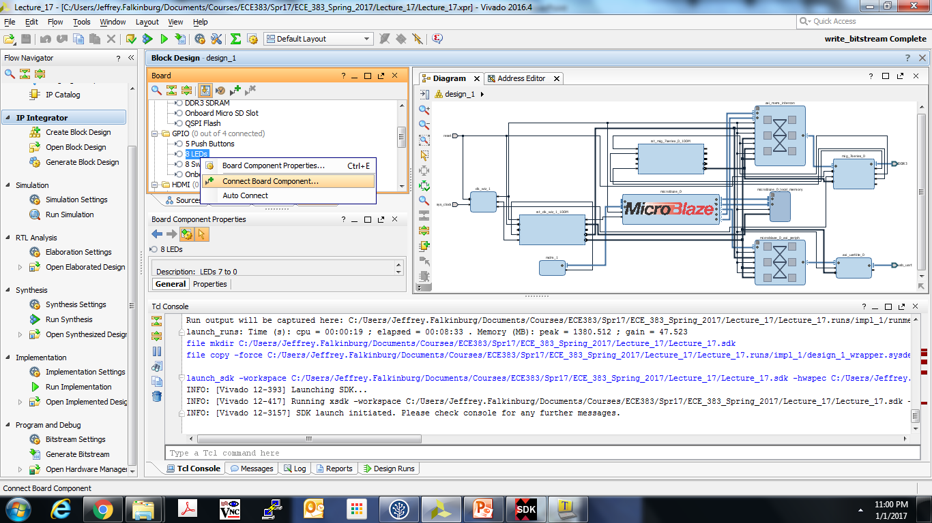
Microblaze – Adding LEDs GPIO

Slide 25
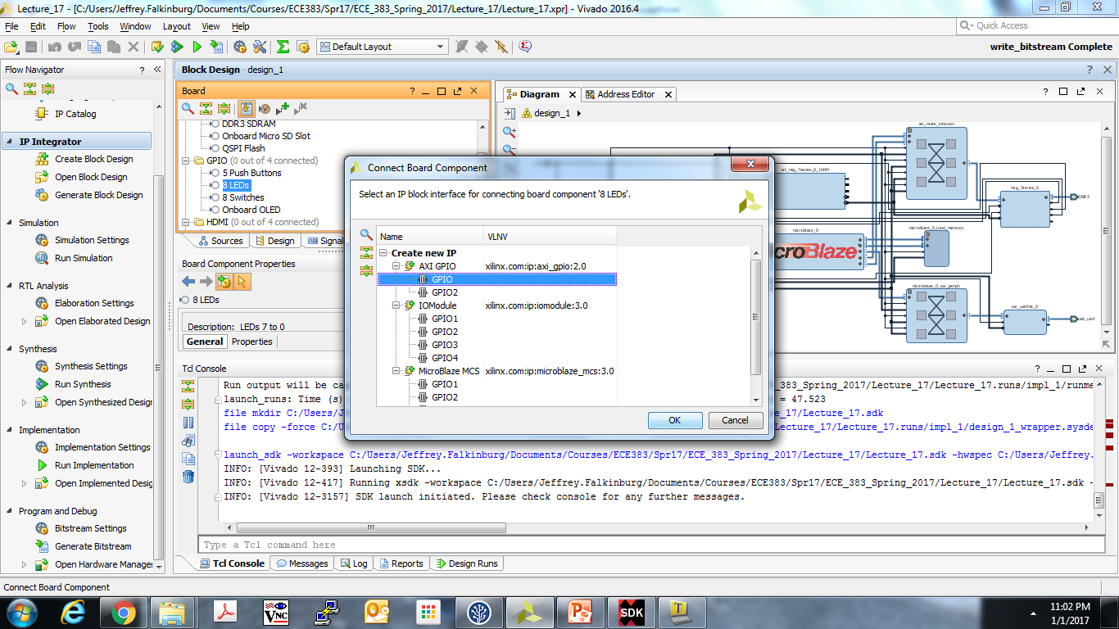
Microblaze – Adding LEDs GPIO

Slide 26
Microblaze – Adding LEDs GPIO
Run Connection Automation

