Slide 1

ECE 383 – Embedded Computer Systems II Lecture 5 – Combination of Elements and Lab Intro
Maj Jeffrey Falkinburg Room 2E46E 333-9193
1

Slide 2
Lesson Outline
Comparator Construction
Gated and Non-Gated Circuit
Lab 1 Intro

Slide 3
Comparator Construction

Slide 4
Comparator Construction
You will generate a signal similar to this CSA in Lab 1:
h_synch <= '1' when ((h_count >= 100) and (h_synch < 200)) else '0';
This is a Non-Gated output Signal
Non-Gated signals Generate glitches on the output!
How is a comparator constructed?

Slide 5
Gated and Non-Gated Circuit

Slide 6
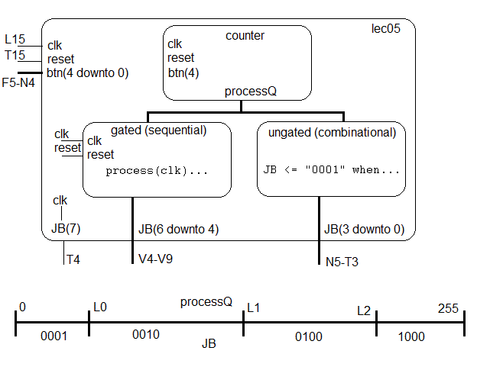
Gated and Non-Gated Circuit
Take a look at lec05.vhdl

Slide 7
Gated and Non-Gated Circuit
Lec5
clk
counter
reset
clk
R4
clk
reset
G4
btn(4)
reset
btn(4)
processQ
btn(4 downto 0)
B22, D22, C22, D14, F15
clk
gated (Sequential)
ungated (combinational)
reset
clk
reset
clk
process (clk)…
JB <= “0001” when…
JB(7)
JB(6 downto 4)
JB(3 downto 0)
Y7
Y8, Y9, W9
W7,V7-V9
processQ
0
L0
L1
L2
255
0001
0010
0100
1000
JB

Slide 8
Gated and Non-Gated Circuit
Combinational Realization – Non-gated
JB(3 downto 0) <= "0001" when ((processQ >= 0) and (processQ < L0)) else "0010" when ((processQ >= L0) and (processQ < L1)) else "0100" when ((processQ >= L1) and (processQ < L2)) else "1000";
Sequential Realization – Gated
process(clk) begin if (rising_edge(clk)) then if (reset = '0') then JB(6 downto 4) <= "000"; elsif ((processQ >= 0) and (processQ < L0)) then JB(6 downto 4) <= "001"; elsif ((processQ >= L0) and (processQ < L1)) then JB(6 downto 4) <= "010"; elsif ((processQ >= L1) and (processQ < L2)) then JB(6 downto 4) <= "100"; elsif (processQ >= L2) then JB(6 downto 4) <= "111"; end if; end if; end process;

Slide 9
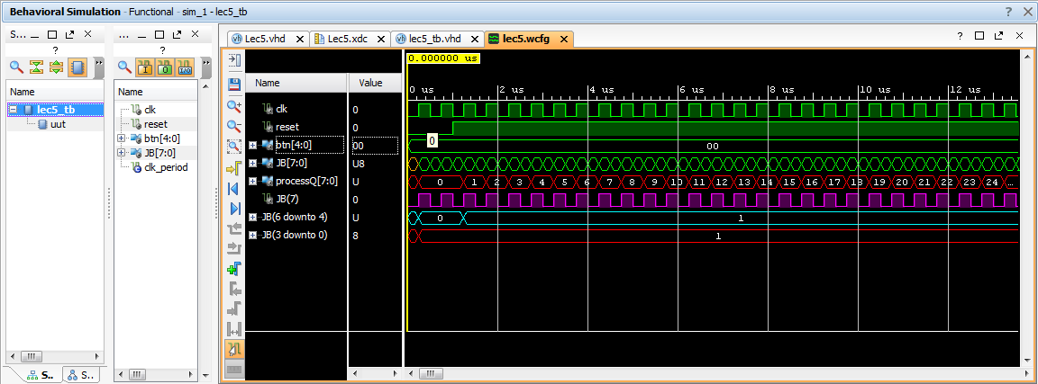

Slide 10
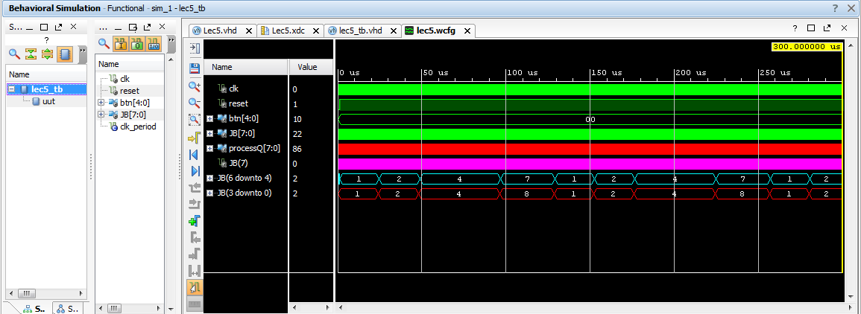

Slide 11
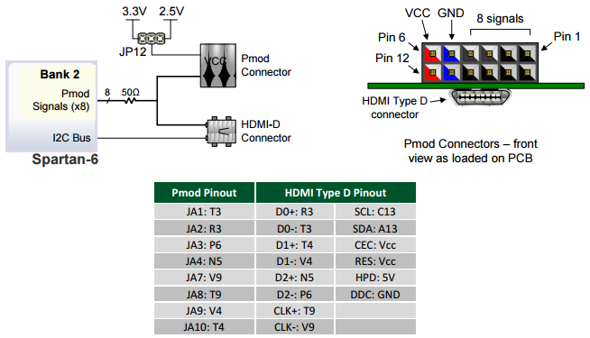
Gated and Non-Gated Circuit – PMOD Connector
PMOD connector (see page 18 of the Atlys Board Reference Manual) corresponding to JB(3) and JB(2) (the most 2 significant bits of the non-gated comparator outputs)

Slide 12
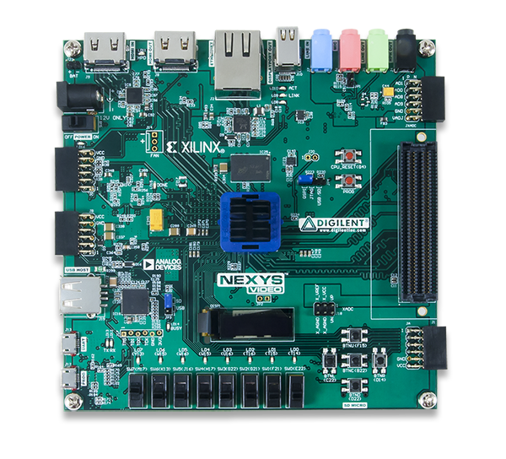
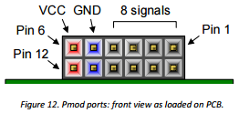
Gated and Non-Gated Circuit – PMOD Connector
JB PMOD
Connector
PMOD connector (see page 20 (Chapter 10) of the Nexys Video Board Reference Manual)

Slide 13
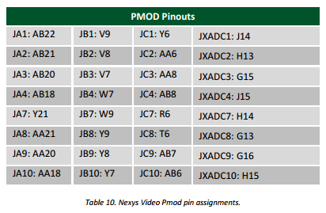
Gated and Non-Gated Circuit – PMOD Connector
JB(3)
JB(2)
JB(2)
JB(3)
PMOD connectors (see page 20 (Chapter 10) of the Nexys Video Board Reference Manual) corresponding to JB(3) and JB(2) (the most 2 significant bits of the non-gated comparator outputs)

Slide 14
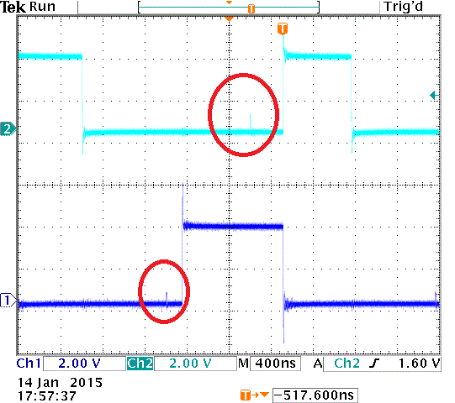
Gated and Non-Gated Circuit
JB(3) and JB(2) (the most 2 significant bits of the non-gated comparator outputs)

Slide 15
Lab 1 Intro

Slide 16
HW 5 – Lab 1 Prelab
Draw a detailed diagram of the oscilloscope grid required for Lab1. A detailed diagram must be drawn on green engineering paper and include
(x,y) corners of the monitor.
(x,y) each of the four major corners (already given).
y-coordinates for all the major horizontal grid lines.
(x,y) coordinates for one set of three horizontal of hatch marks. Indicate with an arrow which set of three.
x-coordinates for al the major vertical grid lines.
(x,y) coordinates for one set of four vertical of hatch marks. Indicate with an arrow which set of four.

Slide 17
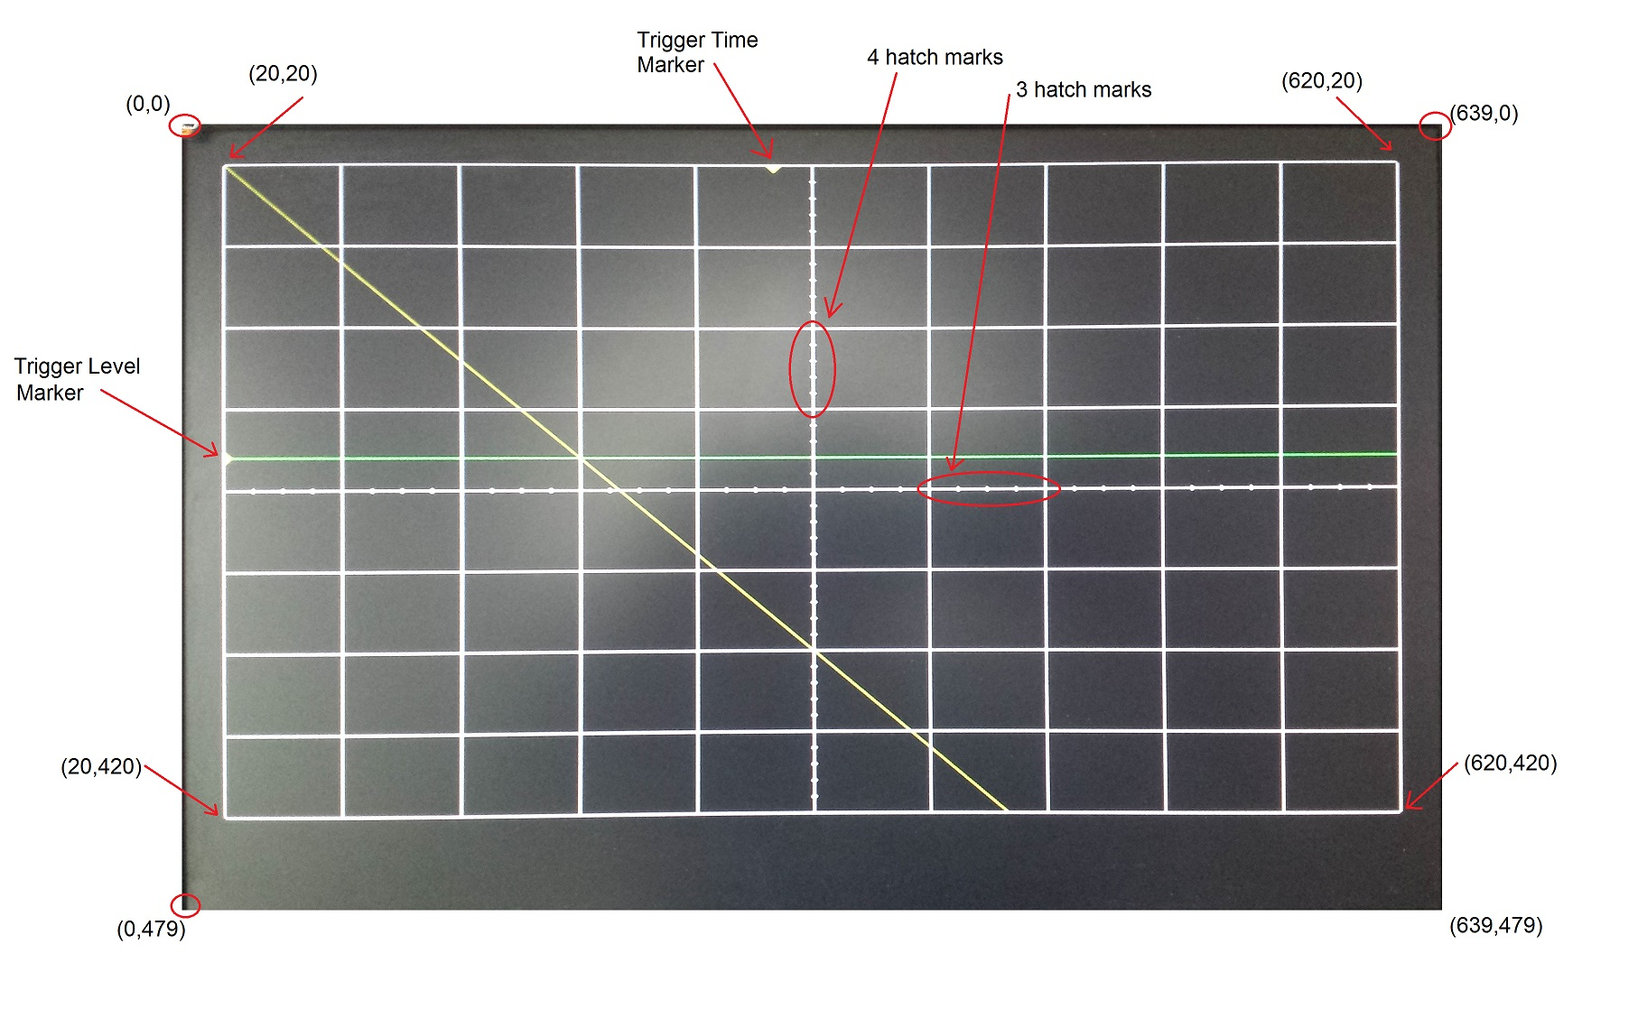
HW 5 – Lab 1 Prelab

Slide 18
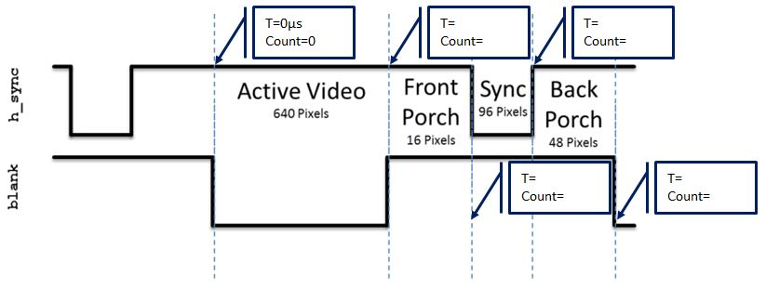
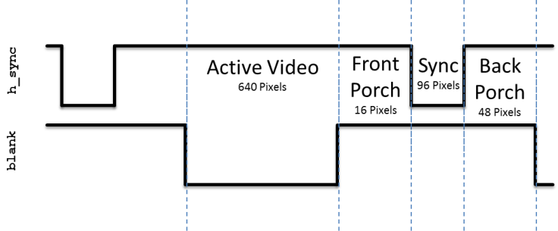
HW 5 – Lab 1 Prelab
Given that the pixel clock is running at 25Mhz, add the durations of the h_synch and v_synch signals show in Lab1. Set time=0 on the blue dashed line on the left side of the region labeled "Active Video".

Slide 19
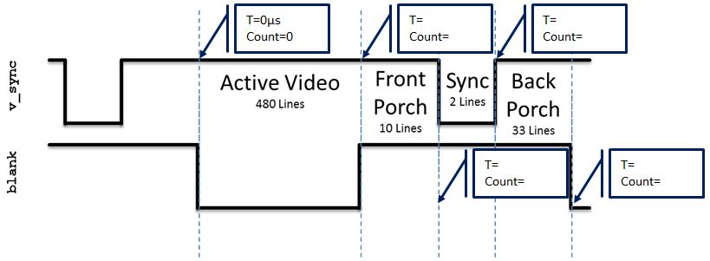
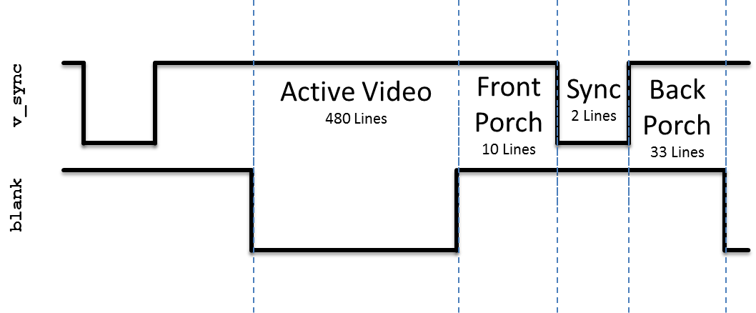
HW 5 – Lab 1 Prelab
Given that the pixel clock is running at 25Mhz, add the durations of the h_synch and v_synch signals show in Lab1. Set time=0 on the blue dashed line on the left side of the region labeled "Active Video".

Slide 20
Lab 1 Intro – VGA Overview
http://www-mtl.mit.edu/Courses/6.111/labkit/vga.shtml

Slide 21
VGA Module
entity vga is
Port( clk: in STD_LOGIC;
reset_n : in STD_LOGIC;
h_sync : out STD_LOGIC;
v_sync : out STD_LOGIC;
blank : out STD_LOGIC;
r: out STD_LOGIC_VECTOR(7 downto 0);
g: out STD_LOGIC_VECTOR(7 downto 0);
b: out STD_LOGIC_VECTOR(7 downto 0);
trigger_time: in unsigned(9 downto 0);
trigger_volt: in unsigned (9 downto 0);
row: out unsigned(9 downto 0);
column: out unsigned(9 downto 0);
ch1: in std_logic;
ch1_enb: in std_logic;
ch2: in std_logic;
ch2_enb: in std_logic);
end vga;

Slide 22
VGA Module
clk | This is the 25Mhz pixel clock generated by the DCM in the video module.
reset_n | This is the same active low reset signal passed into the top level Lab1 module.
tr_volt | This is a 10-bit unsigned value representing the trigger voltage. This value is passed to the scopeFace module so that a yellow arrow (see Trigger Level Marker in the screen show) on the vertical axis.
tr_time | This is a 10-bit unsigned value representing the trigger time. This value is passed to the scopeFace module so that a yellow arrow (see Trigger Time Marker in the screen show) on the horizontal axis.
ch1 | This 1-bit signal signals the VGA module to draw the channel 1 signal on the scope for this row, column pixel. When the value is 1, draw a yellow pixel on the display at the current row,colum position. When 0, do not draw a pixel.
ch1_enb | This 1-bit signal enable the ch1 signal to be drawn.
ch2 | This 1-bit signal signals the VGA module to draw the channel 2 signal on the scope for this row,column pixel. When the value is 1, draw a green pixel on the display at the current row, column position. When 0, do not draw a pixel.
ch2_enb | This 1-bit signal enable the ch2 signal to be drawn.
R | The 8-bit red intensity for this row,column pixel on the screen.
G | The 8-bit green intensity for this row,column pixel on the screen.
B | The 8-bit blue intensity for this row,column pixel on the screen.
Row | The current row being drawn on the display.
Column | The current row being drawn on the display.
blank | The blank signal for the current row,column position. Its the logical OR of the h_blank and v_blank signals.
h_synch | The h_synch signal for the current row,column position.
v_synch | The v_synch signal for the current row,column position.
Behavior | The VGA component contains a pair of cascaded counters which generate the row and column values of the current pixel being displayed. The row and column values are used to generate the blank, h_synch and v_synch signals according to the Figures above. The scopeFace component (more on this below), takes the row and column values (along with some other information) and generates the R,G,B color of that pixel. The three muxes on the output of the R,G,B output of the scopeFace component output the scopeFace R,G,B values for row,column values within the 640x480 displayable region, or 0's for values outside this region.

Slide 23
scopeFace Module
entity scopeFace is
Port ( row : in unsigned(9 downto 0);
column : in unsigned(9 downto 0);
trigger_volt: in unsigned (9 downto 0);
trigger_time: in unsigned (9 downto 0);
r : out std_logic_vector(7 downto 0);
g : out std_logic_vector(7 downto 0);
b : out std_logic_vector(7 downto 0);
ch1: in std_logic;
ch1_enb: in std_logic;
ch2: in std_logic;
ch2_enb: in std_logic);
end scopeFace;

Slide 24
ScopeFace Module
clk | This is the 25Mhz pixel clock generated by the DCM in the video module.
reset_n | This is the same active low reset signal passed into the top level Lab1 module.
tr_volt | This is a 10-bit unsigned value representing the trigger voltage. This value is passed to the scopeFace module so that a yellow arrow (see Trigger Level Marker in the screen show) on the vertical axis.
tr_time | This is a 10-bit unsigned value representing the trigger time. This value is passed to the scopeFace module so that a yellow arrow (see Trigger Time Marker in the screen show) on the horizontal axis.
ch1 | This 1-bit signal signals the VGA module to draw the channel 1 signal on the scope for this row, column pixel. When the value is 1, draw a yellow pixel on the display at the current row,column position. When 0, do not draw a pixel.
ch1_enb | This 1-bit signal enable the ch1 signal to be drawn.
ch2 | This 1-bit signal signals the VGA module to draw the channel 2 signal on the scope for this row,column pixel. When the value is 1, draw a green pixel on the display at the current row, column position. When 0, do not draw a pixel.
ch2_enb | This 1-bit signal enable the ch2 signal to be drawn.
R | The 8-bit red intensity for this row,column pixel on the screen.
G | The 8-bit green intensity for this row,column pixel on the screen.
B | The 8-bit blue intensity for this row,column pixel on the screen.
Row | The current row being drawn on the display.
Column | The current row being drawn on the display.
Behavior | The scopeFace component takes in the current row,column coordinates of the display and generates the R,G,B values at that screen coordinate. For example, if row,column = 20,20 then the R,G,B output should be 0xFF,0xFF,0xFF (white) because the upper left corner of the O'scope grid display is white. Note, you can get the RGB values for common colors at this web site.

Slide 25
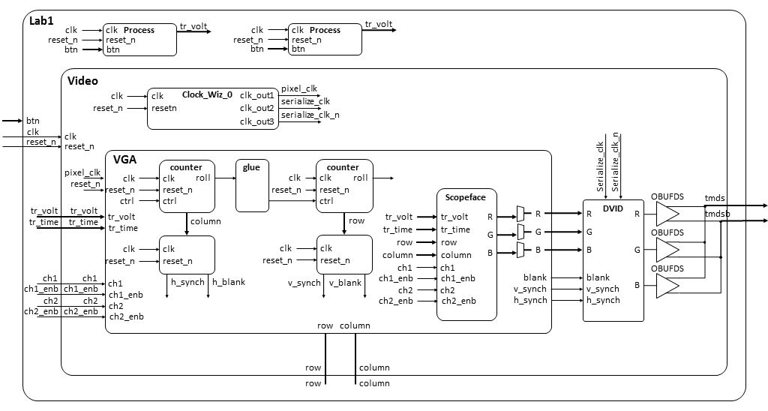
Lab 1 Intro – Architecture

Slide 26
Lab 1 Connections
HDMI Out
Power
CPU Reset
Buttons
USB Prog

Slide 27
Digital Clocking Wizard
Xilinx Clocking Wizard Page:
https://www.xilinx.com/products/intellectual-property/clocking_wizard.html
Clocking Wizard v5.3 - LogiCORE IP Product Guide:
https://www.xilinx.com/support/documentation/ip_documentation/clk_wiz/v5_3/pg065-clk-wiz.pdf

Slide 28
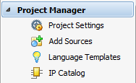
Digital Clocking Wizard
Click on IP Catalog
Search for Clocking Wizard IP

Slide 29
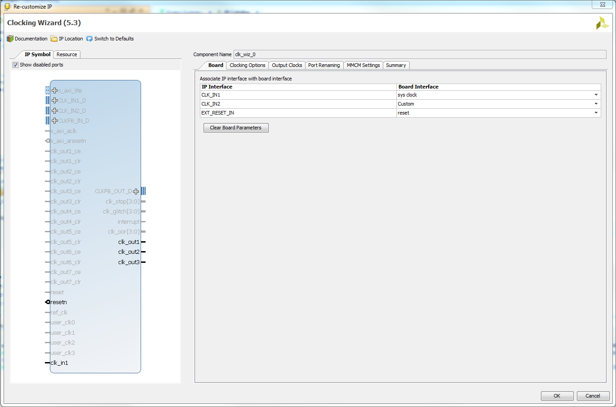
Digital Clocking Wizard

Slide 30
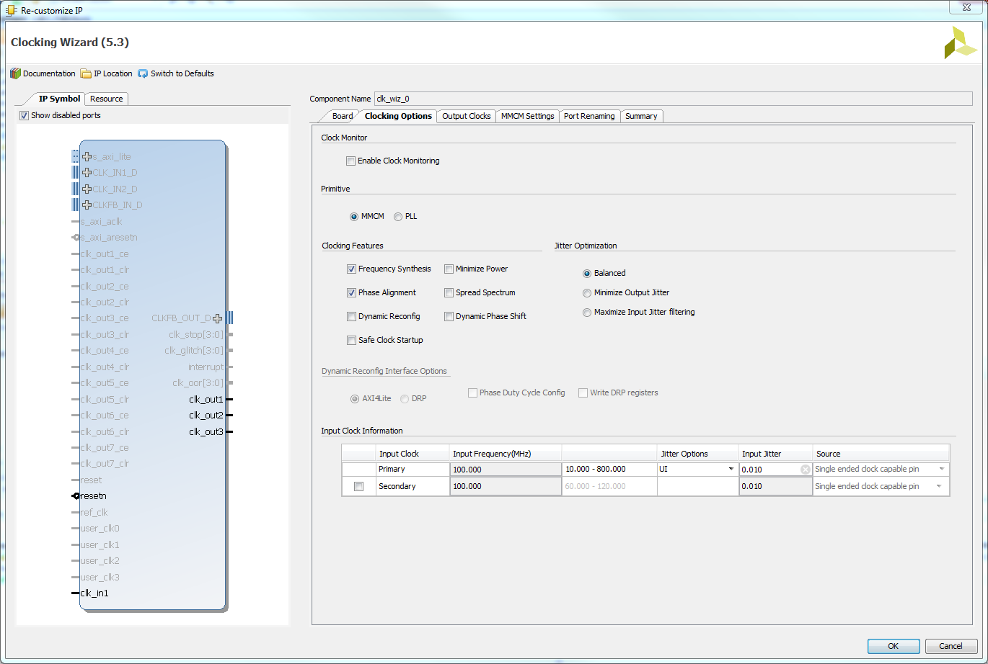
Digital Clocking Wizard

Slide 31
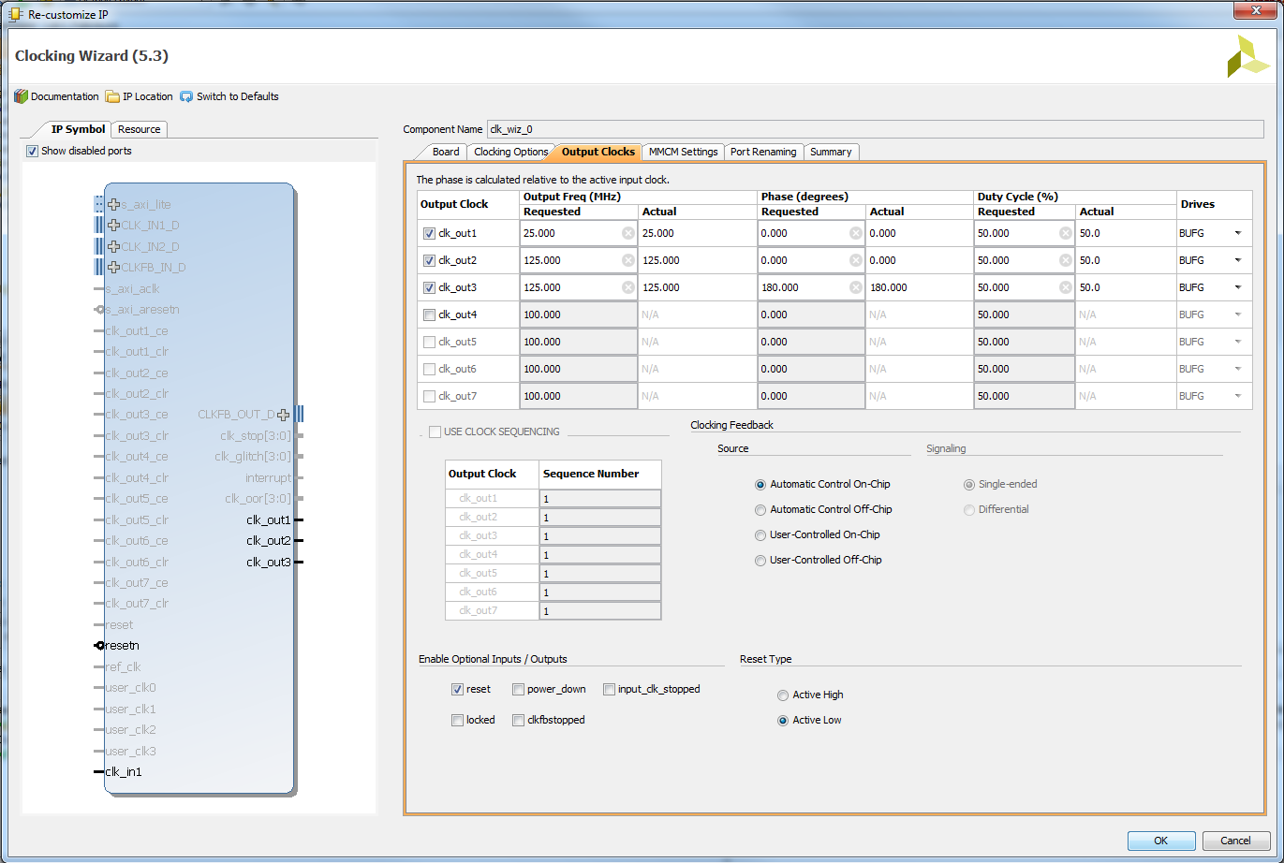
Digital Clocking Wizard

Slide 32
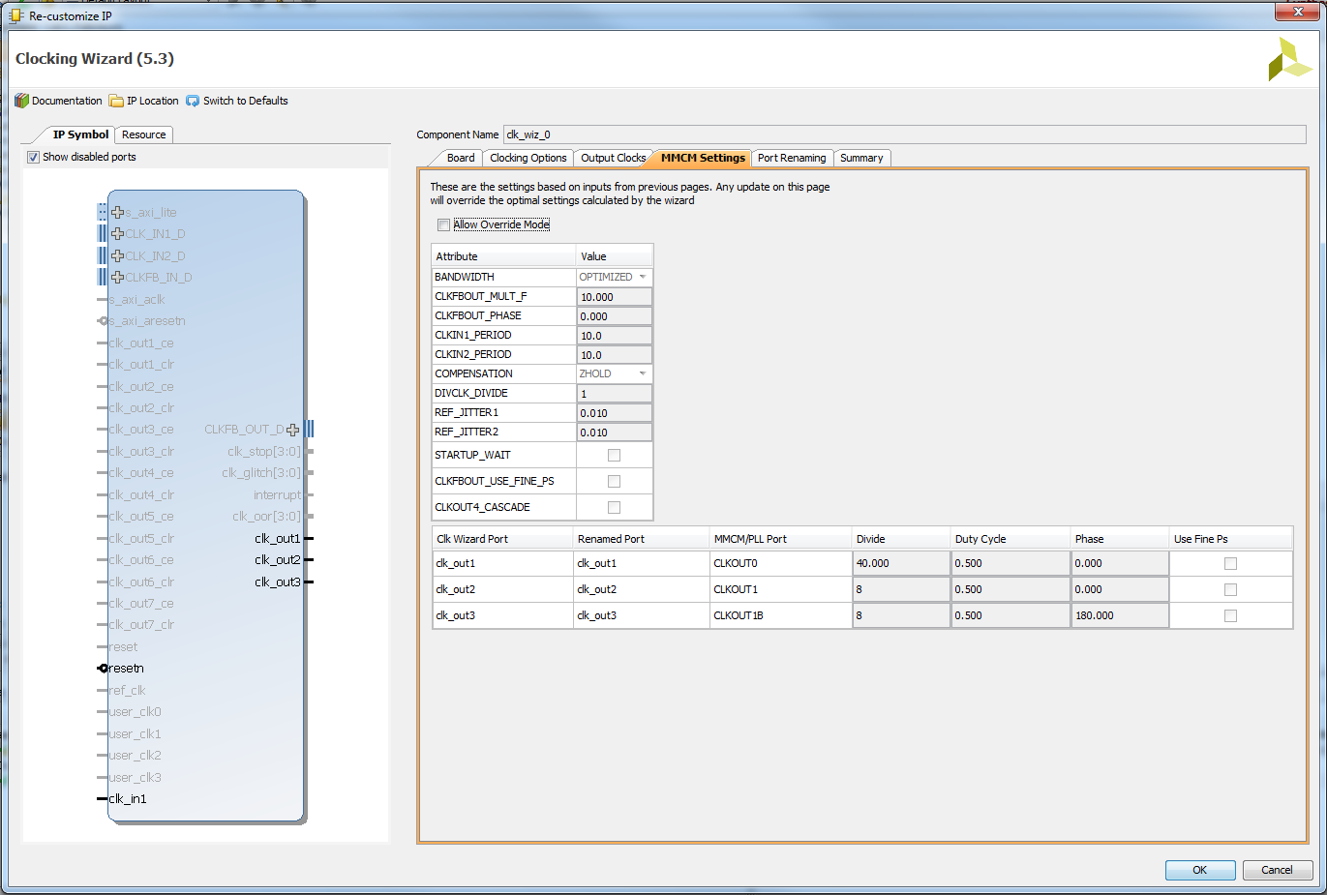
Digital Clocking Wizard

Slide 33
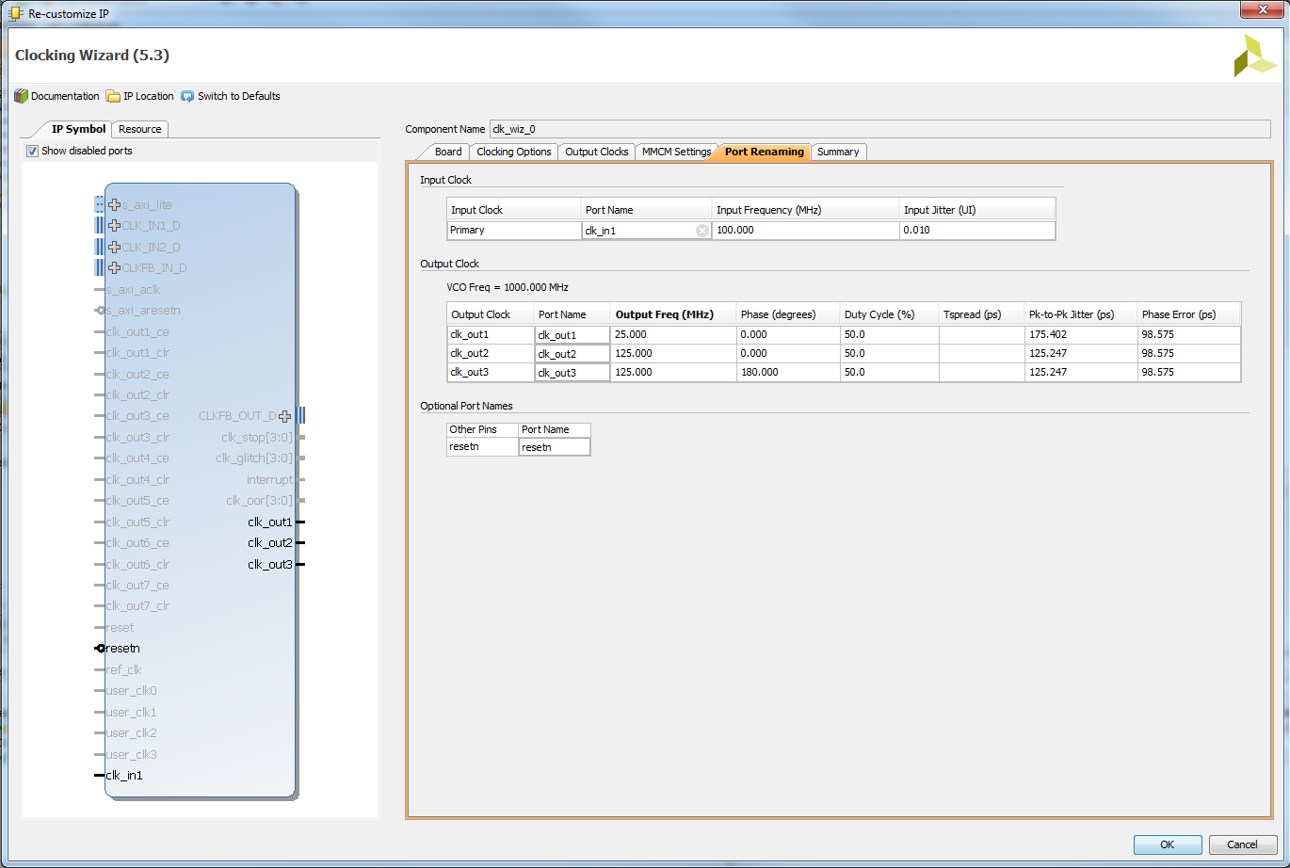
Digital Clocking Wizard

Slide 34
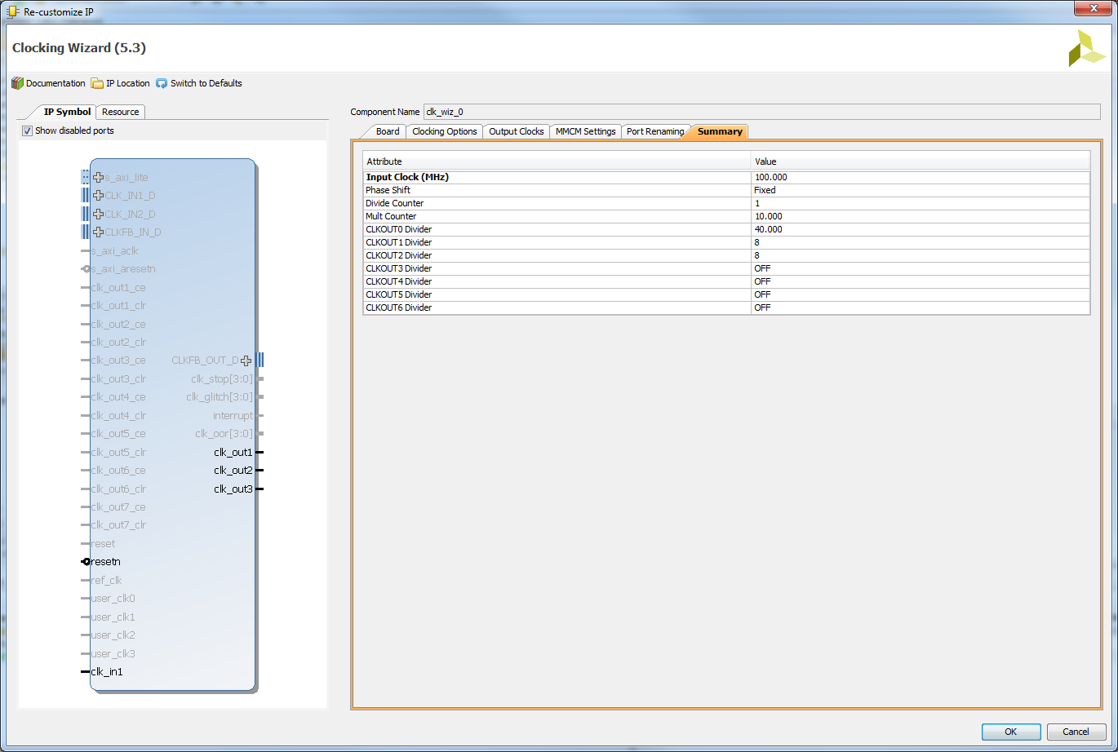
Digital Clocking Wizard

Slide 35
Digital Clocking Wizard
Verify Component Declaration in video.vhd
--------------------------------------------------------------------------
-- Clock Wizard Component Instantiation Using Xilinx Vivado
--------------------------------------------------------------------------
component clk_wiz_0 is
Port (
clk_in1 : in STD_LOGIC;
clk_out1 : out STD_LOGIC;
clk_out2 : out STD_LOGIC;
clk_out3 : out STD_LOGIC;
resetn : in STD_LOGIC);
end component;
Verify Component Instantiation in video.vhd

Slide 36
Digital Clocking Wizard
Verify Component Instantiation in video.vhd
--------------------------------------------------------------------------
-- Digital Clocking Wizard using Xilinx Vivado creates 25Mhz pixel clock and
-- 125MHz HDMI serial output clocks from 100MHz system clock. The Digital
-- Clocking Wizard is in the Vivado IP Catalog.
--------------------------------------------------------------------------
mmcm_adv_inst_display_clocks: clk_wiz_0
Port Map (
clk_in1 => clk,
clk_out1 => pixel_clk, -- 25Mhz pixel clock
clk_out2 => serialize_clk, -- 125Mhz HDMI serial output clock
clk_out3 => serialize_clk_n, -- 125Mhz HDMI serial output clock 180 degrees out of phase
resetn => reset_n); -- active low reset for Nexys Video

Slide 37
Lesson Outline
Comparator Construction
Gated and Non-Gated Circuit
Lab 1 Intro

