Slide 1

ECE 383 – Embedded Computer Systems II Lab 1 Supplement
Maj Jeffrey Falkinburg Room 2E46E 333-9193
1

Slide 2
Lab 1 Intro – VGA Overview
http://www-mtl.mit.edu/Courses/6.111/labkit/vga.shtml

Slide 3
VGA Module
entity vga is
Port( clk: in STD_LOGIC;
reset_n : in STD_LOGIC;
h_sync : out STD_LOGIC;
v_sync : out STD_LOGIC;
blank : out STD_LOGIC;
r: out STD_LOGIC_VECTOR(7 downto 0);
g: out STD_LOGIC_VECTOR(7 downto 0);
b: out STD_LOGIC_VECTOR(7 downto 0);
trigger_time: in unsigned(9 downto 0);
trigger_volt: in unsigned (9 downto 0);
row: out unsigned(9 downto 0);
column: out unsigned(9 downto 0);
ch1: in std_logic;
ch1_enb: in std_logic;
ch2: in std_logic;
ch2_enb: in std_logic);
end vga;

Slide 4
VGA Module
clk | This is the 25Mhz pixel clock generated by the DCM in the video module.
reset_n | This is the same active low reset signal passed into the top level Lab1 module.
tr_volt | This is a 10-bit unsigned value representing the trigger voltage. This value is passed to the scopeFace module so that a yellow arrow (see Trigger Level Marker in the screen show) on the vertical axis.
tr_time | This is a 10-bit unsigned value representing the trigger time. This value is passed to the scopeFace module so that a yellow arrow (see Trigger Time Marker in the screen show) on the horizontal axis.
ch1 | This 1-bit signal signals the VGA module to draw the channel 1 signal on the scope for this row, column pixel. When the value is 1, draw a yellow pixel on the display at the current row,colum position. When 0, do not draw a pixel.
ch1_enb | This 1-bit signal enable the ch1 signal to be drawn.
ch2 | This 1-bit signal signals the VGA module to draw the channel 2 signal on the scope for this row,column pixel. When the value is 1, draw a green pixel on the display at the current row, column position. When 0, do not draw a pixel.
ch2_enb | This 1-bit signal enable the ch2 signal to be drawn.
R | The 8-bit red intensity for this row,column pixel on the screen.
G | The 8-bit green intensity for this row,column pixel on the screen.
B | The 8-bit blue intensity for this row,column pixel on the screen.
Row | The current row being drawn on the display.
Column | The current row being drawn on the display.
blank | The blank signal for the current row,column position. Its the logical OR of the h_blank and v_blank signals.
h_synch | The h_synch signal for the current row,column position.
v_synch | The v_synch signal for the current row,column position.
Behavior | The VGA component contains a pair of cascaded counters which generate the row and column values of the current pixel being displayed. The row and column values are used to generate the blank, h_synch and v_synch signals according to the Figures above. The scopeFace component (more on this below), takes the row and column values (along with some other information) and generates the R,G,B color of that pixel. The three muxes on the output of the R,G,B output of the scopeFace component output the scopeFace R,G,B values for row,column values within the 640x480 displayable region, or 0's for values outside this region.

Slide 5
scopeFace Module
entity scopeFace is
Port ( row : in unsigned(9 downto 0);
column : in unsigned(9 downto 0);
trigger_volt: in unsigned (9 downto 0);
trigger_time: in unsigned (9 downto 0);
r : out std_logic_vector(7 downto 0);
g : out std_logic_vector(7 downto 0);
b : out std_logic_vector(7 downto 0);
ch1: in std_logic;
ch1_enb: in std_logic;
ch2: in std_logic;
ch2_enb: in std_logic);
end scopeFace;

Slide 6
ScopeFace Module
clk | This is the 25Mhz pixel clock generated by the DCM in the video module.
reset_n | This is the same active low reset signal passed into the top level Lab1 module.
tr_volt | This is a 10-bit unsigned value representing the trigger voltage. This value is passed to the scopeFace module so that a yellow arrow (see Trigger Level Marker in the screen show) on the vertical axis.
tr_time | This is a 10-bit unsigned value representing the trigger time. This value is passed to the scopeFace module so that a yellow arrow (see Trigger Time Marker in the screen show) on the horizontal axis.
ch1 | This 1-bit signal signals the VGA module to draw the channel 1 signal on the scope for this row, column pixel. When the value is 1, draw a yellow pixel on the display at the current row,column position. When 0, do not draw a pixel.
ch1_enb | This 1-bit signal enable the ch1 signal to be drawn.
ch2 | This 1-bit signal signals the VGA module to draw the channel 2 signal on the scope for this row,column pixel. When the value is 1, draw a green pixel on the display at the current row, column position. When 0, do not draw a pixel.
ch2_enb | This 1-bit signal enable the ch2 signal to be drawn.
R | The 8-bit red intensity for this row,column pixel on the screen.
G | The 8-bit green intensity for this row,column pixel on the screen.
B | The 8-bit blue intensity for this row,column pixel on the screen.
Row | The current row being drawn on the display.
Column | The current row being drawn on the display.
Behavior | The scopeFace component takes in the current row,column coordinates of the display and generates the R,G,B values at that screen coordinate. For example, if row,column = 20,20 then the R,G,B output should be 0xFF,0xFF,0xFF (white) because the upper left corner of the O'scope grid display is white. Note, you can get the RGB values for common colors at this web site.

Slide 7
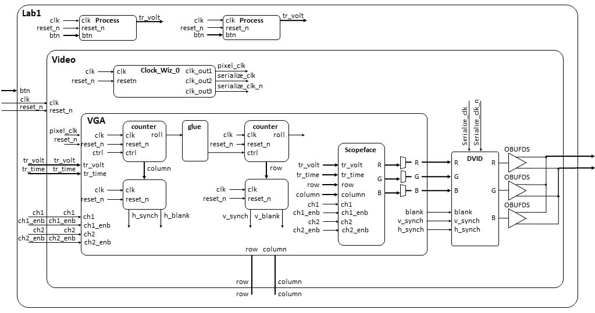
Lab 1 Intro – Architecture

Slide 8
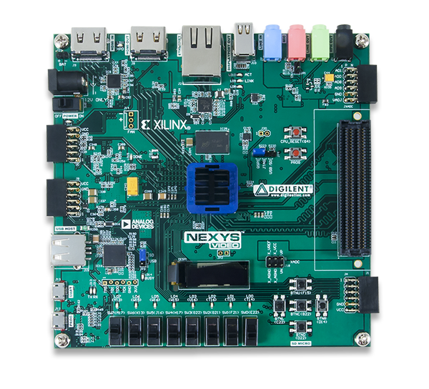
Lab 1 Connections
HDMI Out
Power
CPU Reset
Buttons
USB Prog

Slide 9
Digital Clocking Wizard
Xilinx Clocking Wizard Page:
https://www.xilinx.com/products/intellectual-property/clocking_wizard.html
Clocking Wizard v5.3 - LogiCORE IP Product Guide:
https://www.xilinx.com/support/documentation/ip_documentation/clk_wiz/v5_3/pg065-clk-wiz.pdf

Slide 10
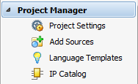
Digital Clocking Wizard
Click on IP Catalog
Search for Clocking Wizard IP

Slide 11
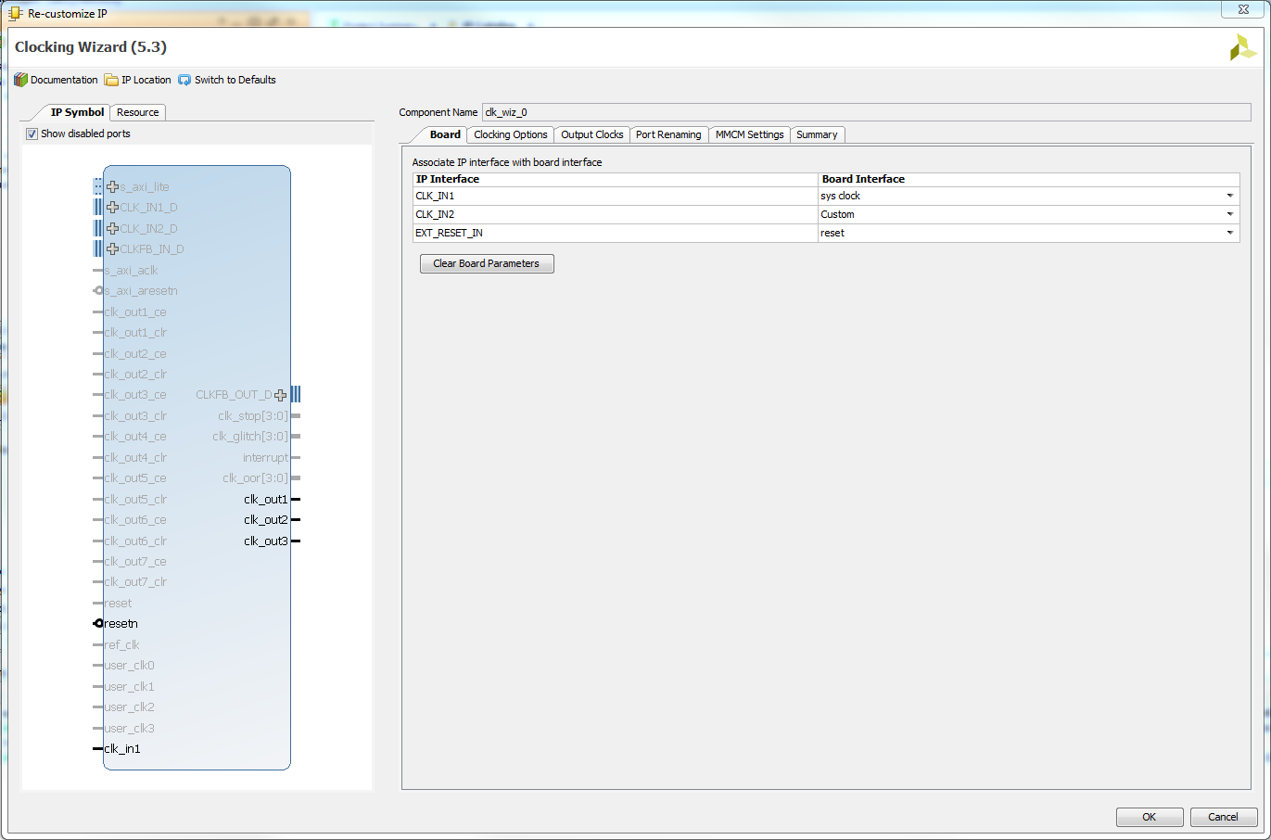
Digital Clocking Wizard

Slide 12
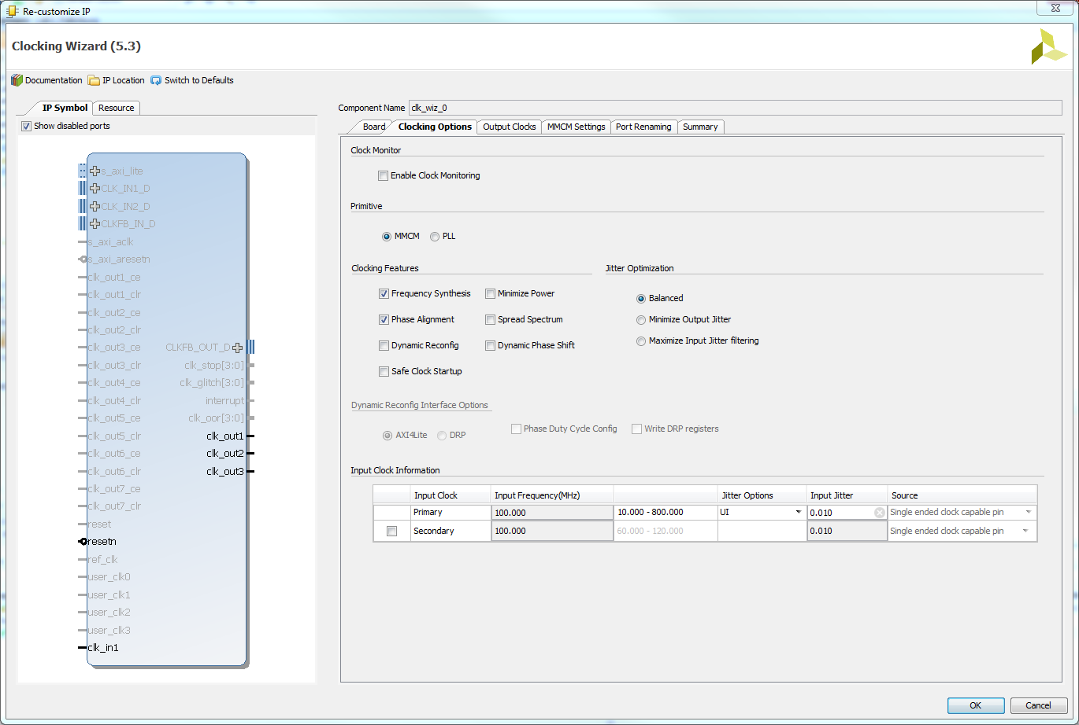
Digital Clocking Wizard

Slide 13
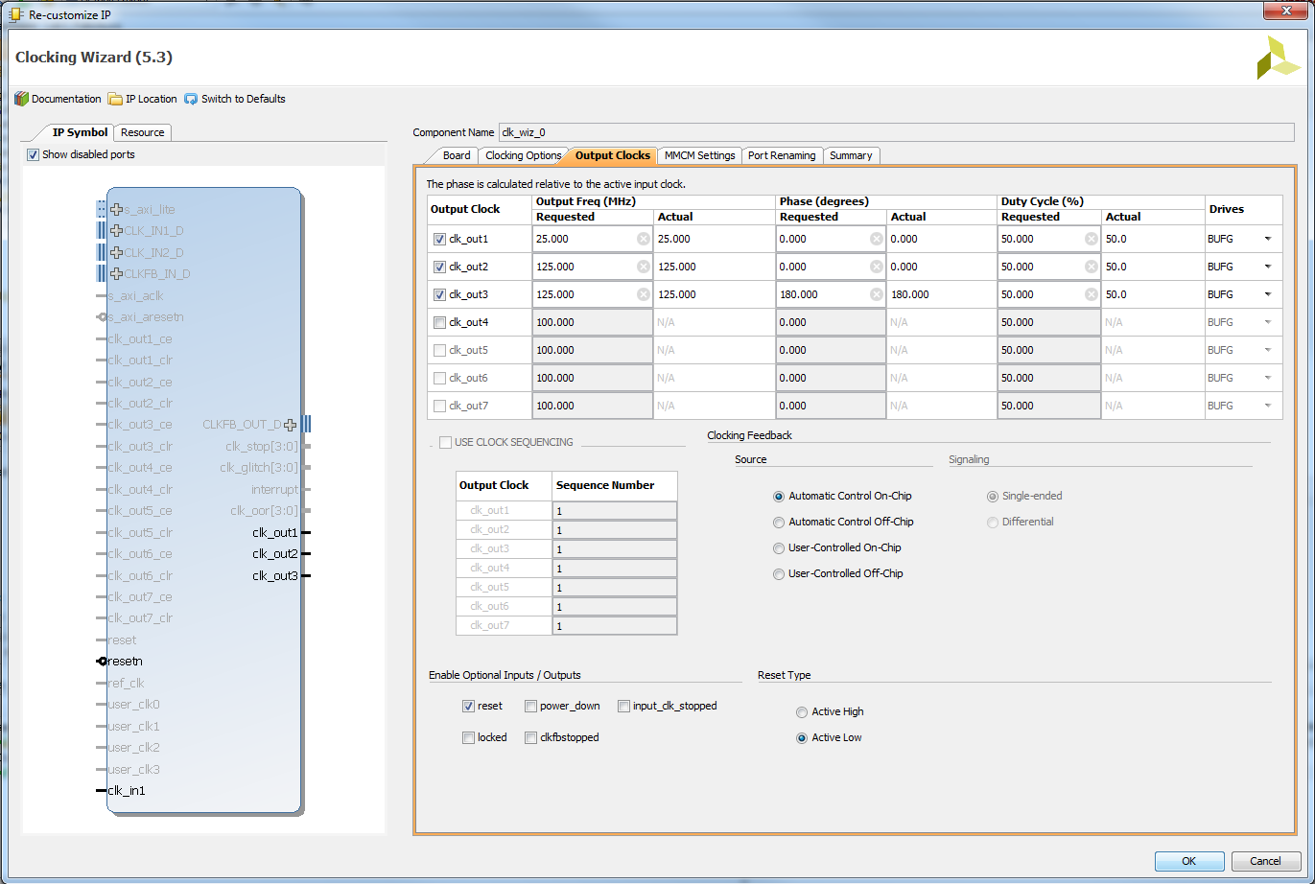
Digital Clocking Wizard

Slide 14
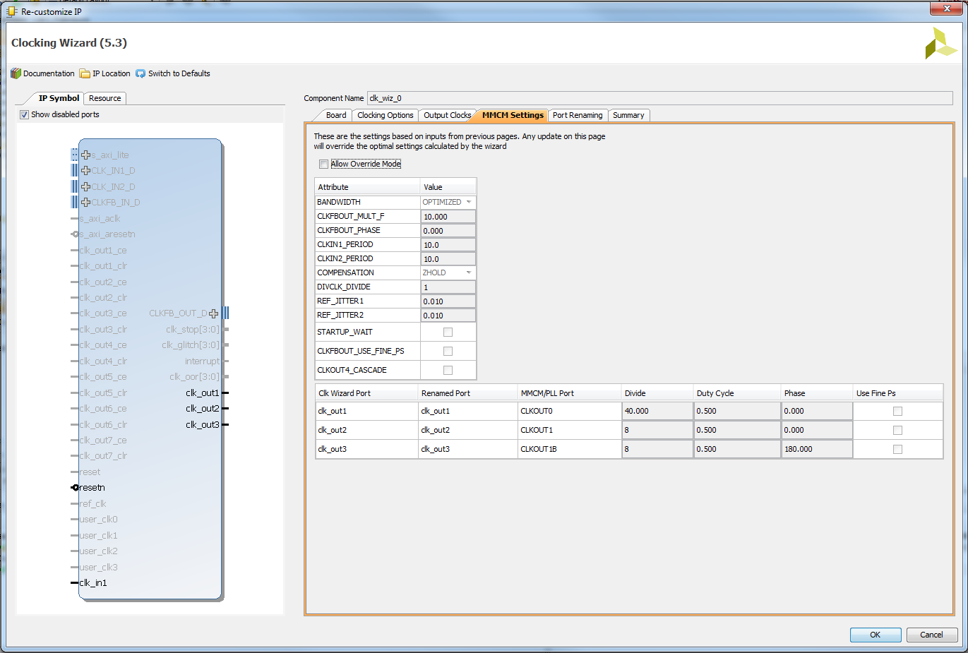
Digital Clocking Wizard

Slide 15
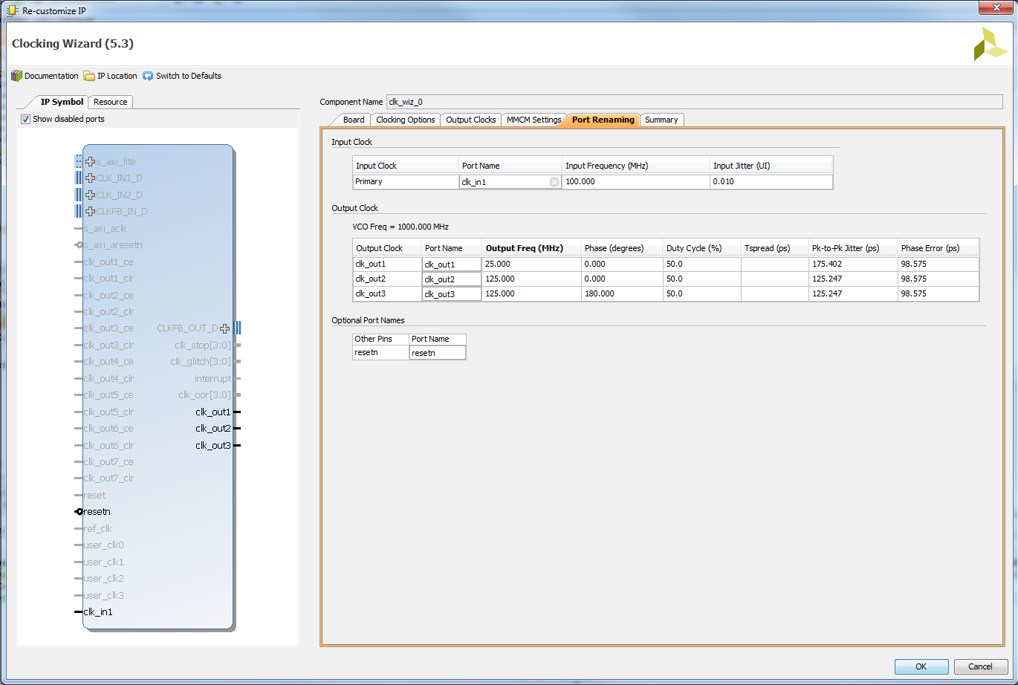
Digital Clocking Wizard

Slide 16
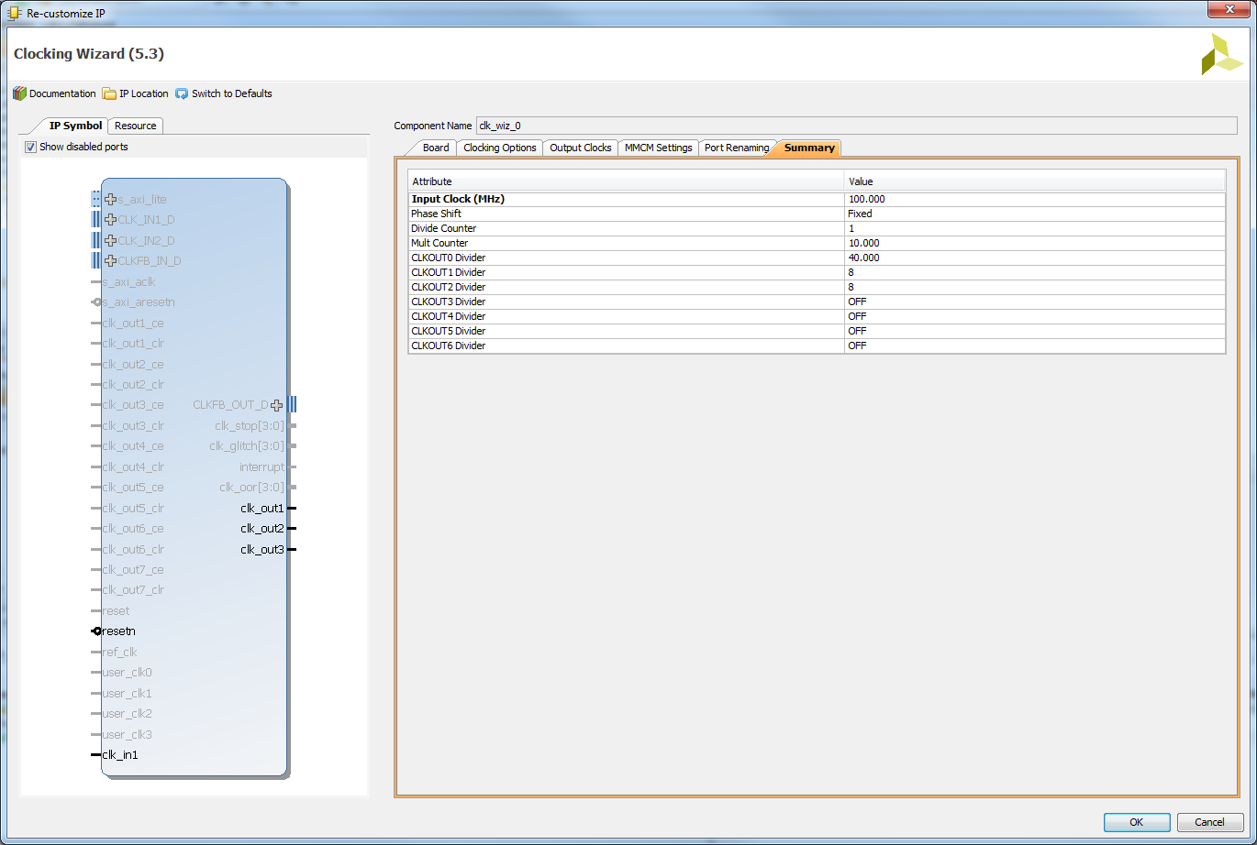
Digital Clocking Wizard

Slide 17
Digital Clocking Wizard
Verify Component Declaration in video.vhd
--------------------------------------------------------------------------
-- Clock Wizard Component Instantiation Using Xilinx Vivado
--------------------------------------------------------------------------
component clk_wiz_0 is
Port (
clk_in1 : in STD_LOGIC;
clk_out1 : out STD_LOGIC;
clk_out2 : out STD_LOGIC;
clk_out3 : out STD_LOGIC;
resetn : in STD_LOGIC);
end component;
Verify Component Instantiation in video.vhd

Slide 18
Digital Clocking Wizard
Verify Component Instantiation in video.vhd
--------------------------------------------------------------------------
-- Digital Clocking Wizard using Xilinx Vivado creates 25Mhz pixel clock and
-- 125MHz HDMI serial output clocks from 100MHz system clock. The Digital
-- Clocking Wizard is in the Vivado IP Catalog.
--------------------------------------------------------------------------
mmcm_adv_inst_display_clocks: clk_wiz_0
Port Map (
clk_in1 => clk,
clk_out1 => pixel_clk, -- 25Mhz pixel clock
clk_out2 => serialize_clk, -- 125Mhz HDMI serial output clock
clk_out3 => serialize_clk_n, -- 125Mhz HDMI serial output clock 180 degrees out of phase
resetn => reset_n); -- active low reset for Nexys Video

