Slide 1

ECE 383 – Embedded Computer Systems II Lecture 18 – Soft Core (MicroBlaze) + Custom IP
1

Slide 2
Lesson Outline
Time Logs!
MicroBlaze + Custom IP

Slide 3
MicroBlaze + Custom IP

Slide 4
MicroBlaze + Custom IP what you are building today
Artix 7 (design_1)
AA19
V18
axi_uartlite_0 @ 40600000
RX
RX
TX
TX
MicroBlaze
my_counter_ip_v1_0.vhd @ 0x44a00000
Design_1.xdc
Lec18.c
axi_lite
my_counter_ip_v1_0_S00_AXI.vhd
R4
G4
clk
Lec18.vhd
reset_n
S_AXI_ACLK
clk
T14
T15
T16
U16
V15
W16
W15
Y13
S_AXI_ARESETN
reset_n
slv_reg1
ctrl
32
slv_reg0
Q/D
32
Lec18.xdc
slv_reg2
roll
LED
8

Slide 5
MicroBlaze + Custom IP with Interrupt
Artix 7 (design_1)
AA19
V18
axi_uartlite_0 @ 40600000
RX
RX
TX
TX
MicroBlaze
my_counter_ip_v2_0.vhd @ 0x44a00000
Design_1.xdc
Lec19.c
axi_lite
my_counter_ip_v2_0_S00_AXI.vhd
R4
G4
clk
Lec18.vhd
reset_n
S_AXI_ACLK
clk
S_AXI_ARESETN
T14
T15
T16
U16
V15
W16
W15
Y13
reset_n
main()
slv_reg1
myISR()
ctrl
32
slv_reg0
Q/D
32
Lec18.xdc
Interrupt
slv_reg2
flagQ
set
roll
slv_reg3
clear
LED
8

Slide 6
MicroBlaze + Custom IP – Workflow
The work flow has three main steps.
Define a new hardware design (MicroBlaze + axi_uartlite) in Vivado IP Integrator
Create and package new custom IP (your custom hardware, which is a my_counter) and import it into your Vivado design
Program the resulting hardware in the SDK environment.
We will assume you did the 1st step in HW#9, and called the project Lecture_18

Slide 7
Xilinx Vivado – IP Integrator
This step requires that you start a new hardware design (MicroBlaze + axi_uartlite) in Vivado IP Integrator in a new project called Lecture_18.
You will add a new Block Design with a MicroBlaze and axi_uartlite following the MicroBlaze Tutorial.
https://reference.digilentinc.com/learn/programmable-logic/tutorials/nexys-video-getting-started-with-microblaze/start

Slide 8
Xilinx Vivado – Create and Package Custom IP
This step requires Create and package new custom IP (your custom hardware) and import it into your Vivado design.
You will defined the logical arrangement of the component in VHDL. Your entity description will contain two types of connections; those targeted at external ports on the Artix 7 chip and those intended to be accessible to the MicroBlaze processor.
You can also use this online tutorial to help guide you.
https://reference.digilentinc.com/learn/programmable-logic/tutorials/zedboard-creating-custom-ip-cores/start

Slide 9
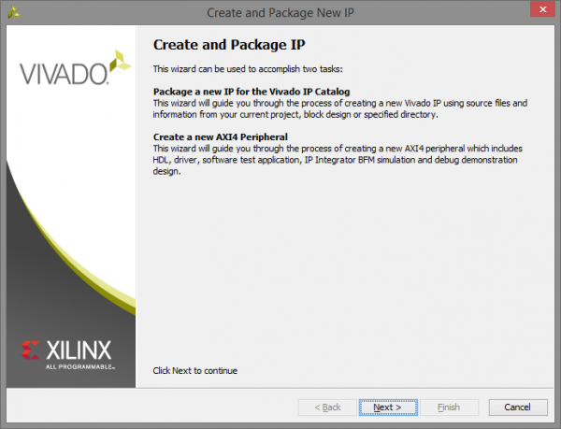
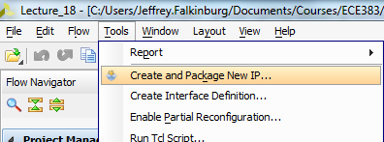
Xilinx Vivado – Create and Package Custom IP (my_counter)
1. Open your Lecture_18 Vivado project
Go to Tools→Create and package IP

Slide 10
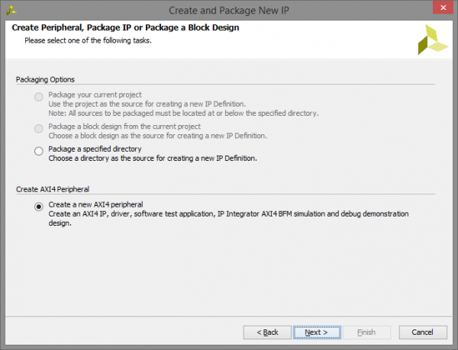
Xilinx Vivado – Create and Package Custom IP
2. Create your custom IP project
2.1) Select Create a new AXI4 peripheral and click Next

Slide 11
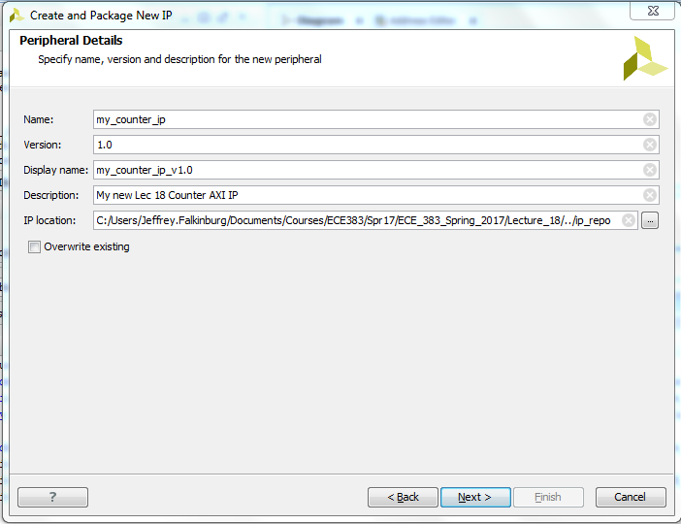
Xilinx Vivado – Create and Package Custom IP
2.2) Input “My_Counter_IP” in the name field and click Next

Slide 12
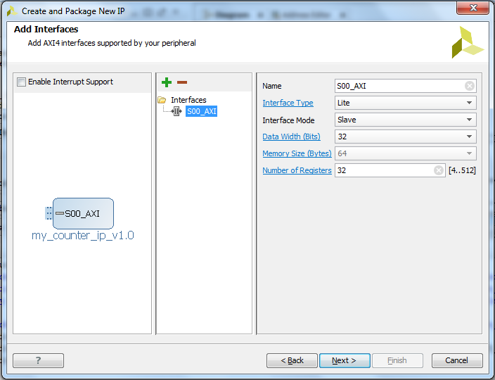
Xilinx Vivado – Create and Package Custom IP
2.3) Change the number of Registers to 32 on the AXI interface and click Next

Slide 13
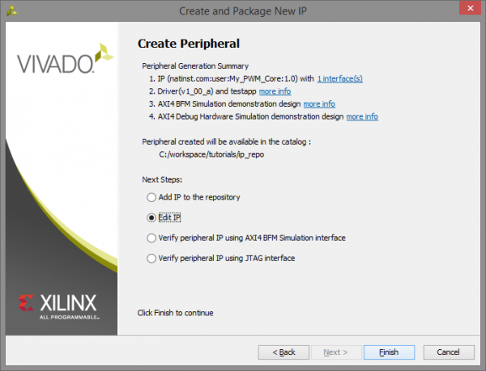
Xilinx Vivado – Create and Package Custom IP
2.4) Select Edit IP and click Finish

Slide 14
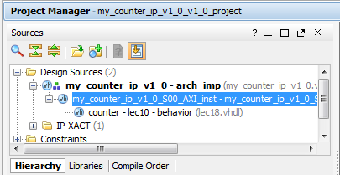
Xilinx Vivado – Create and Package Custom IP
3. Designing the IP core
3.1) A new instance of Vivado will open up for the new IP core. Expand the top level file My_Counter_IP_v1_0. Then double-click on My_Counter_IP_v1_0_S00_AXI to open it in the editor.

Slide 15
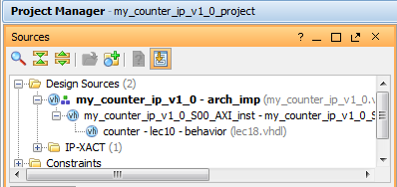
Xilinx Vivado – Create and Package Custom IP
4. Add the Lec 10 Counter to the My_Counter_IP_v1_0
by “Add Sources” → lec18.vhd file
Your counter will not yet be connected to the top level design

Slide 16
Xilinx Vivado – Create and Package Custom IP
4. The lec18.vhd file does not need to be modified
5. The My_Counter_IP_v1_0_S00_AXI.vhd file needs to be modified with the changes seen in the Ninja version to support your counter (line numbers from Ninja version)
Lines 20, 112-122, 671, 759-766
6. The My_Counter_IP_v1_0.vhd file needs to be modified with the changes seen in the version on Ninja
Lines 19, 59, 93
The following slides, diagram, and worksheet are intended to teach you what these modifications mean…
Installation resumes on slide titled “Packaging the IP core”

Slide 17
Part 1a: Hardware Questions/ Notes related to handout
Note: the truth table for the counter is in the comments.

Slide 18
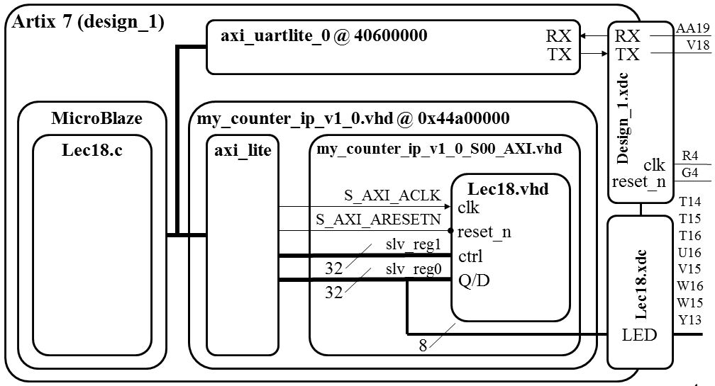
MicroBlaze + Custom IP

Slide 19
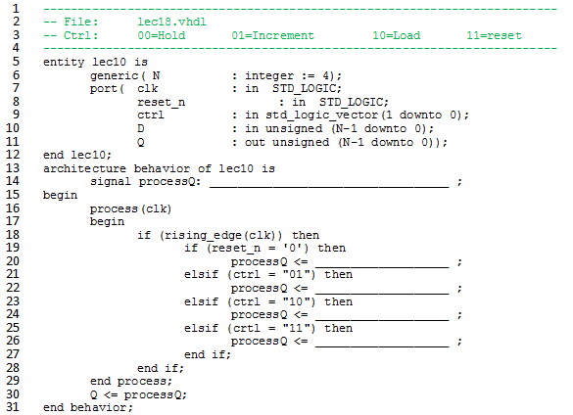
Lec18.vhdl – Lec 10 Counter

Slide 20
Part 1b: Hardware Questions/ Notes related to handout
Q: In my_counter_ip_v1_0_S00_AXI.vhd, what do the generics ..AXI_DATA_WIDTH, ..AXI_ADDR_WIDTH do?
Q: In my_counter_ip_v1_0_S00_AXI.vhd, what two roles is slv_reg0 serving?
Q: In my_counter_ip_v1_0_S00_AXI.vhd, what roles does slv_reg1 serve?
Q: In my_counter_ip_v1_0_S00_AXI.vhd, slv_reg0 is on the left and right-hand side of an assignment. Identify the two lines where this happens.
Q: In my_counter_ip_v1_0_S00_AXI.vhd, on line 62, what is the role does X"000000" serve?

Slide 21
MicroBlaze + Custom IP

Slide 22
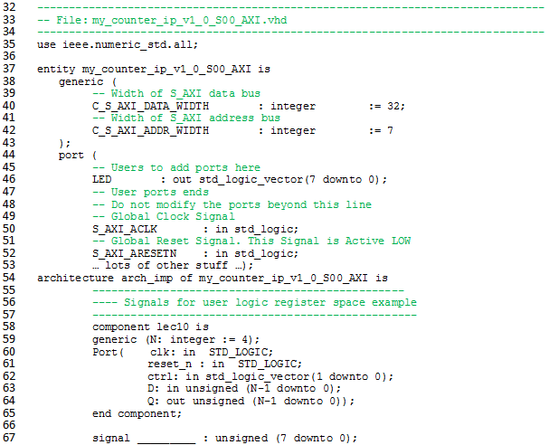
my_counter_ip_v1_0_S00_AXI.vhd – User Logic

Slide 23
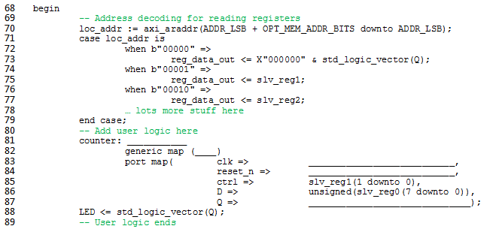
my_counter_ip_v1_0_S00_AXI.vhd – User Logic

Slide 24
Xilinx Vivado – Create and Package Custom IP
5. Modifying My_Counter_IP_v1_0_S00_AXI axi bus interface file
Add a port for the LEDs in the my_counter_ip_v1_0_S00_AXI entity between the comments:
port (
-- Users to add ports here
LED : out std_logic_vector(7 downto 0);
-- User ports ends
-- Do not modify the ports beyond this line
-- Global Clock Signal
S_AXI_ACLK : in std_logic;

Slide 25
Xilinx Vivado – Create and Package Custom IP
5. Modifying My_Counter_IP_v1_0_S00_AXI axi bus interface file
Add the counter declaration and a signal for Q before begin in the my_counter_ip_v1_0_S00_AXI architecture:
component lec10 is
generic (N: integer := 4);
Port( clk: in STD_LOGIC;
reset_n : in STD_LOGIC;
roll : out STD_LOGIC;
ctrl: in std_logic_vector(1 downto 0);
D: in unsigned (N-1 downto 0);
Q: out unsigned (N-1 downto 0));
end component;
signal Q : unsigned (7 downto 0);

Slide 26
Xilinx Vivado – Create and Package Custom IP
5. Modifying My_Counter_IP_v1_0_S00_AXI axi bus interface file
Add the counter implementation and connect the wires within the my_counter_ip_v1_0_S00_AXI architecture:
-- Add user logic here
counter: lec10
generic map (8)
port map( clk => S_AXI_ACLK,
reset_n => S_AXI_ARESETN,
roll => roll_sig,
ctrl => slv_reg1(1 downto 0),
D => unsigned(slv_reg0(7 downto 0)),
Q => Q);
LED <= std_logic_vector(Q);

Slide 27
Xilinx Vivado – Create and Package Custom IP
5. Modifying My_Counter_IP_v1_0_S00_AXI axi bus interface file
Connect the counter implementation Q output signal to slave register 0 (slv_reg0) in the my_counter_ip_v1_0_S00_AXI architecture:
loc_addr := axi_araddr(ADDR_LSB + OPT_MEM_ADDR_BITS downto ADDR_LSB); case loc_addr is
when b"00000" =>
reg_data_out <= x"000000" & std_logic_vector(Q);
when b"00001" =>
reg_data_out <= slv_reg1;
when b"00010" =>
reg_data_out <= slv_reg2;

Slide 28
Part 1c: Hardware Questions/ Notes related to handout
Q: If you want a signal to go outside the Artix 7 chip...
What files must it appear on the entity description?
What other files must contain information about the signal?
Q: If you want a signal to go to the MicroBlaze...
What files must it appear on the entity description?
In order for the MicroBlaze to read the signal, what must you do?
In order for the MicroBlaze to write to the signal, what must you do?

Slide 29
MicroBlaze + Custom IP

Slide 30
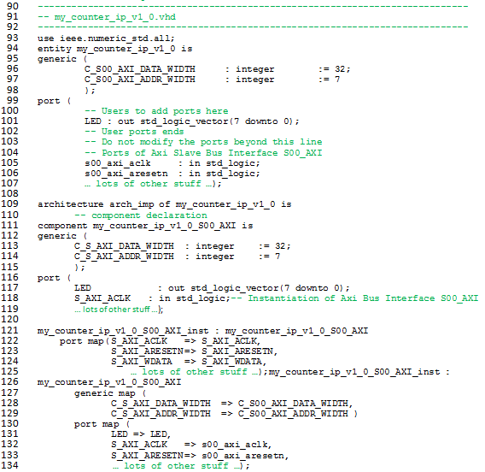
My_Counter_IP_v1_0.vhd – Top Level

Slide 31
My_Counter_IP_v1_0.vhd – Top Level

Slide 32
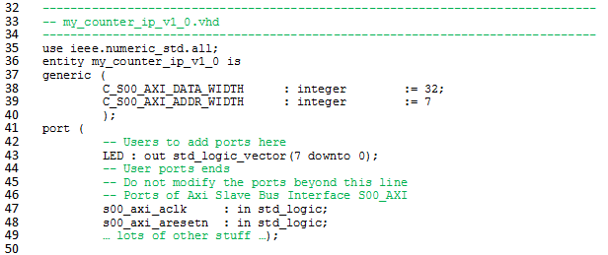
Xilinx Vivado – Create and Package Custom IP
6. Modifying My_Counter_IP_v1_0 top level file
Add a port for the LEDs in the my_counter_ip_v1_0 entity between the comments to expose it to externally:
port (
-- Users to add ports here
LED : out std_logic_vector(7 downto 0);
-- User ports ends
s00_axi_aclk : in std_logic;

Slide 33
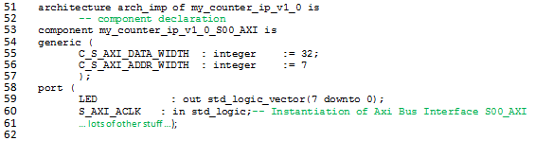
Xilinx Vivado – Create and Package Custom IP
6. Modifying My_Counter_IP_v1_0 top level file
Add a port for the LEDs in the my_counter_ip_v1_0_S00_AXI component declaration:
port (
LED : out std_logic_vector(7 downto 0);
S_AXI_ACLK : in std_logic;

Slide 34

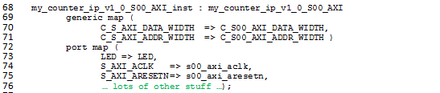
Xilinx Vivado – Create and Package Custom IP
6. Modifying My_Counter_IP_v1_0 top level file
Add a port map for the LEDs in the my_counter_ip_v1_0_S00_AXI component instantiation:
port map (
LED => LED,
S_AXI_ACLK => s00_axi_aclk,

Slide 35
Packaging the IP core
7. Packaging the IP core
Now that we have written the core, it is time to package up the HDL to create a complete IP package.
7.1) Now click on Package IP in the Flow Navigator and you should see the Package IP tab.
Select Compatibility (under Packaging Steps) and make sure “Artix7” are present. If those are not there, you can add them by clicking the plus button. The Life Cycle does not matter at this point.

Slide 36
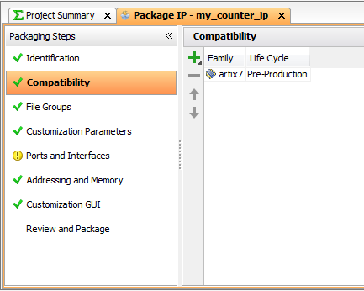
Xilinx Vivado – Create and Package Custom IP
7. Packaging the IP core

Slide 37
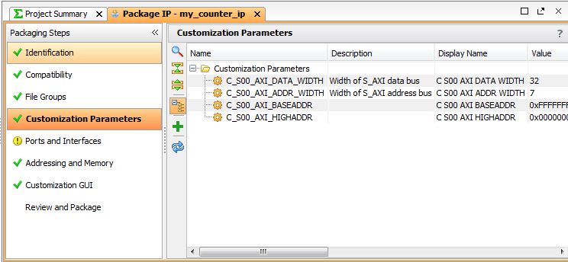
Xilinx Vivado – Create and Package Custom IP
7.2) Select Customization Parameters and select the line for Merge Changes from Customization Parameters Wizard. This will have the My_Counter_IP parameters from the top file.

Slide 38
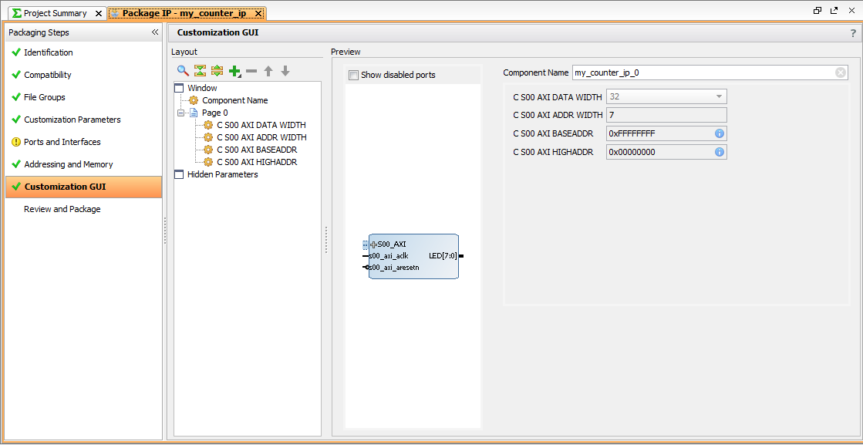
Xilinx Vivado – Create and Package Custom IP
7.3) Select Customization GUI. This is were we get to change our graphical interface. No changes at this time.

Slide 39
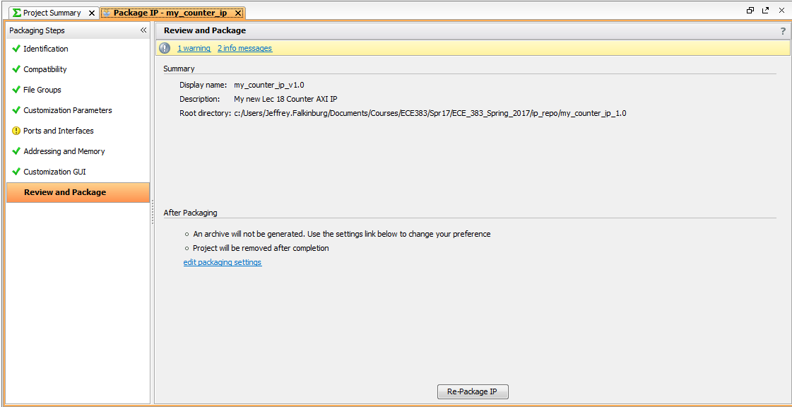
Xilinx Vivado – Create and Package Custom IP
7.4) Now the core should be complete so select Review and Package and click the Re-package IP button.

Slide 40
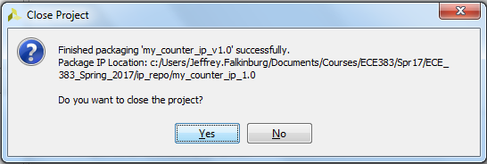
Xilinx Vivado – Create and Package Custom IP
7.5) A popup will ask if you want to close the project, Select Yes.

Slide 41
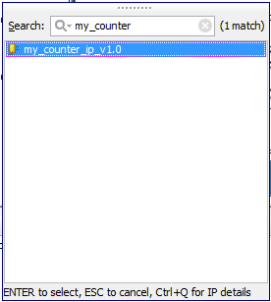
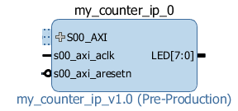
Xilinx Vivado – Create and Package Custom IP
8. Add Custom IP to your design
8.1) In the project manager page of the original window, click Open Block Design. This adds a block design to the project.
8.2) Use the Add IP button to add our my_counter

Slide 42
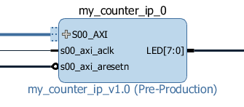
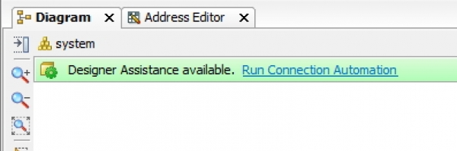
Xilinx Vivado – Create and Package Custom IP
8. Add Custom IP to your design
8.3) Right click on your my_counter output pin LEDs and select Make External and then run Connection Automation

Slide 43
Xilinx Vivado – Create and Package Custom IP
8. Add Custom IP to your design
8.5) Your custom IP should now be connected. Now you need to add a constraints file to add the LED net to the pins on the Artix 7 chip by adding the following lines to the Lec18.xdc file.
Add sources → add or create constraints
## LEDs
set_property -dict { PACKAGE_PIN T14 IOSTANDARD LVCMOS25 } [get_ports { LED[0] }]; #IO_L15P_T2_DQS_13 Sch=led[0]
set_property -dict { PACKAGE_PIN T15 IOSTANDARD LVCMOS25 } [get_ports { LED[1] }]; #IO_L15N_T2_DQS_13 Sch=led[1]
set_property -dict { PACKAGE_PIN T16 IOSTANDARD LVCMOS25 } [get_ports { LED[2] }]; #IO_L17P_T2_13 Sch=led[2]
set_property -dict { PACKAGE_PIN U16 IOSTANDARD LVCMOS25 } [get_ports { LED[3] }]; #IO_L17N_T2_13 Sch=led[3]
set_property -dict { PACKAGE_PIN V15 IOSTANDARD LVCMOS25 } [get_ports { LED[4] }]; #IO_L14N_T2_SRCC_13 Sch=led[4]
set_property -dict { PACKAGE_PIN W16 IOSTANDARD LVCMOS25 } [get_ports { LED[5] }]; #IO_L16N_T2_13 Sch=led[5]
set_property -dict { PACKAGE_PIN W15 IOSTANDARD LVCMOS25 } [get_ports { LED[6] }]; #IO_L16P_T2_13 Sch=led[6]
set_property -dict { PACKAGE_PIN Y13 IOSTANDARD LVCMOS25 } [get_ports { LED[7] }]; #IO_L5P_T0_13 Sch=led[7]

Slide 44
MicroBlaze + Custom IP

Slide 45
Updating Custom IP
For initial class demo: skip to slide titled “validate design.”
For Homework#10, when you need to add the “roll” to your custom hardware, follow the next few slide on “updating Custom IP”

Slide 46
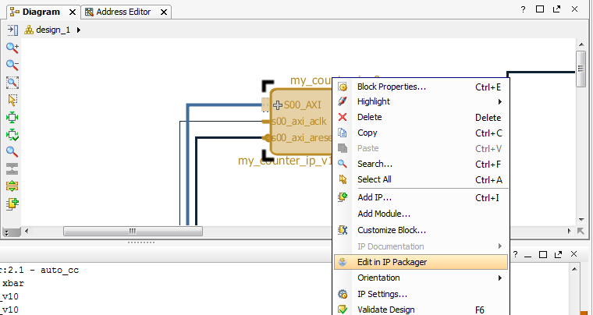
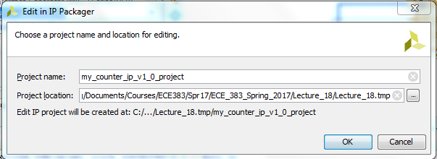
Updating Custom IP
Right click on My_Counter block, right-click, and click Edit in IP Packager if you want to modify! (like adding “roll”)
2
1

Slide 47
Xilinx Vivado – Create and Package Custom IP
Now that you updated the core you need to re-select Review and Package and click the Re-package IP button.

Slide 48
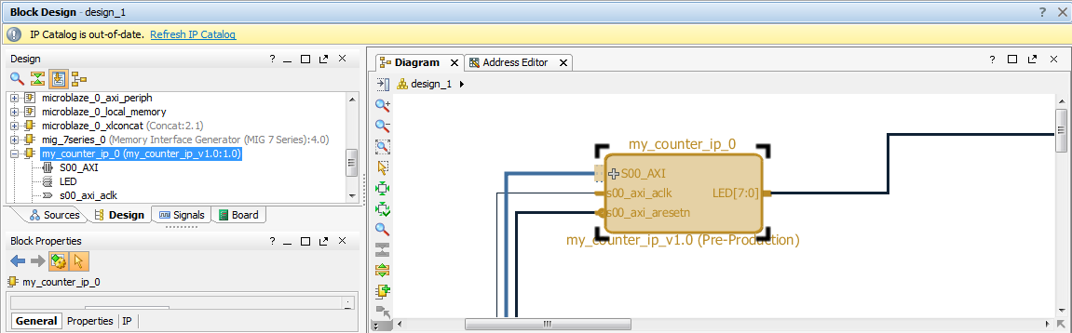
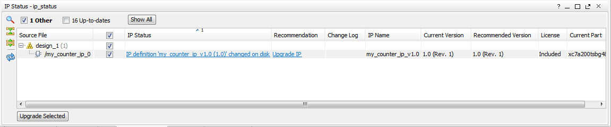
Updating Custom IP
click Show IP Status (on yellow bar in block design)
Select my_counter block
Click Upgrade Selected (box at bottom of screen)
Ok, and Generate (global? Or default?)
1
2

Slide 49
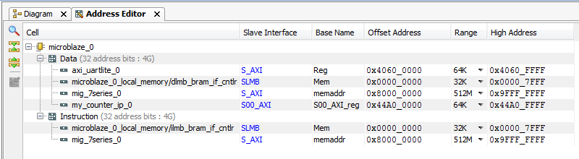
Verify Design
You should verify the addressing for all your design components before continuing.
Verify that the base addresses are the same addresses used in the template C-code.
Should be no changes at this time.
1
2
3

Slide 50
Validate and Export Design
First click validate design_1 (click the check mark)
Regenerate the design_1 HDL wrapper.
- Right click design_1 → “create VHDL wrapper” → OK
Finally you need to generate the Generate Design bitstream
Take a coffee break while it builds
One MIG error is okay (more is not okay)
apply_bd_automation -rule xilinx.com:bd_rule:mig_7series -config {Board_Interface "ddr3_sdram" } [get_bd_cells mig_7series_0]
[BD 41-1273] Error running apply_rule TCL procedure: can't read "board_if": no such variable ::xilinx.com_bd_rule_mig_7series::apply_rule Line 48

Slide 51
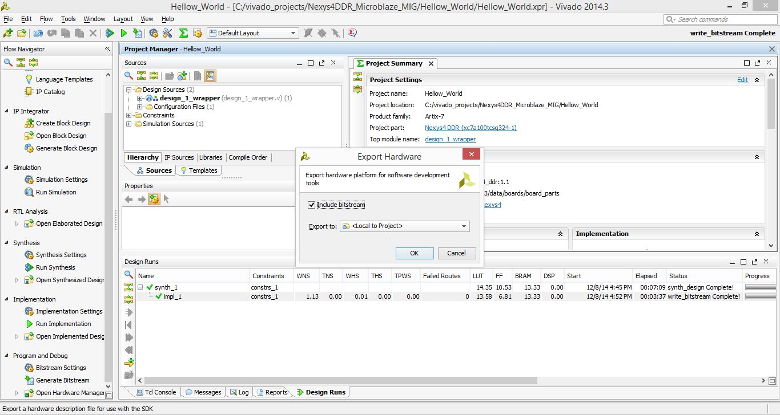
Export Design
Exporting Hardware Design to SDK…be sure to include the bitstream… (File→Export Hardware)

Slide 52
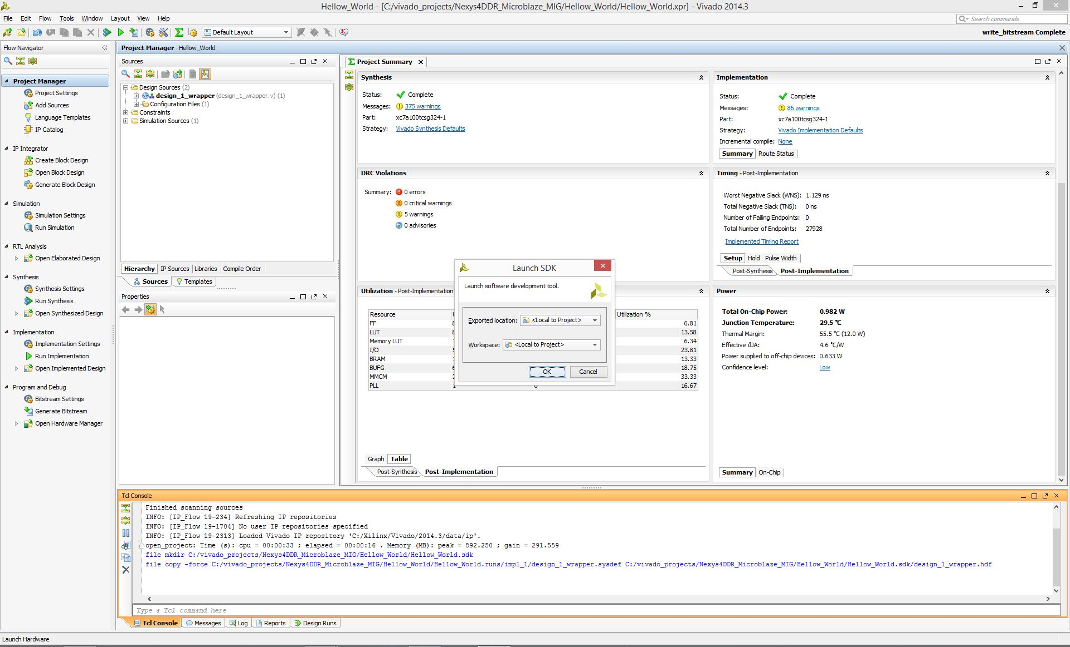
Launch SDK
Go to File and select Launch SDK and click OK.

Slide 53
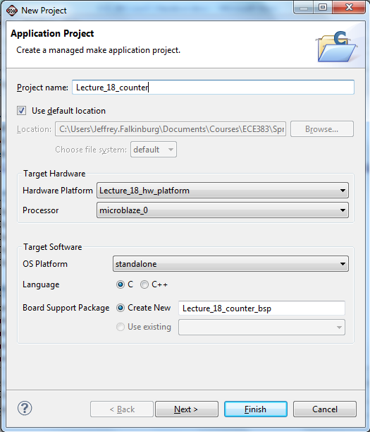
New SDK Project

Slide 54
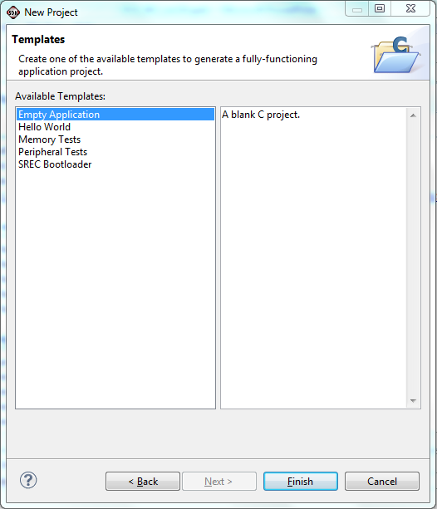
New SDK Project
Need to do the Hello World template so it generates the platform header files!

Slide 55
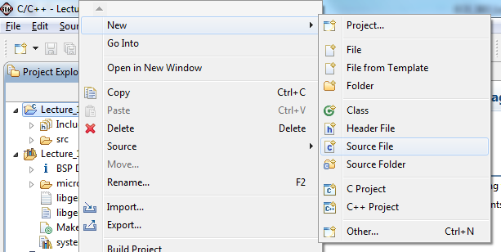
New C Source File

Slide 56
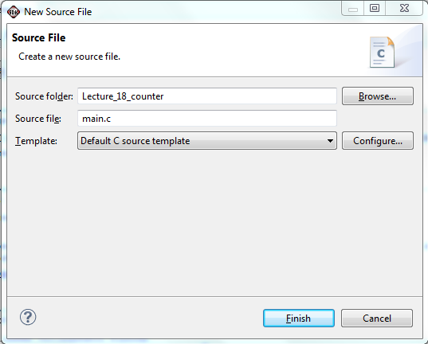
New C Source File

Slide 57
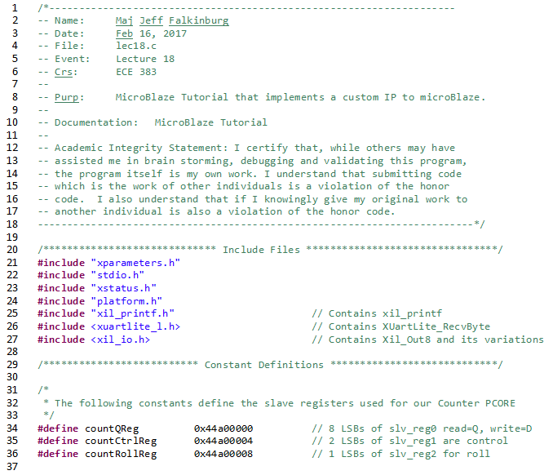
Lec18.c

Slide 58
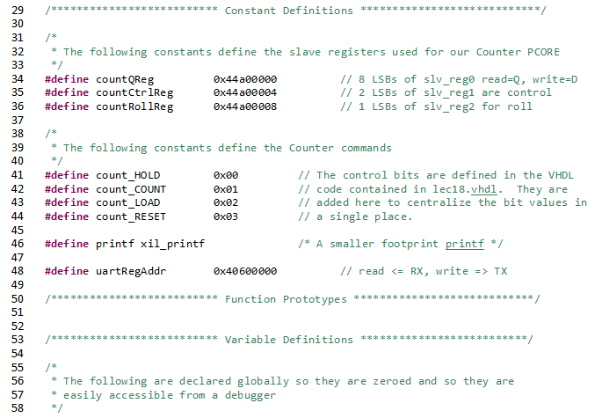
Lec18.c

Slide 59
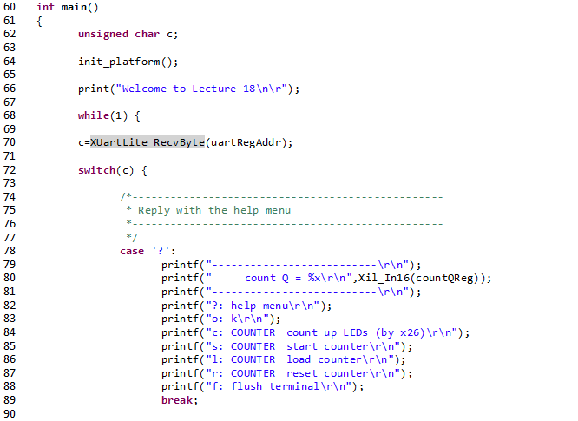
Lec18.c

Slide 60
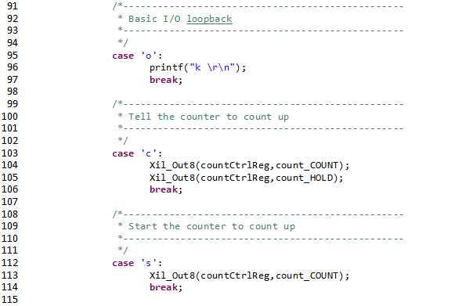
Lec18.c

Slide 61
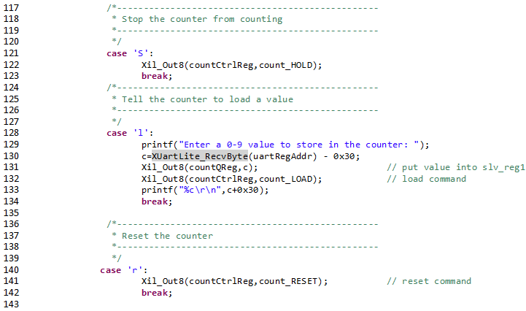
Lec18.c

Slide 62
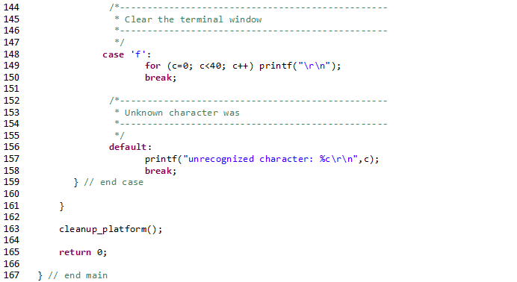
Lec18.c

Slide 63
Part 2: Software Questions/ Notes related to handout
Why doesn't the 'c' command cause the counter to count up by 1?
On line 130, why did I subtract 0x30?
After loading the counter on line 132, something should be done that is missing.
What line of VHDL code in my_counter_ip_v1_0_S00_AXI.vhd is "activated" when line 80 executes?
What line of VHDL code in my_counter_ip_v1_0_S00_AXI.vhd is "activated" when line 141 executes?
What line of VHDL code in lec18.vhdl "activated" when line 141 executes?
What appears to be the naming convention for hardware registers?

Slide 64
Add C code to Source File

Slide 65
Xilinx Software Development Kit - SDK
In the SDK environment, you program the hardware built in the previous step.
The key concept here is that the peripheral defined in Vivado design are accessible through the slave registers as memory mapped devices.
Verify your my_counter_ip_v1_0 Base Address in system.hdf file is assigned to be 0x44a00000.
In the my_counter_ip_v1_0_S00_AXI.vhdl file, I (arbitrarily) assigned counter ports to slave register according to the table below.
Signal | direction | Slave Register | Address
D | Input | slv_reg0(7 downto 0) | 0x44a00000
ctrl | Input | slv_reg1(1 downto 0) | 0x44a00004
Q | Output | slv_reg0(7 downto 0) | 0x44a00000

Slide 66
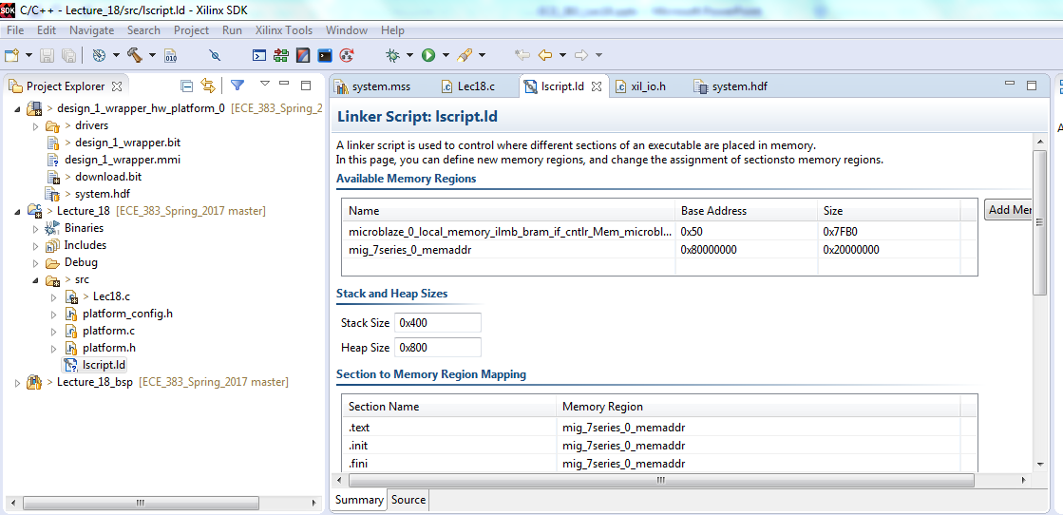
Increase Stack and Heap Size
You may have to add more Stack and Heap to your design
3
2
1

Slide 67
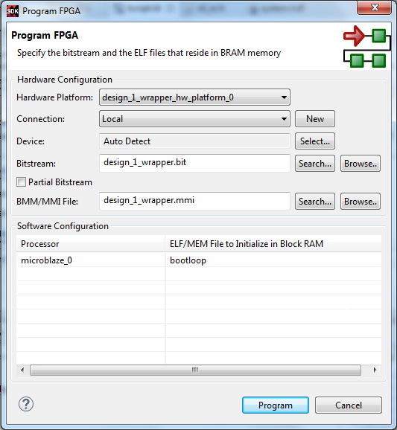
Build and Export to FPGA

Slide 68
Test program using UART
Run Configuration Settings for STDIO Connection
From the Project Explorer panel, right click on the Lecture18_counter project folder. At the bottom of the drop down list, select Run As and then select Run Configurations.
The Run Configurations window is divided into two main sections. In the left panel, under Xilinx C/C++ application(GDB), select Lecture18_counter.elf or Lecture18_counter Debug
On the right side of this window, you will see five main tabs. Select the STDIO Connection tab.
COM Port Selection for STDIO Connection
Port name should be the correct UART port. For me it showed up as COM4. Select Baud Rate as 9600. Have the Connect STDIO to Console box checked. (uncheck if you want to use another terminal emulator)
Now click on Apply and Run.
“Welcome to Lecture 18” will be displayed on the Console tab
Type “?” to see list of commands to control the counter and LEDs

Slide 69
MicroBlaze + Custom IP

