Slide 1

ECE 383 – Embedded Computer Systems II Lecture 19 – Lab 3 – Software control of a datapath
1

Slide 2
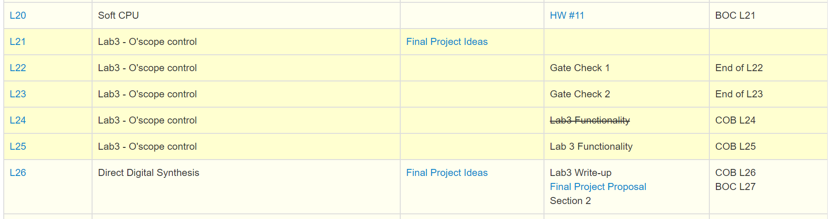

Slide 3
Lesson Outline
Time Logs!
Lab 3 – Software control of a datapath

Slide 4
Lab 3 – Software control of a datapath

Slide 5
Lab 3 – Lab Overview
Lab Overview - In this lab we will integrate the video display controller developed in Lab 2 with the MicroBlaze processor built using the fabric of the FPGA. In the preceding lecture we have learned about the SDK tool chains, now its time to put that knowledge to the test by building a software controlled datapath. Lab 2 revealed some shortcomings of our oscilloscope that this lab intends on correcting.
Using both trigger volt and trigger time for trigger
Using polling and/or interrupts
Ability to enable and disable channels to display
Ability to trigger off channel 2
Ability to change the slope direction for the trigger.

Slide 6
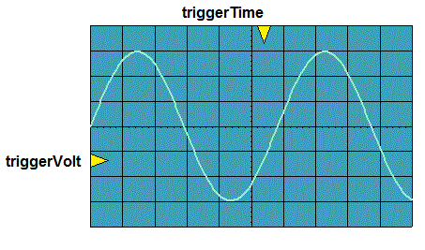
Lab 3 – Lab Overview
The following figure shows required functionality - your program should allow the user to change the position of the triggerVolt and triggerTime indicators with the result that the waveform should be drawn so that the periodic waveform is increasing through that voltage at that time.

Slide 7
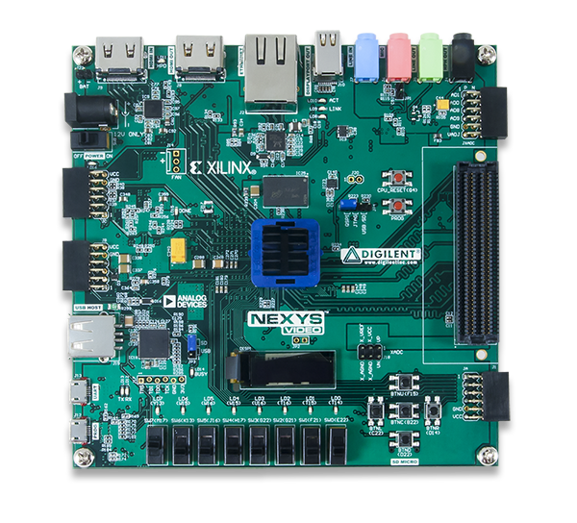
Lab 3 – Connections
HDMI Out
Audio
Input
Audio
Output
Power
CPU Reset
JB PMOD
Connector
For Test Signals
USB UART
Buttons
USB Prog

Slide 8
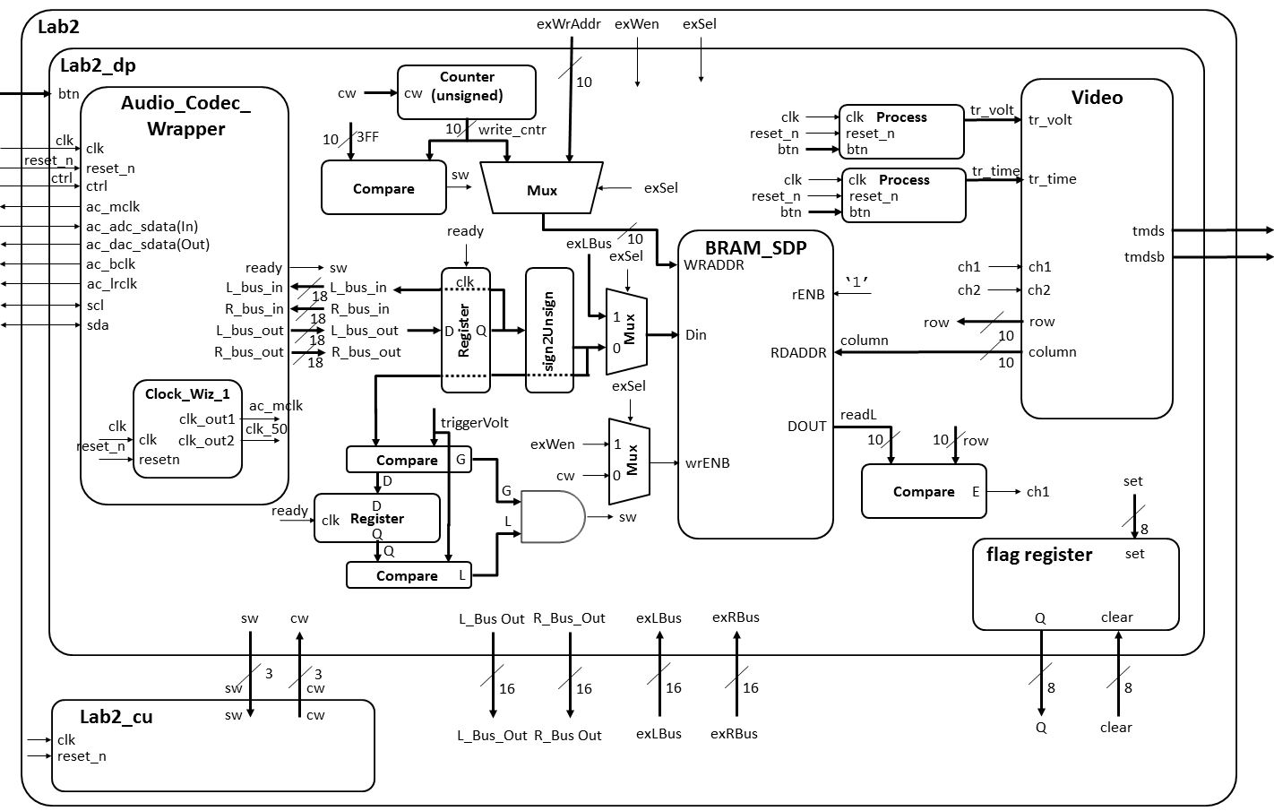
Lab 2 – Architecture

Slide 9
Lab 3 – Architecture
Artix 7 (design_1 for Lab 3)
AA19
V18
axi_uartlite_0 @ 40600000
RX
RX
TX
TX
my_oscope_ip_v2_0.vhd @ 0x44a00000
MicroBlaze
Design_1.xdc
axi_lite
my_oscope_ip_v2_0_S00_AXI.vhd
Lab3.c
R4
G4
S_AXI_ACLK
Lab2_dp.vhd
clk
clk
reset_n
S_AXI_ARESETN
reset_n
32x32
main()
slv_reg0 → 31
To/From Microblaze
Lab2 Signals
myISR()
Interrupt
ready
Lab2.xdc
cw
sw
Pins off
chip
Lab2_fsm.vhd
Signals going In/Out of Artix 7 Chip
Nets to Pins

Slide 10
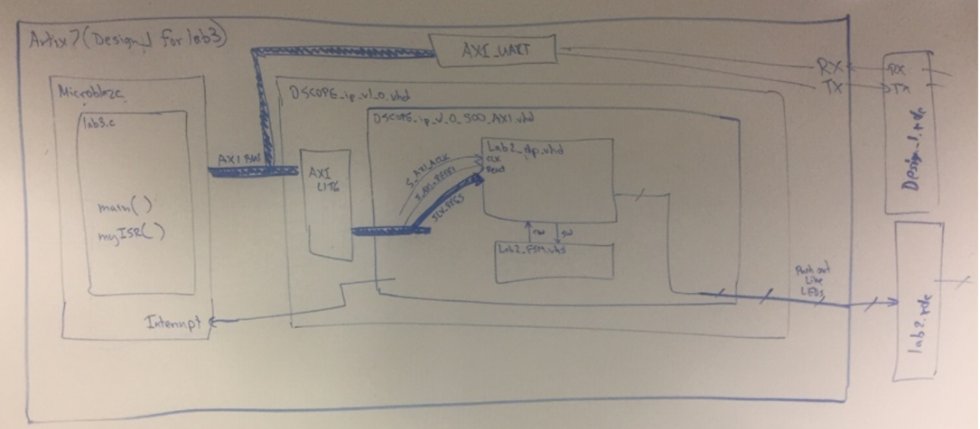

Slide 11
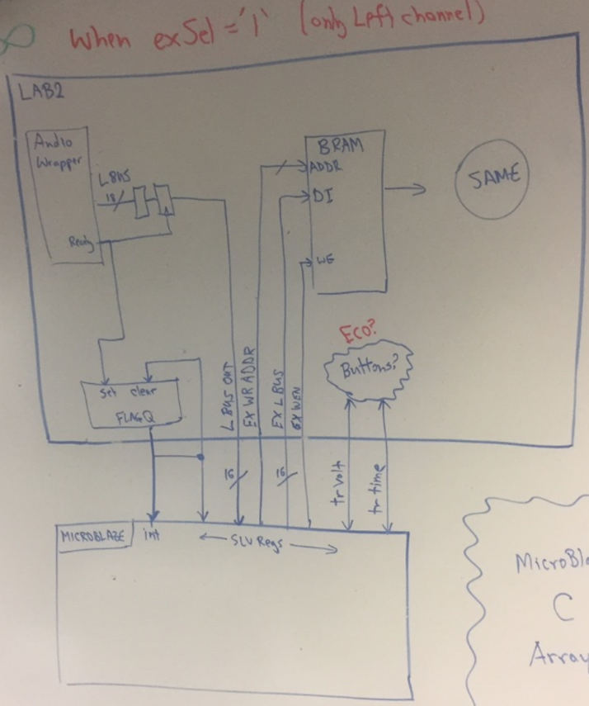

Slide 13
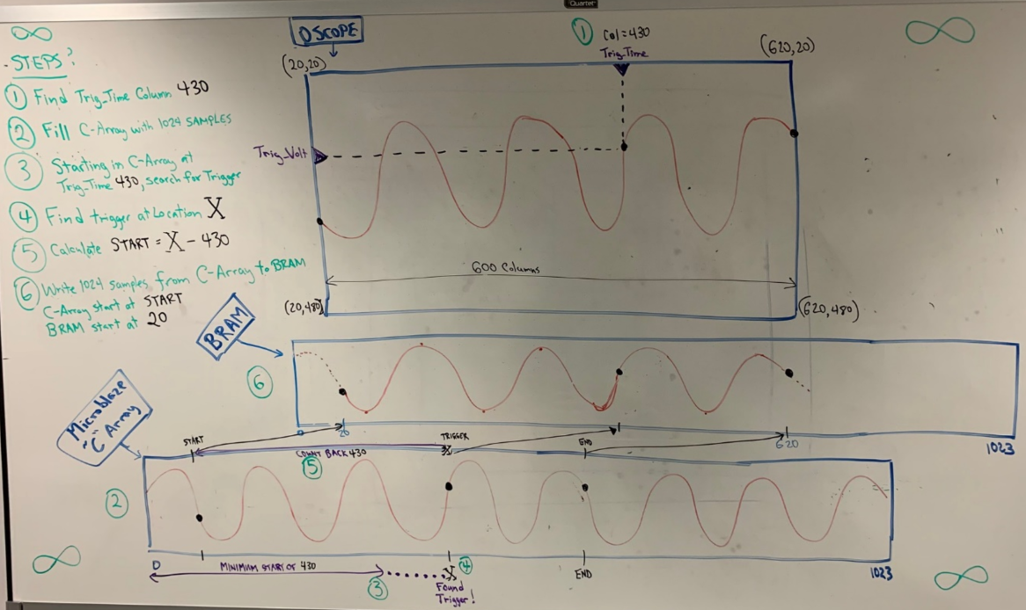

Slide 15
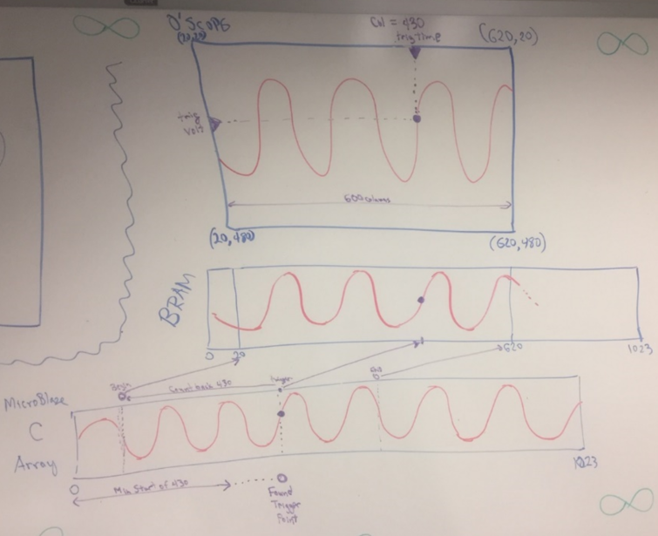

Slide 16
Lab 3 – UART Note
Note: In your program, you may want to check if the users has hit the key on the keyboard without having to actually read the key. For these cases the following command will prove useful. Note that "uartRecReg" is a constant, the address of the uart.
XUartLite_IsReceiveEmpty(uartRecReg);

Slide 17
Lab 3 – Hardware
With the expectation of the following engineering change orders (ECO) in the table below, the hardware you developed in lab2 will be unchanged. For the following ECO, please refer to the high-level architecture in lab 2.
Name: | Trigger Voltage, Trigger Time
Scope: | lab2_dp and lab2
Type: | Change to the entity descriptions.
Details: | Inside the lab2_dp component, remove the logic driving the triggerVolt and triggerTime signals into the video component. Remove the buttons signal from the lab2 and lab2_dp entities. Remove the buttons signal from the ucf file. Add the triggerVolt and triggerTime signals to the lab2 and lab2_dp entity descriptions. Drive the triggerTime and triggerVolt inputs on the video component with the corresponding signals on the lab2_dp entity.
(or Option for 2021: Keep lab 2 buttons, and input Trigger Volt and Time
Into Microblaze using slv_regs

Slide 18
Lab 3 – Signals
Your first step will be to create a component for your lab2 component in your Vivado repository. This will require you to think about what signals are routed to the MicroBlaze and those going outside the Artix 7 chip.
To/From MicroBlaze | Outside Artix 7
exWrAddr | clk
exWen | reset
exSel | ac_mclk
L_bus_out, R_bus_out | ac_adc_sdata
exLbus, exRbus | ac_dac_sdata
flagQ | ac_bclk
flagClear | ac_lrclk
triggerTime | sda
triggerVolt | scl
ready | tmds
Ch1_enb, Ch2_enb ? | tmdsb

Slide 19
Lab 3 – Software
All the memory mapped hardware registers will have their names setup as #define's with a name ending in "Reg".
Any register with bit fields will have the bit index setup as #define's with a name ending in "Bit".
The flagQ and flagClear registers need to be at the same address.

Slide 20
Lab 3 – Requirements Gate Check 1
Gate Check 1
By the conclusion of lesson 22, you need to have all of your Lab 2 functionality implemented with the Microblaze.
That is, you need to export your Lab 2 design into the SDK and be able to achieve the same functionality as you did in Lab 2.

Slide 21
Lab 3 – Requirements Gate Check 2
Gate Check 2
By the conclusion of lesson 23, you need to be able to send UART commands to your FPGA to adjust the trigger on the screen. The trigger on the screen should properly react to moving the trigger either up or down.
(or Option for 2021: Keep lab 2 buttons, and input Trigger Volt and Time
Into Microblaze using slv_regs. Show on UART display you can
read Trigger Volt and Time

Slide 22
Lab 3 – Requirements Required Functionality
Required Functionality
In order to make required functionality you will need to properly trigger the oscilloscope on channel 1 using a positive edge trigger. Control of this process is to be performed using the MicroBlaze. The main tasks of the MicroBlaze will include:
Moving audio samples into a pair of circular buffer. These circular buffers will be maintained in the address space of the MicroBlaze. That is you should have two big arrays defined in your program. Use polling of the ready bit of the flag register.
Examining the samples looking for a trigger event.
Fill the remaining sample slots in memory.
(or Option for 2021: You can use a Linear Buffer instead of a Circular Buffer

Slide 23
Lab 3 – Requirements Required Functionality Cont 1
Required Functionality cont
Move the appropriate buffer values into the display memory of the oscilloscope (lab2) component.
Provide a user menu (through the terminal) allowing the user to adjust the trigger voltage and trigger time.
(or Option for 2021: Keep lab 2 buttons, and input Trigger Volt and
Time into Microblaze using slv_regs. Show on UART display you can
read Trigger Volt and Time

Slide 24
Lab 3 – Requirements
B-level Functionality A-level Functionality
Achieve required functionality.
[10-points] Use the ready bit of the flag register to trigger an interrupt. The ISR should store the samples (left and right), look for a triggering even, and signal when the stored samples should be transferred to the BRAM in the oscilloscope component.
[5-points] Add means to control Ch1_enb and Ch2_enb either by adding two FPGA board switches or controlled by microblaze terminal interface.

Slide 25
Lab 3 – Requirements
A-level Functionality
Ability to trigger off channel 2
Ability to change the slope direction for the trigger.

Slide 26
Lab 3 – Requirements Turn In
Turn In Requirements
All your work in this lab is to be submitted using Bitbucket
README: only needs
Design
Slide 9 diagram (no change?)
Updated lab2 block diagram with correct signals
Mapping of 32 AXI registers to lab2 signals
Evidence of completing Gate Checks 1 and 2, basic functionality, and A-functionality, along with the date/time achieved
Issues and lessons learned

Slide 27
Dummy Waveforms for Testing
Audio_Codec_Wrapper has sim_live
Use switch or C-doe to toggle sim_live?
Walk through example C-code test commands

