Slide 1

ECE 383 – Embedded Computer Systems II Lecture 5 – Combination of Elements and Lab Intro
HQ U.S. Air Force Academy
Capt Jeffrey Falkinburg Room 2E46C 333-7366
I n t e g r i t y - S e r v i c e - E x c e l l e n c e
Notes:
Write on board:
ECE 315
Day 1 – Admin
Section Marcher
Introductions
Syllabus

Slide 2
Lesson Outline
Comparator Construction
Gated and Non-Gated Circuit
Lab 1 Intro

Slide 3
Comparator Construction

Slide 4
Comparator Construction
You will generate a signal similar to this CSA in Lab 1:
h_synch <= '1' when ((h_count >= 100) and (h_synch < 200)) else '0';
This is a Non-Gated output Signal
Non-Gated signals Generate glitches on the output!
How is a comparator constructed?

Slide 5
Gated and Non-Gated Circuit

Slide 6
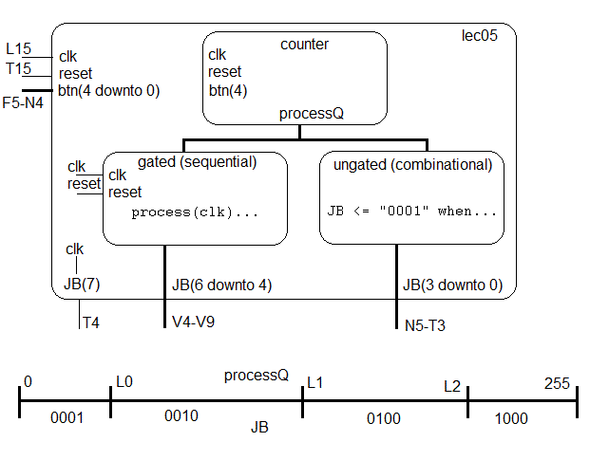
Gated and Non-Gated Circuit
Take a look at lec05.vhdl

Slide 7
Gated and Non-Gated Circuit
Combinational Realization – Non-gated
JB(3 downto 0) <= "0001" when ((processQ >= 0) and (processQ < L0)) else "0010" when ((processQ >= L0) and (processQ < L1)) else "0100" when ((processQ >= L1) and (processQ < L2)) else "1000";
Sequential Realization – Gated
process(clk) begin if (rising_edge(clk)) then if (reset = '0') then JB(6 downto 4) <= "000"; elsif ((processQ >= 0) and (processQ < L0)) then JB(6 downto 4) <= "001"; elsif ((processQ >= L0) and (processQ < L1)) then JB(6 downto 4) <= "010"; elsif ((processQ >= L1) and (processQ < L2)) then JB(6 downto 4) <= "100"; elsif (processQ >= L2) then JB(6 downto 4) <= "111"; end if; end if; end process;

Slide 8
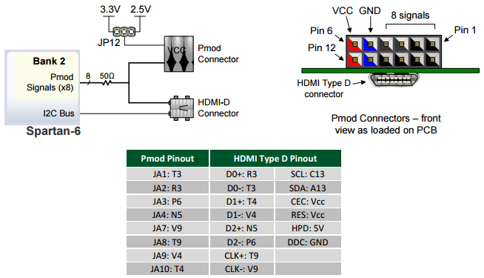
Gated and Non-Gated Circuit – PMOD Connector
PMOD connector (see page 18 of the Atlys Board Reference Manual) corresponding to JB(3) and JB(2) (the most 2 significant bits of the non-gated comparator outputs)

Slide 9
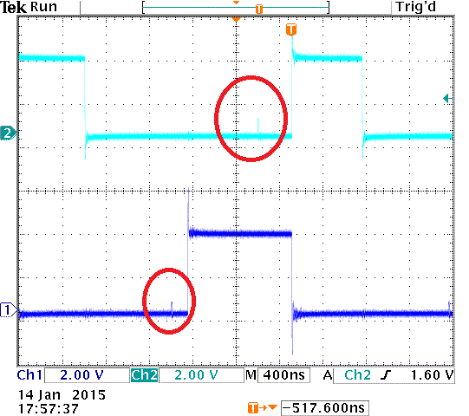
Gated and Non-Gated Circuit
JB(3) and JB(2) (the most 2 significant bits of the non-gated comparator outputs)

Slide 10
Lab 1 Intro

Slide 11
HW 5 – Lab 1 Prelab
Draw a detailed diagram of the oscilloscope grid required for Lab1. A detailed diagram must be drawn on green engineering paper and include
(x,y) corners of the monitor.
(x,y) each of the four major corners (already given).
y-coordinates for all the major horizontal grid lines.
(x,y) coordinates for one set of three horizontal of hatch marks. Indicate with an arrow which set of three.
x-coordinates for al the major vertical grid lines.
(x,y) coordinates for one set of four vertical of hatch marks. Indicate with an arrow which set of four.

Slide 12
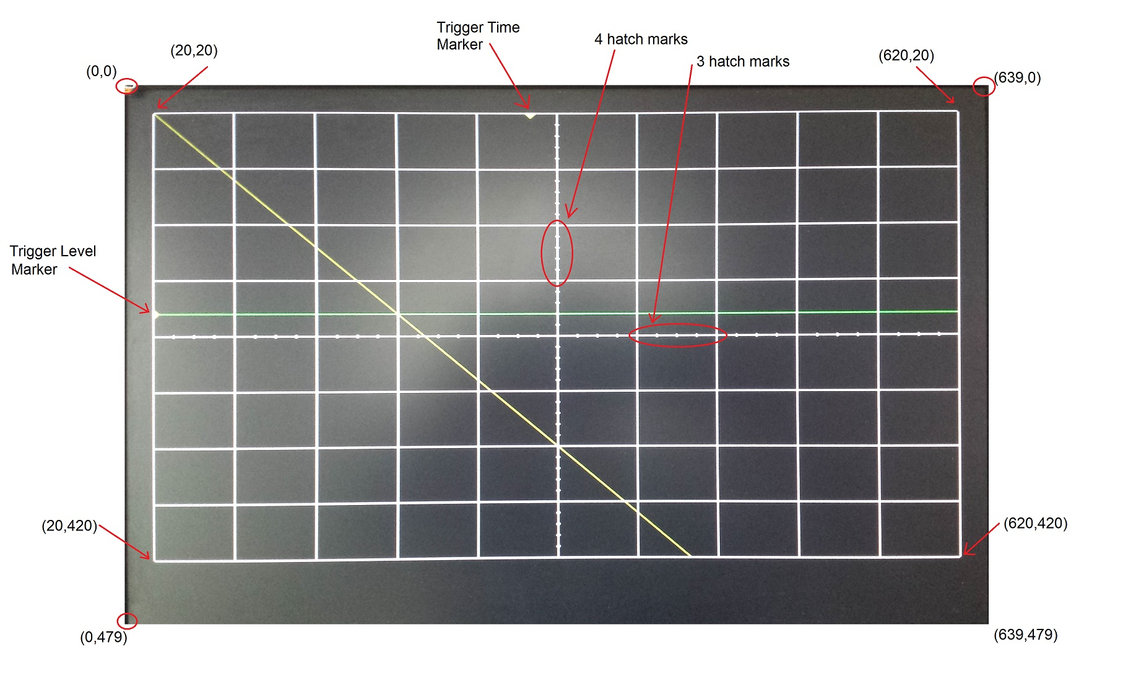
HW 5 – Lab 1 Prelab

Slide 13
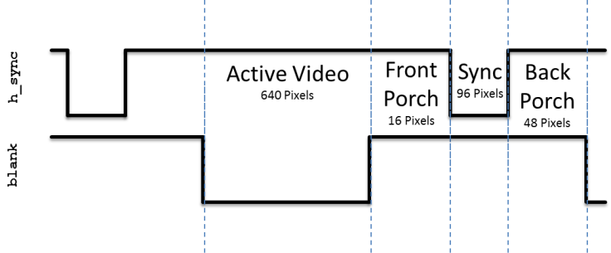
HW 5 – Lab 1 Prelab
Given that the pixel clock is running at 12.5Mhz, add the durations of the h_synch and v_synch signals show in Lab1. Set time=0 on the blue dashed line on the left side of the region labeled "Active Video".

Slide 14
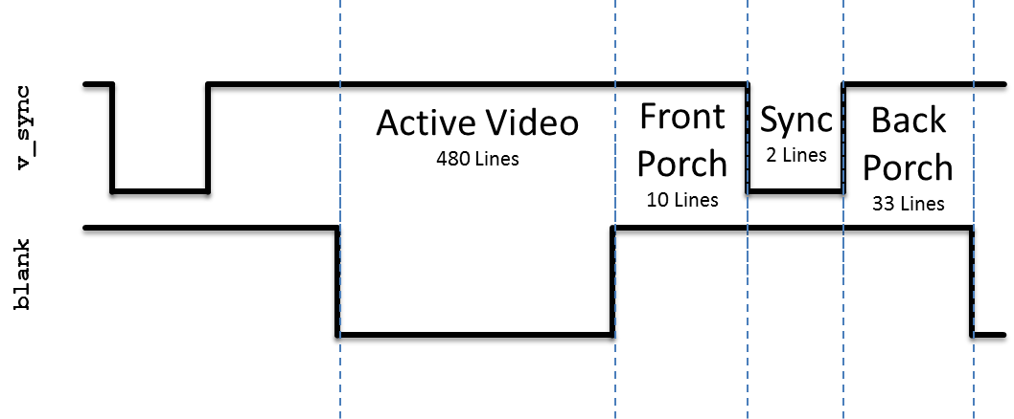
HW 5 – Lab 1 Prelab
Given that the pixel clock is running at 12.5Mhz, add the durations of the h_synch and v_synch signals show in Lab1. Set time=0 on the blue dashed line on the left side of the region labeled "Active Video".

Slide 15
Lab 1 Intro – VGA Overview

Slide 16
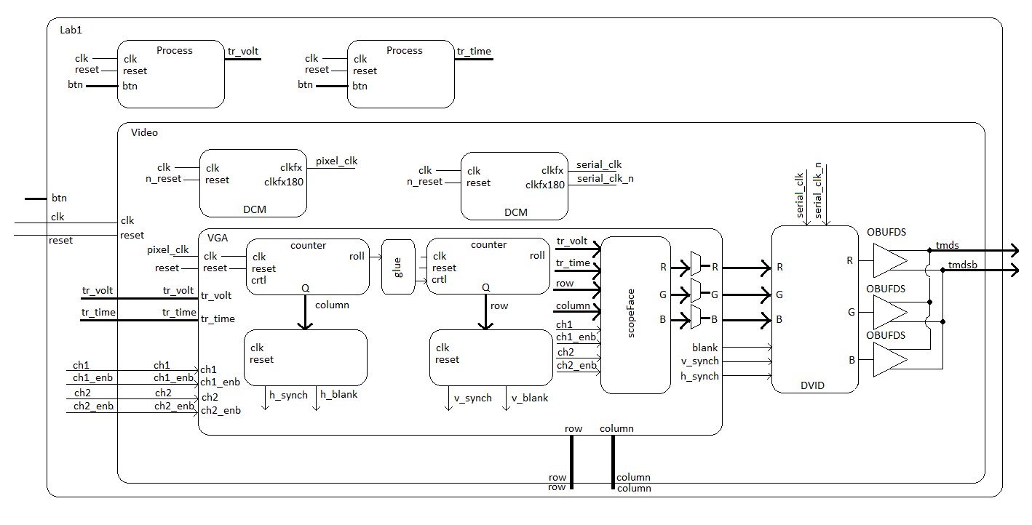
Lab 1 Intro – Architecture

Slide 17
Lesson Outline
Comparator Construction
Gated and Non-Gated Circuit
Lab 1 Intro

