Slide 1

ECE 383 – Embedded Computer Systems II Lecture 19 – Soft Core (MicroBlaze) + Custom IP with Interrupt
Maj Jeffrey Falkinburg Room 2E46E 333-9193
1

Slide 2
Lesson Outline
Time Logs!
MicroBlaze + Custom IP with Interrupt

Slide 3
MicroBlaze + Custom IP with Interrupt

Slide 4
MicroBlaze + Custom IP with Interrupt
Artix 7 (design_1)
AA19
V18
axi_uartlite_0 @ 40600000
RX
RX
TX
TX
MicroBlaze
my_counter_ip_v2_0.vhd @ 0x44a00000
Design_1.xdc
Lec19.c
axi_lite
my_counter_ip_v2_0_S00_AXI.vhd
R4
G4
clk
Lec19.vhd
reset_n
S_AXI_ACLK
clk
S_AXI_ARESETN
T14
T15
T16
U16
V15
W16
W15
Y13
reset_n
main()
slv_reg1
myISR()
ctrl
32
slv_reg0
Q/D
32
Lec18.xdc
Interrupt
slv_reg2
flagQ
set
roll
slv_reg3
clear
LED
8

Slide 5
MicroBlaze + Custom IP – Workflow
The work flow has three main steps.
Define a new hardware design (MicroBlaze + axi_uartlite) in Vivado IP Integrator (using the MicroBlaze Tutorial from Lecture 17)
Create and package new custom IP (your custom hardware) and import it into your Vivado design
Program the resulting hardware in the SDK environment.
Lets start with the first step.

Slide 6
Xilinx Vivado – IP Integrator
This step requires that you start a new hardware design (MicroBlaze + axi_uartlite) in Vivado IP Integrator in a new project called Lecture_19.
You will add a new Block Design with a MicroBlaze and axi_uartlite following the MicroBlaze Tutorial.
http://ece.ninja/383/hand/Nexys_Video_MicroBlaze_Tutorial.pdf
***Deviation from Lecture 17 Tutorial***
Do not include the MicroBlaze Interrupt Controller check box.
If you do you could probably delete it from your design

Slide 7
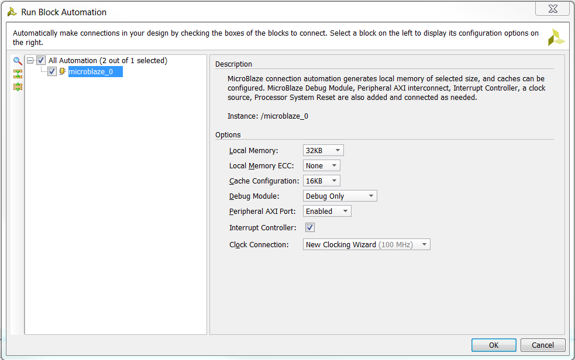
Xilinx Vivado – IP Integrator
This step requires that you start a new hardware design (MicroBlaze + axi_uartlite) in Vivado IP Integrator in a new project called Lecture_19.
You will add a new Block Design with a MicroBlaze and axi_uartlite following the MicroBlaze Tutorial.
http://ece.ninja/383/hand/Nexys_Video_MicroBlaze_Tutorial.pdf
***Deviation from Lecture 17 Tutorial***
Do not include the MicroBlaze Interrupt Controller check box.
If you do you could probably delete it from your design
Don’t Select!

Slide 8
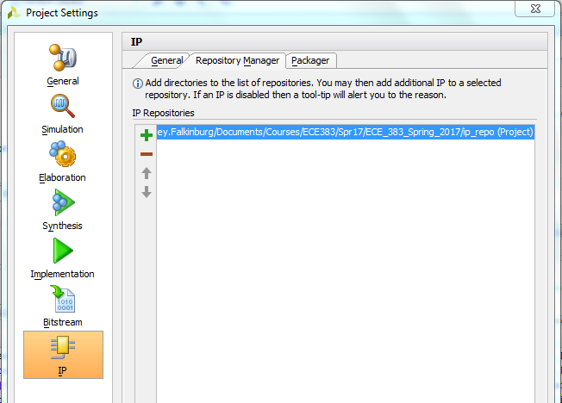
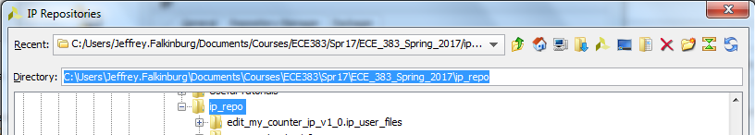
IP Catalog – Adding IP Repo
Open IP Catalog Settings and click on Repository Manager and add your IP Repo to your IP Repositories
/path_to_ip_repo/git_repo/ip_repo
1

Slide 9
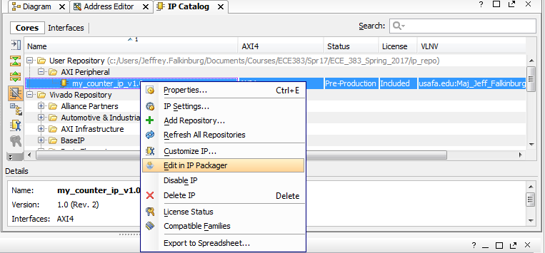
Edit/Create New IP Package
Edit Counter in IP Packager or create a new IP package
I chose to create a new package with a new version.

Slide 10
Edit/Create New IP Package
Expose the Roll Signal to the Artix 7 (design_1) block diagram by following the LED port maps

Slide 11
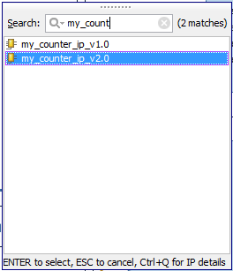
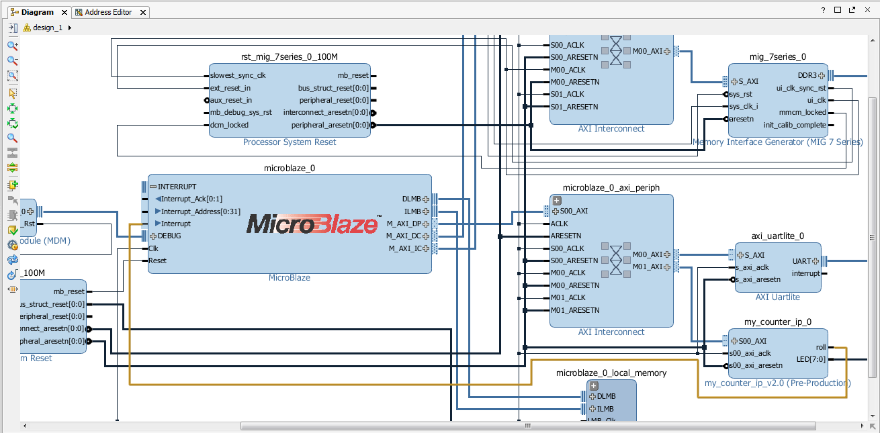
Xilinx Vivado – Create and Package Custom IP
8. Add Custom IP to your design
8.1) In the project manager page of the original window, click Open Block Design. This adds a block design to the project.
8.2) Use the Add IP button to add our v2.0 of our Lec 10 Counter IP Core with the exposed roll signal.
Notice it is v2.0

Slide 12
Edit/Create New IP Package
Click the ‘+’ sign by the MicroBlaze to connect the Roll Signal to the MicroBlaze Interrupt input directly
1
3
2

Slide 13
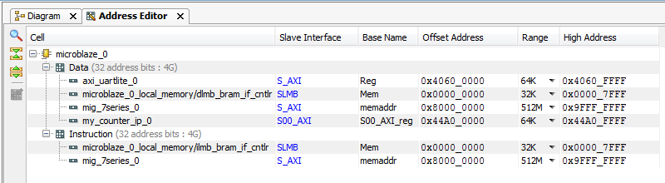
Verify Design
You should verify the addressing for all your design components before continuing.
Verify that the base addresses are the same addresses used in the template C-code.
Should be no changes at this time.
1
2
3

Slide 14
Verify Design
You should verify the addressing for all your design components before continuing.
Verify that the base addresses are the same addresses used in the template C-code.
Should be no changes at this time.

Slide 15
Validate and Export Design
First click validate design_1
Regenerate the design_1 HDL wrapper.
Finally you need to generate the Generate Design bitstream
Take a coffee break while it builds

Slide 16
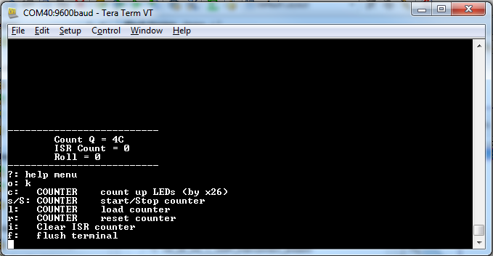
SDK Project
Start with a “Hello World” project once in the SDK.
Rename the hello_world.c to Lec19.c and use the given Lec19.c code to get started
Modify the code to handle the interrupt generated from the counter and increment a counter variable for display.

