Slide 1

ECE 383 – Embedded Computer Systems II Lecture 10 – Datapath and Control
Maj Jeffrey Falkinburg Room 2E46E 333-9193
1

Slide 2
Lesson Outline
Generics
Datapath and Control
Design Process
If
For
While
Assignment
Basic Building Blocks

Slide 3
Generics

Slide 4
Generics – Entity Declaration
Entity Declaration:
entity lec10 is
generic (N: integer := 4);
port( clk: in STD_LOGIC;
reset : in STD_LOGIC;
crtl: in std_logic_vector(1 downto 0);
D: in unsigned (N-1 downto 0);
Q: out unsigned (N-1 downto 0));
end lec10;
Note:
The variable N is available in the entity and architecture context. In this case, you will need it to define the width of vectors.
The value of N must be an integer, not a binary string. Just use positive integers for N.

Slide 5
Generics – Instantiation
Note:
The default value for N is 4. That means, if you do not use the generic map statement in the instantiation below, you will get a 4-bit counter.
The D and Q vectors use N-1 because the vector starts at 0.
Instantiation:
uut: lec10
generic map(5)
port map ( clk => clk,
reset => reset,
crtl => crtl,
D => D,
Q => Q);

Slide 6
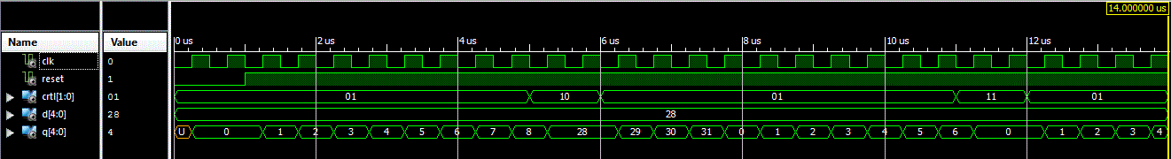
Generics – 5-Bit Counter
In this case, I made a 5-bit counter. The testbench linked on Lesson 10runs the counter through all four control modes and even shows how it rolls over (around 7.5uS).
Control | Description
00 | Hold
01 | Count up mod 10
10 | Load D
11 | Synchronous Reset

Slide 7
Datapath and Control

Slide 8
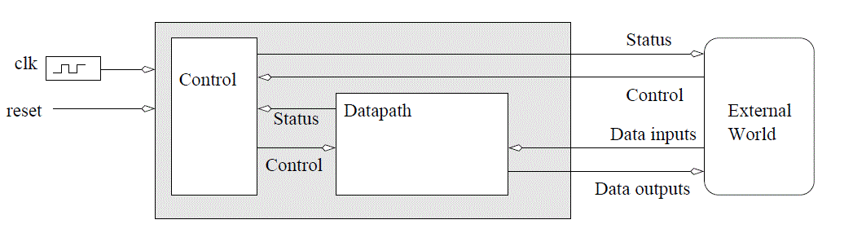
Datapath and Control
Datapath and Control Design Methodology
Datapath - responsible for data manipulations
Control - responsible for sequencing the actions of the datapath
Fig 10.0 - An abstract digital system constructed from a datapath and a control unit.

Slide 9
Design Process

Slide 10
Design Process
Building digital systems using the datapath and control approach is a three-step process.
Write an algorithmic description for the solution to the problem.
Parse the algorithmic description into datapath building blocks and control states.
Define the MIEs and OEs for the control unit.

Slide 11
mini-C
The programming language used to formalize an algorithmic solution to design problem is referred to as mini-C (a derivative of the C-programming language)
IF
if (condition) then BODY_1 else BODY_2
FOR
for (i=A; i<B; i += 1)
WHILE
while(condition) BODY
ASSIGNMENT
X = value

Slide 12
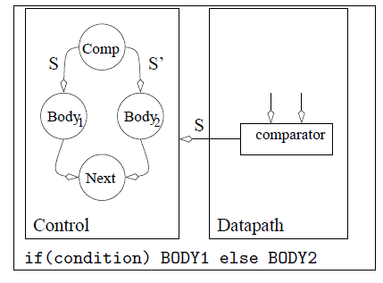
Design Process – If/Then/Else
Fig 10.1 - The datapath and control components required to realize an if/then/else structure.

Slide 13
Design Process – If/Then/Else
if boolean_expr_1 then
sequential_statements;
elsif boolean_expr_2 then
sequential_statements;
elsif boolean_expr_3 then
sequential_statements;
…
else
sequential_statements;
end if;

Slide 14
Design Process – If/Then/Else 4-to-1 Mux
architecture if_arch of mux4 is
begin
process (a,b,c,d,s)
begin
if (s =“00”)then
x <= a;
elsif (s=“01”)then
x <= b;
elsif (s=“10”)then
x <= c;
else
x <= d;
end if;
end process;
end if_arch;

Slide 15
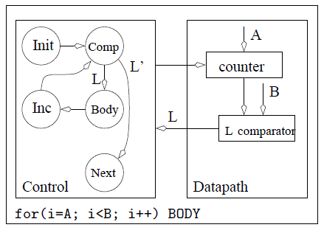
Design Process – For Loop
Fig 10.2 - The datapath and control components required to realize a for loop.

Slide 16
Design Process – For Loop
for index in loop_range loop
sequential statements;
end loop;

Slide 17
Design Process – For Loop Bitwise xor operation
entity bit_xor is
port( a, b: in std_logic_vector(3 downto 0);
y: out std_logic_vector(3 downto 0) );
end bit_xor;
architecture demo_arch of bit_xor is
constant WIDTH: integer := 4;
begin
process (a,b)
begin
for i in (WIDTH-1) downto 0 loop
y(i) <= a(i) xor b(i);
end loop;
end process;
end demo_arch;

Slide 18
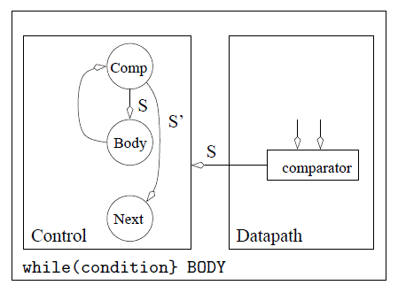
Design Process – While Loop
Fig 10.3 - The datapath and control components required to realize a while statement.

Slide 19
Design Process – While Loop
while condition loop
sequential statements;
end loop;

Slide 20
Design Process – While Loop
process (A)
variable I :
integer range 0 to 4;
begin
Z <= "0000";
I := 0;
while (I <= 3) loop
if (A = I) then
Z(I) <= '1';
end if;
I := I + 1;
end loop;
end process;

Slide 21
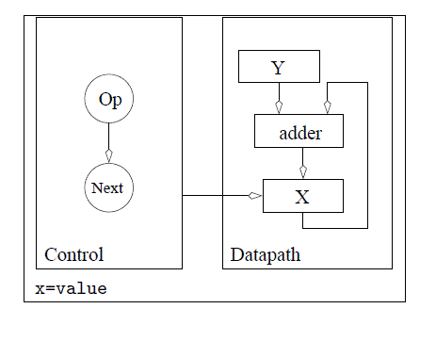
Design Process – Assignment
Fig 10.5 - The datapath and control components required to realize an assignment statement of the form X=X+Y.

Slide 22
Basic Building Blocks

Slide 23
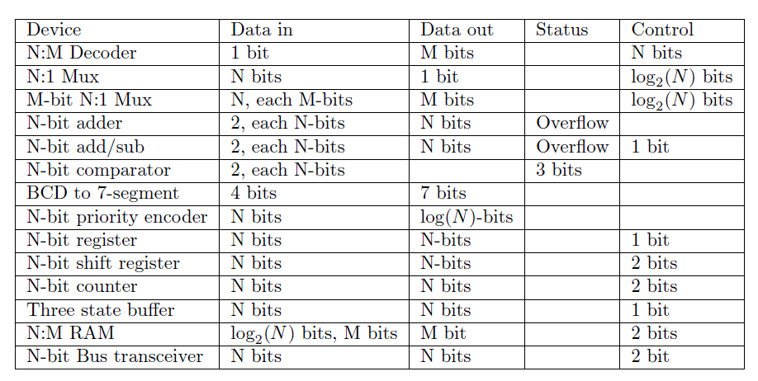
Basic Building Blocks
Table 10.6 - The list of all the basic building blocks and some of their attributes.

Slide 24
Lesson Outline
Generics
Datapath and Control
Design Process
If
For
While
Assignment
Basic Building Blocks

