Slide 1

ECE 383 – Embedded Computer Systems II Lecture 11 – Datapath and Control
Maj Jeffrey Falkinburg Room 2E46E 333-9193
1

Slide 2
Lesson Outline
Time Logs!
Datapath and Control – Timing
VHDL Instantiation
Keyboard serial to parallel converter

Slide 3
Datapath and Control - Timing

Slide 4
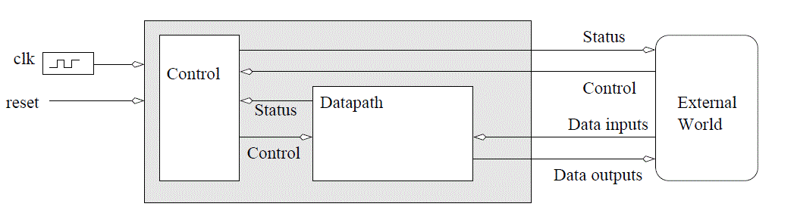
Datapath and Control - Timing
Datapath and Control Design Methodology
Datapath - responsible for data manipulations
Control - responsible for sequencing the actions of the datapath
Fig 10.0 - An abstract digital system constructed from a datapath and a control unit.

Slide 5
Datapath and Control - Timing
Reasons to examine the timing behavior of a datapath and control circuit.
First, so that we can make informed predictions about the expected clocking frequency of our circuits.
Second, so that we can identify critical paths in our circuit.
Third, so that we can develop our intuition about the operation of these complex circuits.

Slide 6
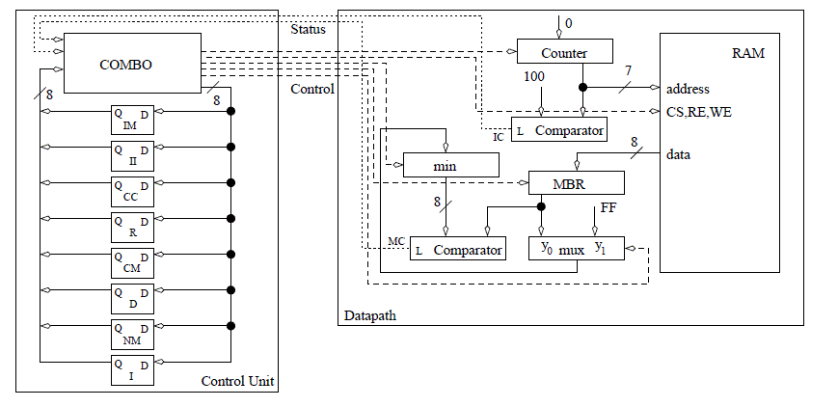
Datapath and Control - Timing
Circuit from Lesson 10 – Search algorithm for minimum

Slide 7
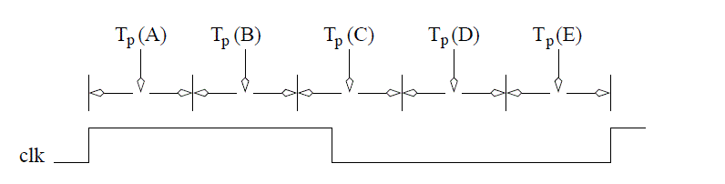
Datapath and Control - Timing
T_{p}(A) – T_{pd}(FF) – Propagation Delay of Flip Flops
FF is input to OEs
T_{p}(B) – Q_{valid} – OEs assert their new values
T_{p}(C) – SW_{valid} – time difference between the application of a valid control word to the datapath and the status input to the control unit becoming valid

Slide 8
Datapath and Control - Timing
T_{p}(D) – D_{valid} – delay between the status inputs becoming valid and the MIEs becoming valid
T_{p}(E) – T_{setup} – Once the memory inputs have stabilized, they must be allowed some setup time

Slide 9
VHDL Instantiation

Slide 10
VHDL Instantiation
Binding - technique of assigning signals in the top-level entity (caller) to the signals in the instance
uut: lec10
Generic map(5)
PORT MAP (
clk => clk,
reset => reset,
crtl => crtl,
D => loadInput,
Q => cntOutput);
Signals clk, reset, crtl, D and Q were defined inside the lec10 component
signals clk, reset, crtl, loadInput, and cntOutput were defined as signals in the higher-level testbench

Slide 11
VHDL Instantiation
We could shorten this instantiation by using the default binding calling convention shown in the code below
uut: lec10
Generic map(5)
PORT MAP (clk, reset, crtl, loadInput, cntOutput);
Important Note: When you use the default binding, the order of the signals must match the exact same order that is defined in the entity description.
Generates a more compact instantiation statement.

Slide 12
Unused outputs and open keyword
However, we could shorten this instantiation by using the default binding calling convention below:
entity compare is
generic(N: integer := 4);
port(x,y : in unsigned(N-1 downto 0);
g,l,e: out std_logic);
end compare;
Important Note: Note that g=1 when x>y, and l=1 when x<Y and e=1 when x=y
example: compare port map (A,B,OPEN, OPEN, equal);
Synthesis engine can remove the logic associated with any of the OPEN signals and reduce the resources used on the FPGA.

Slide 13
Subvectors and Concatenation
There are times when we will need to rebuild a std_logic_vector from pieces of other vectors.
Vector is defined as signal(7 downto 0), you can replace the limits with anything in between to get a small subvector
For example, you could ask for signal(5 downto 2) for a 4-bit sub-vector of signal.

Slide 14
Subvectors and Concatenation
The concatination operation, &, is a way to "glue" two vectors together.
For example, to build a 8-bit vector you could legally write in VHDL signal(3 downto 1) & signal (7 downto 3);
These two concepts come together in the shift register used in the lecture 11 code, which contains the following line of VHDL code.
shiftReg <= kbData & shiftReg (10 downto 1);

Slide 15
Keyboard Serial to Parallel Converter

Slide 16
Keyboard Serial to Parallel Converter
Nomenclature: | PS/2 Keyboard
Data Input: | none
Data Output: | 1-bit data, nominally logic 1
Control: | none
Status: | none
Others: | 1-bit clk, nominally logic 1
Physical Input: | key press and key release events
Physical Output: | none
Behavior: | When a key is pressed, its 8-bit make code is transmitted. When a key is released, an 8-bit break code is transmitted, immediately followed by the key's 8-bit scan code.

Slide 17
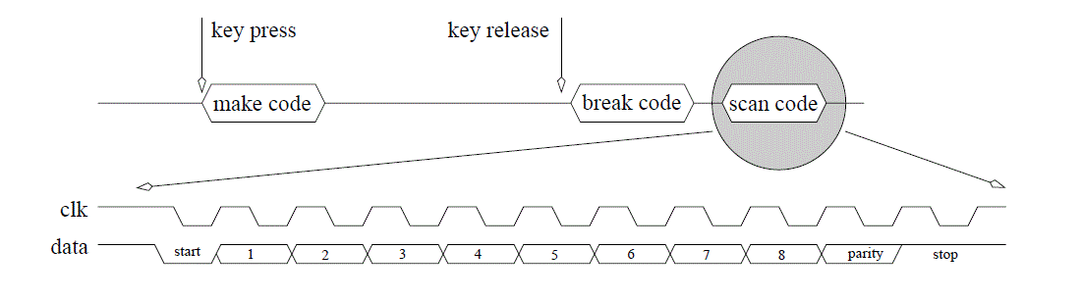
Keyboard Serial to Parallel Converter

Slide 18
Keyboard Serial to Parallel Converter
Nomenclature: | Keyboard scan code reader
Data Input: | 1-bit kd data, nominally logic 1 1-bit kd clk, nominally logic 1
Data Output: | 8-bit scan code
Control: | none
Status: | 1-bit busy, nominally logic 0
Others: | 1-bit clk, nominally logic 1
Behavior: | Interprets the PS/2 keyboard clk and data signal from a keypress event and outputs the associated scan code. The busy signal goes high when the first data bit arrives and stays high until the last data bit is received. Busy is low only when there is a valid scan code on the output.

Slide 19
Unused outputs and open keyword
Looking at the timing diagram and the description on previous slide, we get the following algorithm.
1. while(1) {
2. busy=0;
3. while (kb_clk == 1);
4. busy=1;
5. for (count=0 count<33; count++) {
6. while(kb_clk == 1);
7. shift = (shift << 1) | kb_data;
8. while(kb_clk == 0);
9. } // end for
10. scan = shift[9-2]
11. } // end while 1

Slide 20
Homework #8
Now lets build the datapath and control using the technique learned in lecture 10.
Your homework is to build the control unit for the keyboard scancode reader.

