Slide 1

ECE 383 – Embedded Computer Systems II Lecture 12 – Datapath and Control
Maj Jeffrey Falkinburg Room 2E46E 333-9193
1

Slide 2
Lesson Outline
Time Logs!
HW# 8 Due Now!
GR Next Time!
Lab 1 – Lab Notebook Revisions due COB 12 Feb
For up to half the points back…must send me an issue request!
Datapath and Control – BRAM
Packages
2-Line Handshake

Slide 3
Datapath and Control - BRAM

Slide 4
Datapath and Control - BRAM
Artix 7 FPGA
First page of 7 Series Family Overview: https://www.xilinx.com/support/documentation/data_sheets/ds180_7Series_Overview.pdf
Third page lists quantities how many of these resources our Nexys Video boards have.
For reference we are using the XC7A200T chip and the SBG484 package.

Slide 5
Datapath and Control - BRAM
In our upcoming Lab2, you will need a large RAM to store 18-bit audio samples streaming in from the ATLYS board.
The Xilinx FPGA on our board, a Artix 7, contains built in block RAMs (BRAMs).
You can select of the three main BRAMSconfiguration (BRAM_SDP_MACRO, BRAM_SINGLE_MACRO, BRAM_TDP_MACRO) available in the UNIMACRO library.
We will be using a BRAM_SDP_MACRO in our design.
According to Vivado Design Suite 7 Series FPGA Libraries Guide:

Slide 6
Datapath and Control - BRAM
FPGA devices contain several block RAM memories that can be configured as general-purpose 18Kb or 36Kb RAM/ROM memories.
These block RAM memories offer fast and flexible storage of large amounts of on-chip data.
Both read and write operations are fully synchronous to the supplied clock(s) of the component.
However, READ and WRITE ports can operate fully independently and asynchronously to each other, accessing the same memory array.
Byte-enable write operations are possible, and an optional output register can be used to reduce the clock-to-out times of the RAM.

Slide 7
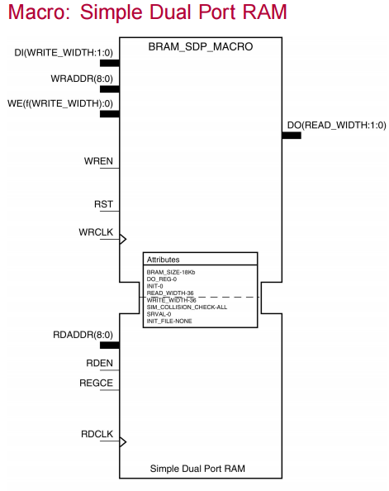
Datapath and Control - BRAM
This is a schematic symbol of BRAM memory.
Notes:
Inputs are on left
Outputs are on the right.
Left top side - write functions
Left bottom - the read functions
The three types of BRAMs are highly configurable, but may be overwhelming to the new designer.

Slide 8
Datapath and Control – BRAM Example Instantiation
----------------------------------------------------------------------------
-- Reference: Vivado Design Suite 7 Series FPGA Libraries Guide
-- UG953 (v 2012.4) July 25, 2012
--
-- Page: 10
-----------------------------------------------------------------------------
sampleMemory: BRAM_SDP_MACRO
generic map (
BRAM_SIZE => "18Kb", -- Target BRAM, "18Kb" or "36Kb"
DEVICE => "7SERIES", -- Target device: "VIRTEX5", "VIRTEX6", "SPARTAN6, 7SERIES"
DO_REG => 0, -- Optional output register disabled
INIT => X"000000000000000000", -- Initial values on output port
INIT_FILE => "NONE", -- Not sure how to initialize the RAM from a file
WRITE_WIDTH => 18, -- Valid values are 1-72 (37-72 only valid when BRAM_SIZE="36Kb")
READ_WIDTH => 18, -- Valid values are 1-72 (37-72 only valid when BRAM_SIZE="36Kb")
SIM_COLLISION_CHECK => "NONE", -- Collision check enable "ALL", "WARNING_ONLY", "GENERATE_X_ONLY" or "NONE"
SRVAL => X"000000000000000000") -- Set/Reset value for port output

Slide 9
Datapath and Control – BRAM Instantiation continued
port map (
DO => readOutput, -- Output read data port, width defined by READ_WIDTH parameter
RDADDR => vecAddrRead, -- Input address, width defined by port depth
RDCLK => clk, -- 1-bit input clock
RST => reset, -- active high reset
RDEN => cw(5), -- read enable
REGCE => '1', -- 1-bit input read output register enable - ignored
DI => writeInput, -- Input data port, width defined by WRITE_WIDTH parameter
WE => cw(3 downto 2), -- since RAM is byte read, this determines high or low byte
WRADDR => vecAddrWrite, -- Input write address, width defined by write port depth
WRCLK => clk, -- 1-bit input write clock
WREN => cw(4)); -- 1-bit input write port enable

Slide 10
Datapath and Control – Class Activity
Class Activity:
Determine what will happen inside the RAM defined above when subject to the following signals.
-- vecAddrRead = vecAddrWrite - 1
-- writeInput <= "10101010101010" & vecAddrWrite(3 downto 0);
cw(5) <= '1', '0' after 7 us, '1' after 8 us; -- READ ENABLE
cw(4) <= '1', '0' after 3 us, '1' after 4 us; -- WRITE ENABLE
cw(3 downto 2) <= "11", "10" after 4 us, "01" after 5 us, "11" after 6us; -- BYTE WRITE ENABLE
cw(1 downto 0) <= "01"; -- COUNTER CONTROL

Slide 11
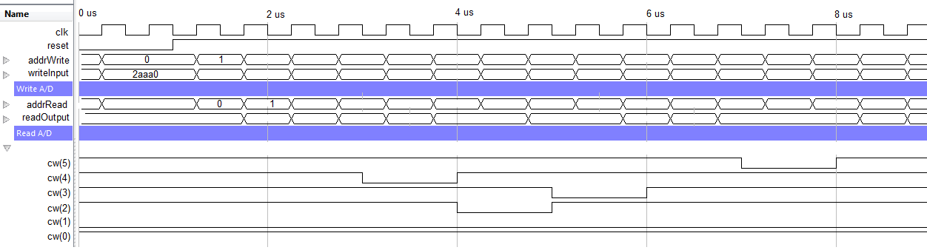
Datapath and Control - BRAM
Addr | writeInput | WREN=cw(4) | WE=cw(3,2) | RDEN=cw(5) | readOutput
0x0 | 0x2AAA0
0x1 | 0x2AAA1
0x2
0x3
0x4
0x5
0x6
0x7
0x8 | 0x2AAA8
0x9
0xA
0xB
0xC
0xD
0xE | 0x2AAAE
0xF

Slide 12
Datapath and Control - Packages
Packages are a nice way to hide lots of component declarations
Redundancy is one of the main contributors of complexity in software is redundancy.
Having an entities declaration in several different architectures is redundant.
Pulling all these declarations into one file eliminates this redundancy and make the code much easier to maintain and update.
So how do you create a Package?

Slide 13
Datapath and Control - Packages
Packages – Package for Lab 2
http://ece.ninja/383/lecture/code/lab2_pack.vhdl
Include this at the top of your file:
use work.lab2Parts.all; -- all my components are declared here

Slide 14
2-Line Handshake
In most cases, digital systems require data from the external world in order to perform their tasks.
In cases where the digital system and the outside word operate on independent clocks, the transfer of data is complicated by the lack of a common clock.
To understand how a reliable transfer of data can be performed in this circumstance, consider the following scenario of a producer trying to deliver a packet of candies to a consumer.
Figure 12.2: A timing diagram of a data transfer between a producer and a consumer.

Slide 15
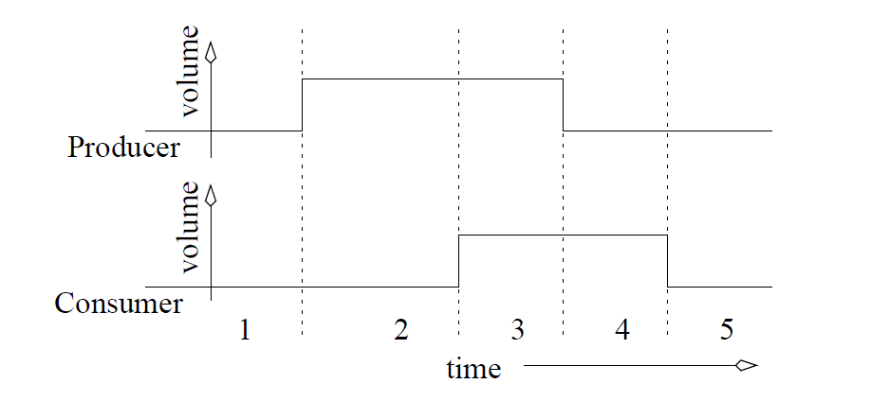
2-Line Handshake
Figure 12.2: A timing diagram of a data transfer between a producer and a consumer.

Slide 16
2-Line Handshake
This protocol, regardless of who is the producer or consumer, is called a two-line handshake because the communicating agents must have two, coordinating signals Request (REQ) and Acknowledge (ACK) and at least one data line.
REQ signal - used by the active agent to signal a readiness to perform a data transfer.
ACK signal - used by the passive agent to acknowledge the data has been transferred.
Figure 12.2: A timing diagram of a data transfer between a producer and a consumer.

Slide 17
2-Line Handshake
An algorithm description of the two-line handshake for a digital circuit which is the passive consumer is shown below.
while(REQ==0); // Do nothing but wait
register = DATA // Latch the data
ACK=1; // Acknowledge the producer
while(REQ==1); // Do nothing but wait
ACK=0; // Acknowledge the producer
In Line 1 and Line 4, the body of the while loops are empty; there is nothing to do but wait.
Furthermore, with respect to the external world, the ACK and REQ signals act as status and command bits, respectively.
The algorithm above is translated into datapath and control in Figure 12.3.
Figure 12.2: A timing diagram of a data transfer between a producer and a consumer.

Slide 18
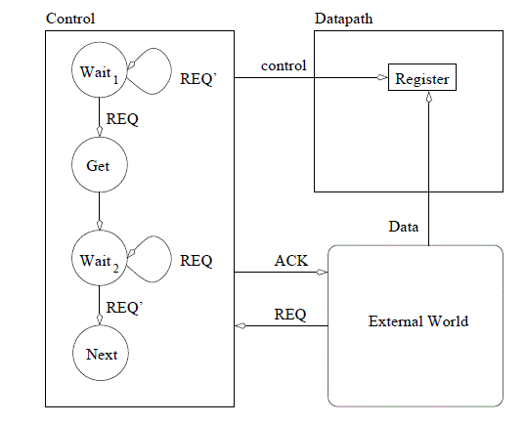
2-Line Handshake
while(REQ==0);
// Do nothing but wait
register = DATA
// Latch the data
ACK=1;
// Acknowledge the producer
while(REQ==1);
// Do nothing but wait
ACK=0;
// Acknowledge the producer
Figure 12.3: The datapath and control components required to implement a two-line handshake where the digital system is the passive consumer.

Slide 19
Datapath and Control - Exercise
Build a circuit to read in an 8-bit KEY using a two-line handshake; the circuit is a passive consumer.
The circuit should search an 18kx18 RAM, counting the number of words that match KEY.
Assume the RAM is preloaded with data and it can respond to a read request with valid data within one clock
1. while(1) {
2. while(REQ == 0);
3. KEY = data;
4. ACK = 1;
5. while(REQ == 1);
6. ACK = 0;
7. match = 0;
8. for(i=0; i<8191; i++) {
9. MBR = RAM[i];
10. if (MBR == KEY) {
11. match=match+1;
12. } // end if
13. } // end for
14. } // end while

Slide 20
Homework #8
Now lets build the datapath and control using the technique learned in lecture 10.
Your homework is to build the control unit for the keyboard scancode reader.

Slide 21
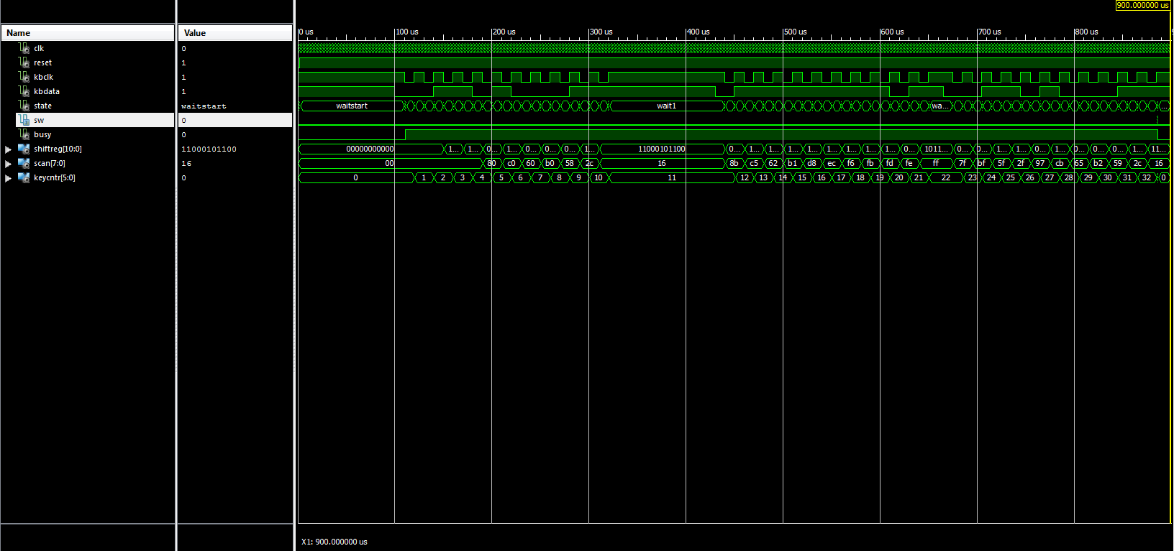
Homework #8

