Slide 1
ANALYSIS AND MODELING OF CREDIT RISK TRANSFER NOTES AND CORRESPONDING DEFAULT MODELS
Junyao Zhao
Ratnakar Chitturi
Ian Lipman

Slide 2
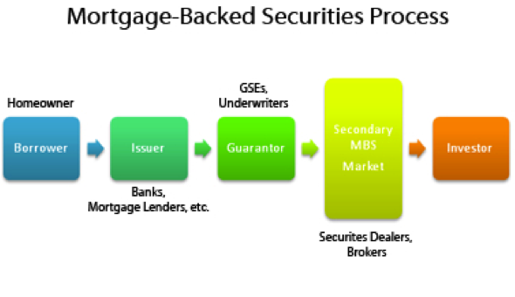
Creation of a Mortgage Backed Security
The homeowner receives a [qualified] mortgage from a commercial bank (Bank of America, Wells Fargo, etc) or lender
The commercial bank/lender gets the loan guaranteed by a Government Sponsored Enterprise (GSE) in exchange for a fixed fee paid by the homeowner (borrower)
The loans are sold to securities dealers and brokers
The securities dealers and brokers will package similar loans together and sell the loans to investors
The investors will receive principal and interest as it is paid, and, in case of default, they are guranteed all of the pricipal and interest as a result of the guarantee from the GSEs

Slide 3
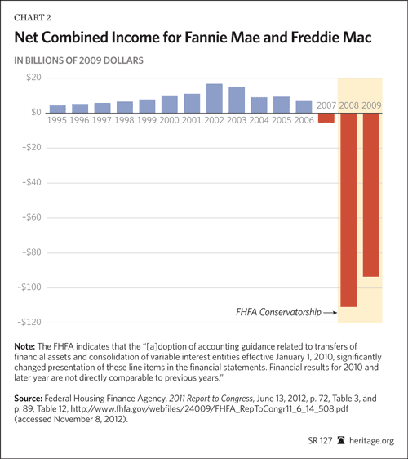
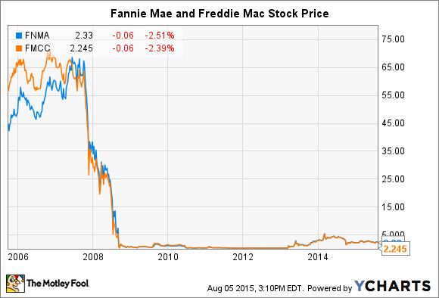

Slide 4
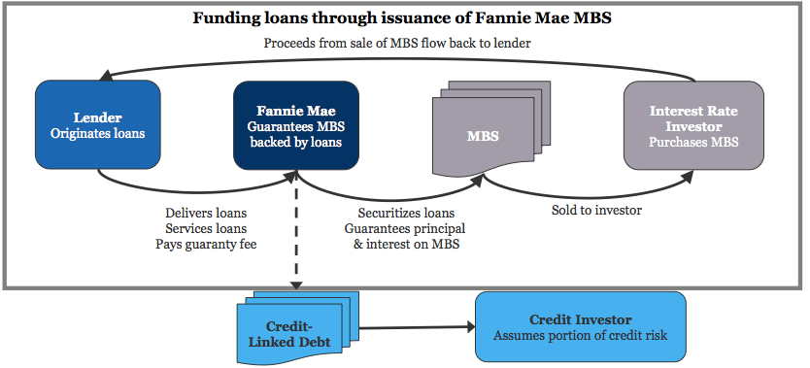

Slide 5
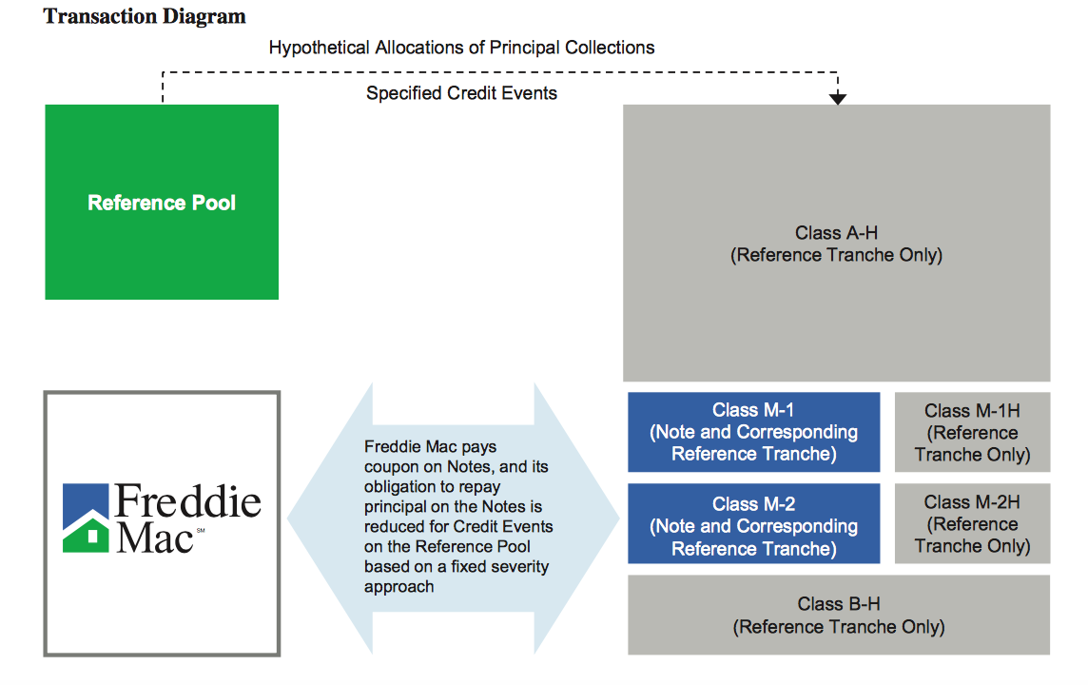
Securitization of a Credit Risk Transfer.
Investors
Interest
Principal
Principal payment to the tranches is based on the actual principal payments and Minimum Credit Enhancement Test and Cumulative net credit event.

Slide 6
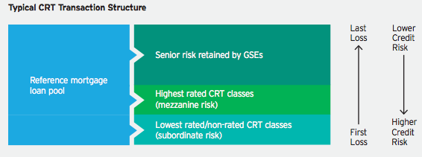

Slide 7
Difference between a CRT and MBS.
 | MBS | CRT
Prepayment Risk | Investors | Depends on the deal, but the major risk goes to Freddie Mac.
Default Risk | Freddie Mac because it guarantees the principal payments. This also depends on the deal. | The last tranche takes the default risk based on the severity percentage and then M2 and M1 takes the risk.
Mortgage Interest Rate Risk | Investors | Doesn’t influence the CRT.
Additional / Interest | Freddie Mac guarantees all principal and Interest to be paid to investors, no matter what happens | Freddie Mac pays the interest to the investors who purchased tranche

Slide 8
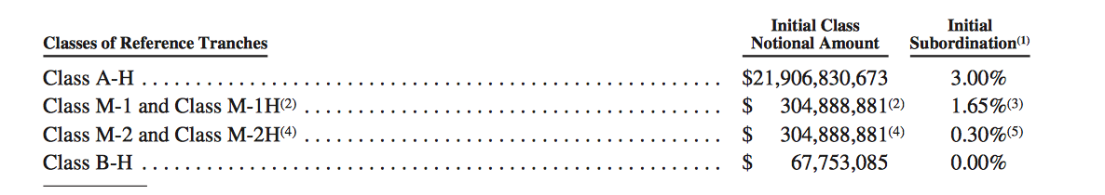
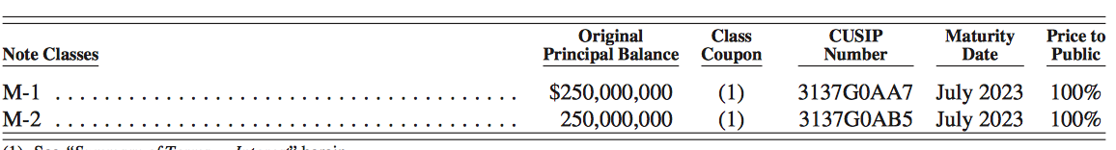
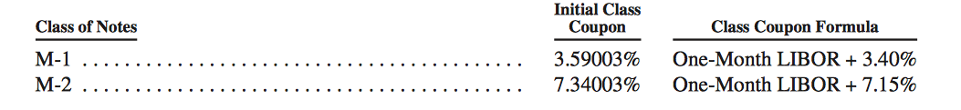
Structure of tranches of the 2013 STACR 2013 DN1.
Tranches issued to the public.
Interest payment to the M1 and M2 tranches.

Slide 9
Tranche | Percentage of the total pool.
Class A –H | 97.00 %
Class M1 and M1 H | 1. 35 % (1. 1070 % (M-1) + 0.2403 % (M-1 H))
Class M2 and M2 H | 1. 35 % (1. 1070 % (M-2) + 0.2403 % (M-2 H) )
Class B H | 0.30 %
Freddie Mac owns 97.78 % of the security and the remaining portion of the security is sold to the investor.
The payments to the tranches depends on the principal payments on the reference pool.
Principal payments from the loans are transferred to the tranches such that made Cumulative Net Credit Event and Minimum Credit Enhancement Test.
Payments are made to the M2 tranche after M1 tranche is completely paid off.
B-H tranches takes the loss based on the loss severity and when the B-H tranches is written off, M2 and M2 H tranches takes the loss on pro-rata basis and then to M1 and M1 H.

Slide 10
Minimum Credit Enhancement Test:
The subordinate class (M1, M2 and BH) percentage must be greater than 3 %. If it is less than the 3% unscheduled principal payments is made to the notes.
Loss Severity:
1% of the Cumulative Credit Event has 15 % severity.
The Cumulative Credit Events in between 1% and 2% has the loss severity is 25 %.
Further increase in the Cumulative Credit Events has the loss severity has 40%.

Slide 11
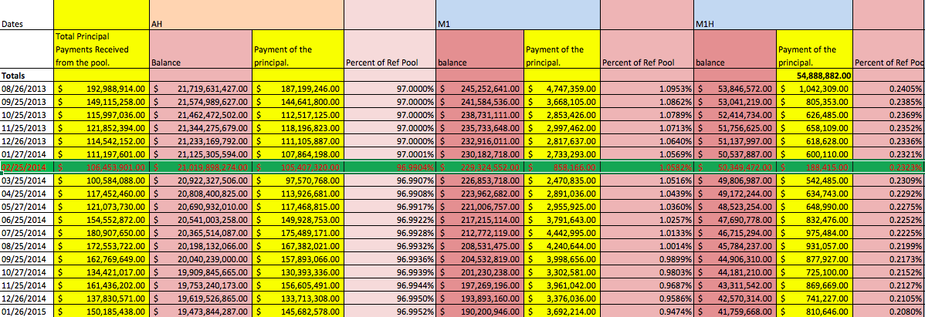
Unscheduled payments is made to AH tranche compared to M1 tranche.
The subordinate percentage is less than 3%.
The subordinate percentage is greater than 3%.
Total Principal received from the Housing pool + prepayments + (1 - Loss severity )% of the credit events.
Payment made to the AH tranche. Usually (97 %)
Payment made to the M1 tranche.
Payment made to the M1H tranche.
=
+
+

Slide 12
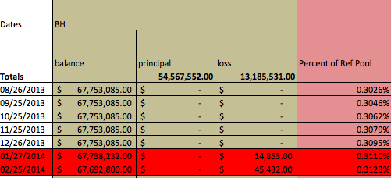
First Credit Event :
Credit Events here is the default of the loans.
The B-H tranche is written off based on the loss severity.
The Cumulative Net credit is less than 1 % so the loss severity is 15% of the principal outstanding in the defaulted loans.
The defaulted notes are removed from the reference pool.
Reference pool
-
Defaulted loans.
=
Reference pool without the defaulted loans.
=
=
Total Balance on all the tranches
-
Loss severity % written on the BH tranche.
-
(1- Loss severity )% paid to the senior tranches.
=
Total Balance on all the tranches

Slide 13
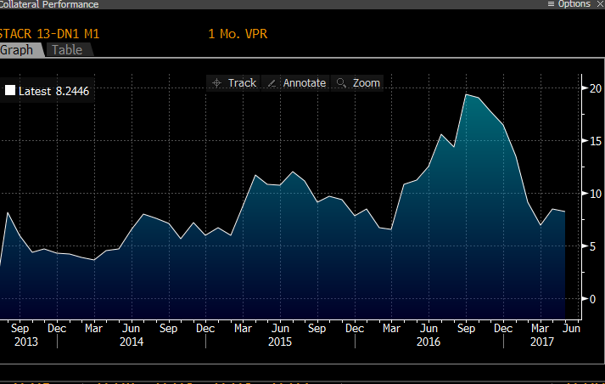
VOLUNTARY PREPAYMENT RATE FOR STACR 2013 DN1

Slide 14
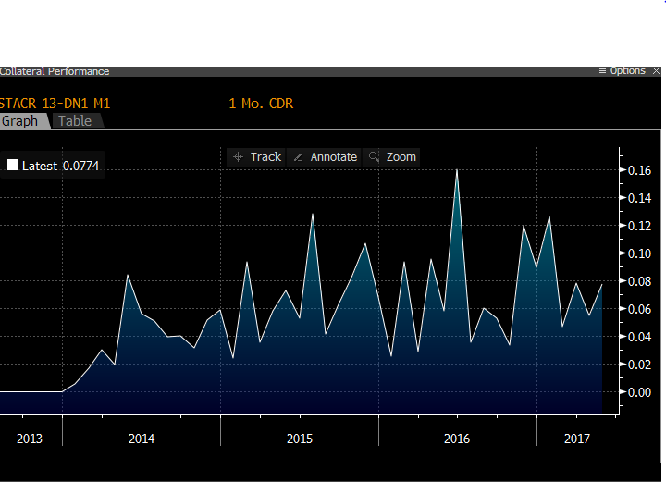
CONSTANT DEFAULT RATE FOR STACR 2013 DN1

Slide 15
CASH FLOW MODELING OF STACR 2013 DN1

Slide 16
Modeling Default and Prepayment
One of the main components in modeling a CRT is estimating the default rate (CDR - Constant Default Rate) and the prepayment rate ( VPR - Voluntary Prepayment Rate)
For default rate, Housing Price Index and Unemployment were the important variables, but for prepayment rate, Weighted Average Loan Age and Refinance Rate (the current market mortgage rate versus the Weighted Average Coupon)
Although we did not have very much time to model, we performed several rudimentary attempts at modeling a CDR and VPR
We used both OLS tactics in Stata and more advanced techniques in Python
For OLS, R² never exceeded 0.55.
However, regressions run in Python utilized a Leave One Out Cross validation method. This allows the machine to adapt itself to the model
In conclusion, none of the regressions were perfect, as they never will be, but they did give us some idea of what default and prepayment could look like down the line.

Slide 17
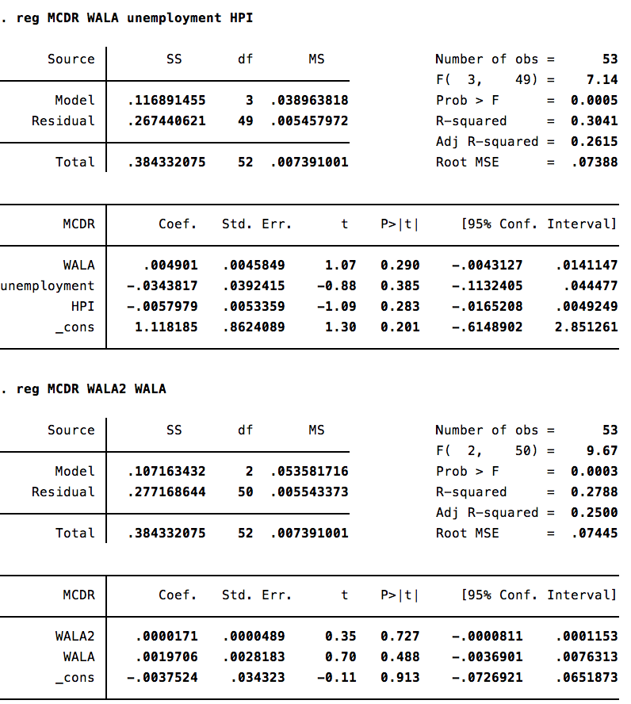
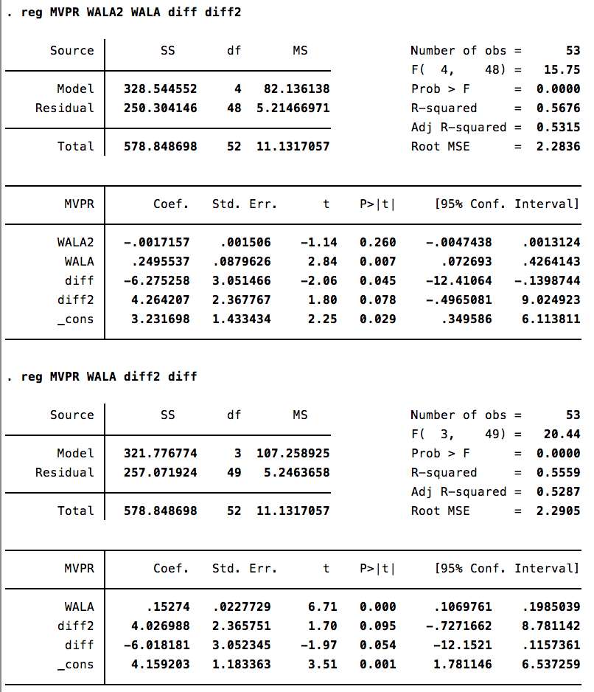
Explanatory Regressions Using Stata
Variable | Decription
MCDR | Mortgage Constant Default Rate
MVPR | Mortgage Voluntary Prepayment Rate
unemployment | Unemployment Rate
HPI | Housing Price Index
WALA | Weighted Average Loan Age
WALA2 | WALA²
diff | Refinance rate
diff2 | diff²

Slide 18
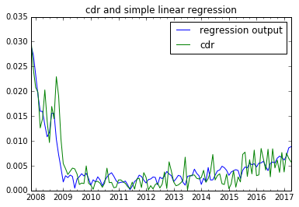
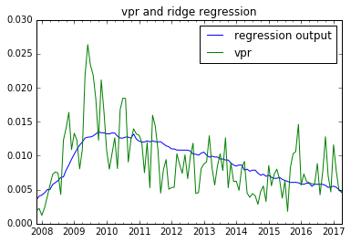
Explanatory Regressions Using Python

Slide 19
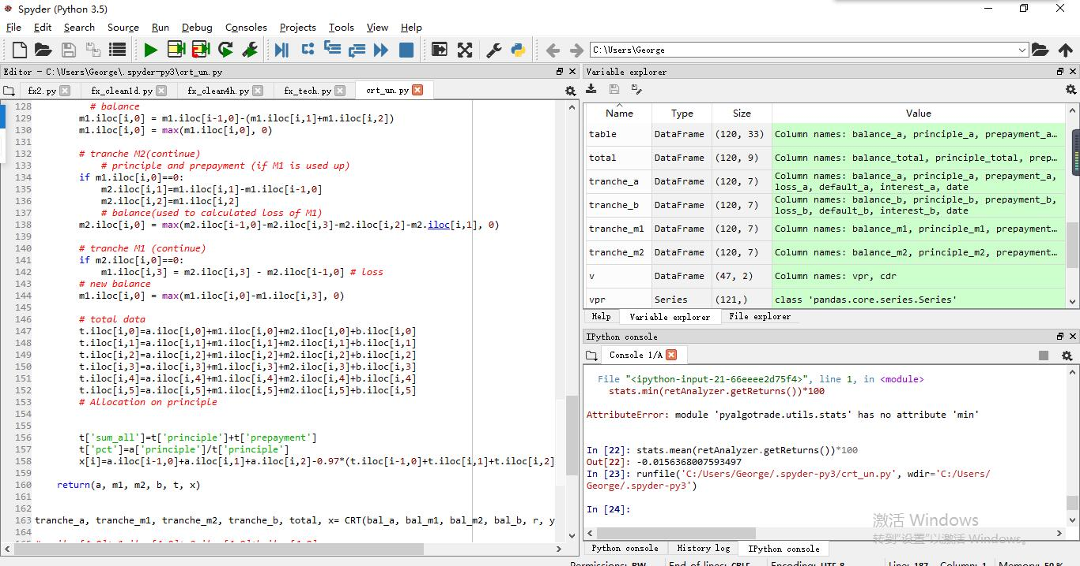
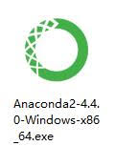
DATA ANALYSIS USING ANACONDA WITH PANDAS PACKAGES

Slide 20
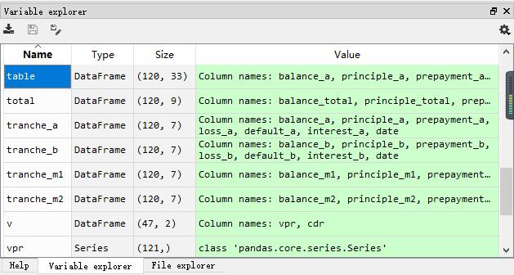

Slide 21




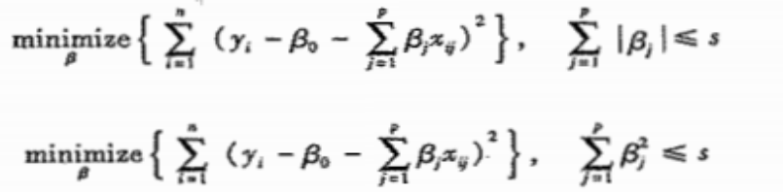
Predictive Models

Slide 22
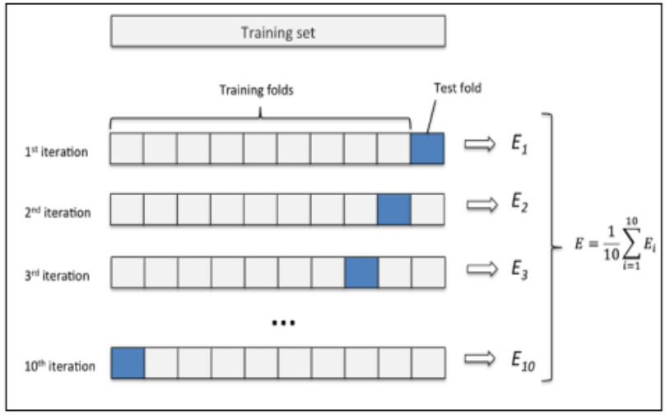
Cross validation

Slide 23
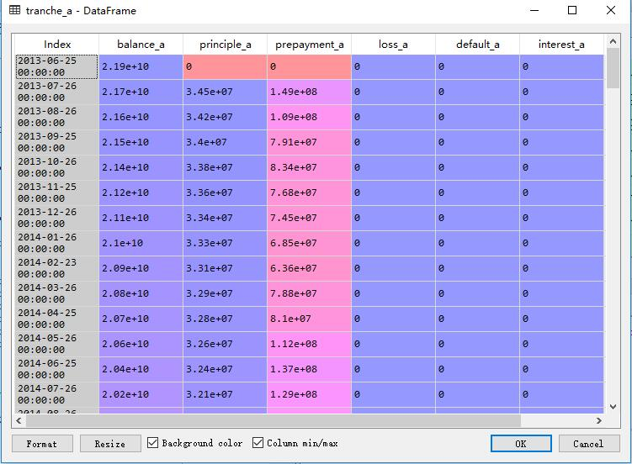

Slide 24
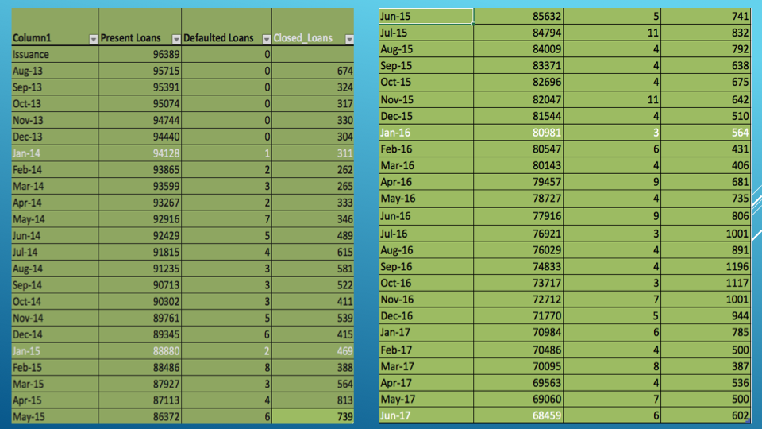

Slide 25
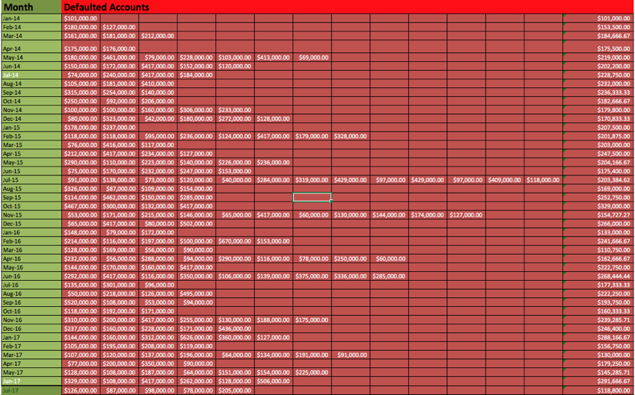

Slide 26
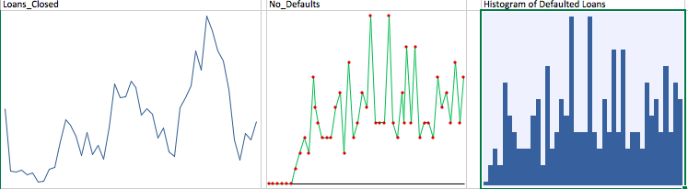

Slide 27



Slide 28
Extension: Creating and Analyzing a New STACR
Ian Lipman
Junyao Zhao

Slide 29
“2017 STACR DN3” - September 2017
The goal of creating a new CRT was to see how it compared to the guarantee fees Freddie Mac would be receiving from guaranteeing mortgages if it were to start at the present time:
We modeled our CRT as closely as possible to recent STACR issues by Freddie Mac
Here are the details concerning the tranches:
Tranche | Balance | % of CRT | % Retained by Freddie Mac | Coupon (for Investors)
AH | $14,250,000,000 | 95% | 100% | N/A
M1/M1H | $250,000,000 | 1.5% | 44.2322% | LIBOR + 175
M2/M2H | $250,000,000 | 1.5% | 44.2322% | LIBOR + 275
M3/M3H | $250,000,000 | 1.5% | 44.2322% | LIBOR + 635
B/BH | $75,000,000 | 1.5% | 86.1581% | LIBOR + 1275

Slide 30
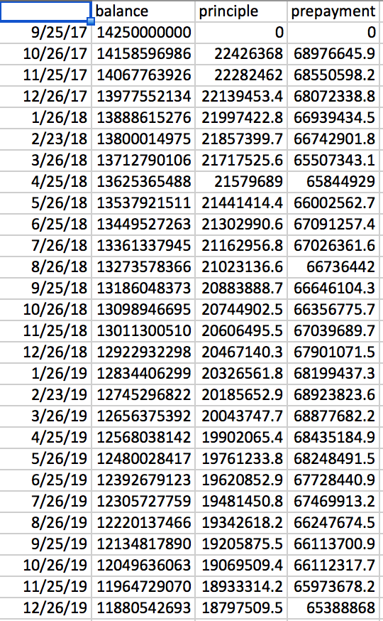
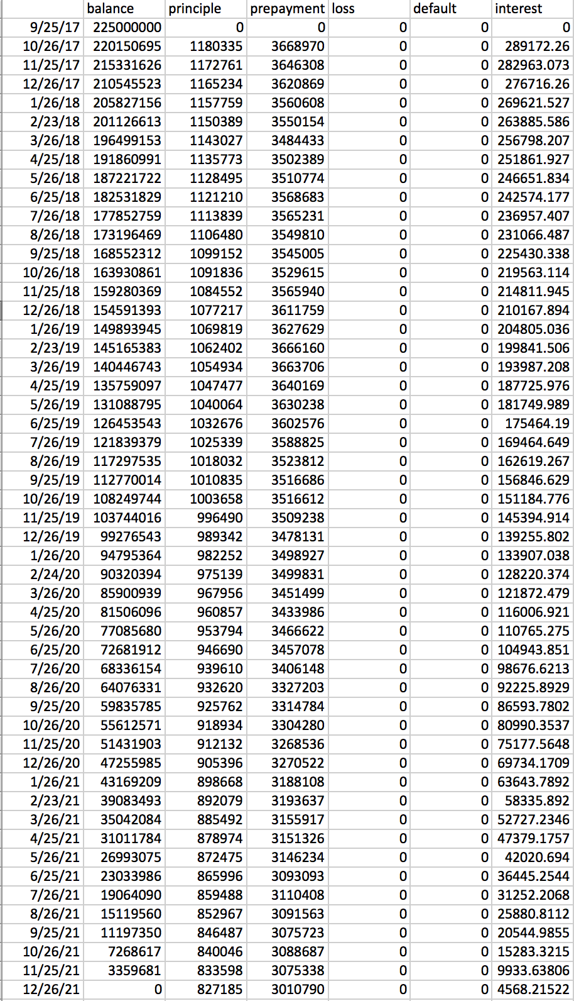
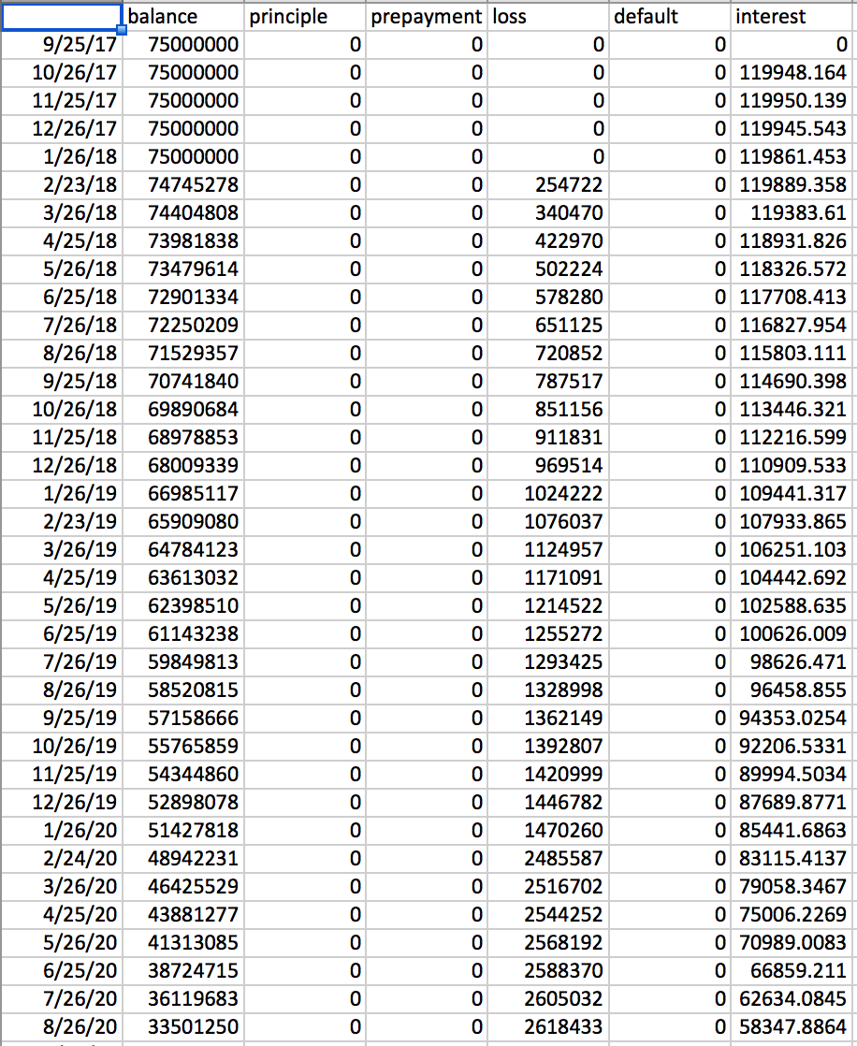
Examples of Cash Flows

Slide 31
Results
To compare to guarantee fees, we estimated that guarantee fees would constitute 20 basis points on the remaining mortgage balance
We used a stochastic process consisting of brownian motion and the vasicek model to predict the LIBOR Rates for the next 15 years
After 10 simulations, our mean present value of guarantee fees was $41,905,252.53, with a 95% confidence interval ranging between ($41,019,835.30, $42,790,669.75)
In contrast, the mean present value of the total paid to investors in the CRT is $72,149,888.53 with a 95% confidence interval ranging between ($69,948,030.48,$74,351,746.58)

