Slide 1
The Fish Game
PLAY
Highscore
Quit

Slide 2
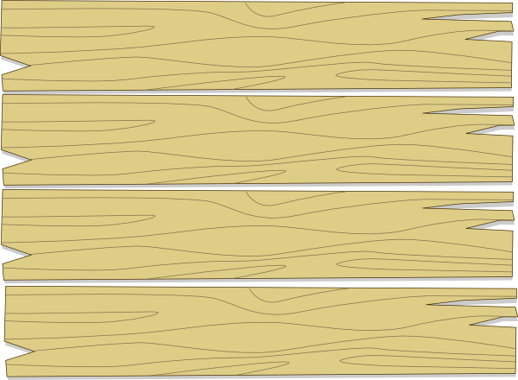
GAME PAUSED

Slide 3
Match Making

Slide 4
Player 3
Game Duration:
Ready
Press 1 to Join
Difficulty:
Player 1
Sharks:
Difficulty:
Player 2

