Slide 1
MedCue
Subtitle review for medical education
AUTOMATIC CAPTION
AFTER LISTENING
mersa
MRSA
“gonorrhea mersa these bedbugs are”
Actual automatic captions from public NLM audio. The editor makes the correction.
Notes:
Sources: https://github.com/Georgefifth/medcue/blob/codex/medcue/evaluation/editor-study/README.md
NLM source: https://medlineplus.gov/medlineplus-videos/antibiotics-vs-bacteria-fighting-the-resistance/
Actual ASR cue 4. This is a selected example, not an accuracy or prevalence claim.

Slide 2
The review workflow
01
02
03
04
Open
Listen
Review
Export
SRT and matching audio
Replay the selected cue
Edit against the original
SRT keeps its timing
Review & next
Original text and timestamps remain available throughout
One action records the decision and selects the next cue
Audio stays on the device. Editing and export work without AI.
Notes:
Implementation: https://github.com/Georgefifth/medcue/blob/codex/medcue/src/main.js
These are editor actions, not enforced playback prerequisites. The one-action review transition is structural, not measured human time savings.

Slide 3
The recording guides the decision
01
02
03
04
Open
Listen
Review
Export
SRT and matching audio
Replay the selected cue
Edit against the original
SRT keeps its timing
Review & next
Replay includes nearby audio
One action records the decision and selects the next cue
Audio stays on the device. Editing and export work without AI.
Notes:
Implementation: https://github.com/Georgefifth/medcue/blob/codex/medcue/src/main.js
These are editor actions, not enforced playback prerequisites. The one-action review transition is structural, not measured human time savings.

Slide 4
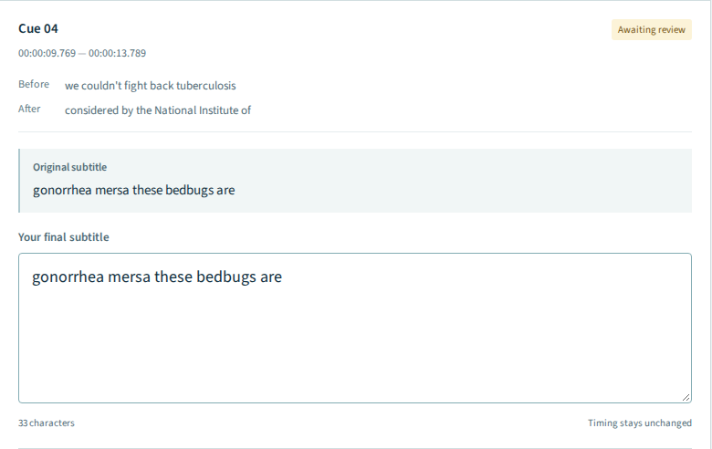
Evidence beside the edit
01
Nearby original context
02
Original stays unchanged
03
The editor owns the final text
Notes:
Screenshot captured from https://georgefifth.github.io/medcue/ in an isolated recorder session on 2026-10-19. No text or review decisions altered for this screenshot. Crop is of the original evidence area, not a mockup.

Slide 5
The editing loop runs in the browser
DEVICE FILES
BROWSER
SRT + audio
Review desk
SRT + project
Existing subtitles and recording
Parser, WaveSurfer and glossary rules
Export text or save review decisions
Originals, edits and review history
Audio playback stays here
The public Pages edition has no AI backend. No API key is collected there.
Notes:
Sources: https://github.com/Georgefifth/medcue/blob/codex/medcue/src/main.js and src/core.js. GitHub Pages serves static assets. User audio is not uploaded. Browser draft storage is localStorage, not encrypted medical-record storage. Audio is reattached after reload.

Slide 6
Optional AI request
SERVER EDITION ONLY
Explicit click
Node API
Model
Suggestions
Selected cue + glossary
Request limits and server-side key
Cloud API or Ollama
Quotes to investigate
Audio stays in the browser
The editor accepts every change
Rate-limit or provider failures leave editing and export available. No automatic retries.
Notes:
Sources: https://github.com/Georgefifth/medcue/blob/codex/medcue/server/ai.mjs and src/main.js. Only a selected cue and glossary are sent after explicit Check with AI. The Node server protects its key and applies spacing/concurrency/budget guards. A configured cloud endpoint or server-side Ollama returns unverified suggestions. Pages has no such backend. No live model call is made during this video.

Slide 7
Changed words, unchanged timing
SOURCE CUE 4
MANUALLY REVIEWED CUE 4
4
00:00:09,769 --> 00:00:13,789
gonorrhea mersa these bedbugs are
4
00:00:09,769 --> 00:00:13,789
Gonorrhea. MRSA. These bad bugs are
All 14 cues exported
13 still await review
SRT carries text and timing. Save a project file to retain decisions and history.
Notes:
Source: public/sample/antibiotics.srt cue 4 and src/core.js exportSrt. The reviewed wording shown is a manual demonstration correction, supported by the separately preserved publisher captions across adjacent publisher cues. This is a prepared example. The live demonstration exports all 14 cues while only one has been marked reviewed. Other cues may still contain errors.

Slide 8
Text and timing survived the round trip
257
actual automatic-caption cues
22 core/API checks and 14 browser tests pass
Developer-run checks. Human time savings and medical correctness remain unmeasured.
Notes:
Data: https://github.com/Georgefifth/medcue/blob/codex/medcue/evaluation/editor-study/README.md
Natural ASR antibiotics=134 cues, naloxone=123 cues, sum=257. These are developer-run import/export checks. Selected-cue playback was tested, not a manual listening review of every cue. They are not medical accuracy data. Current release tests: docs/verification.json, core=9, API=13, browser=14.

Slide 9
An AI suggestion can misdirect attention
RECORDED GEMINI RESPONSES
A useful lead
A misplaced warning
“mersa”
“gonorrhea”
“possible mishearing of medical term MRSA”
“Check for similar-sounding medical terminology”
Four selected checks included a misplaced warning on a correct term. Suggestions never apply themselves.
Notes:
Recorded responses: https://github.com/Georgefifth/medcue/blob/codex/medcue/evaluation/editor-study/gemini-natural-asr.json
Four developer-selected, unblinded cases. Displayed quotes and reasons below are exact model output. The gonorrhea cue contains a different actual mismatch (death vs deaf in the reference); the suggested quote misses it. No inference is performed for the video. Not an accuracy estimate.

Slide 10
MedCue demo
georgefifth.github.io/medcue/
Choose “Try a real recording”
37.5 seconds of public NLM audio with actual automatic captions
Source and server setup: github.com/Georgefifth/medcue
Notes:
Public site: https://georgefifth.github.io/medcue/
Source: https://github.com/Georgefifth/medcue
The hosted edition runs editing only. No account is required. AI requires the server edition. This video uses a real recording walkthrough and illustrative diagrams, not a human validation study.

