Slide 1
BUNNIEX HACKATHON
Unfog
Snap confusing paperwork → get plain words, real deadlines, and a plan.
Powered by Featherless AI · Qwen3-VL + Qwen2.5-72B
Live: unfog-oaye.onrender.com · Code: github.com/Georgefifth/unfog

Slide 2
THE PROBLEM
Paperwork is written to confuse.
🧾 Medical bills
CPT codes, 'adjustments', insurance math nobody can verify
🅿️ Tickets & fines
escalating penalties buried in legalese
🏠 Lease notices
auto-renewal traps, quiet fee changes
🛡️ Insurance denials
written to discourage appeals
🌍 And the burden is unequal
hardest for students, immigrants, the elderly — anyone reading in a second language
The cost isn't confusion.
It's missed deadlines. Overpaid fees. Appeals never filed. Money lost to fine print.
github.com/Georgefifth/unfog · unfog-oaye.onrender.com

Slide 3
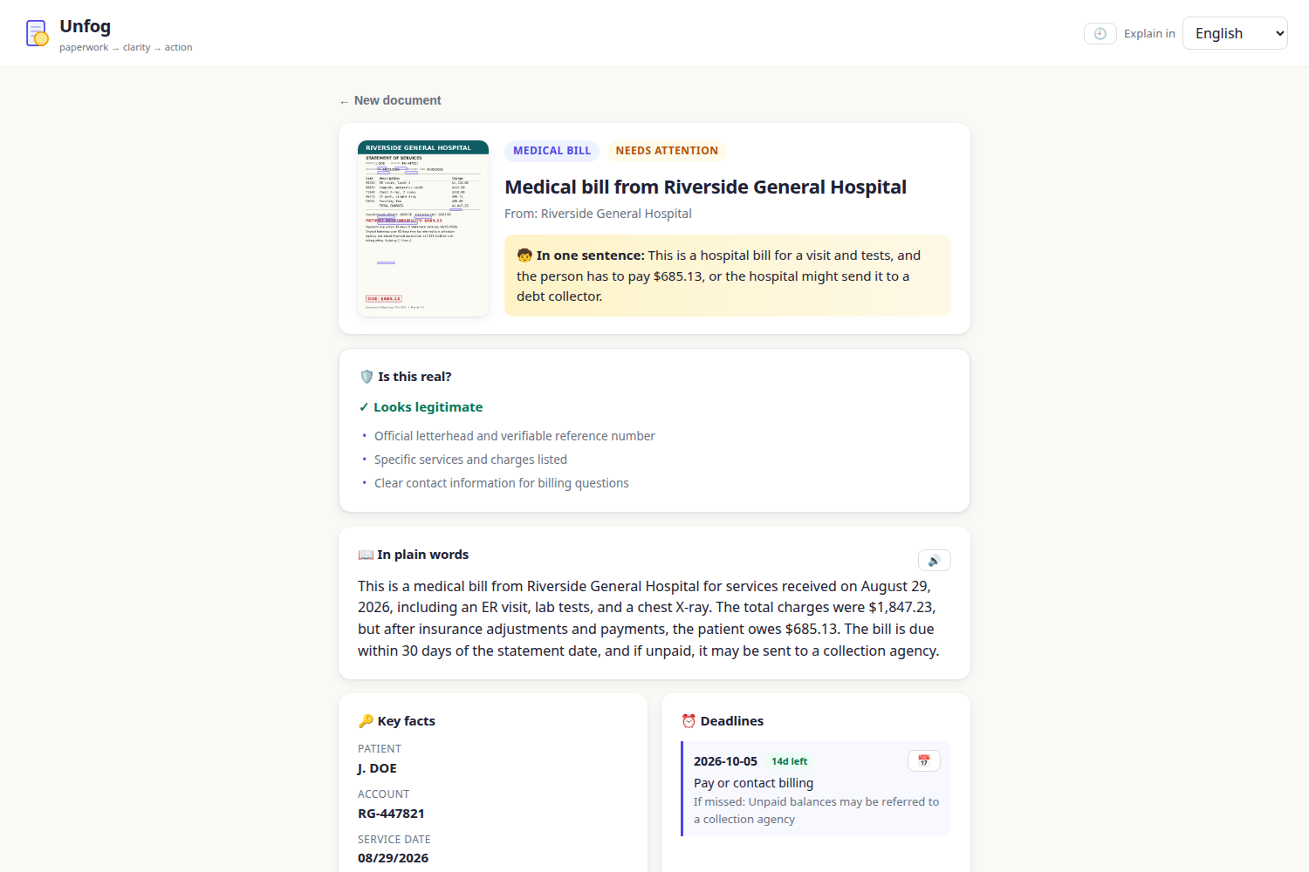
THE SOLUTION
Photo in → clarity and a plan out
github.com/Georgefifth/unfog · unfog-oaye.onrender.com

Slide 4
WHAT IT DOES
Not a summarizer — a decoder
📖 Plain-language summary + ELI5
what it says, in words anyone understands
🎯 Grounded facts
hover a fact → see where it sits on the page (VL bounding boxes)
⏰ Deadlines
countdowns + one-tap calendar export
🛡️ Scam check
is this document even real? gift-card demands, arrest threats flagged
✅ Action checklist
every step has a 'how do I do this' button
✍️ Drafts that know your facts
dispute letters pre-filled with real account numbers
🎭 Call rehearsal
practice the scary phone call — by voice — vs an AI rep
💬 Grounded Q&A + 🌍 12 languages
answers quote your document, not generic advice
github.com/Georgefifth/unfog · unfog-oaye.onrender.com

Slide 5
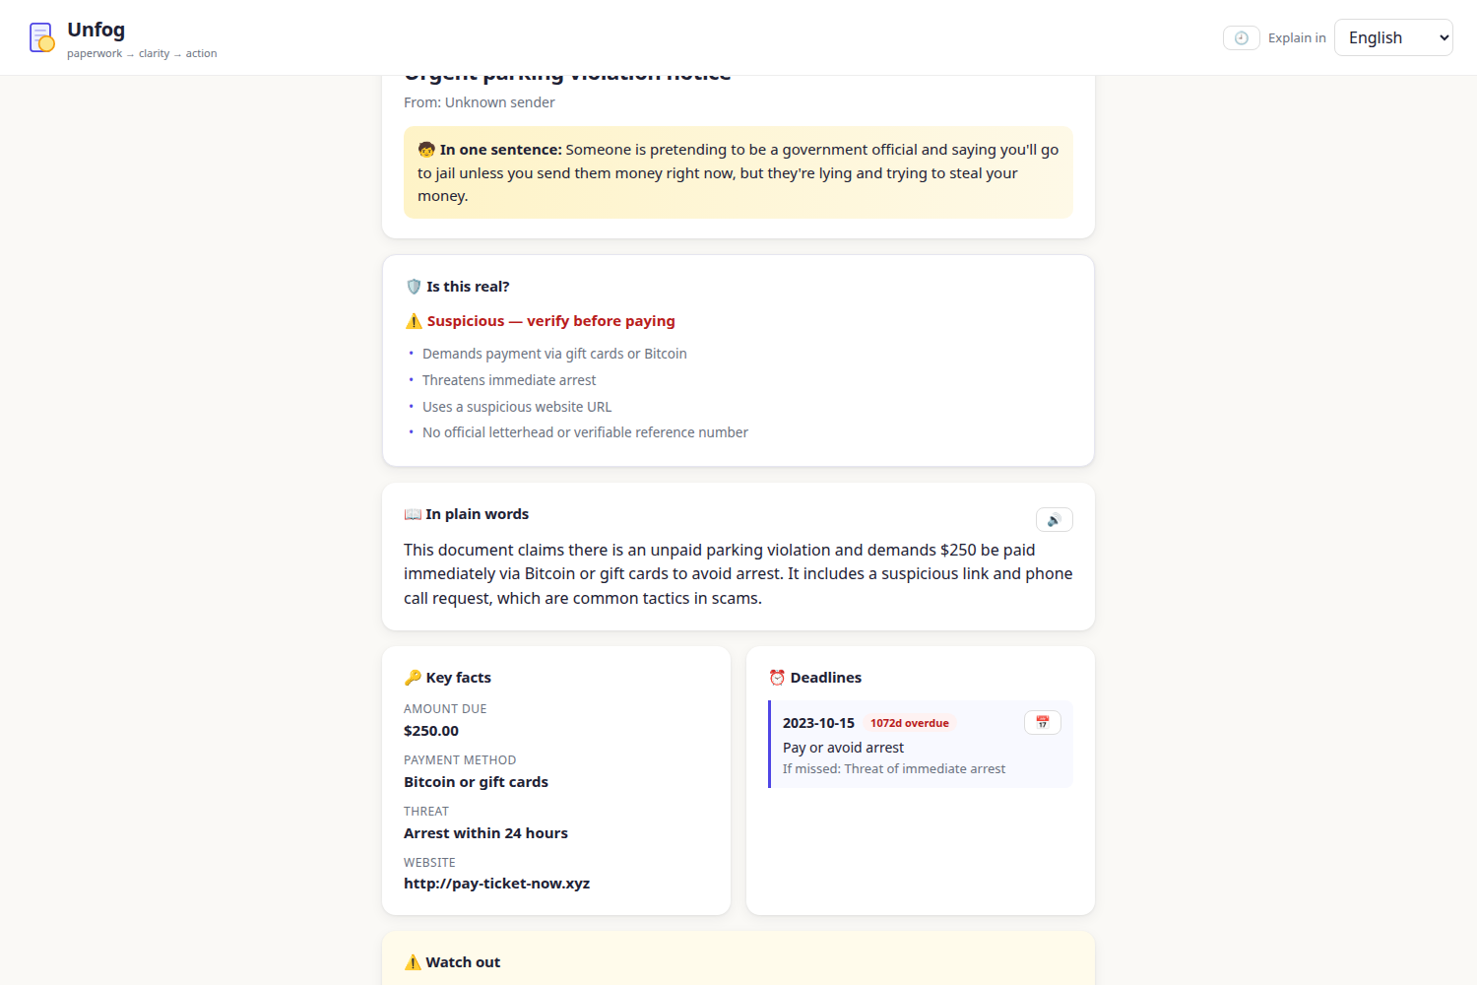
TRUST LAYER
"Is this even real?"
github.com/Georgefifth/unfog · unfog-oaye.onrender.com

Slide 6
HOW IT'S BUILT
Featherless AI, end to end
📷
Photo / PDF / text
🖼️
Pillow + PyMuPDF
preprocess
👁️
Qwen3-VL-30B
vision → JSON + bbox
✍️
Qwen2.5-72B
drafts · chat · roleplay
📱
Vanilla JS UI
SSE streaming
Resilience: multi-model fallback chain
gated models, capacity exhaustion, and '!'-token floods rerouted mid-flight
Streaming everything
SSE token streaming + elapsed timers make 25s cold starts feel instant
Privacy by default
no server storage — history lives in the browser's localStorage
github.com/Georgefifth/unfog · unfog-oaye.onrender.com

Slide 7
CHALLENGES → FIXES
Open models need babysitting
✗ Pure '!'-token floods from upstream
→ detect + reroute to next model mid-stream
✗ Llama weights gated, VL capacity exhausted
→ fallback chain: Qwen2.5-72B → Qwen3-32B → Mistral-Small
✗ Models wrap JSON in chatter
→ defensive extraction + retry loop
✗ Blocking HTTP froze the event loop
→ inference moved to threadpool
✗ 25s+ cold starts
→ SSE streaming, elapsed timers, honest placeholders
github.com/Georgefifth/unfog · unfog-oaye.onrender.com

Slide 8
Nobody should lose money to fine print.
▶ Live demo: unfog-oaye.onrender.com
📦 Code: github.com/Georgefifth/unfog
🎬 Video: demo.mp4 (narrated, 56s)
Next: verified-org lookup · document diffing · deadline push alerts · PWA

