Slide 1



OSS Interface & Functionality Demonstration
COMP2411 Presentation
Rodrigo, Kent, Kasey, Albert, George, Peter

Slide 2
How do we implement the OSS?
A Fully-featured User-friendly Website
With Universe-themed Background
SQL for Database Query and Update
HTML, CSS & Javascript for UI
PHP: Handle the Logic & Connect to the Database

Slide 3


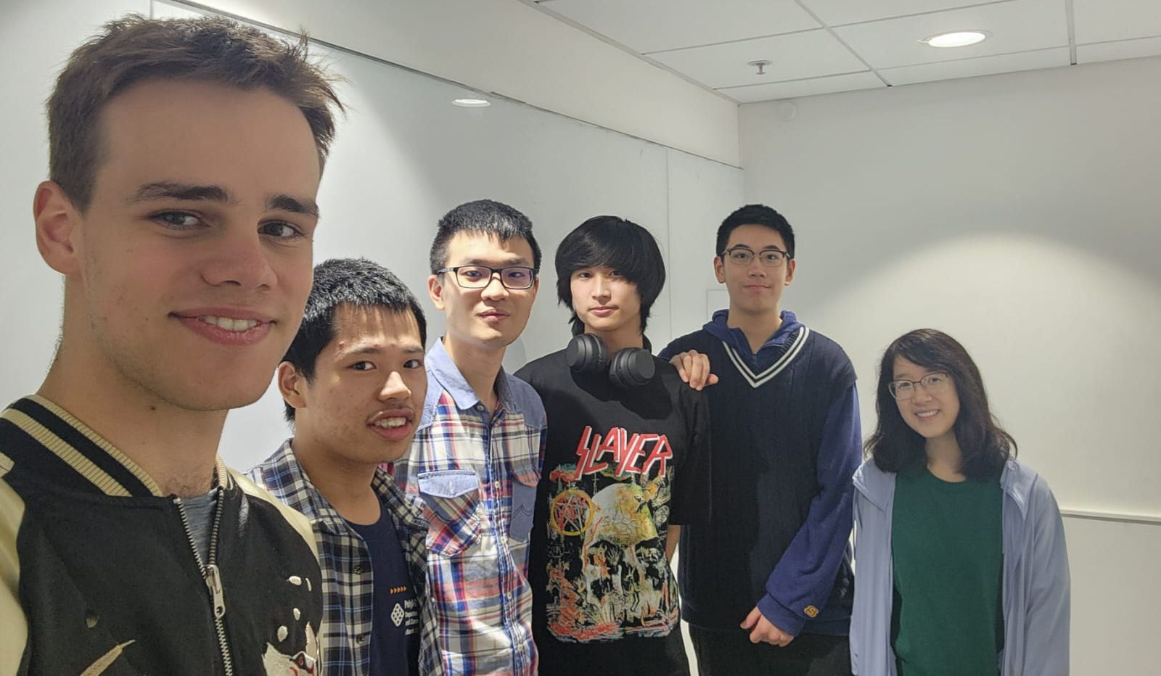
Our Team
UI Team
SQL Team
PHP Team

Slide 4
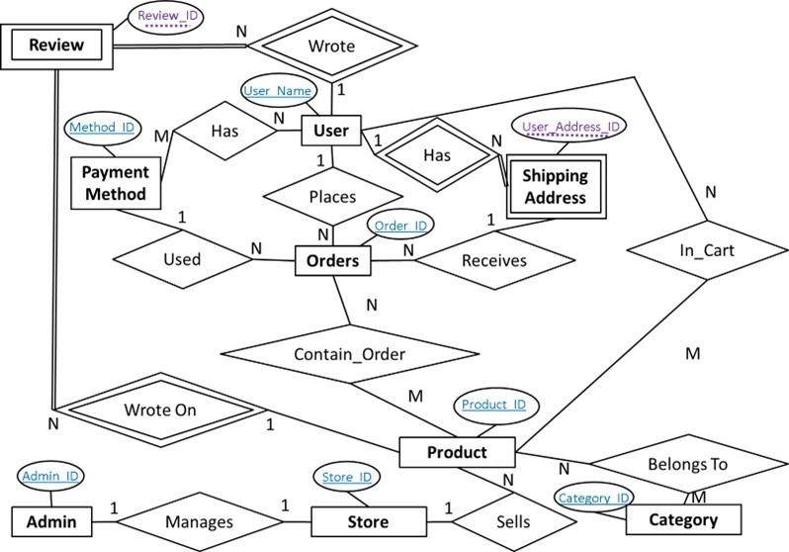

Slide 5




All Our Functionalities
OSS
Login & Signup
Customer Interface
Admin Interface
Product Listing & Search
Checkout
Inventory Search
Report Generation

Slide 6
THANKS
Do you have any questions?
Please keep this slide for attribution

