Slide 1
Understanding Drivers of Earning Above/Below $50k
A walkthrough of the approach, insights, and modelling pipeline.

Slide 2
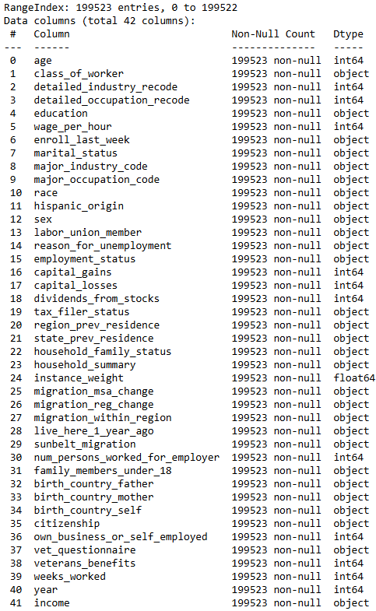
What data are we working with?
Key Characteristics
US Census data from 1994/1995
~300k rows / anonymised individuals
Demographics, education, job features
Target column is binary (>$50k or <=$50k)
Data Health
No nulls/missing values
High target (income) class imbalance:
  Only ~6% of observations above $50k

Slide 3
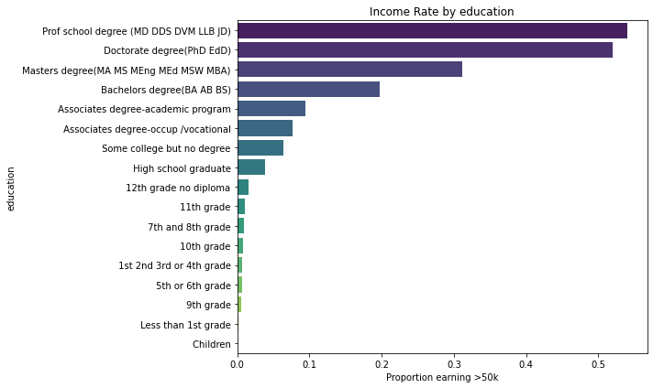
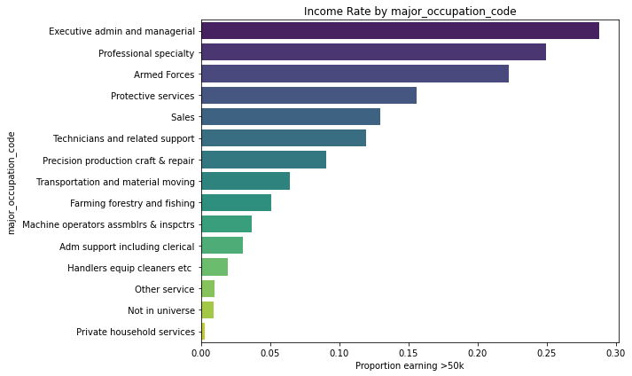
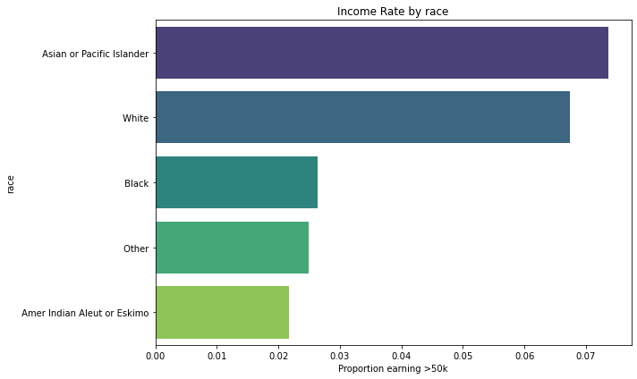
What stood out at first glance?
Education
Occupation
Protected Characteristics
Individuals with higher educational attainment are far more likely to fall into the >$50k income group
Managerial and certain specialised roles show a strong concentration of higher earners compared to other occupations
Demographic groups differ noticeably in income distribution. These patterns reflect broader social and structural factors

Slide 4
Approach to protected characteristics
Race, marital status, gender, age and others should be treated with caution
They will be used as part of this analysis and experimentation piece
For any actions off the back of this or any deployed use cases, an established process should be followed:
  Consultation with Risk area
  Fairness and ethical assessment
  Inclusion into product governance
  Potential masking/exclusion of features
“People should be protected from unsafe or ineffective automated systems, and from discrimination by algorithms.”
- White House Blueprint for an AI Bill of Rights (2022)

Slide 5
Data preprocessing overview
Key Steps
Dropped the “instance_weight” column
Standardized categorical values:
  String conversion
  Whitespace trimming
Retained the “Not in universe” entries
For the models that require it, encoded as follows:
  One-Hot encoding for low cardinality features
  Target encoding for high cardinality features
Normalized any numeric features using Z-score normalization

Slide 6


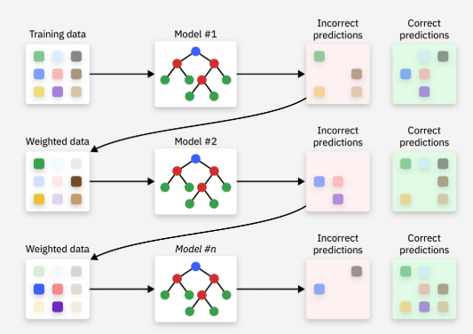
Modelling Approach
Logistic Regression
Random Forest
CatBoost
Parametric model tailored for binary classification
Highly interpretable
Fast to train
Strong baseline for benchmarking
Ensemble of decision trees
Captures non-linear relationships
Flexible tuning via hyperparameters
Robust to outliers
Gradient boosting model
Optimised for categorical data
Does not require heavy preprocessing
Generalises well on test data

Slide 7
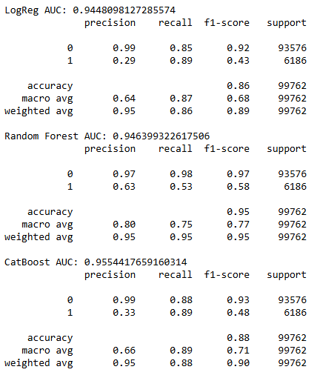
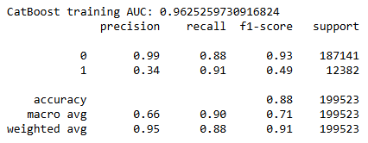
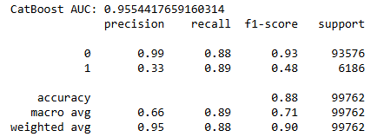
Which model performed best?
CatBoost is the clear winner
Overfitting is not a concern
Accuracy
Logistic Regression: 86%
Random Forest: 95%
CatBoost: 88%
..but this does not paint the bigger picture!

Slide 8
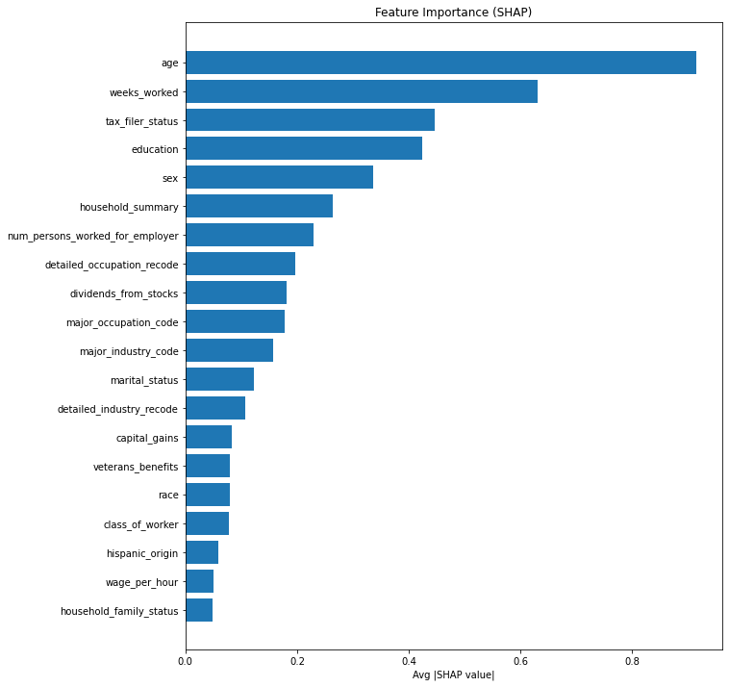
What drives high income in the model?
The top five features in terms of importance for the model are:
Age
Weeks worked (within the last year)
Tax filer status
Education
Sex
These are largely in line with the observations from the initial EDA
But how do these features impact the output?

Slide 9
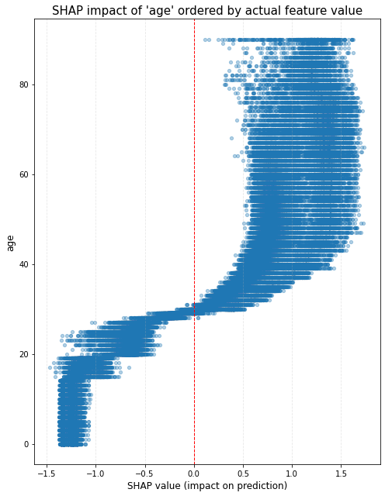
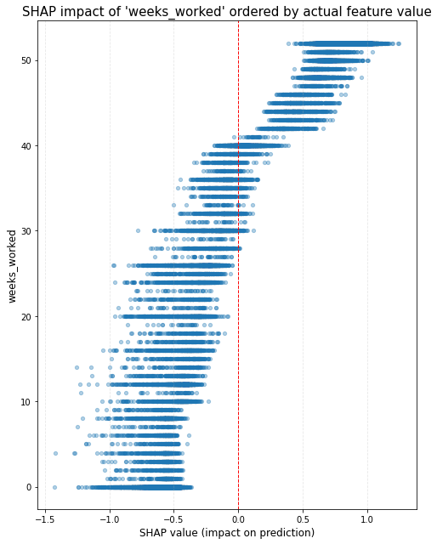
Visualizing the impact (1)

Slide 10
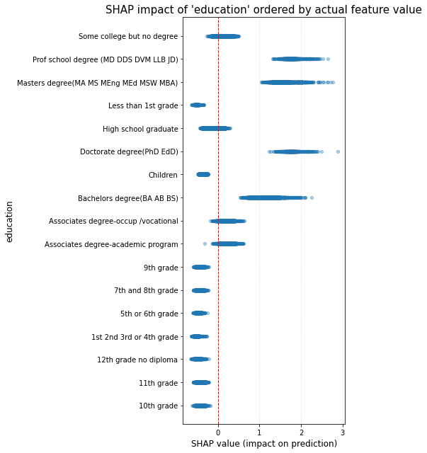
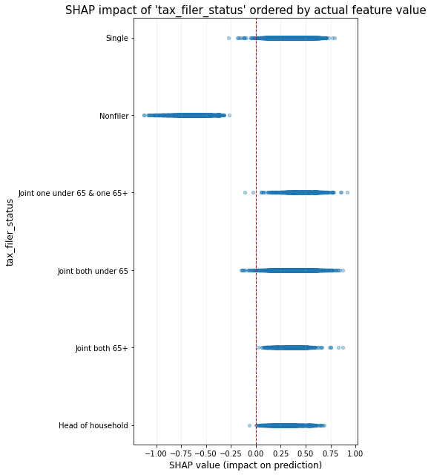
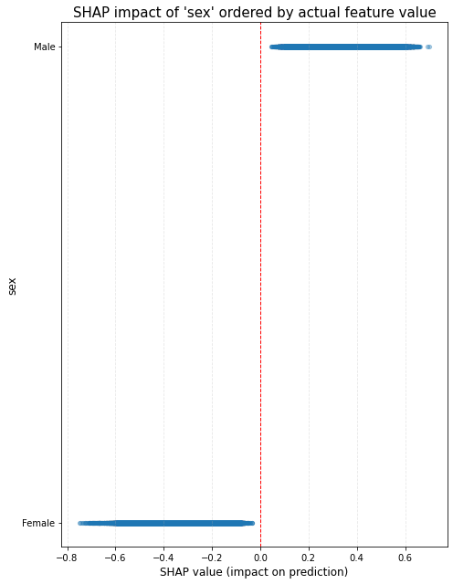
Visualizing the impact (2)

Slide 11
Limitations & future work
Limitations
Protected characteristics included in the analysis but would likely not be used in a production setting for any inference
The binary target limitation: modelling a more granular target (either buckets of income or numerical values) might uncover more nuanced relationships in the data
Correlation does not equal causation – the underlying cause-and-effect relationships will need to be examined to eliminate the risk of making discriminatory and costly decisions
Future work
Undertake further feature engineering (e.g. buckets for high cardinality categorical features, log transforms for outliers)
Improve CatBoost’s performance by hyperparameter tuning
Productionize the notebook code into reproducible and tested pipelines (incl. data refresh, training, prediction and monitoring)
Use Data Science Studio to create a monitoring dashboard and deploy the model as an API endpoint for inference

Slide 12
Questions

