Slide 1
PROCESSING: Play Samples
Interactive Media 31080/32027

Slide 2
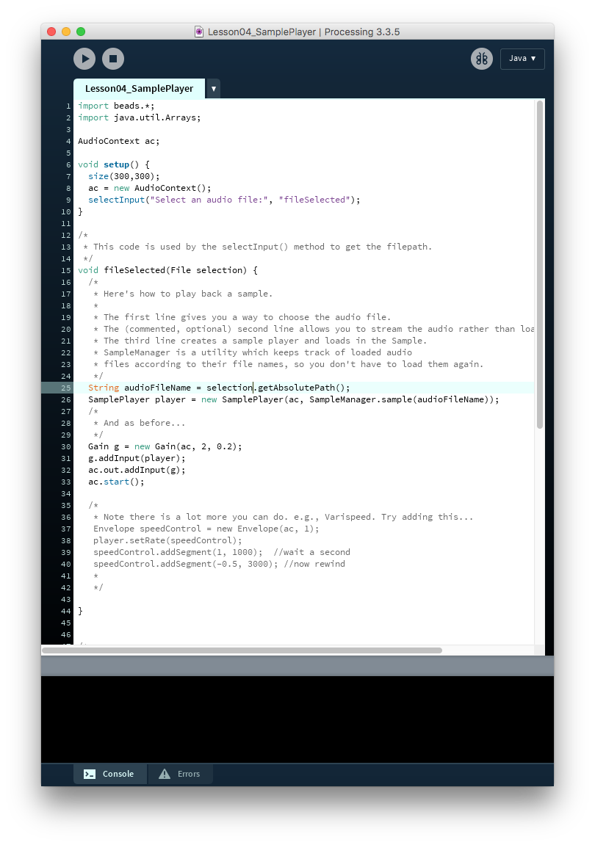
Play a Sample
SamplePlayer is an object you can use to play a sound file.
You can select the file or give a direct path to some files. This loads it into memory.
Then you need to play it out of a chain like a WavePlayer.

Slide 3
Stereo or Mono Sample?
Many samples are 1-channel mono samples, while many others are 2-channel stereo. Stereo files have the individual samples interleaved in the file.

Slide 4
Panner
Input
Pan = 0.5
* -1 + 1
*
*
Panning is the application of proportional gain to move sounds between two speakers.

Slide 5
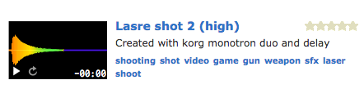
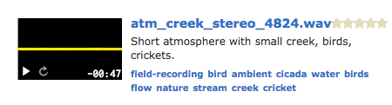
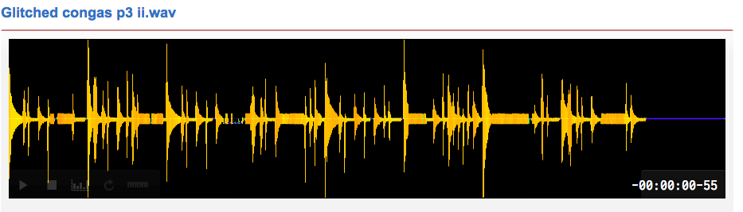
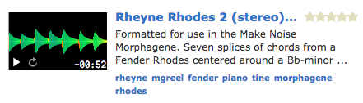

Samples of Different Types
Samples of different sounds should be used in various ways.
1-hit
Background noise
Rhythmic (or chordal) sound
Pad
Speech

Slide 6
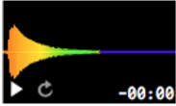
Sample play rate
The sample playback rate determines proportionally determines its pitch and duration relative to the normal sample rate.

Slide 7
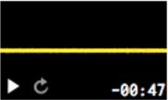
Sample Looping
Some samples, like background sound or rhythmic samples, can be looped.
Looping just means replaying it exactly after it finishes.
Rhythmic samples need to edited exactly, otherwise the looping doesn’t work.

Slide 8
Sample Groups
For various samples, especially 1-hit, the sounds can be repetitive if they are replayed.
Sample groups - folders of sounds which all sound nearly, but not identically, the same, can solve this through allowing random selection.

Slide 9
Delays
Input
Feedback
Delay is a simple effect made by storing the sound and replaying it a short time later like an echo.
It requires a ‘delay buffer’, a ‘record head’ and a ‘play head’. Sometimes there is also a feedback loop.
Buffer
*
Output
Direct Out

Slide 10
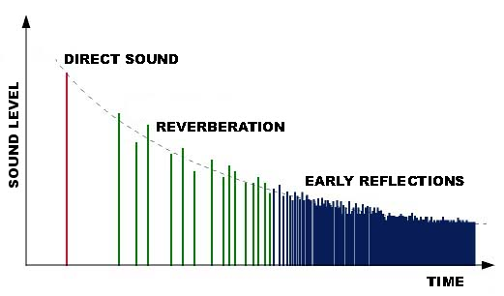
Reverb
Reverberation is a simulation of the effect of sound bouncing around a room.
There is the direct sound first, followed by a number of distinct reflections from each large surface (e.g. walls) followed by the later, more chaotic, reflections.

Slide 11
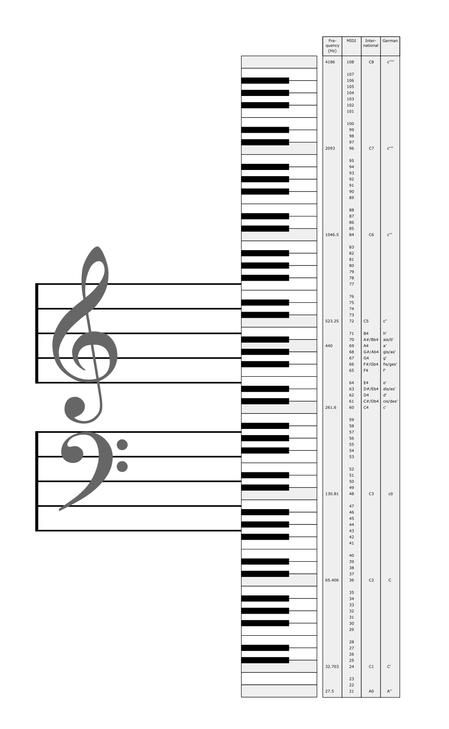
Scales
Musical notes are drawn a scale generally. This scale is a selection of notes from a 12 note space.
There are many scales and modes (related to scales), but the most common are the minor and the major scale.

Slide 12
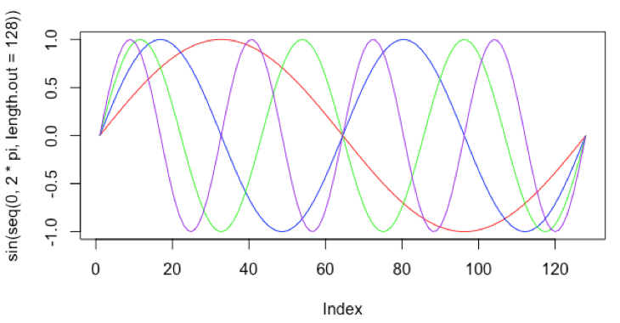
Octaves and Harmonics
The harmonic series describes the relationship between waves. Integer multiples of a waveform result in pitches that resonate in the same dimensions.

Slide 13
CONCLUSION
Hopefully you now:
Can play Samples and control their rate
Can apply effects like Delay and Compression
Can use Frequency Modulation Synthesis
Use Low Frequency Oscillators
Use Chords and Harmony

