Slide 2
Email was never built for teams to collaborate
sales@company.com support@company.com
? ?
?
Productivity slowdown
Lost business
Bad customer experience

Slide 3

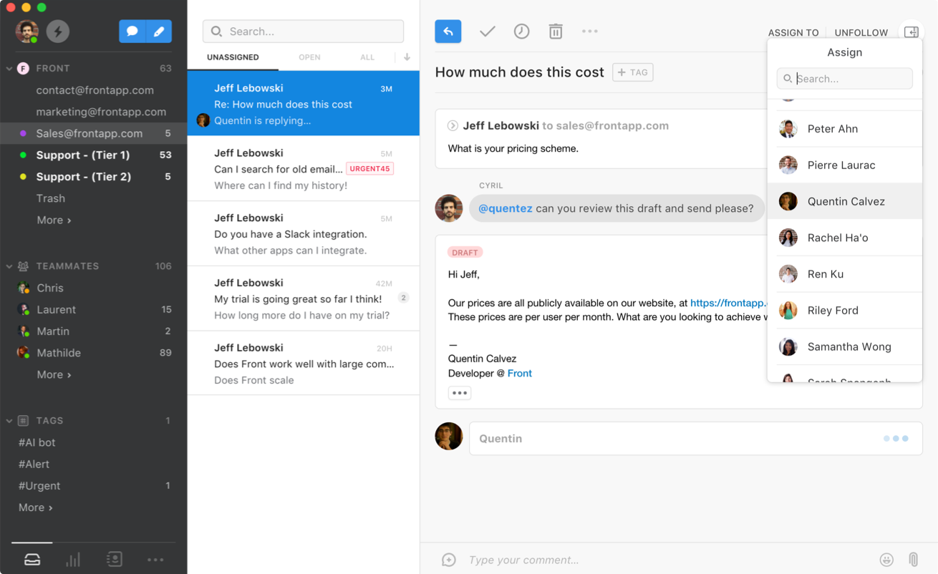
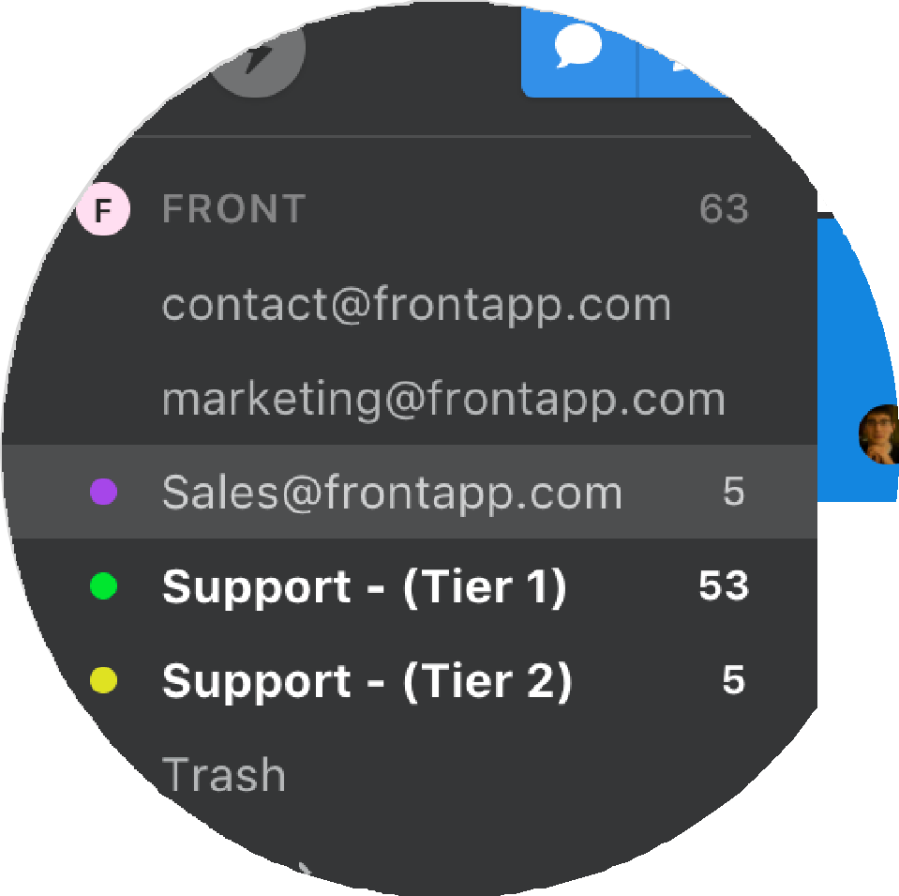
So we built the first shared email client

Slide 4

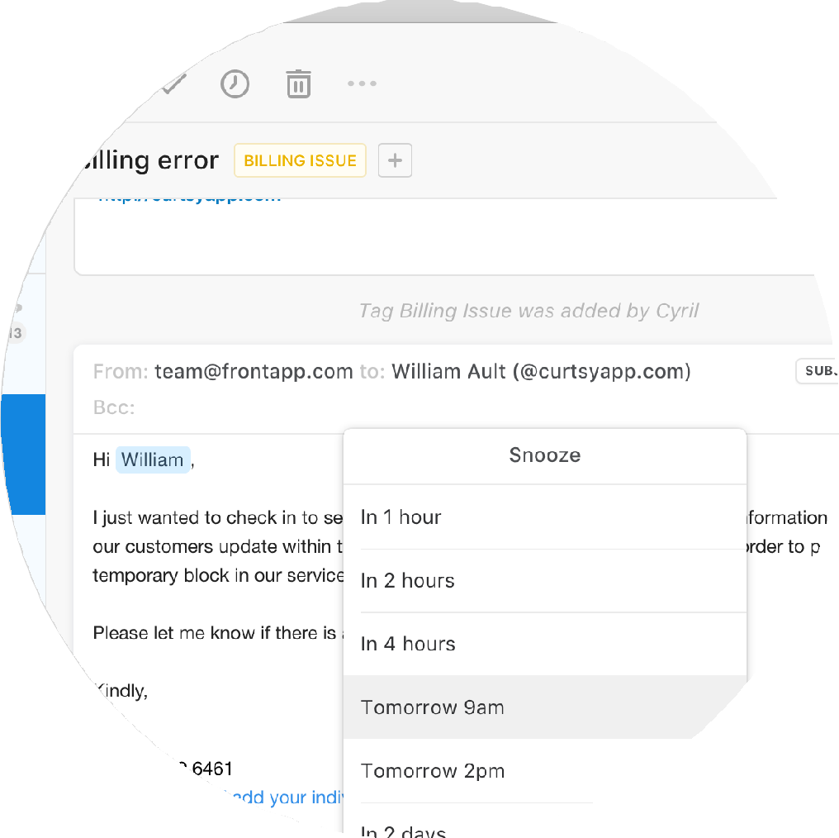


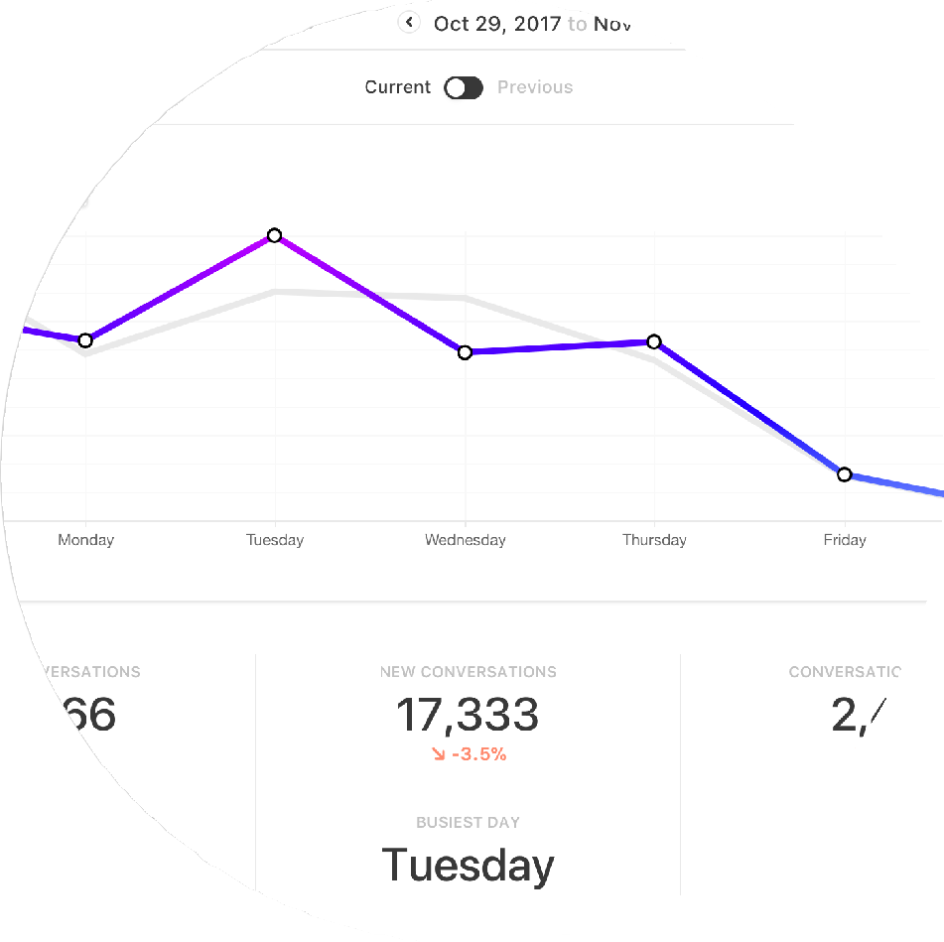
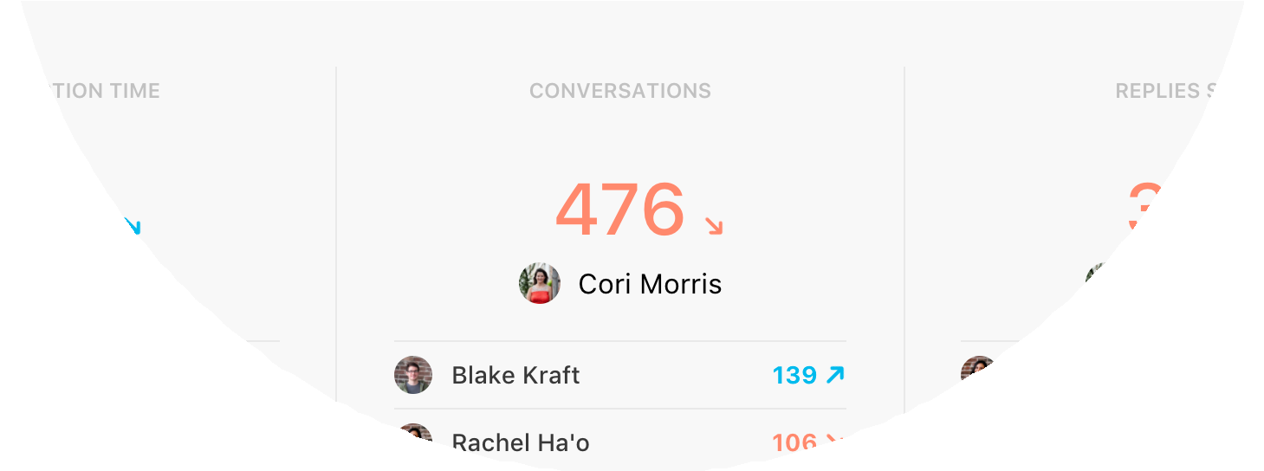
So we built the first shared email client
Automated rules
Assign email
Reminders
Comment & mention
Canned answers
Share draft
Robust analytics

Slide 5



We rapidly broadened our value proposition
Multi-channel
Individual yet collaborative
Integrated
Shared Email
Collaborative Communication

Slide 6







2300 companies use Front today
Diversity of industries
Diversity of use-cases
Tech Media Travel
Client Services Ecommerce Cons. goods Education Finance Real estate Logistics
Other
Customer Support Client Services
IT
Operations
Sales Admin., HR, Legal
Marketing
Product & eng.
Other
0%
10%
20%
30%
40%
0%
10%
2
0%

Slide 7
A very consistent growth of revenue
ARR

Slide 8
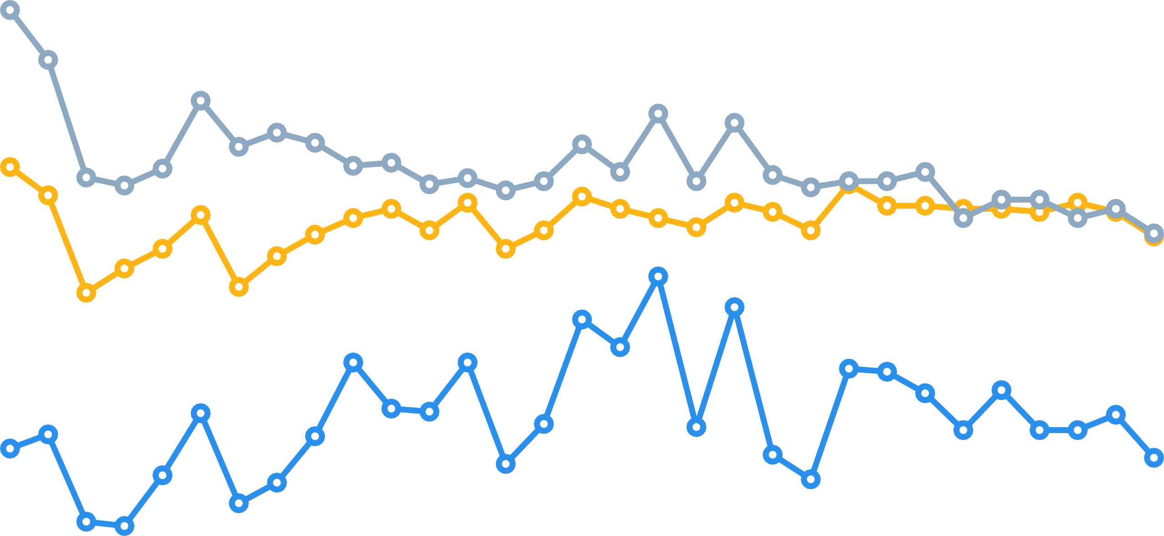



Churn keeps trending down…
Gross churn Net MRR churn Logo churn

Slide 9
… while usage grows exponentially
Messages sent
Individual email users
Comments & mentions

Slide 10
Building a predictable sales organization (1/2)
Growing team
Delivering above capacity
12
9
6
3
0
Q1 17 Q2 17
Fully ramped reps
Q3 17
Q1 17
Q2 17 Q3 17
Reps ramping up
Actual sales
Sales capacity

Slide 11

Building a predictable sales organization (2/2)
ASP up every quarter
More large deals
10
5
0
Q2 16 Q3 16 Q4 16 Q1 17 Q2 17 Q3 17
Q3 14
Q3 15
Q3 16
Q3 17
customer 1
Transportation
$xx ARR xx seats
customer 2
Operations Management
$xx ARR xx seats
customer 3
Online Retail
$xx ARR xx seats

Slide 12





Building a lead generation engine from scratch
More marketing spend Lead growth
Unpaid Paid
Q1 17
Q2 17
Q3 17
Q1 17
Q2 17
Q3 17
On a sustainable trajectory
Q1 17 Q2 17 Q3 17
18% 18% 19%
2.5 2.6 4.4
The team isn’t one year old
joined 6 months ago
Spend as
% of revenue
LTV / CAC
2 weeks ago
10 months ago
2 months ago
10 months ago

Slide 13
Cohorts keep growing across all metrics
All cohorts keep growing ACV doubled in 15 months
120% net retention rate at 6 months
150% net retention rate at 1 year
Q2 16 Q3 16 Q4 16 Q1 17 Q2 17 Q317
Usage intensifies over time
3.9x more messages sent per user after 1 year
4.9x more comments written per user after 1 year
EOY15
Q2 16
Q4 16
Q2 17
Q3 17

Slide 14




Team growth is built upon solid foundations
Headcount evolution
Low attrition
60
0
voluntary departures among
employed for more than 3 months
45
30
15
0
3/1/15
11/1/15
7/1/16
3/1/17
11/1/17
Highest Glassdoor metrics
Last team offsite ratings
40
30
20
10
0
5.0
100%
Recommend to a friend
100%
Approve of CEO
Mathilde Collin
17 Ratings
1
2
3
4
5

Slide 15
We have a track record of capital efficiency
Seed to Series A
$3.1m raised
$xx spent
$xx ARR added
Series A to date
$10m raised
$xx spent
$xx ARR added
“Default alive” †
Profitable in 10 months
Cash on hand
Runway *
$7m left
18 months
* assuming current spend and 0% growth
† assuming no hiring and 5% monthly growth

Slide 16
As a business, we are in a great position
Aiming for $xx ARR by end of 2018
Positive operating margin by end of 2019
100%
75%
50%
25%
0%
-25%
-50%
-75%
-100%
1/1/18
5/1/18
9/1/18
12/1/18
1/1/18 5/1/18
Gross margin
9/1/18 12/1/18
Operating margin
ARR
Cash

Slide 17
Where do we go from there?

Slide 18






As a product, we are in a unique position
Unreasonable stickiness
Access to critical data
Relevant across all teams
2.5 hours
per user per day
Messages
Files
64%
DAU / MAU ratio
Contacts
Meetings

Slide 19


Our two areas of focus for 2018
Add more users to make our platform more valuable
Improve our platform to make it easier to build on top of it

Slide 20





Our two areas of focus for 2018
Add more users to make our platform more valuable
Maintain leadership on our core targets
Improve our platform to make it easier to build on top of it
Ship our new Extension API
Become a great email client
Extend our collaborative model beyond messaging
Ship products that expand our value proposition
Launch an app-store, host 3rd party apps

Slide 21
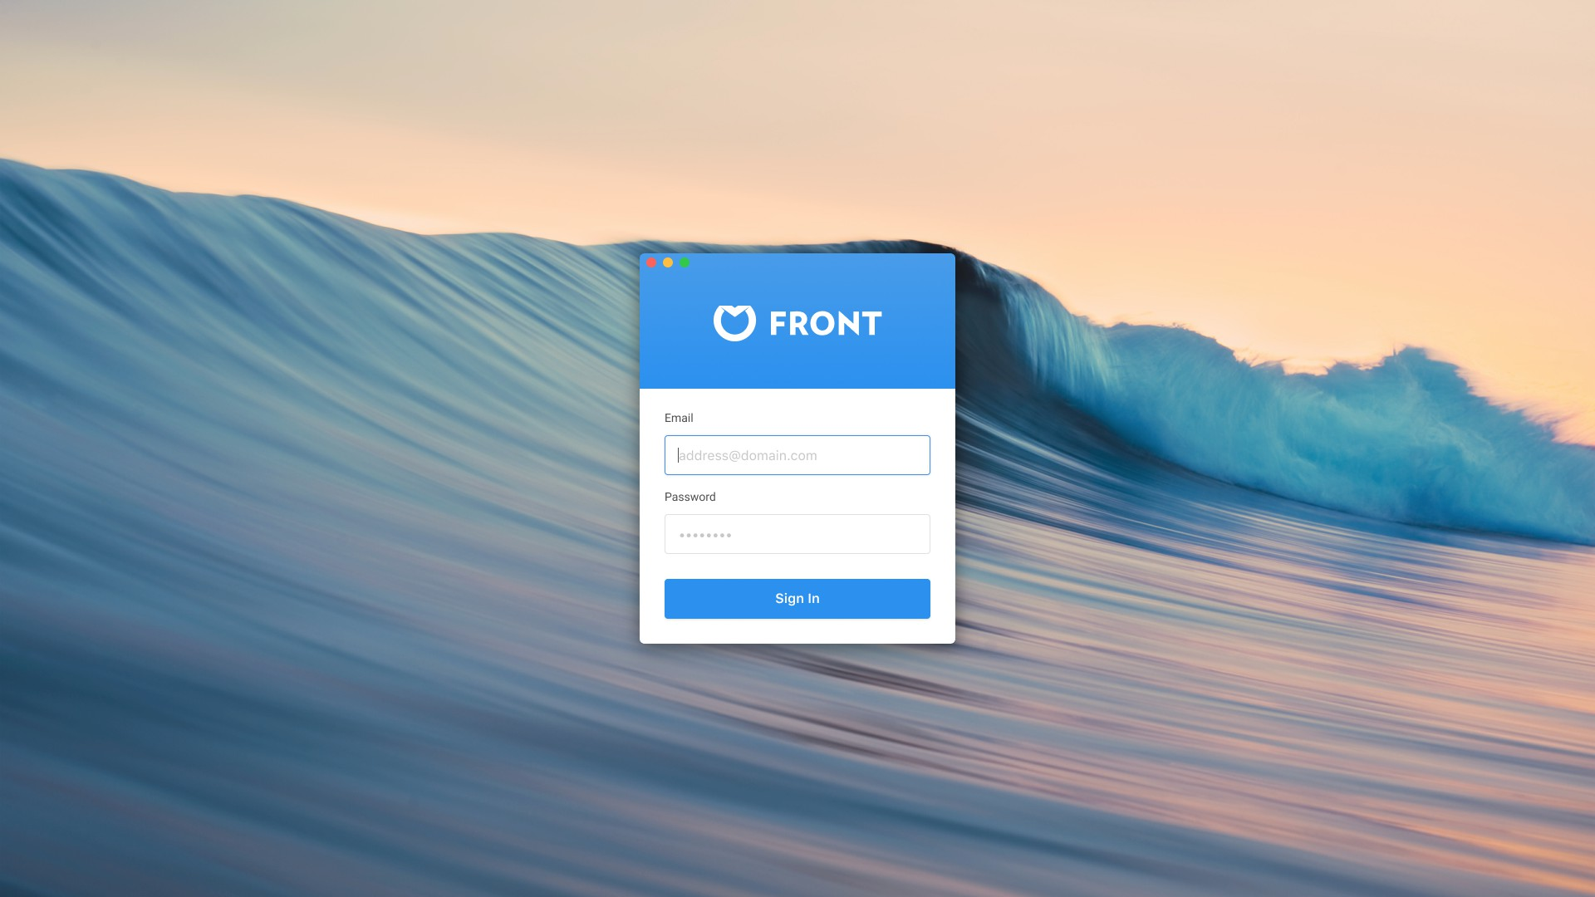

Long-term vision

Slide 22

Long-term vision
Head over to frontapp.com/jobs if you want to find out more about our long term vision

Slide 23


Raising our Series B
Confidential
Good email client Extensible platform
Collaborative Communication
Shared email address
We are here
$xx ARR
$xx ARR
$xx ARR
$xx ARR

Slide 24
Thanks

