Slide 1


Slide 2

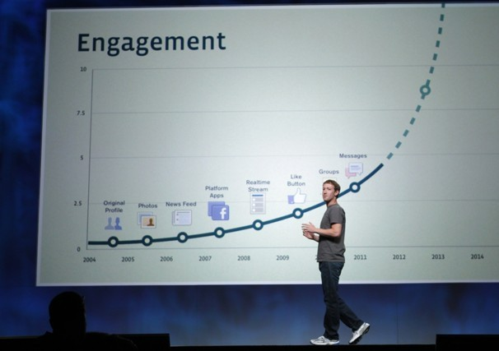

Social, the most important trend
“the amount a user shares today is twice the amount they shared a year ago”
- Zuckerberg’s Law
“it won’t be long before Social Media Marketing will surpass SEO” - Donanza

Slide 3

How do you use social to drive traffic?

Slide 4

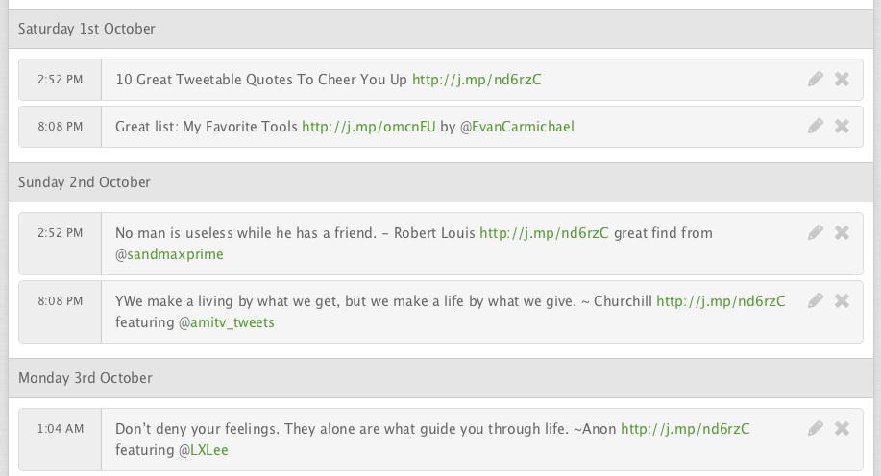
Queue your updates

Slide 5

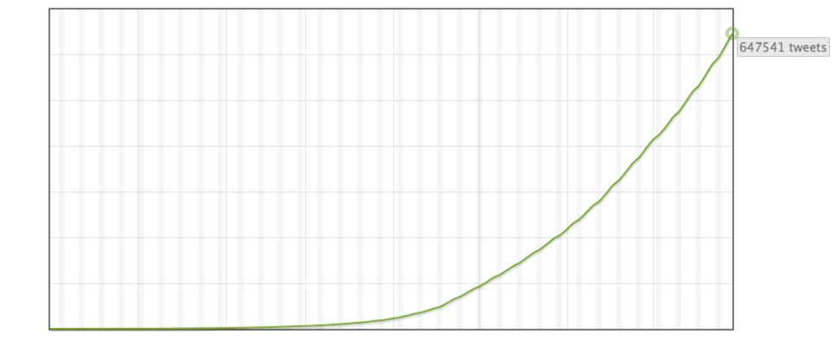

Traction
800 Paying Users
$150,000 annual revenue run rate
97% margins
55,000 users, growing 40% per month
1.5 million updates Buffered

Slide 6

Milestones
Launched web app
January 2011
55,000 users ($150K revenue)
October 2011
Launch the API
October 2011
Integrated in 50 apps
December 2011
100,000 users ($288K revenue)
January 2012
1 million users ($3.6M revenue)
January 2013

Slide 7

Business Model
Freemium model with consistent 2% conversion from Free to Paid plans
5% churn equates to a LTV of $240 and allows us to pay up to $5 to acquire a free user
At 1M users, our projected revenue is $3.6M

Slide 8

Social Media Landscape
Of 200M daily Tweets, 55% contain links
4 billion items shared on Facebook per day
Zuckerberg’s Law shows exponential growth of sharing
Traffic through social is soon to surpass traffic from search

Slide 9

The effect of Buffering
“Buffer Finds Tweet Scheduling Can Increase Clicks by 200%”

Slide 10

A sharing standard
6 integrations so far
in talks with Reeder, Pocket and Feedly
We plan to become the default sharing standard in any app

Slide 11
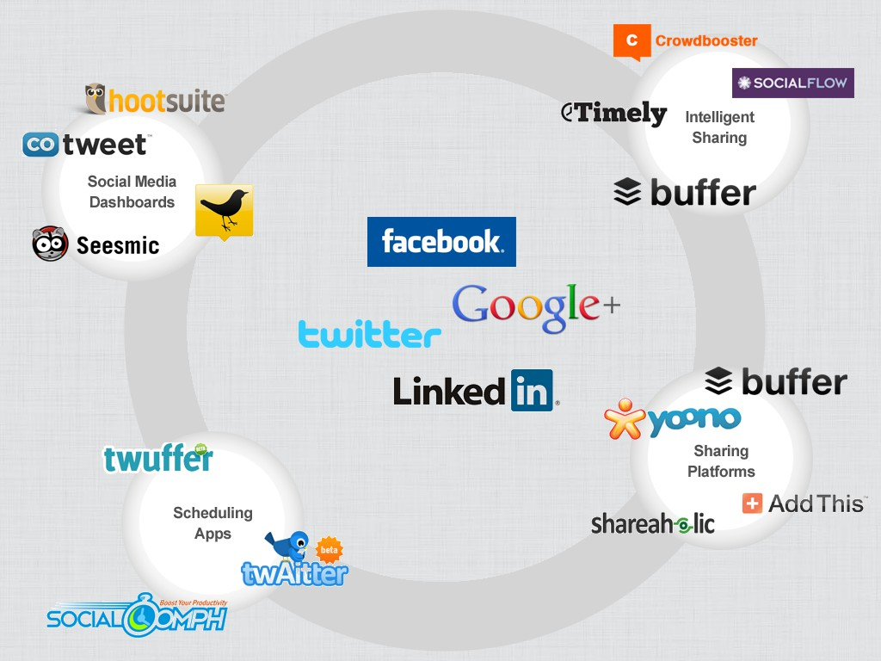
Competitive Landscape
Competition
• Dashboards: Hootsuite, CoTweet, TweetDeck, Seesmic
• Intelligent sharing: CrowdBooster, SocialFlow, Timely, Buffer
• Publishers: Shareaholic, AddThis, yoono, Buffer
• Scheduling apps: SocialOomph, Twaitter, LaterBro, Twuffer
• Our differentiation: a platform approach

Slide 12





Team
Joel Gascoigne
Co-Founder, took the idea to revenue in 7 weeks, Masters in CS
Leo Widrich
Co-Founder, marketeer, took Buffer from 200 to 55,000 users
Advisors
Guy Kawasaki
Former Chief Evangelist of Apple. Co-Founder of Alltop. Author of ten books
Previous Investors
Hiten Shah
CEO / Co-Founder of KISSmetrics. Previously started CrazyEgg & ACS

Slide 13

founders@bufferapp.com

