Slide 1
Lecture 6: Continuous Models - Part 2
Intro to Data Science for Public Policy
Jeff Chen

Slide 2
Roadmap
Motivation
Regularization
KNN
Homework assignment
Intro to Data Science for Public Policy

Slide 3

Regularization

Slide 4

Regularization

Slide 5
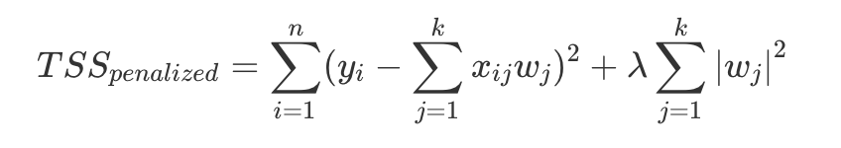

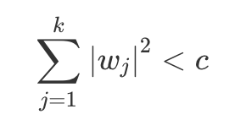
Regularization

Slide 6
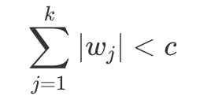
Regularization

Slide 7
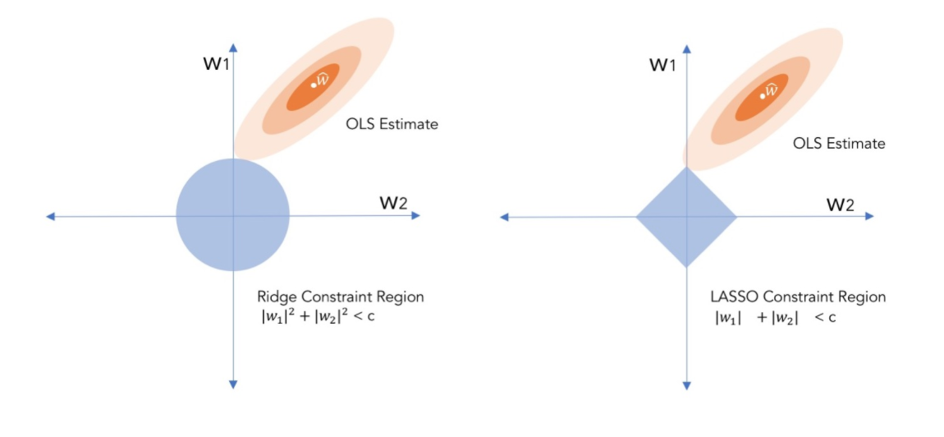
Regularization

Slide 8
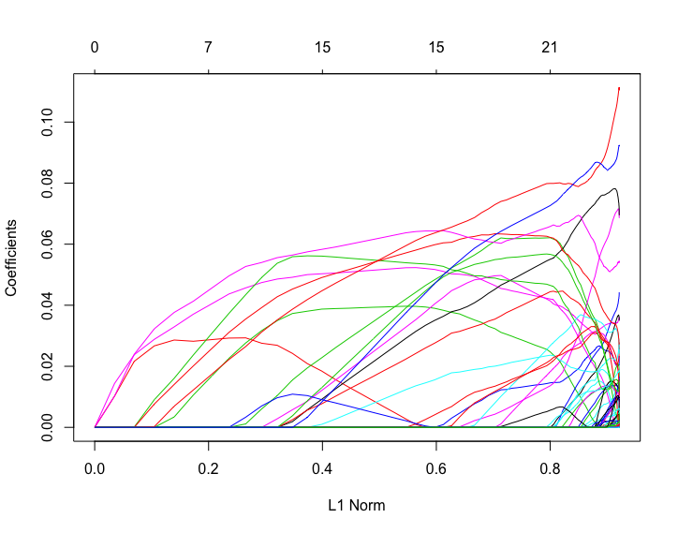
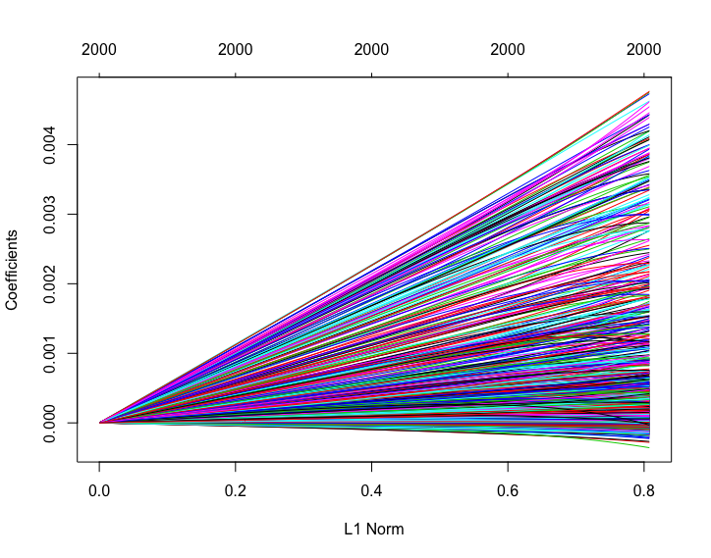
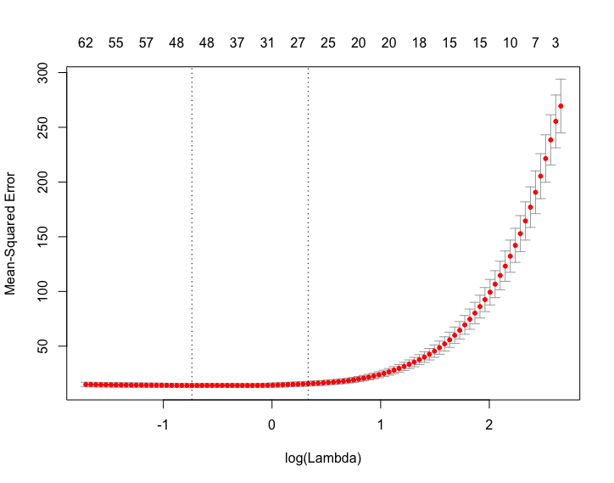
Regularization

Slide 9
Regularization

Slide 10
Roadmap
Motivation
KNN
Homework assignment
Intro to Data Science for Public Policy

Slide 11
Given buildings on a grid, how would you predict whether the green buildings will catch fire?
Bldg 1
Bldg 7
Bldg 13
Bldg 19
Bldg 25
Bldg 31
Bldg 2
Bldg 8
Bldg 14
Bldg 20
Bldg 26
Bldg 32
Bldg 3
Bldg 9
Bldg 15
Bldg 21
Bldg 27
Bldg 33
Bldg 4
Bldg 10
Bldg 16
Bldg 22
Bldg 28
Bldg 34
Bldg 5
Bldg 11
Bldg 17
Bldg 23
Bldg 29
Bldg 35
Bldg 6
Bldg 12
Bldg 18
Bldg 24
Bldg 30
Bldg 36
KNN
OLS

Slide 12
From the visual, we can see spatial clusters of activity. Perhaps there isn’t a grand unifying formula for fires…
Bldg 1
Bldg 7
Bldg 13
Bldg 19
Bldg 25
Bldg 31
Bldg 2
Bldg 8
Bldg 14
Bldg 20
Bldg 26
Bldg 32
Bldg 3
Bldg 9
Bldg 15
Bldg 21
Bldg 27
Bldg 33
Bldg 4
Bldg 10
Bldg 16
Bldg 22
Bldg 28
Bldg 34
Bldg 5
Bldg 11
Bldg 17
Bldg 23
Bldg 29
Bldg 35
Bldg 6
Bldg 12
Bldg 18
Bldg 24
Bldg 30
Bldg 36
KNN
OLS

Slide 13
What if the 4 nearest buildings provide the most information?
Bldg 8
No buildings caught fire, meaning 0% chance that Bldg 29 will catch fire
Bldg 3
Bldg 9
Bldg 15
Bldg 10
Bldg 28
3 bldgs with fire means a 50% chance that Bldg 9 will catch fire
Bldg 23
Bldg 29
Bldg 35
Bldg 30
OLS
KNN

Slide 14
What if the 8 nearest buildings provide the most information?
Bldg 2
Bldg 8
Bldg 14
2 bldgs caught fire, meaning 25% chance that Bldg 29 will catch fire
Bldg 3
Bldg 9
Bldg 15
Bldg 4
Bldg 10
Bldg 16
Bldg 22
Bldg 28
Bldg 34
6 bldgs with fire means a 75% chance that
Bldg 9 will catch fire
Bldg 23
Bldg 29
Bldg 35
Bldg 24
Bldg 30
Bldg 36
OLS
KNN

Slide 15
Which is better if both buildings actually caught fire?: k = 4 or k = 8?
Correctly Predicted
k = 4
1 of 2
k = 8
2 of 2
KNN
OLS

Slide 16
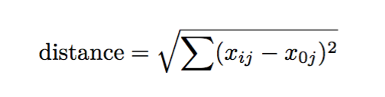
kNNs assume that observations that are closer together are more related. Relatedness can be represented by the k-number of nearest records as measured by distance of variables.
KNN
OLS

Slide 17
Start
Training model
For each observation for a given k
Calculate distance to all other records
If continuous, calculate mean of Y for k-nearest records
If discrete, calculate proportion Y=1
Done!
If Error is acceptable?
Y
N
Predict and calculate error based on validation
If continuous, calculate RMSE or MAPE
If discrete, calculate AUC or ROC
Repeat process for k to k ≤ n
Compare error across all k’s
KNN
OLS Process

Slide 18
KNN Assumptions
All input features need to be scaled similarly.
All input features have equal weight.
Uncommon assumption: While KNN is a non-parametric method, high collinearity should be kept to a minimum such that redundant variation is not disproportionately represented.
KNN
OLS

Slide 19
KNN Good/Bad
Good for low dimensional data (few variables)
Good for when no theory exists
Good for imputation of missing values
Bad for high dimensional data as each observation needs to be processed
Bad if data contains both discrete and continuous
Bad if you want an interpretation
KNN
OLS

Slide 20
Coded example
KNN

Slide 21
Roadmap
Motivation
Regularization
KNN
Homework assignment
Intro to Data Science for Public Policy

