Slide 1
Lecture 6: Continuous Models - Part 2
Intro to Data Science for Public Policy
Jeff Chen

Slide 2
Roadmap
Regularization
KNN
Homework assignment
Intro to Data Science for Public Policy

Slide 3
Microarrays
Regularization

Slide 4
Google search
Regularization

Slide 5
Google search
Regularization

Slide 6
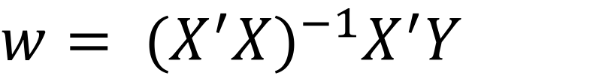
The typical notation for estimating coefficients in a linear regression
$${w= (X^{′}X)}^{−1}X^{′}Y$$
Transpose of X multiplied by X
Transpose of X multiplied by Y
Inverse
Regularization

Slide 7
What if k > n??
$${w= (X^{′}X)}^{−1}X^{′}Y$$
Unlikely to have an invertible solution (a ’singular matrix’. Even as k approaches n, we run the risk of having overly sensitive estimates.
Regularization

Slide 8
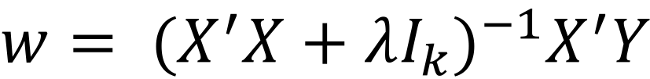
Regularization in regression reduces noisy coefficients – cuts the slack.
Add a bias term in the form of a constant times an identity matrix
$${w= (X^{′}X+λI_{k})}^{−1}X^{′}Y$$
Transpose of X multiplied by X
Bias Term
Transpose of X multiplied by Y
Inverse
Regularization

Slide 9
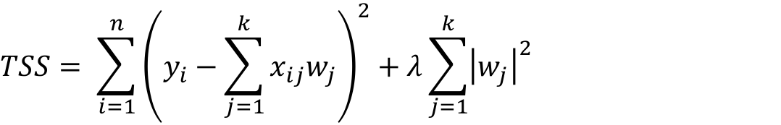
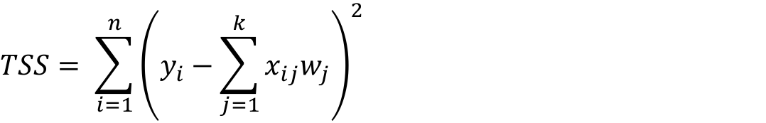

The bias term essentially equates to a constraint on the Total Sum of Squares:
$$TSS= \sum_{i=1}^{n}{{\left(y_{i}−\sum_{j=1}^{k}{x_{ij}w_{j}}\right)}^{2}+λ\sum_{j=1}^{k}{{\left|w_{j}\right|}^{2}}}$$
or
$$TSS= \sum_{i=1}^{n}{{\left(y_{i}−\sum_{j=1}^{k}{x_{ij}w_{j}}\right)}^{2}}$$
$$\sum_{j=1}^{k}{{\left|w_{j}\right|}^{2}<c}$$
subject to
Where c is a constant that is typically is identified through cross validation.
Regularization

Slide 10
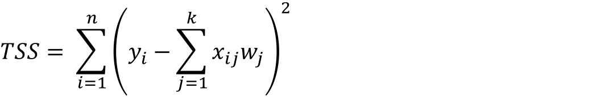

What is this really saying?
$$\sum_{j=1}^{k}{{\left|w_{j}\right|}^{2}<c}$$
$$TSS= \sum_{i=1}^{n}{{\left(y_{i}−\sum_{j=1}^{k}{x_{ij}w_{j}}\right)}^{2}}$$
subject to
Ok, team. We have to do more with less.
Yes’m!
How do we do if c = 0.9
20 coefs left, MSE = 4
How about c = 0.7
15 coefs left, MSE = 3
How about c = 0.6
10 coefs left, MSE = 3.5
Ok, c = 0.7 it is.
Regularization

Slide 11
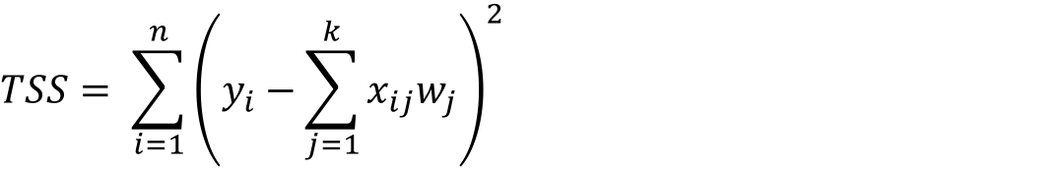

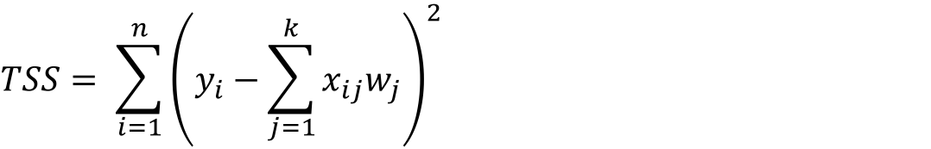

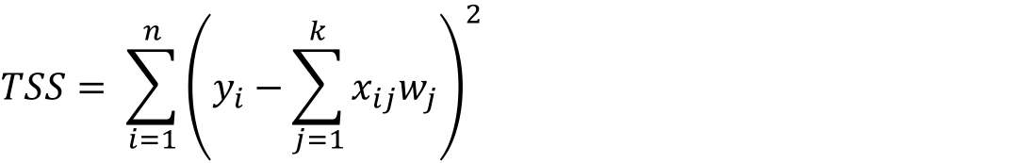
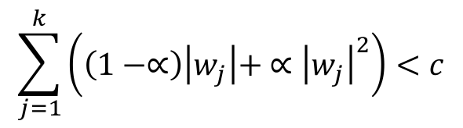
Various types of regularization
$$TSS= \sum_{i=1}^{n}{{\left(y_{i}−\sum_{j=1}^{k}{x_{ij}w_{j}}\right)}^{2}}$$
Ridge Regression
(Hoerl and Kennard (1970))
$$\sum_{j=1}^{k}{{\left|w_{j}\right|}^{2}<c}$$
subject to
Least Absolute Shrinkage + Selection Operator (LASSO)
(Tibshirani, 1996)
$$TSS= \sum_{i=1}^{n}{{\left(y_{i}−\sum_{j=1}^{k}{x_{ij}w_{j}}\right)}^{2}}$$
$$\sum_{j=1}^{k}{\left|w_{j}\right|<c}$$
subject to
$$TSS= \sum_{i=1}^{n}{{\left(y_{i}−\sum_{j=1}^{k}{x_{ij}w_{j}}\right)}^{2}}$$
$$\sum_{j=1}^{k}{\left(\left(1−∝\right)\left|w_{j}\right|+ ∝{\left|w_{j}\right|}^{2}\right)<c}$$
Elastic Net Regression
(Hybrid of Ridge and LASSO – Zou + Hastie (2005))
subject to
Regularization

Slide 12
Various types of regularization
The Details
Methods
Mathematical Driver
Usage
Comments
Ridge Regression
(Hoerl and Kennard (1970))
L2-norm
Handles multicollinearity, does not to conduct variable selection
Least Absolute Shrinkage + Selection Operator (LASSO)
(Tibshirani, 1996)
L-1 norm
k > n, but also conduct variable selection
Elastic Net Regression
(Hybrid of Ridge and LASSO – Zou + Hastie (2005))
Weighted average of L1- and L2- norms
Borrow properties from each LASSO and Ridge
Regularization

Slide 13
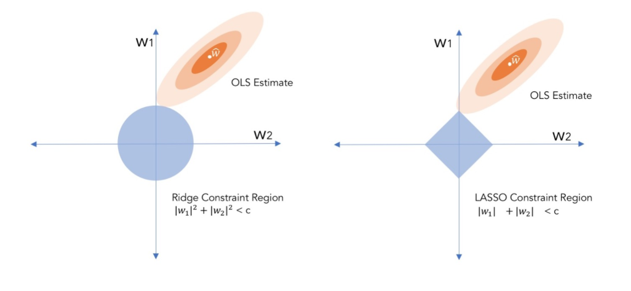
Geometric Interpretation of
Ridge + LASSO
It is possible that a coefficient can be exactly ‘zeroed’ out
Regularization

Slide 14



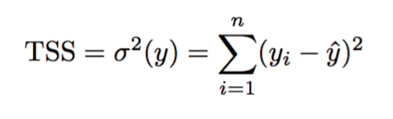


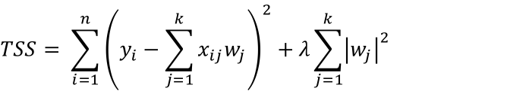
Start
Done!
Training model
If Error is acceptable?
Objective: Select ƛ through cross validation, minimize MSE
N
Y
$$TSS= \sum_{i=1}^{n}{{\left(y_{i}−\sum_{j=1}^{k}{x_{ij}w_{j}}\right)}^{2}+λ\sum_{j=1}^{k}{{\left|w_{j}\right|}^{2}}}$$
Evaluate Trained Model
Benchmark error
Prediction: Results in a linear equation that produces Y-hat
Regularization Process

Slide 15
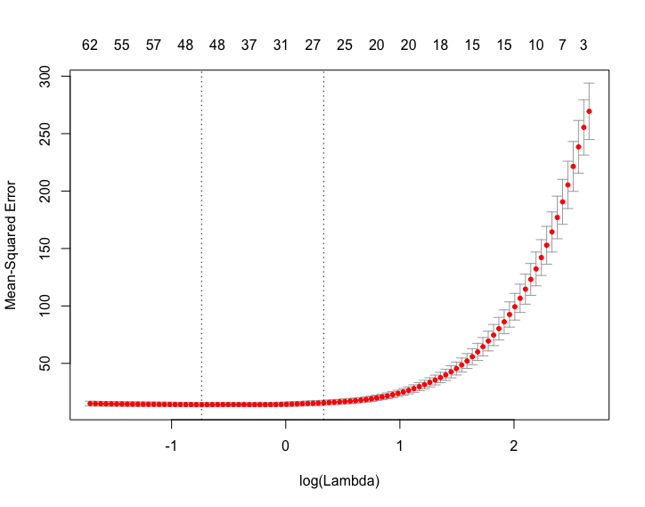

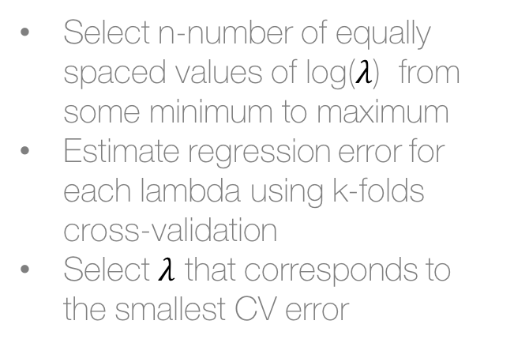
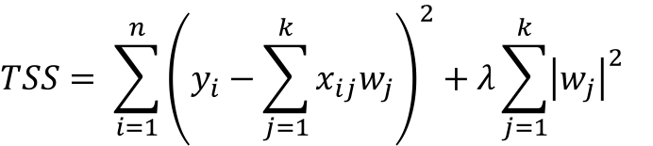
Calibrating $λ$using K-folds cross-validation
$$TSS= \sum_{i=1}^{n}{{\left(y_{i}−\sum_{j=1}^{k}{x_{ij}w_{j}}\right)}^{2}+λ\sum_{j=1}^{k}{{\left|w_{j}\right|}^{2}}}$$
Select n-number of equally spaced values of log($λ$) from some minimum to maximum
Estimate regression error for each lambda using k-folds cross-validation
Select $λ$ that corresponds to the smallest CV error
Regularization

Slide 16
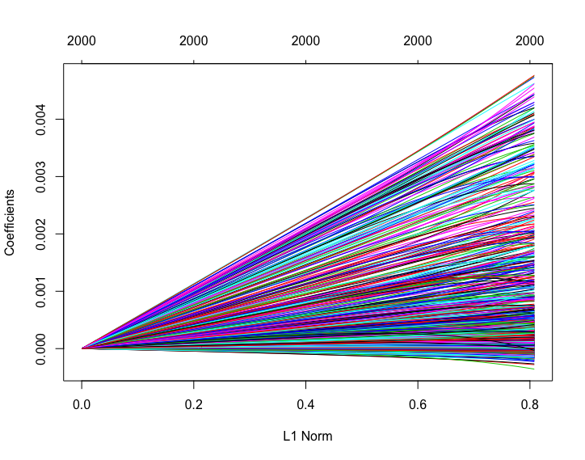
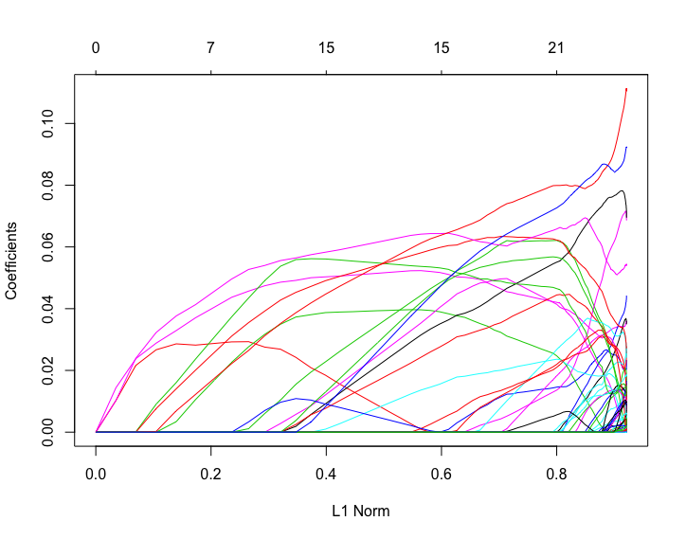
Coefficient Paths
Due to the type of penalty, the behavior of each coefficient will differ for each value of lambda.
Ridge Regression
LASSO Regression
Regularization

Slide 17
Regularization Assumptions
[]
Regularization
OLS

Slide 18
Regularization Good/Bad
Good for surfacing interpretable parameters from a large pool
Bad if true relationships are not linear
Regularizaiton
OLS

Slide 19
Coded example
Regularization

Slide 20
Roadmap
Regularization
KNN
Homework assignment
Intro to Data Science for Public Policy

Slide 21
Given buildings on a grid, how would you predict whether the green buildings will catch fire?
Bldg 1
Bldg 7
Bldg 13
Bldg 19
Bldg 25
Bldg 31
Bldg 2
Bldg 8
Bldg 14
Bldg 20
Bldg 26
Bldg 32
Bldg 3
Bldg 9
Bldg 15
Bldg 21
Bldg 27
Bldg 33
Bldg 4
Bldg 10
Bldg 16
Bldg 22
Bldg 28
Bldg 34
Bldg 5
Bldg 11
Bldg 17
Bldg 23
Bldg 29
Bldg 35
Bldg 6
Bldg 12
Bldg 18
Bldg 24
Bldg 30
Bldg 36
KNN
OLS

Slide 22
From the visual, we can see spatial clusters of activity. Perhaps there isn’t a grand unifying formula for fires…
Bldg 1
Bldg 7
Bldg 13
Bldg 19
Bldg 25
Bldg 31
Bldg 2
Bldg 8
Bldg 14
Bldg 20
Bldg 26
Bldg 32
Bldg 3
Bldg 9
Bldg 15
Bldg 21
Bldg 27
Bldg 33
Bldg 4
Bldg 10
Bldg 16
Bldg 22
Bldg 28
Bldg 34
Bldg 5
Bldg 11
Bldg 17
Bldg 23
Bldg 29
Bldg 35
Bldg 6
Bldg 12
Bldg 18
Bldg 24
Bldg 30
Bldg 36
KNN
OLS

Slide 23
What if the 4 nearest buildings provide the most information?
Bldg 8
No buildings caught fire, meaning 0% chance that Bldg 29 will catch fire
Bldg 3
Bldg 9
Bldg 15
Bldg 10
Bldg 28
3 bldgs with fire means a 50% chance that Bldg 9 will catch fire
Bldg 23
Bldg 29
Bldg 35
Bldg 30
OLS
KNN

Slide 24
What if the 8 nearest buildings provide the most information?
Bldg 2
Bldg 8
Bldg 14
2 bldgs caught fire, meaning 25% chance that Bldg 29 will catch fire
Bldg 3
Bldg 9
Bldg 15
Bldg 4
Bldg 10
Bldg 16
Bldg 22
Bldg 28
Bldg 34
6 bldgs with fire means a 75% chance that
Bldg 9 will catch fire
Bldg 23
Bldg 29
Bldg 35
Bldg 24
Bldg 30
Bldg 36
OLS
KNN

Slide 25
Which is better if both buildings actually caught fire?: k = 4 or k = 8?
Correctly Predicted
k = 4
1 of 2
k = 8
2 of 2
KNN
OLS

Slide 26
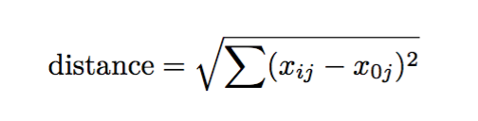
kNNs assume that observations that are closer together are more related. Relatedness can be represented by the k-number of nearest records as measured by distance of variables.
KNN
OLS

Slide 27
Start
Training model
For each observation for a given k
Calculate distance to all other records
If continuous, calculate mean of Y for k-nearest records
If discrete, calculate proportion Y=1
Done!
If Error is acceptable?
Y
N
Predict and calculate error based on validation
If continuous, calculate RMSE or MAPE
If discrete, calculate AUC or ROC
Repeat process for k to k ≤ n
Compare error across all k’s
KNN
OLS Process

Slide 28
KNN Assumptions
All input features need to be scaled similarly.
All input features have equal weight.
Uncommon assumption: While KNN is a non-parametric method, high collinearity should be kept to a minimum such that redundant variation is not disproportionately represented.
KNN
OLS

Slide 29
KNN Good/Bad
Good for low dimensional data (few variables)
Good for when no theory exists
Good for imputation of missing values
Bad for high dimensional data as each observation needs to be processed
Bad if data contains both discrete and continuous
Bad if you want an interpretation
KNN
OLS

Slide 30
Coded example
KNN

Slide 31
Roadmap
Regularization
KNN
Homework assignment
Intro to Data Science for Public Policy

