Slide 1

Are you displeased with your JavaScript Exam results?
Do you feel as if it is all Nakov’s fault?
Do you want to feel better?
WE HAVE WHAT YOU NEED!!!

Slide 2
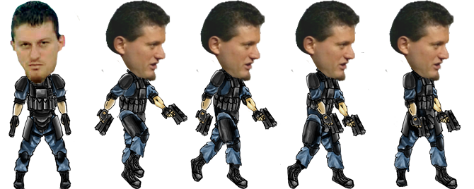
Nakov Sky
Team Carnation Mini-Alibi
Tsvetan Ganchev - ZvetanIG
Dimitar Bonev - Kibork
Yana Slavcheva - jabalka
Georgi Teoharov – Gteoharov
Alexander Pelev - apelev

Slide 3
Nakov Sky – main game idea
Your cannon is attacked by planes
Planes drop parachutists
All the parachutists are… NAKOV!!!
Nakov used to be immortal
Fortunately we fixed the collisions ☺
If 3 * Nakov reach the ground – you loose ☹

Slide 4
Where to find the game?
http://nakov-sky.slavcheva.net/
https://github.com/TeamCarnation-mini-Alibi/GAME

Slide 5
Nakov Sky
Demo

Slide 6
Team work
Tsvetan – a lot of JS work, design
Dimitar – a lot of JS work, design
Yana – JS work, design
Georgi – JS work
Alexander – JS work
Excellent Teamwork, Excellent Team

Slide 7
Questions?

