Slide 1
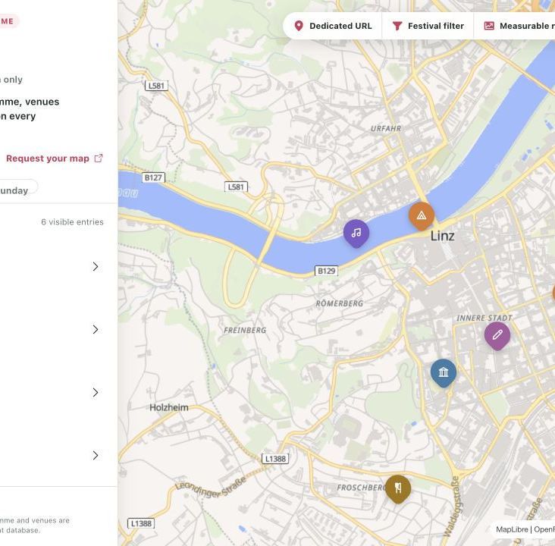
OKOLO FOR FESTIVAL PARTNERS
Put your whole festival
on one map
A dedicated Okolo map connects every venue, time and approved programme link.
okolo.events/partners/demo
OKOLO · FESTIVAL PARTNERS
1
Notes:
[Sources]
- /Users/georgikostov/Repositories/eventmap/output/screenshots/partner-demo/03-public-partner-demo-desktop-overview.png

Slide 2
OKOLO FOR FESTIVAL PARTNERS
A timetable lists events. A map helps visitors decide.
01
Where is it?
Every venue becomes visible in relation to the rest of the festival.
02
When should I go?
Day and programme filters reduce a long timetable to the next useful choice.
03
What happens next?
Each event carries the visitor to the organizer-approved source.
OKOLO · FESTIVAL PARTNERS
2
Notes:
[Sources]
- /Users/georgikostov/Repositories/eventmap/docs/design/design-doc.md

Slide 3
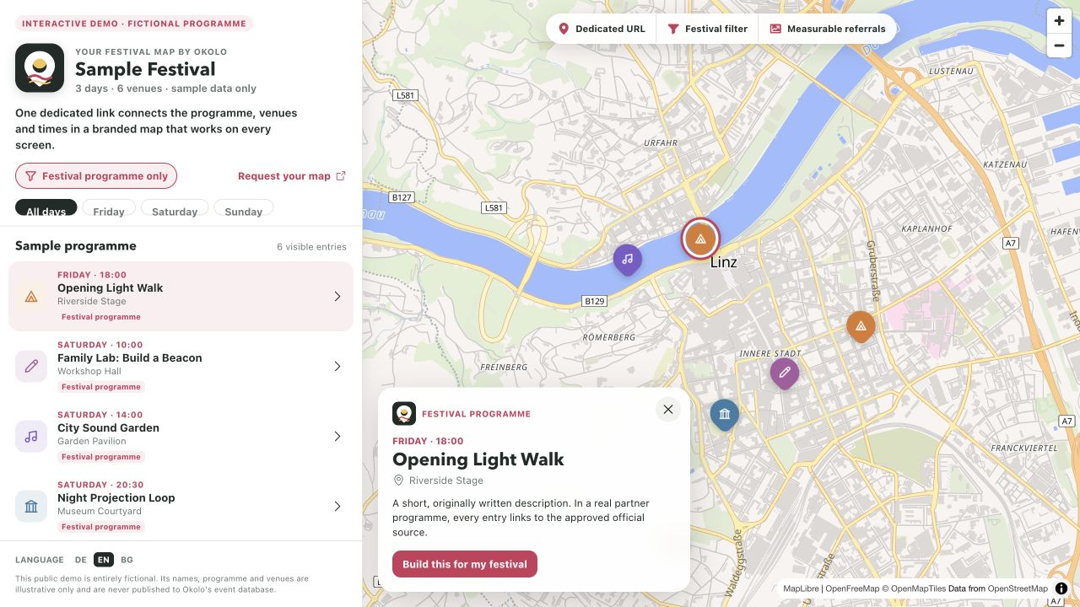
OKOLO FOR FESTIVAL PARTNERS
A dedicated URL becomes the festival’s front door
PUBLIC DEMO
okolo.events/
partners/demo
Fictional programme
Original sample identity
No production event records
Open it. Filter it. Tap any pin.
OKOLO · FESTIVAL PARTNERS
3
Notes:
[Sources]
- /Users/georgikostov/Repositories/eventmap/output/screenshots/partner-demo/01-public-partner-demo-desktop.png
- /Users/georgikostov/Repositories/eventmap/app/partners/demo/page.js

Slide 4
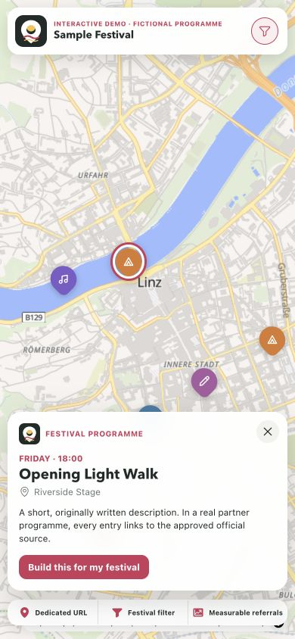
OKOLO FOR FESTIVAL PARTNERS
The festival identity stays visible from map to detail
Brand first
The organizer lockup remains above the map.
Context preserved
Day, time, venue and programme label travel into event detail.
One next action
Visitors continue to the approved programme or ticket source.
OKOLO · FESTIVAL PARTNERS
4
Notes:
[Sources]
- /Users/georgikostov/Repositories/eventmap/output/screenshots/partner-demo/02-public-partner-demo-mobile.png

Slide 5
OKOLO FOR FESTIVAL PARTNERS
The partner layer adds value without taking over the map
Dedicated URL
Approved identity
A shareable festival destination on Okolo.
Logo slot, name and edition across map and event surfaces.
Programme lens
Source continuity
Partner-only and day filters make a large programme manageable.
Facts stay concise; every event links back to the approved source.
OKOLO · FESTIVAL PARTNERS
5
Notes:
[Sources]
- /Users/georgikostov/Repositories/eventmap/docs/decisions/2026-08-29-partner-festival-maps.md

Slide 6
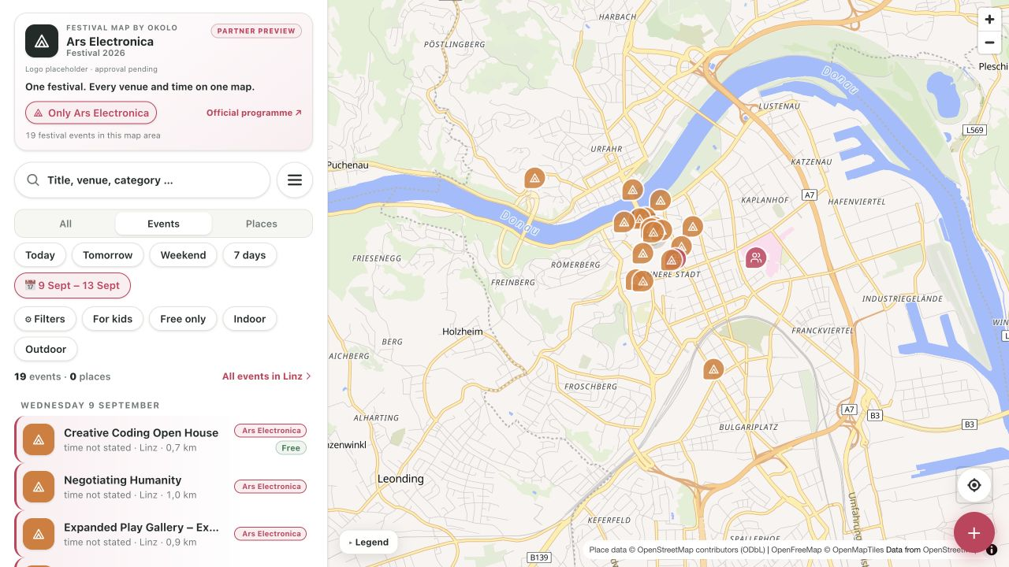
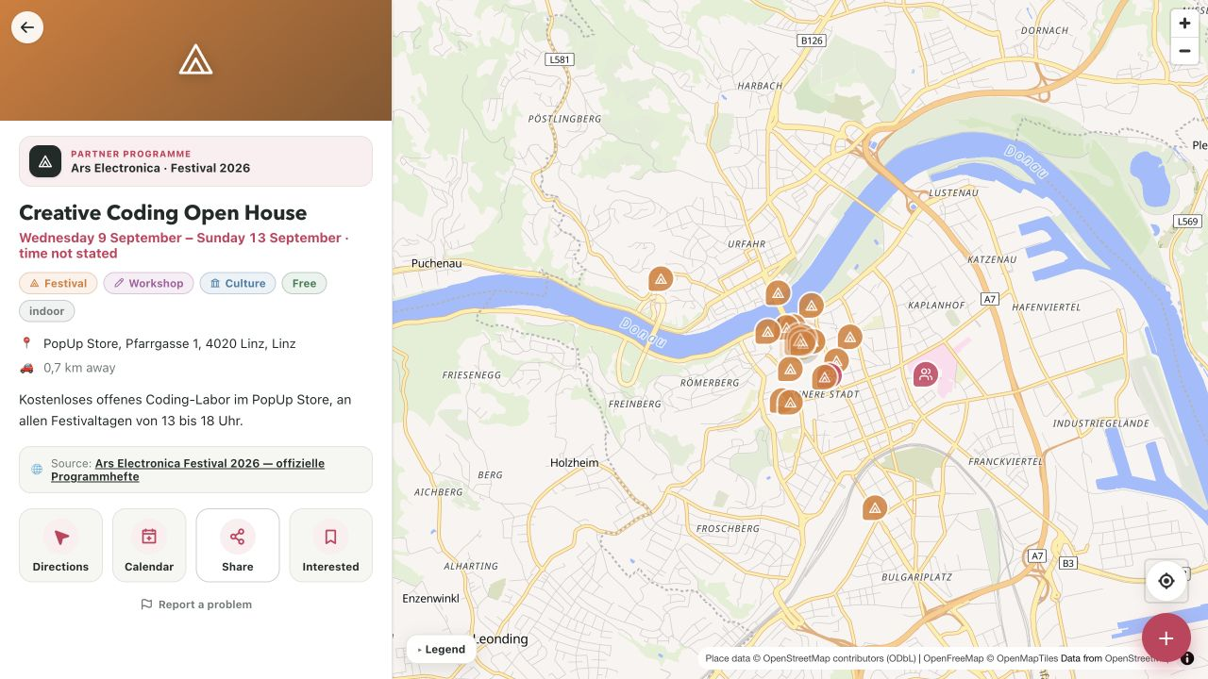
PRIVATE CONCEPT EXAMPLE
We can prototype an organizer-specific map before launch
Uncommissioned concept · no affiliation or endorsement · real artwork and partner language require written approval.
PRIVATE SALES MATERIAL · DO NOT PUBLISH AS A PARTNERSHIP
6
Notes:
[Sources]
- /Users/georgikostov/Repositories/eventmap/output/screenshots/partner-showcase/01-aec-partner-map-desktop.jpg
- /Users/georgikostov/Repositories/eventmap/output/screenshots/partner-showcase/02-aec-partner-event-detail-desktop.jpg
- https://ars.electronica.art/negotiatinghumanity/en/download/
- https://ars.electronica.art/about/en/impress/

Slide 7
OKOLO FOR FESTIVAL PARTNERS
Partners can see what visitors use—and where they continue
01
02
03
04
Map view
Filter
Event open
Source referral
The dedicated festival map is opened.
Visitors choose the festival or a programme day.
A pin or list item becomes an event detail.
The visitor continues to the official source.
Measurement supports a partner report; it does not alter event facts or ranking rules.
OKOLO · FESTIVAL PARTNERS
7
Notes:
[Sources]
- /Users/georgikostov/Repositories/eventmap/docs/ops/advertiser-proof.md
- /Users/georgikostov/Repositories/eventmap/lib/analytics.js

Slide 8
OKOLO FOR FESTIVAL PARTNERS
Start with one festival and one measurable visitor journey
1 · Approve
2 · Configure
3 · Share & learn
Programme source, logo rights and launch dates.
Partner URL, filters, identity and event linkbacks.
Promote one map and review opens and referrals.
hello@okolo.events · Request a festival map pilot
OKOLO · FESTIVAL PARTNERS
8
Notes:
[Sources]
- mailto:hello@okolo.events?subject=Festival%20map%20partnership

