Slide 1
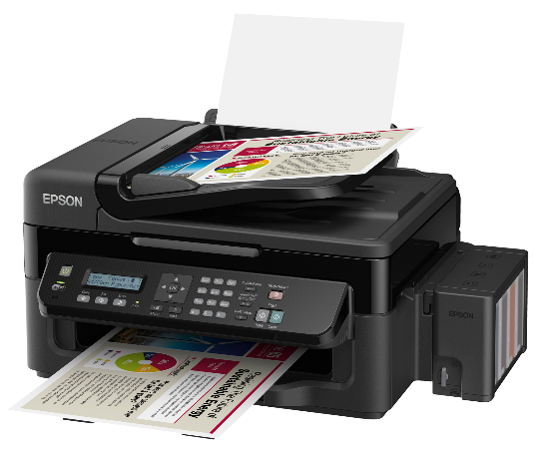





Desktop.net
Black Friday
Discount period: 24.11.2017-27.11.2017
-20%
-30%
1500$
70$
Mac 2015 - 512GB
Laser Printer HP
-20%
-20%
600$
1000$
iPhone 7 – 128GB
Macbook Pro – 512GB
-30%
-30%
10$
100$
Canyon - Mouse
HDD – 1TB
Georgi Bozhinov №2
IXᵅ class
Mira Emilova №12

