Slide 1
Biomimetic Control of a Hexapod Robot
By Georgi Tsatsev

Slide 2
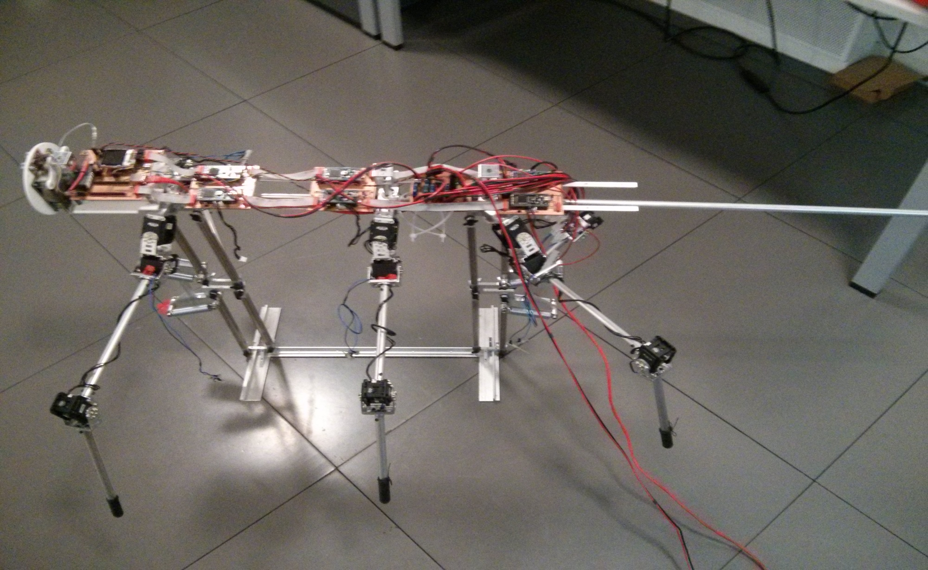
The Hexapod Robot:

Slide 3
Introduction
Idea of the project:
-program a hexapod robot so that it mimics the sensory-motor control loop of the stick insect stepping motion.
Project stages:
- implement single leg controller
- implement basic walking
- implement walking and turning algorithms

Slide 4
What I have done so far?
Researched neural-network model (von Twickel) for single leg movements.
Researched inter-segmental coordination during stick insect walking.
- derived finite state machine for leg movements.
Acquired code for single leg (middle left) controller and understood most of its inner workings. ( by Yiming Yao)
Acquired code for communication between the mbeds and the servos (by Georgios Petrou)

Slide 5
Previous Work – Georgios Petrou
Build the hexapod Robot
Created a library to control MX28 servos that is used for controlling the hexapod.
Implemented hard-coded movements of the robot:
- http://www.youtube.com/watch?v=jQZfs4vVuUA

Slide 6
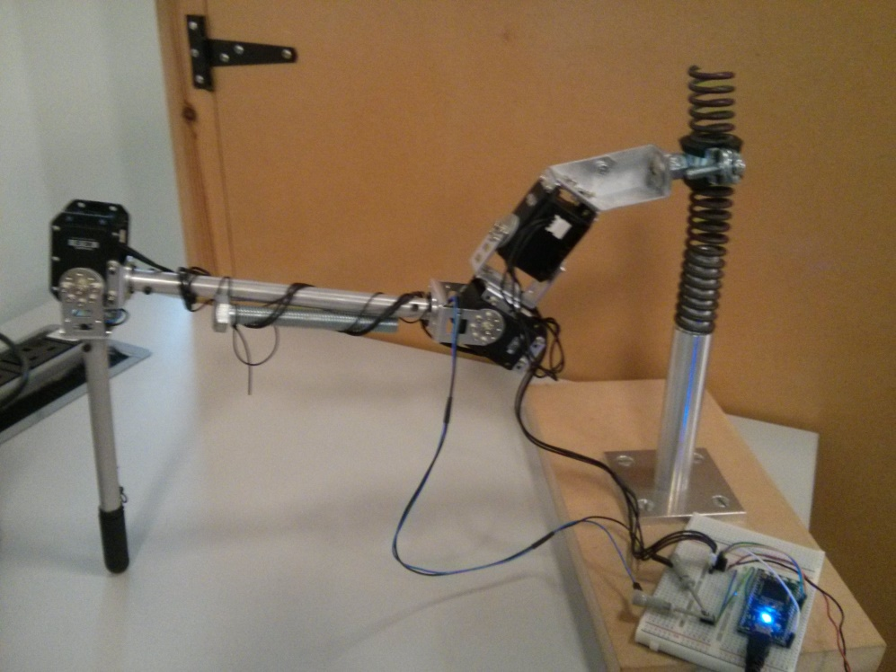
Previous Work – Yiming Yao
Implemented a single leg neural network for each of the six legs.
Tested the synapses of the neural network controller with different weights and neuron biases.

Slide 7
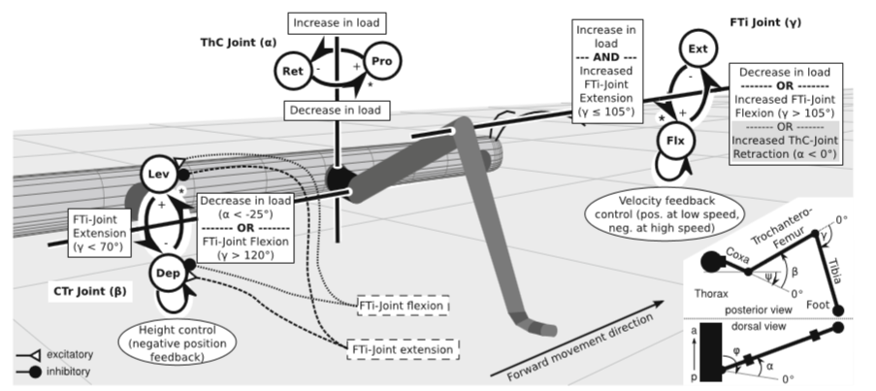
Summary of rules for joints

Slide 8
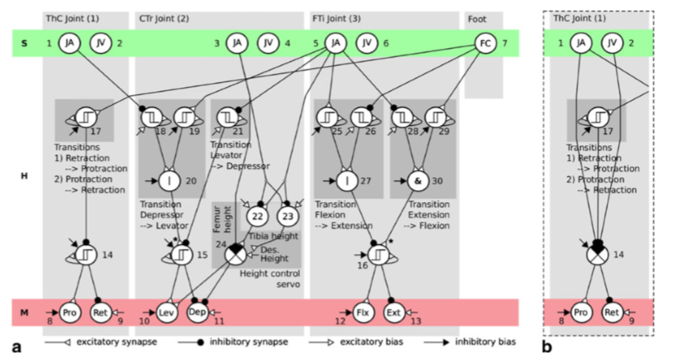
Neural Network Controller (applicable for front and middle legs)

Slide 9
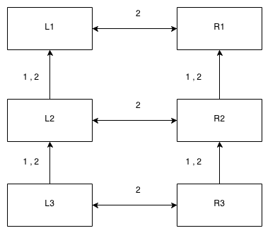
Simplified Walknet for Brain
Suggested future implementation of the brain module:

Slide 10
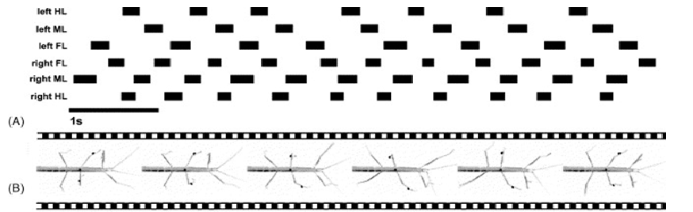
Walking Gaits

Slide 11
Future Work
Deriving or acquiring code for other legs.
Implementing a central pattern generation network for stick insect walking gaits.

Slide 12
Future Work
Research and implement turning algorithms.
- implementation requires a new set of bistable neurons to be added in all six legs.
- turning motion would be active while turning phase

Slide 13
Thank you for your time!

