Slide 1
C Software Development
GNC Software Onboarding Lecture #1

Slide 2
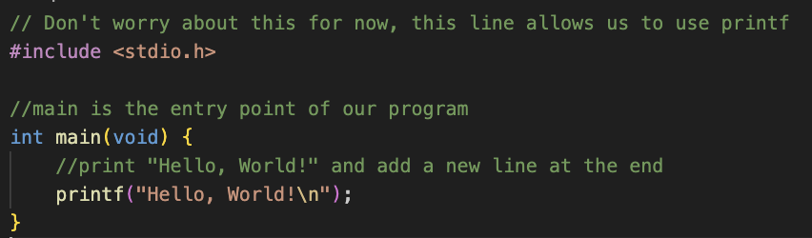
Hello, World!
Demo: hello_world.c

Slide 3
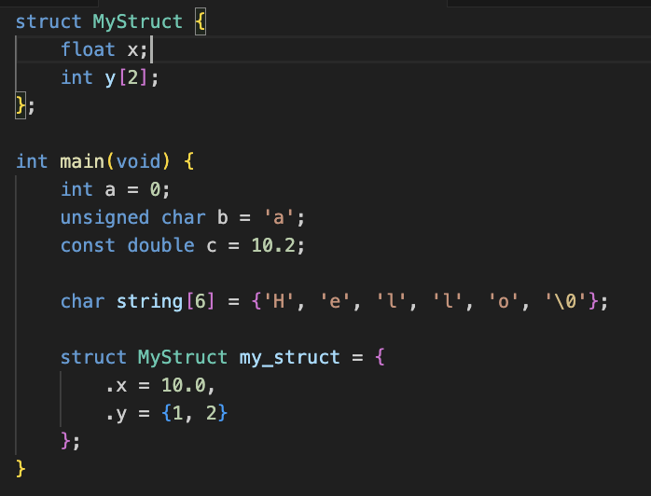
Data Types
Numeric
  (unsigned/signed) int, char, long
  float/double
Arrays
  Use brackets [N], where N is the size of the array
Text
  Char - Single character using the ASCII standard
  Strings are represented as lists of chars with a special null (‘\0’) character at the end to indicate the string end
Structs
  A struct is a structured collection of the primary data types mentioned above
  You can access a member of a struct using the “.” character
    Ex. my_struct.x or my_struct.y
Prepending a data type with the keyword ‘const’ makes it a constant
Demo: datatypes.c

Slide 4
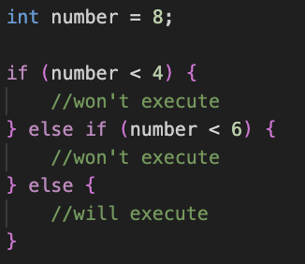
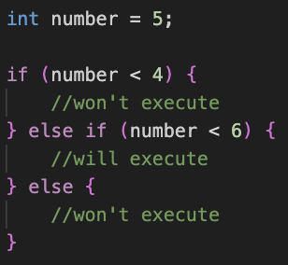
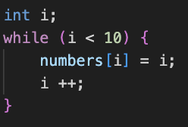
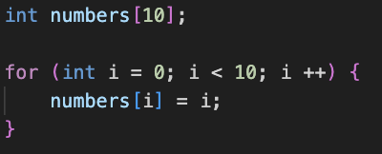
Control Flow

Slide 5
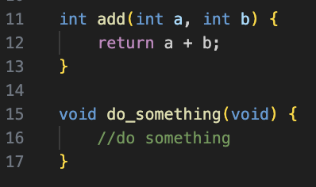
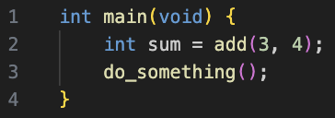
Functions
<Return Type> <Function Name> (<Parameter 1>, <Parameter 2>, …) {}
To call a function, use the function name with parameters in parenthesis

Slide 6
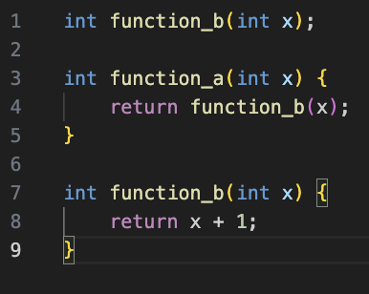
Function Prototypes
The C compiler works top-to-bottom
  If you define a function on line 7 and try to use it on line 4, the compiler won’t know what function you are talking about
Function prototypes solve this problem by defining the input parameters and return type of the function without actually defining the body of the function
Demo: functions.c

Slide 7
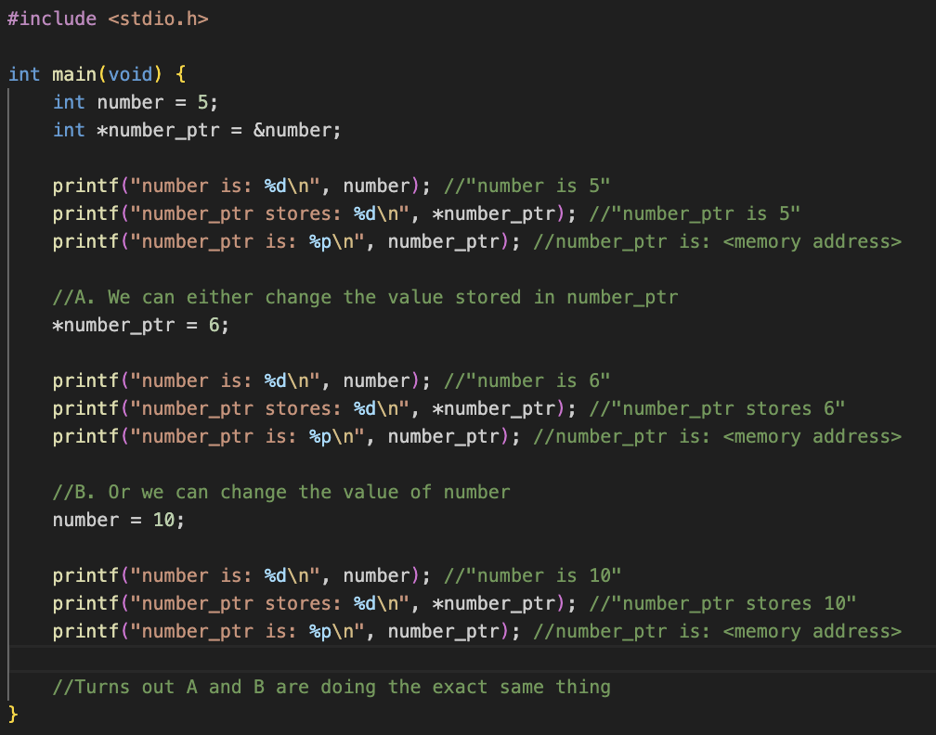
Pointers
Denoted by a * after the type name
When you create a variable, think of it being stored on a “location” in your computer (called a memory address)
  A pointer is a number that specifies where a value is stored
Use the & symbol to create a pointer that points to a variable
Use the * symbol to access or modify the value the pointer points to
  This is called dereferencing
Demo: pointers.c

Slide 8
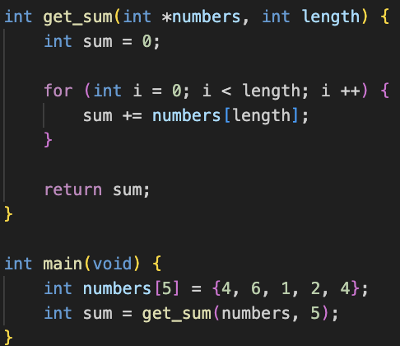
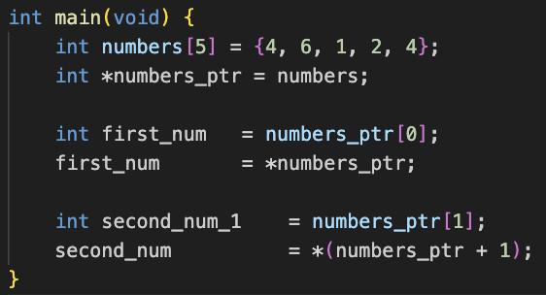
Arrays as Pointers
We can also use pointers to represent arrays in a different way
  points to the start of the array
Arrays are stored in contiguous memory locations, meaning that we can find the next element in the array by looking in the next memory address
When we access elements of the array using square brackets, we are just adding an offset to that memory location
  This is called pointer arithmetic

Slide 9
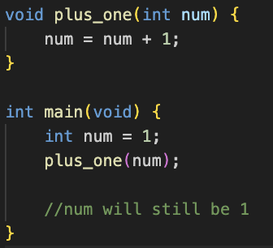
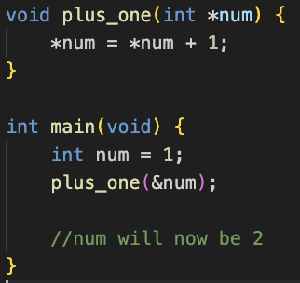
Pass by Value vs. Pass by Reference
When you pass a parameter to a function, the data is copied from outside the function call to inside the function call
This means that if we modify any parameters in the function itself, those modifications will not be reflected outside of the function
Demo: pass_by_value.c, pass_by_reference.c

Slide 10
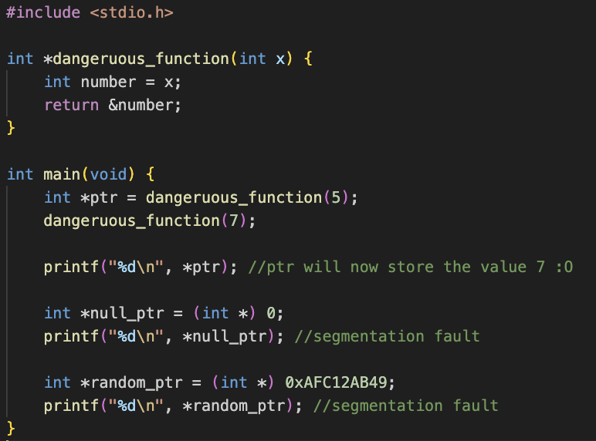
The Danger of Pointers
Pointers are a powerful tool, but can cause some serious headache if not treated carefully
Some things you cannot do:
  Return a pointer that references a local variable
  Dereference a null pointer (memory address 0)
  Dereference a pointer to memory your program does not own
Demo: dangerous_pointers.c

Slide 11
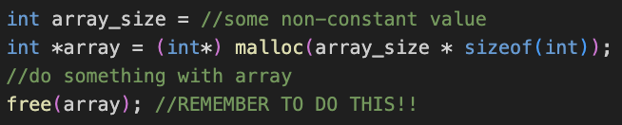
Memory Management
In our previous examples, the compiler has known ahead of time how much memory we need
  It can do this because we explicitly declared things such as array lengths
…but what if we don’t know the size array we need at the time of writing the code?
Enter malloc() and free()
  malloc dynamically allocates memory and returns a pointer to the memory it has set aside
  free does the opposite, returning the memory back to the operating system
If you don’t free your malloc’d memory, you have a memory leak!
  This can cause your program to eventually run out of memory and crash
  We almost always avoid using malloc in GNC for this reason
Demo: malloc_free.c

Slide 12
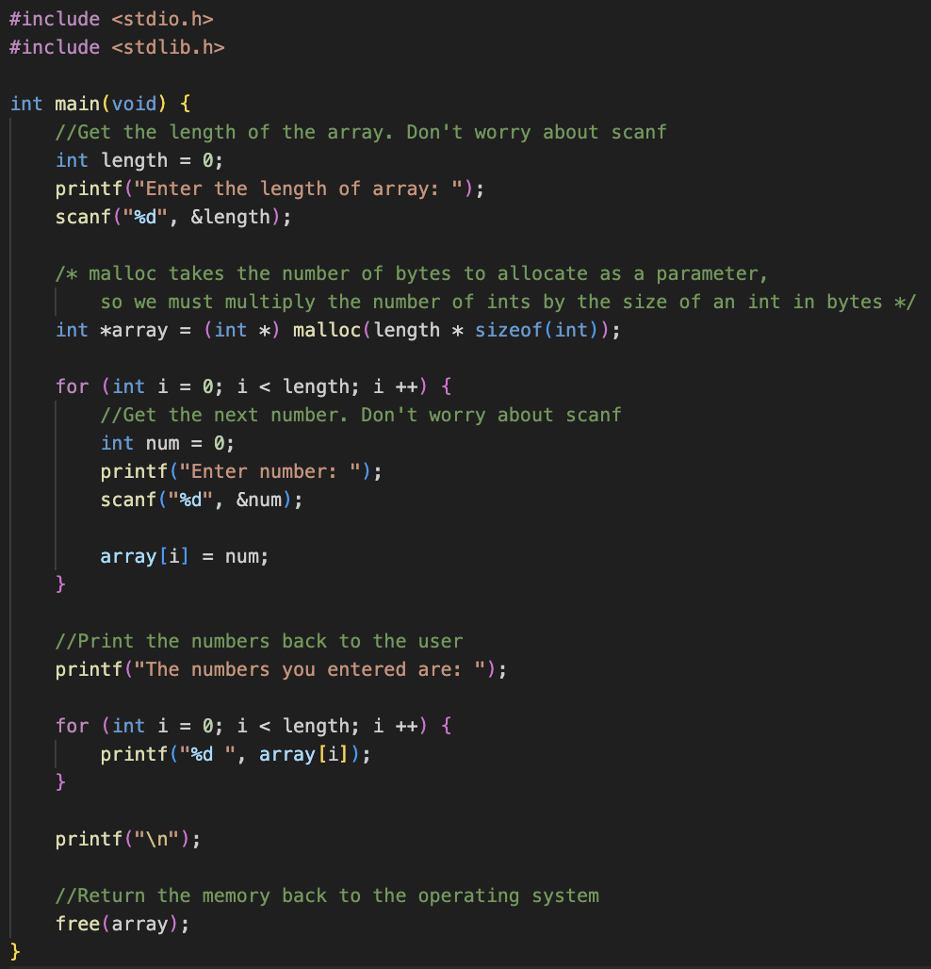
Malloc/Free Example

Slide 13
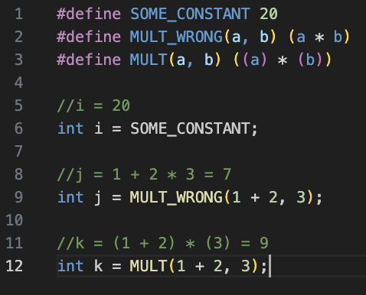
The C Pre-Processor (Macros)
Sometimes, you may want to define shortcuts for certain constants or for statements that are repeated often
Macros are just a systematic way to tell the compiler to do text replacement
Use the pre-processor directive #define
Typically one-line
Can have parameters just like functions, but not quite the same…
  See MULT_WRONG vs MULT

Slide 14
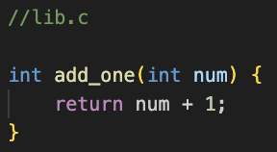
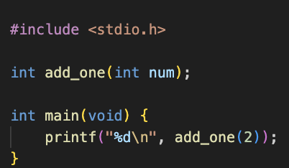
Using Multiple Files
Say we want to have a lib.c file that provides certain functions for main.c to use
The compiler treats each .c file one at a time with no context shared between them
  This means that we cannot just use a function from lib.c in main.c, because main.c does not define it
We can use function prototypes to solve this
  Although main.c does not provide an implementation for add_one, it is enough for the compiler to know what the function prototype is
  After the compiler runs, a separate program called the linker will then look for a definition for the function add_one and link it to the function call in main.c

Slide 15
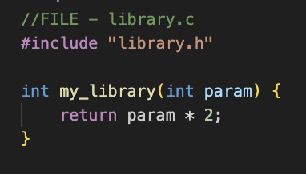
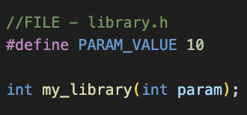
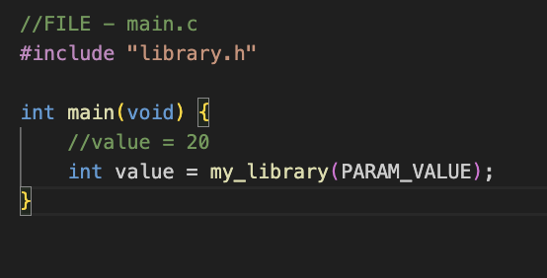
The C Pre-Processor (Header Files)
The previous example works fine, but what if we want to use more functions? What if we want to use lib.c in more than just main.c?
  There would be a lot of repetition of function prototypes across multiple different files
Header files allow us to consolidate multiple function prototypes in a separate file to then be “included” in any C file that wants to use those functions
Use the #include keyword followed by the file name to tell the pre-processor to add the contents of the .h file to the start of the c file
Demo: multiple_files

Slide 16
Version Control (Git)
In any software development team, members need a way to work on the same project simultaneously
Changes you make in git are called commits, and these commits are structured in a repository, often hosted online on GitHub or elsewhere
  A local copy of the repository exists on your computer, and may or may not be in sync with the online version
  The online host is often referred to as the origin or remote
  Syncing between the remote and local repositories is done through pushes and pulls
At its most basic level, you can make a repository that has an entirely linear history of commits
  One commit comes after the other and builds on the previous commit
But if two developers are trying to work on the same code at the same time, we run into issues because they cannot continuously sync their changes
Example of a linear git history. Each color corresponds to a feature

Slide 17
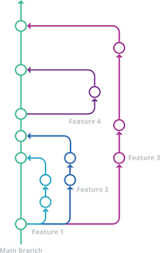
Git Branches
In git, a “branch” is an isolated line of development that starts from a single commit
  Typically, a branch is created for each feature to be developed, or for each developer working on the project
  Two developers typically can’t be working on the same branch at once
Once development is complete on a branch, it is then ”merged” with a mainline branch that contains the current state of the application

Slide 18
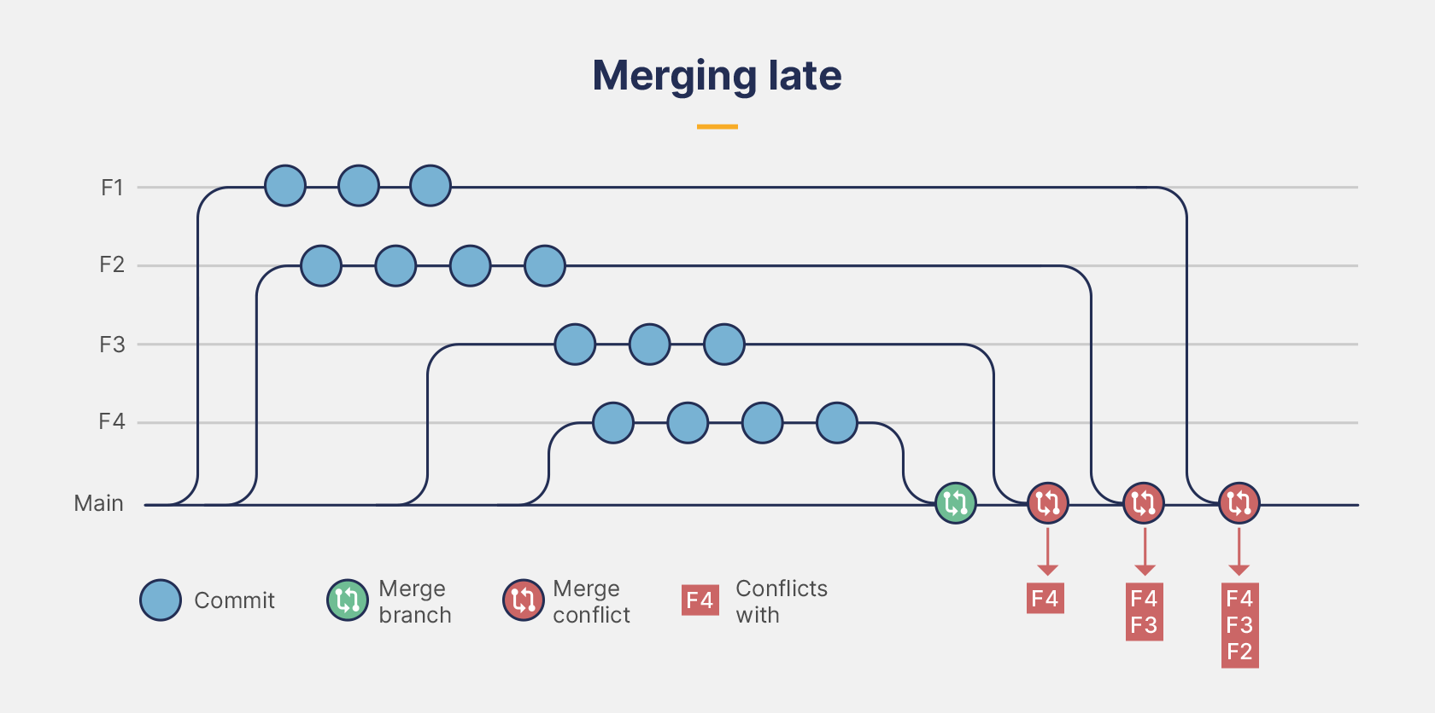
Git Merges
Imagine the following chain of events
  Create feature branch A from main
  Create feature branch B from main
  Change file main.c in branch A
  Make a different change to file main.c in branch B
  Merge branch B into main
  Merge branch A into main
Which version of main.c ends up in main?
  In all but the simplest cases, git produces a “merge conflict,” and a developer must manually decide which changes from branch A go into main.c and which changes from branch B go into main.c

Slide 19


Basic Development Environment Setup
If you are on windows
  Install Windows Subsystem for Linux (WSL)
Visual Studio Code
  The happy blue one, not the evil purple one… it will take all of your memory and run with it
  Extensions
    C/C++
Install git
  Ubuntu/WSL: sudo apt-get install git
  MacOS: brew install git (install brew from brew.sh)
Clone the flight software repository
  git clone https://github.gatech.edu/gnc/flight-software.git
For flight software development, there are quite a few other tools you need to install, which will be listed in the flight software repository. If not, talk to Sam

Slide 20
Practice Exercises
Go to https://github.gatech.edu/gnc/software-onboarding and do exercise 1
  1. Run “git clone https://github.gatech.edu/gnc/software-onboarding”
  2. Create a branch by running “git checkout –b <first name>-exercise1”
    Ex. Sam would run “git checkout –b sam-exercise1’
    This creates a new branch
  3. Do the exercise following the instructions in the exercise 1 README
  4. Stage your changes by running “git add .”
  5. Commit your changes by running “git commit –m <commit message>”
    Ex. git commit –m “Sam exercise 1”
  6. Push your changes by running “git push origin <first name>-exercise1”
  7. Create a pull request in GitHub to merge your branch into the main branch

Slide 21
Reference Materials

Slide 22
Useful Links
https://learngitbranching.js.org – Interactive git tutorial
https://www.learn-c.org/ - Interactive C tutorial

Slide 23
Various C Utility Functions
memcpy(void* dest, const void* src, size_t num)
  Copies num bytes of src to dest
memset(void* ptr, int value, size_t num)
  Sets num bytes of ptr to value
realloc(void* ptr, size_t new_size)
  Reallocates a previously allocated pointer to a new size
calloc(size_t num, size_t size)
  Like malloc, but sets the values to 0
sprintf(char* str, const char* format, ...)
  Dynamically format a string using variables as parameters
strlen(const char* str)
  Get the length of a string by counting the number of characters until the null character (‘\0’)
strcpy(char* dest, const char* src)
  Copies the string src to dest

