Slide 1
Embedded Systems
GNC Software Onboarding Lecture #2

Slide 2
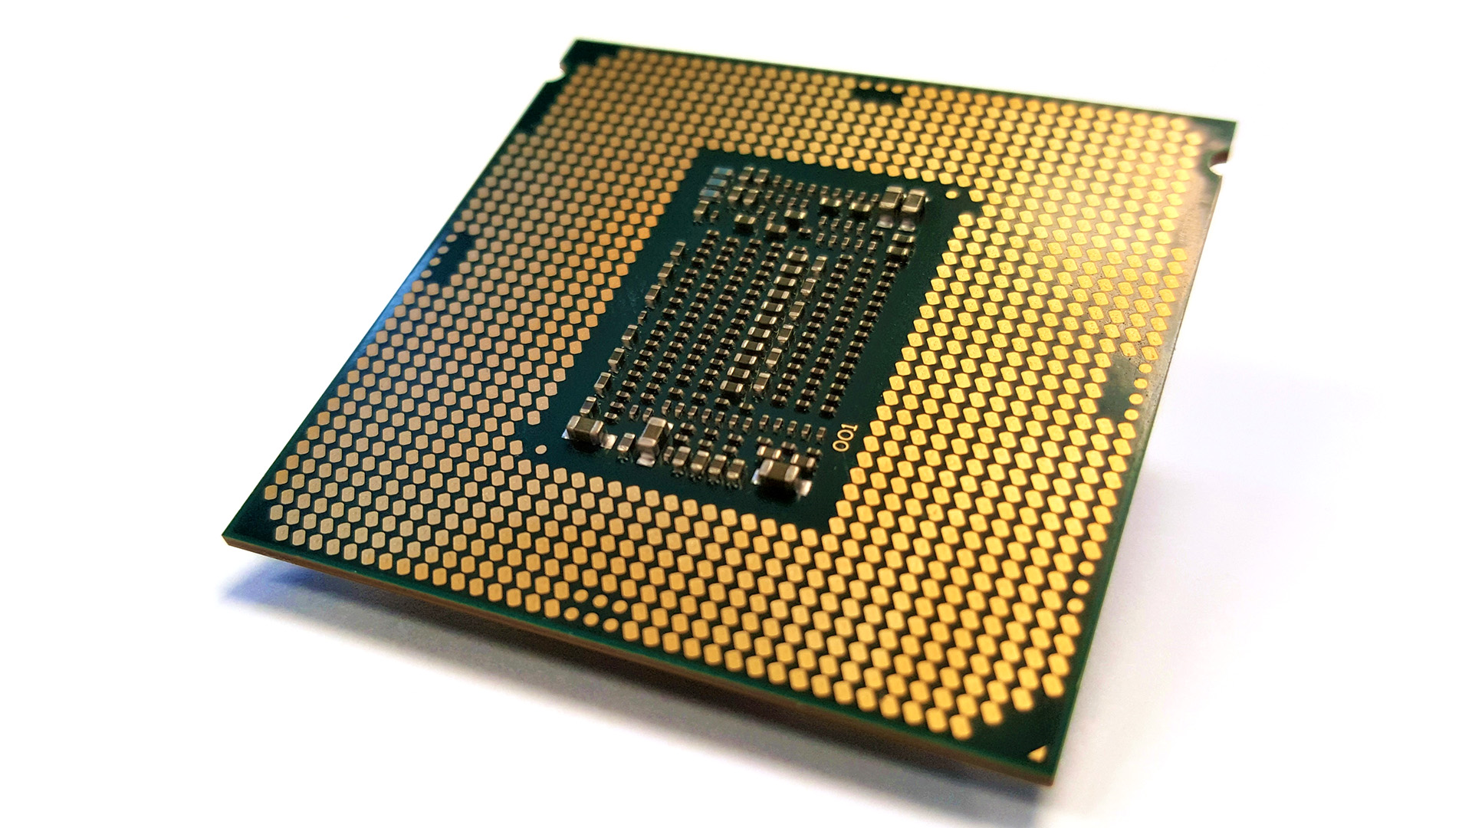
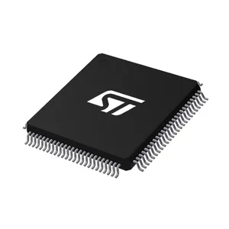
What is an Embedded System?
An embedded system is a computer system that differs from a desktop computer, laptop, or similar in that it has limited resources
  Often limited in size, computational power, memory
Typically use the ARM processor architecture instead of Intel/x86 processors found on modern desktop/laptop computers
Instead of central processing units (CPUs), we call their embedded counterparts microcontrollers (MCUs) and microprocessors (MPUs)
  MPUs are similar to MCUs, except MPUs typically have more processing power and memory available to them
Example of an MCU
Bottom of a CPU

Slide 3
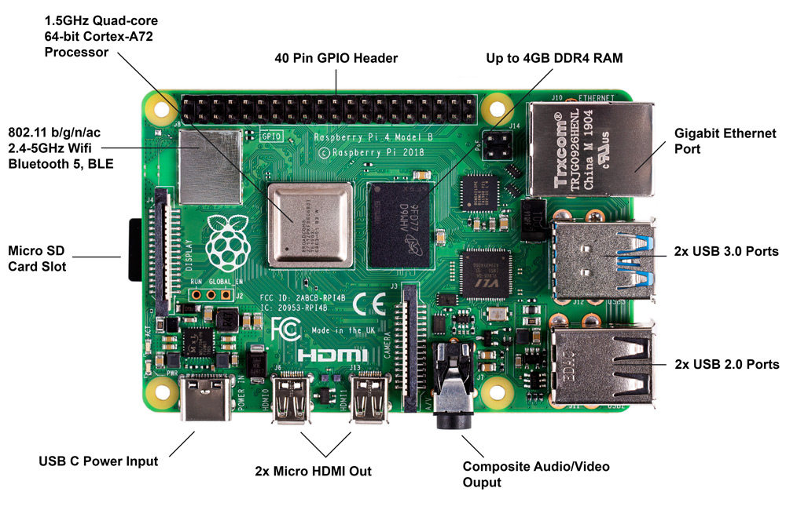
Components of an Embedded System
MCU/MPU - Typically identifiable as the biggest chip with the most pins on the board
GPIOs/ports – metal contacts exposed through headers, PCB traces, or I/O ports like USB or Ethernet
  All these connections lead directly back to the pins on the MCU/MPU
Memory – sometimes integrated on the MCU/MPU itself, sometimes connected separately through additional GPIOs
Peripherals – sensors, actuators, displays, human interface devices (keyboards, mice, etc), buttons, speakers, microphones, etc.
Raspberry Pi

Slide 4
How does the MCU interact with the outside world?
The MCU itself is just a black box that can generate high and low digital signals on each one of its pins
  How can we leverage this to cause outside side effects?
Basic GPIO functions
  Turning an LED on by writing a GPIO pin high
  Igniting a rocket motor by writing a GPIO pin high
  Responding to a button push through a GPIO input
Communication with peripherals
  Typically multiple GPIO pins dedicated to sending data to and from a specific peripheral
  We have standard ways of doing this called communication protocols

Slide 5
A Simple Communication Protocol
Say device A wants to send a message to device B
Let’s dedicate one wire as an output on A and an input on B
At the lowest level, any form of communication is just a structured stream of information transmitted through a sequence of bits
  Ex. The message ‘Hi’ could be encoded using the the sequence ‘01001000 01101001’
Define a zero as when the wire has a low voltage, and a one as when the wire has a high voltage
Every millisecond, transmit the next bit by changing the voltage on the wire to represent the next bit in the message
  Our sequence would be low, high, low, low, high, low, low, low, …

Slide 6
A few problems with our solution…
What if we don’t want to send any message at all?
  Currently, holding the wire at a low or high voltage would transmit a steady sequence of 0’s or 1’s
What if we want to transmit data at a faster/slower speed?
How can we send data from device B to device A?

Slide 7
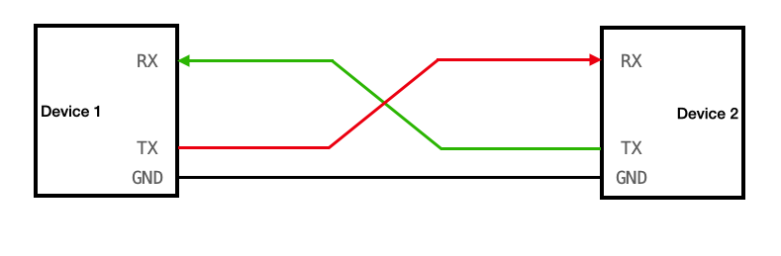
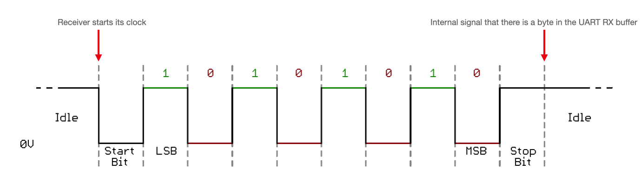
UART
The Universal Asynchronous Receiver/Transmitter (UART) protocol is one of the simplest embedded protocols
Two signal wires: RX and TX
RX and TX operate identically, but the only difference is the direction of the message being sent
Wire is high when idle, and a device will pull its TX pin low to 0 when it wants to send a byte
At the end of a byte, set the pin back high
Bits are then sent at an agreed upon rate called the baud rate

Slide 8
How does UART solve these problems?
What if we don’t want to send any message at all?
  We can hold the UART line high to indicate that it is idle
  When we send a zero to indicate a message start, we send 8 bits and then the message is over
What if we want to transmit data at a faster/slower speed?
  Both devices agree on a baud rate
How can we send data from device B to device A?
  Separate RX and TX wires

Slide 9
Communicating with multiple devices
One problem with UART is that each device needs its own RX/TX pair with the MCU
How can we use one wire that multiple devices share?
  We need some way to coordinate access to this wire to not create a short circuit
  When a device isn’t actively communicating, it needs to not be driving a 1 or a zero on the shared wire
We call this “shared wire” concept a bus

Slide 10
Buses
When we said earlier that digital logic only has two states, that was an oversimplification
In digital logic, there is a third state called floating/high impedance, often denoted by the letter ‘Z’
  Happens when there is nothing actively driving the wire high or low
A bus can utilize this third logic state to have more than one device communicating on a single wire
Still, only one device can drive the bus at a time
  All other devices must have their output as Z while a device is outputting on the bus

Slide 11
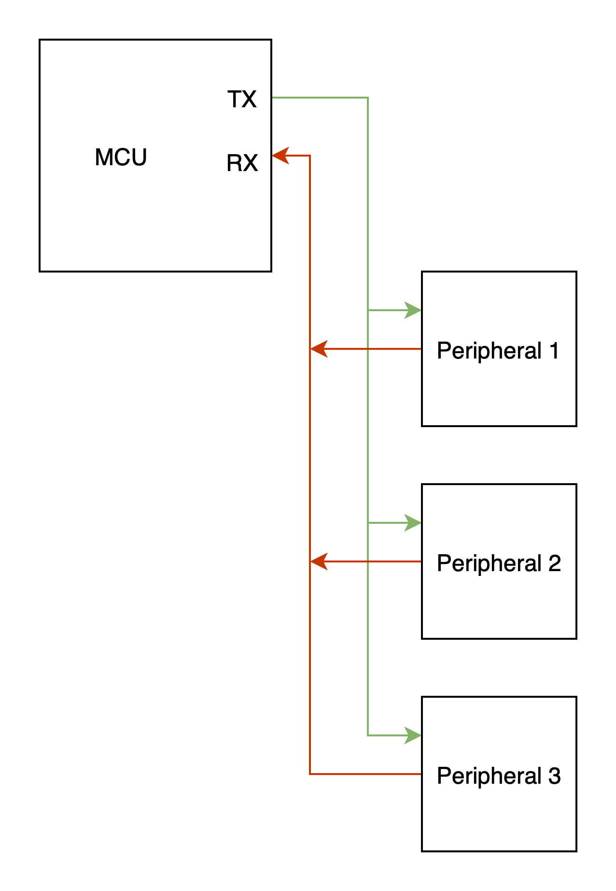
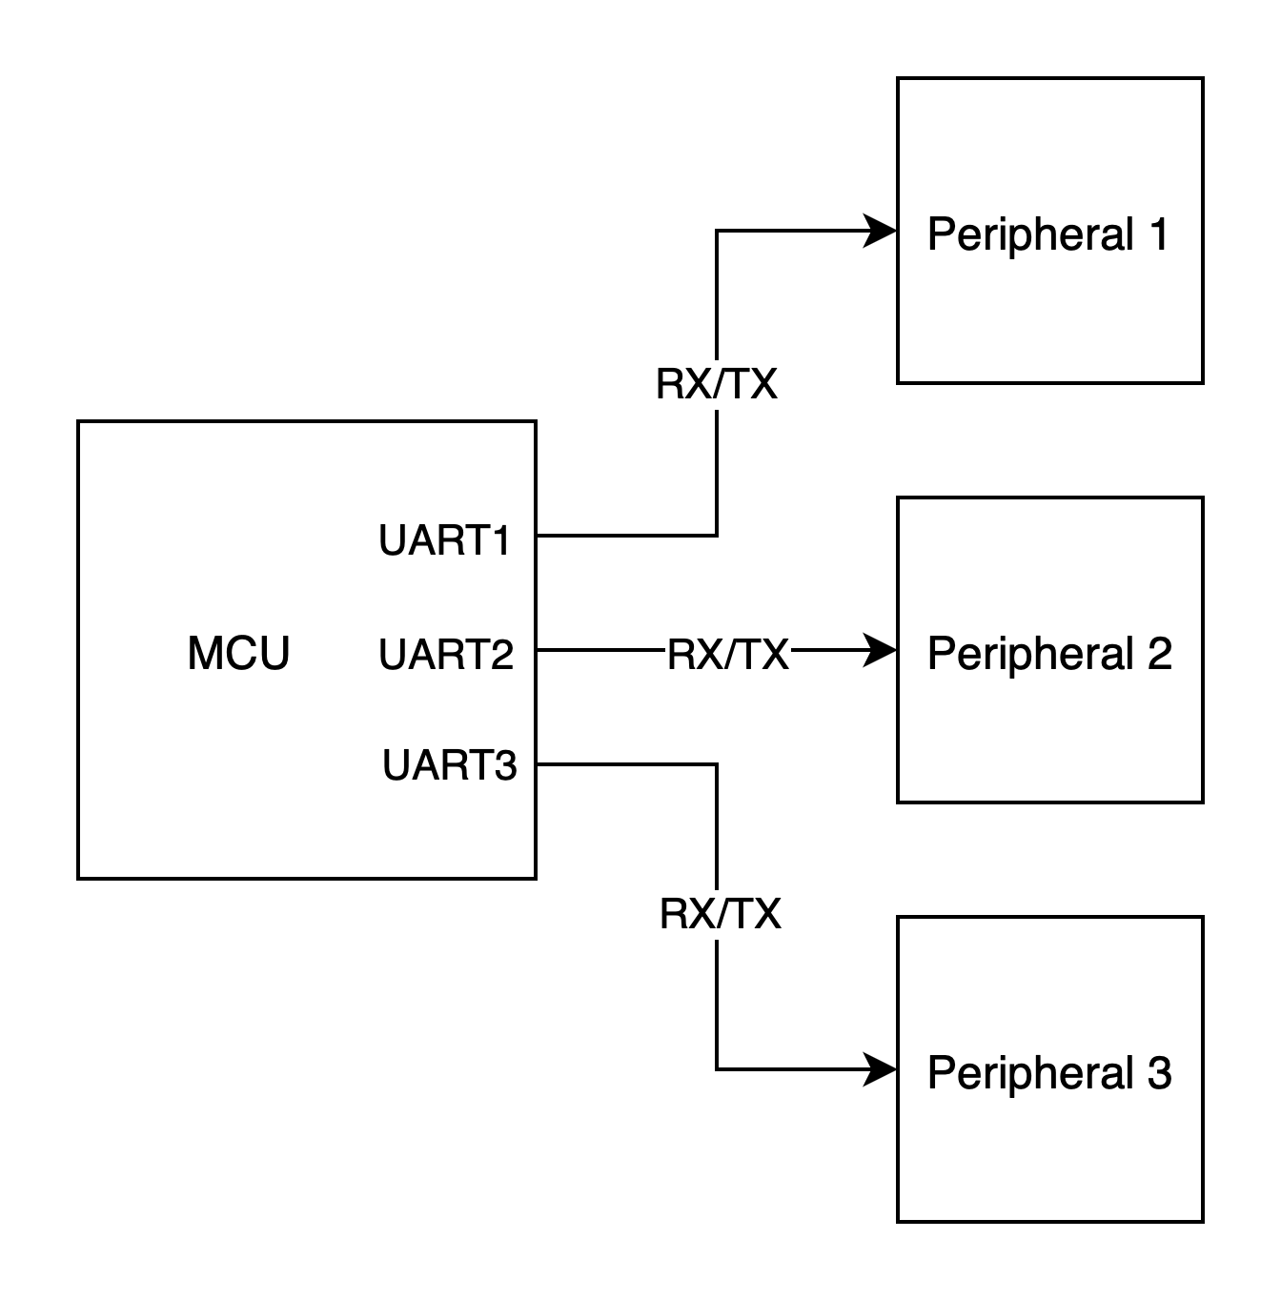
Buses (Continued)
RX/TX pair per peripheral
RX/TX pair on a bus
*note that UART typically cannot function on a bus. This is just an example

Slide 12
SPI
The Serial Peripheral Interface (SPI) introduces the concept of a master and a slave
  Master is the MCU, slave is the peripheral
Four wires
  Master Out Slave In (MOSI) carries data from the master to the slave (BUS)
  Master In Slave Out (MISO) carries data from the slave to the master (BUS)
  Serial Clock (SCLK) controls the rate at which data is sent
  Slave Select / Chip Select (SS/CS) – low when the master activates the slave, high when inactive
There is no concept of start/stop bytes as there is in UART
  Data is streamed continuously between master and slave
On the same SPI bus, multiple slaves can be connected, but they all need their own SS/CS line
  So, an SPI bus would consist of shared MOSI, MISO, and SCLK lines

Slide 13
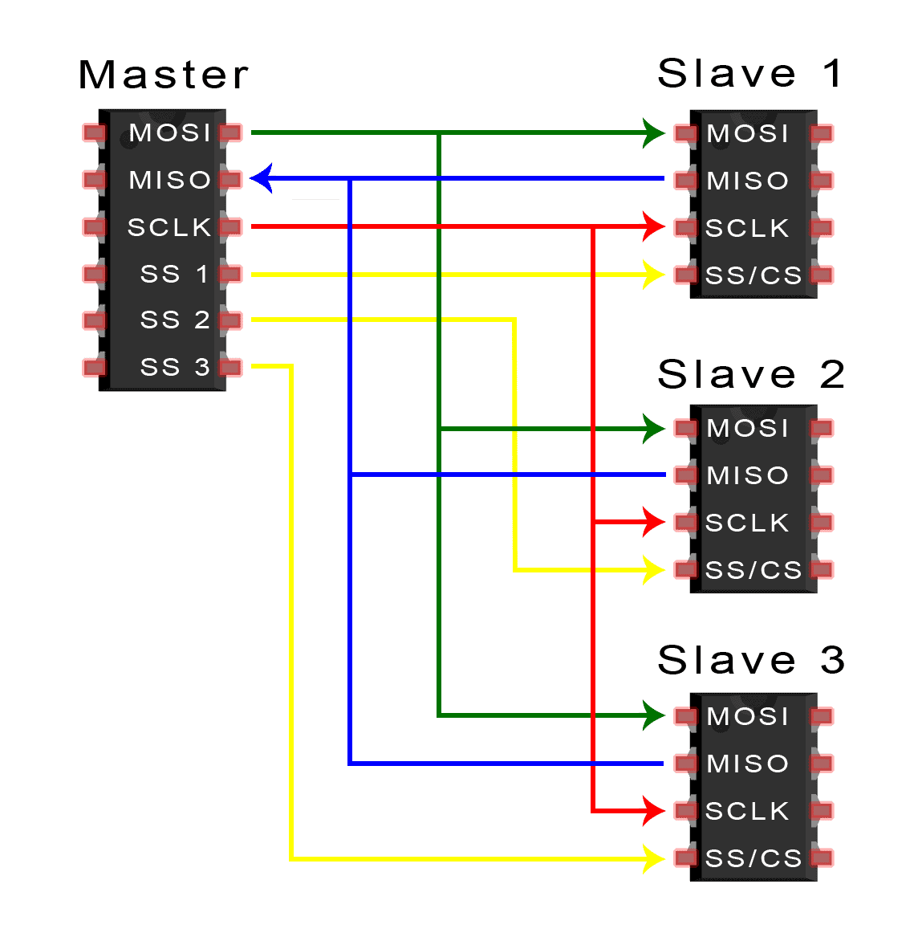
SPI (Continued)
  Master Out Slave In (MOSI) carries data from the master to the slave (BUS)
  Master In Slave Out (MISO) carries data from the slave to the master (BUS)
  Serial Clock (SCLK) controls the rate at which data is sent
  Slave Select / Chip Select (SS/CS) – low when the master activates the slave, high when inactive

Slide 14
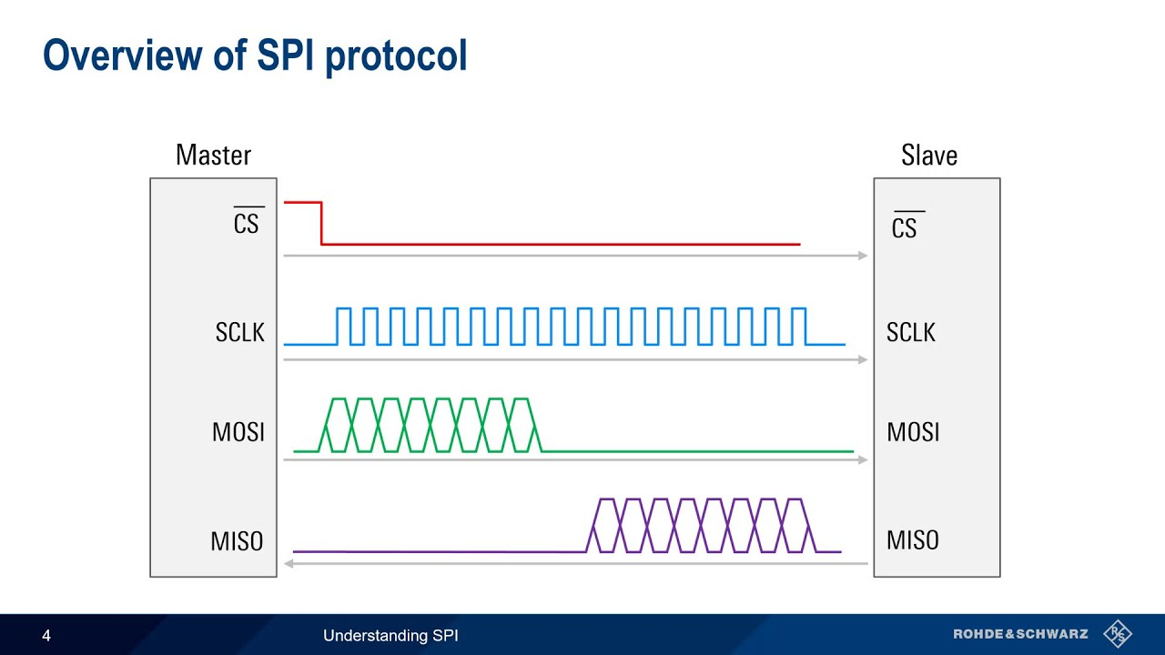
SPI (Continued)
  Master Out Slave In (MOSI) carries data from the master to the slave (BUS)
  Master In Slave Out (MISO) carries data from the slave to the master (BUS)
  Serial Clock (SCLK) controls the rate at which data is sent
  Slave Select / Chip Select (SS/CS) – low when the master activates the slave, high when inactive

Slide 15
I2C
Inter-Integrated Circuit (I2C) protocol
Two wires: SDA and SCL
  SDA (Serial Data) carries the data (BUS)
  SCL (Serial Clock) carries a clock signal
As in SPI, multiple slaves can be connected to the same SDA and SCL lines
  We distinguish between slaves by giving them unique 8 byte addresses
  A device will only take control of the bus if it detects its address on the bus

Slide 16
Responding to Real-Time Events
Imagine a system where a button press needs to cause some immediate action to be taken
We could read the GPIO input every so often and perform the action when we read it as high (polling)
  Waste of computation time
  Now our entire software is bound to this checking loop, since we must always be ready to respond to the event
Interrupts eliminate the need to poll by stopping the regular flow of code execution at a hardware level
Once the button is pressed, an interrupt will be triggered and the MCU will jump to a special function called an Interrupt Service Routine (ISR)
  We then perform our action in the ISR
Code that was being executed when the interrupt fires resumes execution as if nothing ever happened

Slide 17
Interrupts and Communication Protocols
Say our MCU is waiting for data from another device over UART. How can we tell when data is available for us to process?
Create an ISR that fires when we receive a byte over UART
  From that ISR, perform whatever processing we need to do on that byte

Slide 18
STM32 HAL
In GNC, we typically use MCUs from a company called STMicroelectronics (STM)
  Their MCUs are broadly named “STM32”
While the physical details of the chips differ across specific STM32 products, they are similar enough that STM offers a generic library for their line of MCUs called the Hardware Abstraction Library (HAL)
It contains functions to control all of the communication protocols we covered previously, and then some
Allows for control of individual GPIOs, writing them high or low
Also includes many other on-chip peripherals not covered in this presentation

Slide 19
Practice Exercises
Go to https://github.gatech.edu/gnc/software-onboarding and do exercise 2
  1. Run “git clone https://github.gatech.edu/gnc/software-onboarding”
  2. Create a branch by running “git checkout –b <first name>-exercise2”
    Ex. Sam would run “git checkout –b sam-exercise2’
    This creates a new branch
  3. Do the exercise following the instructions in the exercise 2 README
  4. Stage your changes by running “git add .”
  5. Commit your changes by running “git commit –m <commit message>”
    Ex. git commit –m “Sam exercise 2”
  6. Push your changes by running “git push origin <first name>-exercise2”
  7. Create a pull request in GitHub to merge your branch into the main branch

Slide 20
Reference Materials

Slide 21
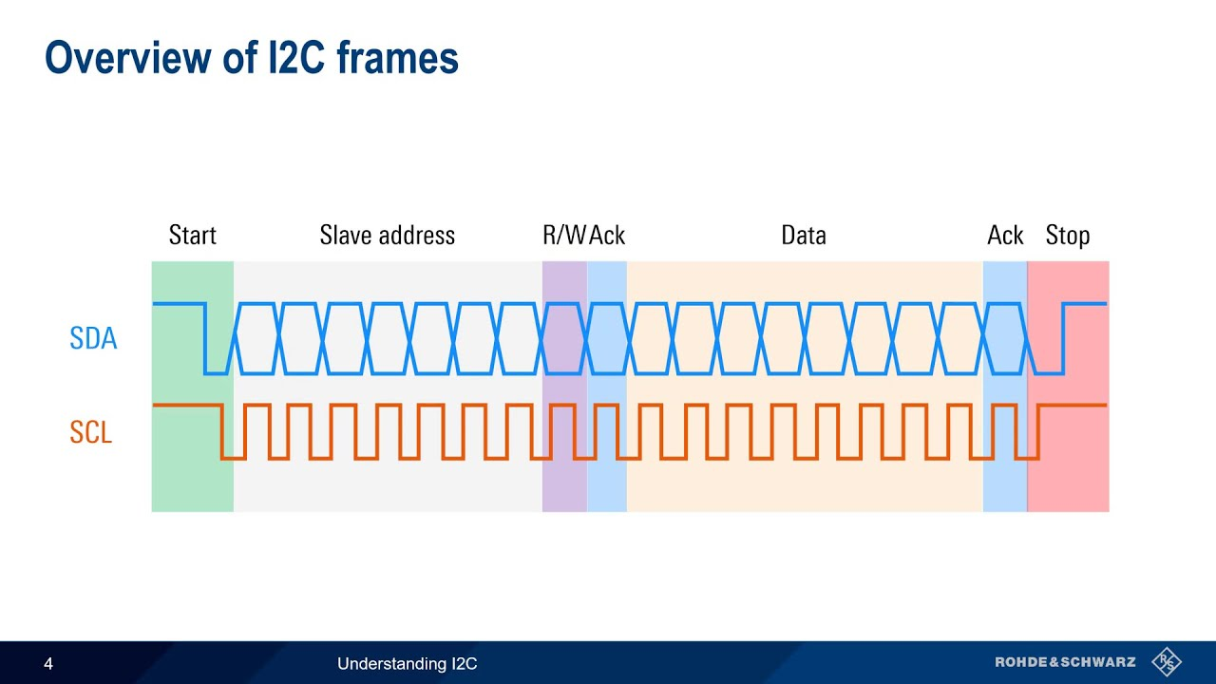
I2C (Continued)
Steps in I2C communication
  1. Start Bit - Master pulls the idle SDA line low before SCL goes low
  2. Slave Address – Master transmits the address of the slave to communicate with
  3. Read/Write – Master sends a 1 to read data, 0 to write data
  3. Slave Acknowledge – Slave sends a 0 to accept, 1 to reject the request
  4. Data – Master or slave 8 bits, depending on read/write
  5a (Read). Master Acknowledge – Master sends a 0 to accept, 1 to reject the data
  5b (Write). Slave Acknowledge – Slave sends a 0 to accept, 1 to reject the data
  6. Stop bit – Master releases SDA line to high after SCL goes high

