Slide 1
Real-Time Operating Systems
GNC Software Onboarding Lecture #3

Slide 2
What is an Operating System?
MacOS, Windows, Linux
An operating system (OS) is software that acts as an intermediate layer between user programs and the computer’s hardware
Responsibilities
  Allocating CPU time between user programs
  Delegating memory to each program
  Interacting with the hardware on the computer – memory, storage, USB devices, displays
    The OS will allow user programs to indirectly control this hardware

Slide 3
What Does “Real-Time” Mean?
On a desktop environment, operating systems may go several milliseconds between executing tasks
  Usually, this delay is still not noticeable to users
  Also caused by background processes
This is acceptable for systems in which it is not strictly necessary that things happen exactly when they need to
  If you click your mouse and there is a few millisecond delay, it’s not the end of the world
In a rocket, what if the OS takes a few milliseconds longer to get data from a sensor?
  Now the control loop is lagging behind the true state of the rocket, and we all of a sudden run into some pretty serious problems
In rocket flight software, precise timing is critical

Slide 4
Real-Time Operating Systems
A real-time operating system (RTOS) is an operating system that specializes in responding quickly to real-time events
GNC uses a free and open-source solution developed by Amazon called FreeRTOS
Components of FreeRTOS
  Tasks – independent loops that perform some dedicated function
  Notifications – allows tasks to send signals to each other
  Stream buffers – allows tasks to send data to each other
  Mutexes – guarantees that only one task is accessing a resource at a time

Slide 5
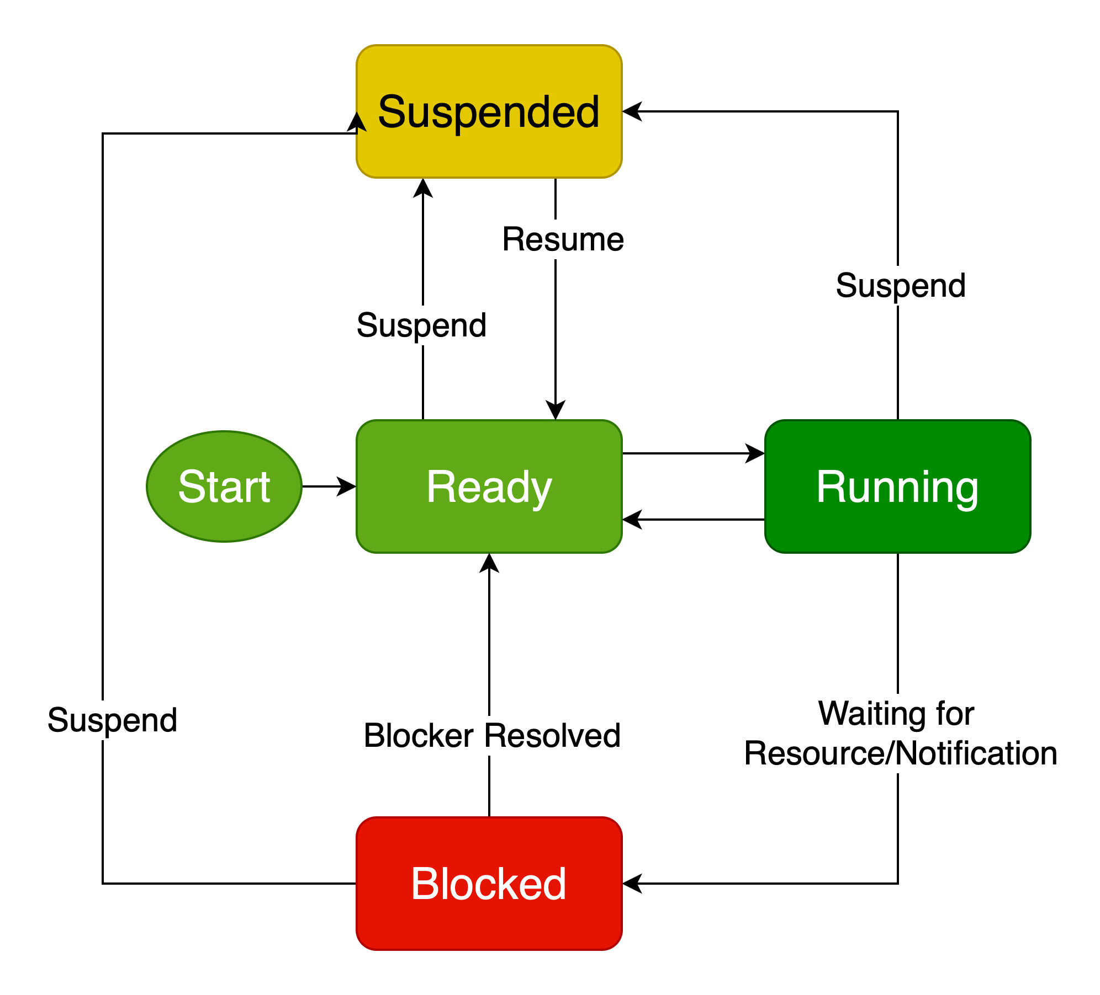
Tasks
A task is the basic unit of execution in FreeRTOS
They are functions that continuously loop
Only one task can truly be running at a time, but the scheduler switches between tasks extremely quickly to give the illusion that they are executing in parallel
Tasks have specific states: ready, blocked, running, suspended

Slide 6
Notifications
Say that in our flight software, we need to wait for some external event to happen before we begin logging data
  Ex. Waiting for a “go” signal from ground station
In the task that logs data, wait on a notification from another task that handles telemetry
When we receive a notification, check that it is the “go” signal

Slide 7
Stream Buffers
Say we have task A that produces some data such as sensor readings, and we want to process that data in task B
  This frees task A to read more sensor data while task B is processing
We could use a stream buffer to send sensor readings from A to B
You can think of a stream buffer as a pipe from task A to task B through which task A will send data and task B will receive it
Task B will wait for data in the stream buffer and process it

Slide 8
Mutexes
Say that instead of sending data from one task to another, we want to share some data between an arbitrary number of tasks
We cannot just create a global variable and read/modify it in each task that needs it
  This creates undefined behavior, as we may switch to a different task in the middle of modifying that global variable
Instead, one solution is to create a mutex
A mutex signals access to a shared resource between tasks such that only one task can own that resource at a time
  Before modifying/reading a shared variable, you must take ownership of the mutex
  It is not guaranteed that the resource will be available, so you can specify a timeout

Slide 9
Practice Exercises
Go to https://github.gatech.edu/gnc/software-onboarding and do exercise 3
  1. Run “git clone https://github.gatech.edu/gnc/software-onboarding”
  2. Create a branch by running “git checkout –b <first name>-exercise3”
    Ex. Sam would run “git checkout –b sam-exercise3’
    This creates a new branch
  3. Do the exercise following the instructions in the exercise 3 README
  4. Stage your changes by running “git add .”
  5. Commit your changes by running “git commit –m <commit message>”
    Ex. git commit –m “Sam exercise 3”
  6. Push your changes by running “git push origin <first name>-exercise3”
  7. Create a pull request in GitHub to merge your branch into the main branch

Slide 10
Reference Materials

Slide 11
Useful Links
https://www.freertos.org/Documentation/01-FreeRTOS-quick-start/01-Beginners-guide/00-Overview – Beginner’s guide to FreeRTOS
https://www.freertos.org/Documentation/02-Kernel/02-Kernel-features/00-Developer-docs - FreeRTOS documentation
https://github.gatech.edu/gnc/flight-software/tree/refactoring-main/Tasks – a few FreeRTOS tasks used in the current flight software

