Slide 1
Your experiences with R
Was it how you expected? Easier? Harder?
What were your difficulties?
What strategies did you develop to deal with these?

Slide 2
Troubleshooting
Make sure R and RStudio are up to date
RStudio:
Help -> Check for updates
R:
Run sessionInfo() in console to check current version
download and install latest version
for Mac: https://cran.r-project.org/bin/macosx/
for Windows: https://cran.r-project.org/bin/windows/base/
Google error messages
Ask for help: Google, Stackoverflow, https://community.rstudio.com/

Slide 3
Introduction to Multi-Level Modeling
Notes:
A topic that came up for almost all of the groups as something you are either already using or could use to further explore your data is multi level modeling. Even if most of you aren’t going to use this in your final thesis we thought we could just give you an introduction today and you can use it in an exploratory way on your data even if you don’t end up including in your thesis.
Disclaimer: this is a very big and complex topic. obviously we only have a limited time today so I don’t expect that after this you will find it easy or be able to run any model with no problems. I just want to give you an idea and familiarty with the basic ideas and priniciples so if you end up seeing them later e..g in your masters thesis, it won’t be so foreign and you will already have an understanding of why these models can be useful.
For that reason I’m not going to go deeply into the statistics behind it and go heavy with lots of formulas and equations, we’re just gonna stick more to the underlying ideas and then go through some examples in R.

Slide 4
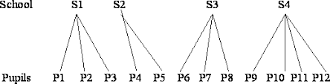
What are multi-level models?
Method of analyzing data that is nested
Where in your data structure do you have nested data?
What other examples can you think of?
What are examples of research questions that you could answer with this kind of data?
What are the problems?
What could be a way to deal with this?
Notes:
Multi-level models, you might also see them referred to as hierarchical linear models or mixed effects models, are a method of analyzing data that is nested. Examples?
Discussion.
For example, this could be data collected from students who are nested within classrooms which might further be nested within multiple schools, or alternatively, as I know many of you have in your data sets, multiple measurements collected from each participant. You might see these levels referred to as Level 1, Level 2 etc and what this means is that the Level 1 variable is the lowest level of measurement, so that would be student in the schools example or in the second example say you were measuring performance on the Stroop task, performance would be the Level 1 variable here. Then the Level 2 variable is the next level up so classroom or participant, and you could theoretically then have higher levels such as schools if you had a more complex data structure.
Can look at variables at different levels, e.g. in an organization, you can look at and compare the effect of say working hours or work climate, at the whole organization level vs the department level. As for the measurement within particpinat example, you can use these methods to look at the development of certain variables across time and how for example different personality constructs influence or interact with that.

Slide 5
What are multi-level models?
Method of analyzing data that is nested
For example:
data collected from students nested within classrooms nested within schools
multiple time points collected from each participant
 | Students in schools | Measurements within participant
Level 3 | School
Level 2 | Classroom | Participant
Level 1 | Student | Measurement
Notes:
For example, this could be data collected from students who are nested within classrooms which might further be nested within multiple schools, or alternatively, as I know many of you have in your data sets, multiple measurements collected from each participant. You might see these levels referred to as Level 1, Level 2 etc and what this means is that the Level 1 variable is the lowest level of measurement, so that would be student in the schools example or in the second example say you were measuring performance on the Stroop task, performance would be the Level 1 variable here. Then the Level 2 variable is the next level up so classroom or participant, and you could theoretically then have higher levels such as schools if you had a more complex data structure
Can look at variables at different levels, e.g. in an organization, you can look at and compare the effect of say working hours or work climate, at the whole organization level vs the department level. As for the measurement within particpinat example, you can use these methods to look at the development of certain variables across time and how for example different personality constructs influence or interact with that.

Slide 6
Assumptions of regression
Normality: residuals are normally distributed
Homogeneity of variance (homoscedasticity): variance of residuals is constant across levels of predictor
Independence: all data points are independent of one another
Clusted data violates the independence assumption
→ underestimate the standard error, increase probability of false positives
Notes:
To see why MLMs are important we can have a look at the assumptions you make when you do a standard regression or an ANOVA. You should be familiar with these so I won’t go into them too much but just as a reminder: You have the normality assumption which states that the residuals should b enormally distributed. Note that the outcome doesn’t need to be normally distributed: that doesn’t matter, it’s about the residuals. If your raw data are a bit skewed but the residuals are normal, that’s totally fine.
Regression also assumes homogeneity of variance, or homoscedasciticy that means that the residual variance should be the same across levels of the predictor. It should’t be the case that when X is small, your residuals are small, but when X is big, the residuals are also large. The residual error should be fairly constant across levels of X.
The independence assumption, means that the residuals should not be correlated. Put simply, if osme of your data points are related to or influenced by some of your other data points, this violates the independence assumption.
Now regression is actually quite robust to violations of the normality or homogeneity of variance assumption. But regressions and ANOVAs and other statistical tests that you’ve probably encountered, are typically not robust to violations of the independence assumption. Violating the independence assumption typically has much more consequential effects on the inferences you can make from your analyses than violating other regression assumptions. If you don’t account for dependencies within your data, this essentially amounts to artificially inflating your sample size. What I mean by this is that if you assume independence when it’s not given, you’re overestimating the amount of independent pieces of information your data contain. For example, if you have 100 independent data points, you have 100 pieces of information telling you about the relationship between x and y. If however, you have 10 participants and they each provide 10 data points, you don’t have 100 pieces of independent information, you’re not getting all new information from all of these points. This is because some of these points are related to each other, namely the ones coming from the same participant, and so if you ignore these dependencies and claim to have 100 independent data points, you will be over confident in your results. This means that the SE will be underestimated and you increase the chance of a Type 1 error, or false positive, which is not what we want.
SO what do we do?

Slide 7
Solutions to the independence assumption violation
Design studies with no clusters
Reduces statistical power
Aggregation across groups
Lose a lot of information
Can produce misleading results
Notes:
One option has to do with design choices. You could in theory, design all of your studies so you only measure one student per class, or you only measure each participant once. This also isn’t always feasible or sensible. Imagine you are doing a reaction time study and you have each participant come in, press a button once, and then send them away again. Or, if you measure a participant multiple times, you can aggregate across all these measurements to just end up wit hone data point per participant. A lot of you will have already done this approach, where you take for example each participant’s mean performance and then use this data to do a standard regression or anova.
This is a perfectly valid approach, but this reduces your statistical power, since you lose a lot of information when you only use a mean value. If you have the option to measure data from multiple students in a class, or take multiple measurements from each participant, then this is going to give you more information and more power and you should do this.
As it happens, it’s very common in research designs in very many fields to have these kinds of groupings where you take multiple measurements from some group, like a classroom or a participant, and this isn’t a bad thing, we just need to pay attention to it when it comes to the analysis stage of the project.
Now to see an example of how this can also misleading conclusions if we don’t pay attention to groupings when we analyse the data.

Slide 8
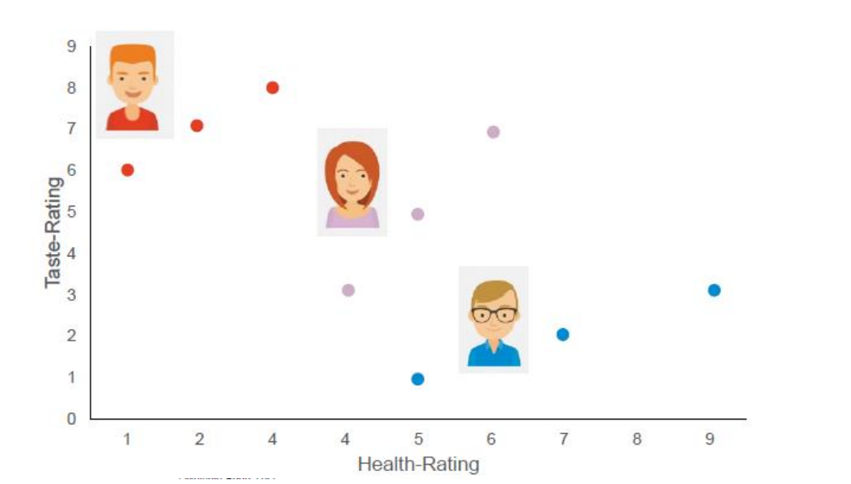

Slide 9
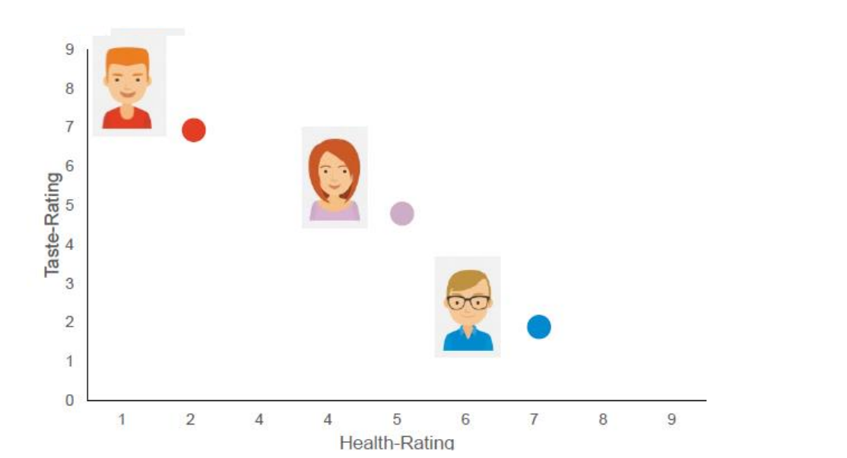

Slide 10
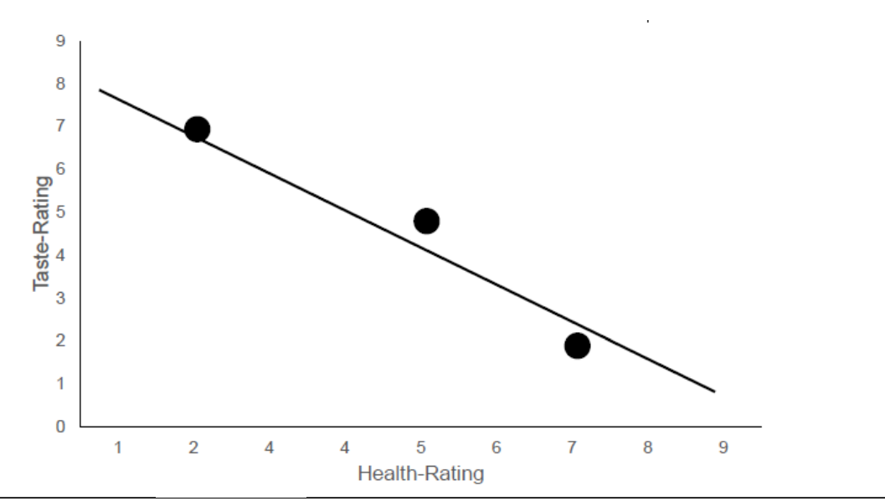

Slide 11
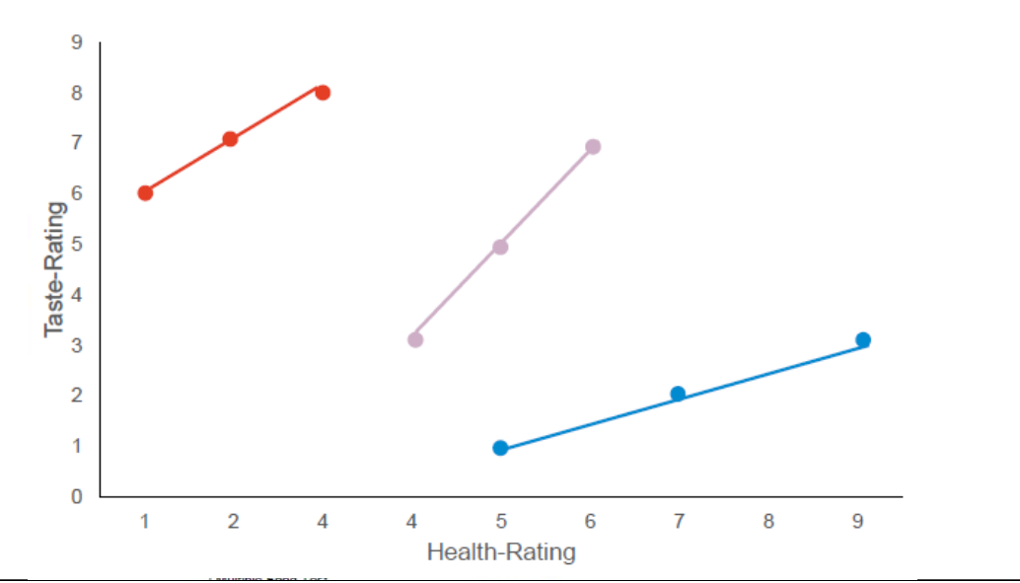
Simpson’s paradox: relationship between X and Y is different within compared to between groups

Slide 12
Advantages of multi-level models
Traditionally dealt with by using a repeated measures ANOVA. However:
Needs complete data for each group or else the entire group will be deleted
reduces power if there are many cases with missing data
Dependent variable must be continuous and independent variable must be categorical
no information about magnitude or direction of effect sizes
no individual coefficient estimates
Notes:
A limitation of ANOVAs is that they don’t deal too well with missing data. Say you measure each participant 10 times, but one participant you only get 9 measurement points for, that whole participant is going to be dropped from the analysis. This can be problematic if you have lots of cases with missing data points, you can end up dropping a lot of information and this is really going to hurt your statistical power.
There are also restrictions on the types of data that can be analysed with this approach. ANOVAs assume that the dependent variable is continuous and the independent variables are categorical.
Experiments in which the outcome is categorical, for example whether they got a particular trial correct or not, must either be aggregated or analyzed using a different technique. And if you have continuous predictors (e.g., time in a longitudinal study) must be treated categorically, so chop them up into bins, which reduces statistical power and makes it difficult to model nonlinear relationships between predictors and outcomes.
A final drawback of ANOVAs is that although they indicate whether an effect is significant, they do not provide information about the magnitude or direction of the effect; that is, they do not provide individual coefficient estimates for each predictor that indicate growth or trajectory.

Slide 13
Advantages of multi-level models
Handles missing data and unbalanced designs better
Groups with more missing cases have a weaker influence on the parameter estimates than groups with more cases
Can also be used with continuous predictors and a variety of types of response variables (e.g. categorical outcomes)
Fitted model provides coefficient estimates that indicate the magnitude and direction of the effects of interest
Notes:
These shortcomings of ANOVAs and multiple regression can be avoided by using multilevel modeling.
Multi level modeling handles missing data and unbalanced designs quite well; although when an observations is missing it will obviously have to be removed, the remaining observations in that group can still be included. So going back to our previous example, if we have 10 measurements per participant, and for one participant we only have 9, we can still include those 9 observations in the model. This is obviously much better for the statistical power of the model.
What the model can also account for, is that participants or items with more missing cases also have weaker influences on parameter estimates than partipants with more data points, which is good because the more information you have from a group, the more confidence you can have in the reliability of that data.
Further, continuous predictors do not pose a problem for mixed-effects models, and the models can be extended to handle a variety of types of response variable including categorical outcomes.
The fitted model provides coefficient estimates that indicate the magnitude and direction of the effects of interest, so you can know not only if a predictor has an effect but how big the effect is and in which direction.
Mixed-effects modeling is therefore appropriate in many cases in which standard ANOVAs, repeated measures ANOVAs, and multiple regression are not. Thus, it is a more flexible analytic tool.

Slide 14
Fixed and random effects
Fixed effect:
Variables used in standard regression
Usually variables of interest in your data
Random effect:
Grouping variables that you wish to account for in your data
Not interested in specific cases but want to control for their effect
Example: Experimental condition
Example: Participant in a repeated measures design

Slide 15
TASK
Copy and paste the following code to simulate alternative output data:
sleepstudy <- sleepstudy %>% group_by(Subject) %>% mutate(ReactionA = mean(Reaction) + rnorm(10, 0, 5), ReactionB = mean(sleepstudy$Reaction) + rnorm(10, 0, 10))
Plot the original data using the following code, and then adapt it to plot the simulated data to compare:
ggplot(sleepstudy, aes(x = Subject, y = Reaction)) + geom_boxplot() + geom_point(aes(colour = Subject)) + stat_summary(fun = "mean") + labs(title = "Original data")
Predict how the ICC will differ between the three outcome variables
Plot the null model and calculate the ICC for the three output variables and see if your predictions were correct.

Slide 16
TASK
Use the example_data_wide dataset from Moodle, first convert from wide to long format
Create a new variable ‘time’ that is the proportion of the blocks completed, i.e. block/15
Create a model predicting performance over time with a random intercept for each subject (first keep slope constant)
What is the intercept of Subject 7?
What is the slope of Subject 10?
Now add a random slope for time.
what is the correlation between the random effects?
What is the intercept and slope of Subject 8?

Slide 17
TASK
Add group as a fixed effect to your previous model with example_data
Output the results in a table showing the 95% confidence intervals, standard error and test statistic. Give the table a title and export to a Word document.
Plot the model using plot_model, showing a separate line for each group
Use a likelihood ratio test to see if adding group significantly improves the model fit.

