Slide 1

Assessment of Market-sets:
Competitive & Complementary

Slide 2
Why?
Because knowing who can help to leverage our attendance and sales through cooperation will benefit us.
- and -
Because knowing how well we compare to others (e.g., service, amenities, etc) will predict our ability to remain a viable choice

Slide 3

Progressive Improvement:
Layers of an onion
We are probably not going to produce the most-comprehensive assessment the first time we do it.
But each time we update it, the assessment should get a little better, more accurate, more detailed, more-closely resembling reality.

Slide 4

What defines a ‘competitor’?
Proximity
Kinds of Amenities / Experiences / Services
Consider events, not just brick-and mortar sites
Quality of Amenities / Experiences / Services
They consider us a competitor
Target Audience
Price range
... and lots and lots
of other characteristics …

Slide 5
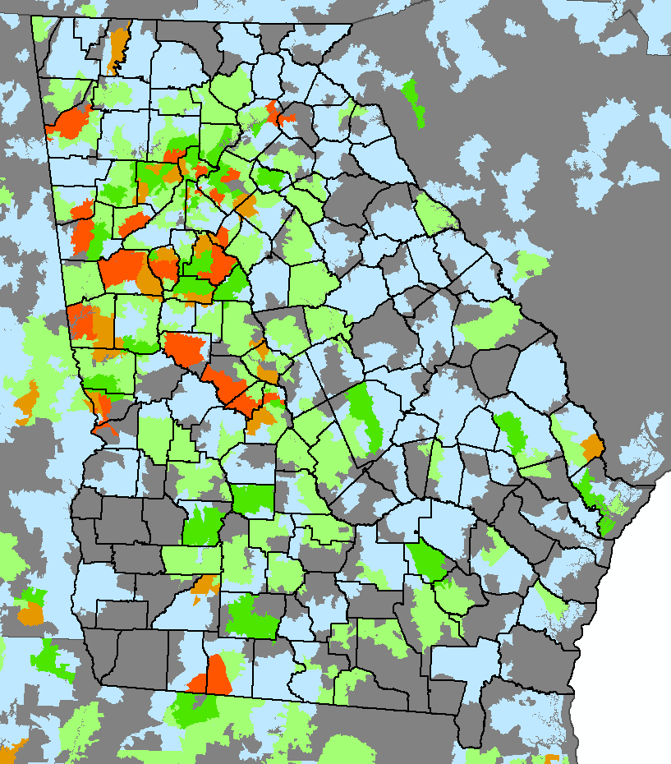
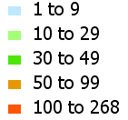
Mapping, Predicting, Capturing
So, we get lots of people from Upson County, but hardly anyone from Pike and Meriwether Counties.
Why?
Is there something better there?

Slide 6
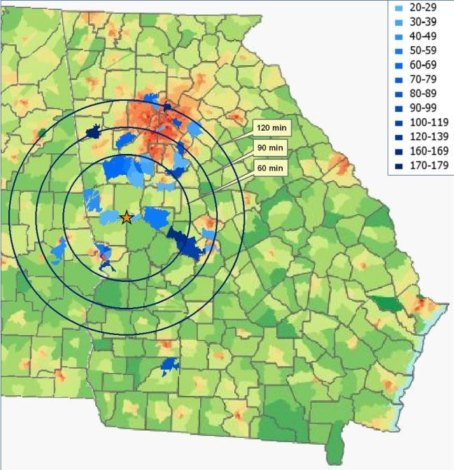
What’s our
‘reach’?

Slide 7

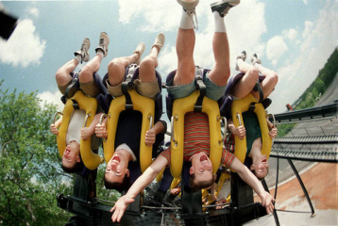
What is not a ‘competitor’?
Not every entity vying for a dollar is a competitor.
Considering Roosevelt’s Little White House…
Auto parts store? No.
Grocery store? Eh, no, not really.
Six Flags over Georgia? I don’t think so.
National Infantry Museum (1hr away)? Yes.
vs.

Slide 8
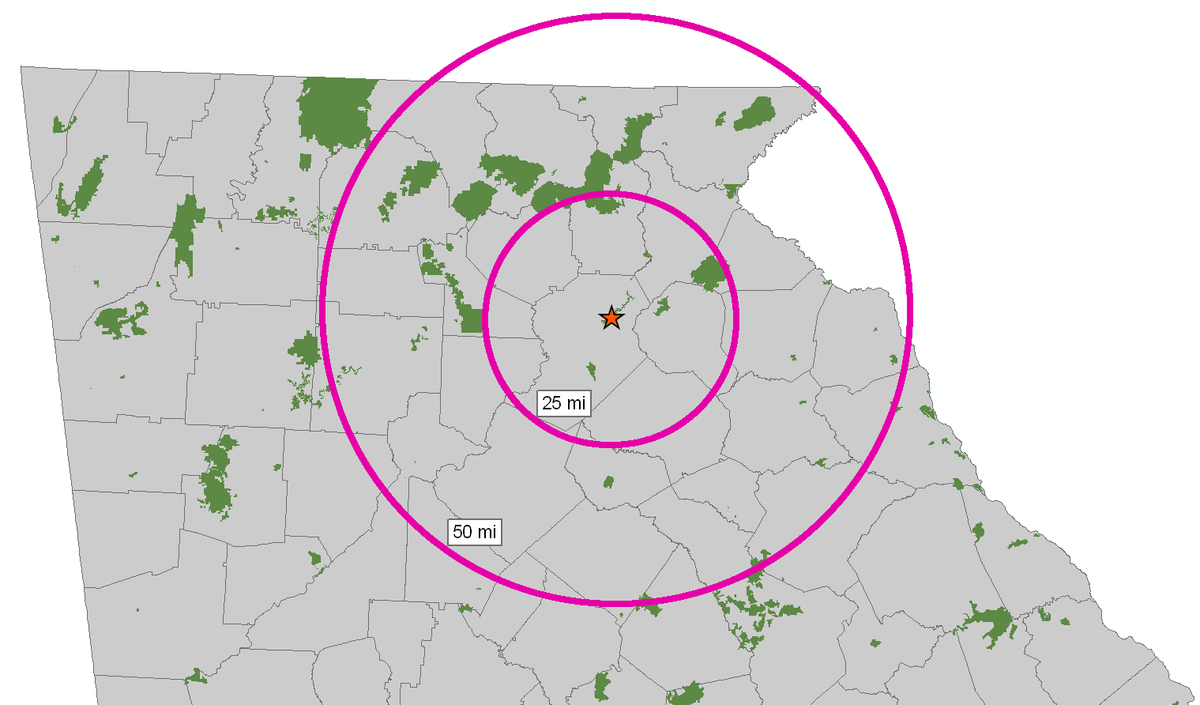
What is not a ‘competitor’?
What about other (GA) State Parks? Wildlife Management Areas? USACE lands? USFS lands?

Slide 9
Websites
Google Maps
E-Podunk (www.epodunk.com)
Goby.com
ReserveAmerica.com Often identifies state and federal sites, rarely private operations.
Camping.com Often identifies private sites (not government sites)
Recreation.gov Identifies federal sites
Trails.com
GoCamping.com
ExploreGeorgia.org
Sadly, PRHSD properties often do not
show up on these searches. Why not?

Slide 10









Websites

Slide 11
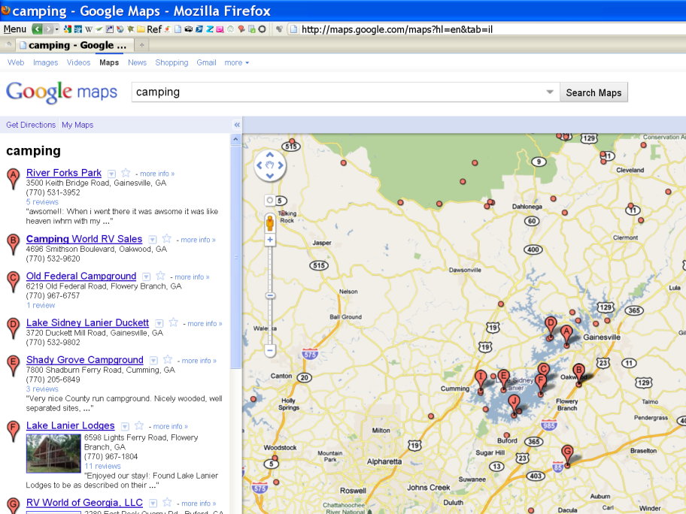

Slide 12
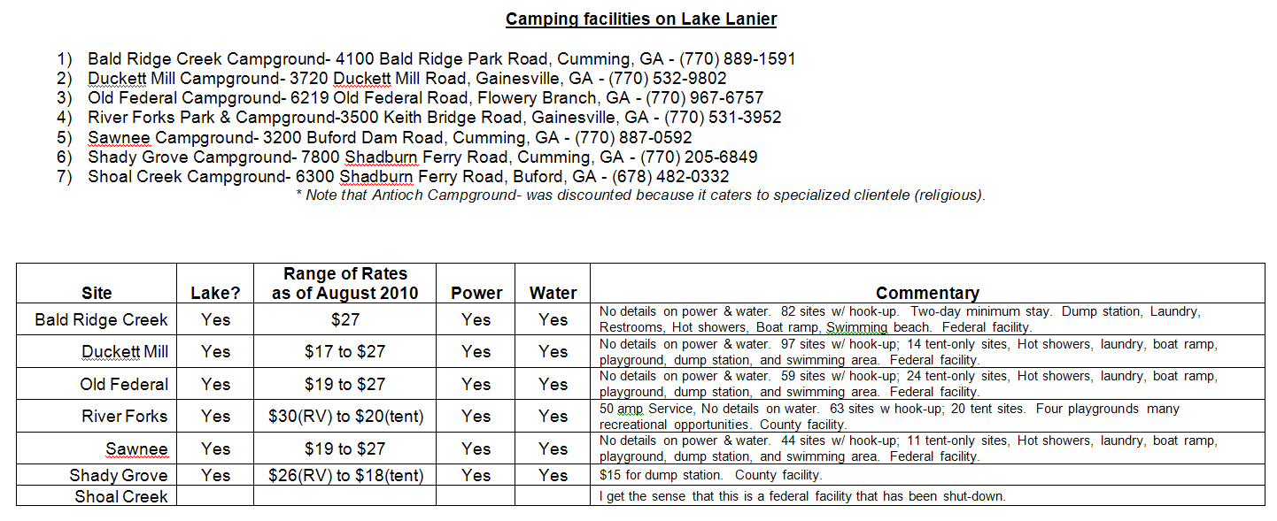

Slide 13
Special Note on Cabins
Often, the terms ‘cabin’ or ‘cottage’ will return results that represent larger, stand-alone, private homes
(rented for weeks or months at a time).

Slide 14
Progressive Improvement:
Layers of an onion
We are probably not going to produce the most-comprehensive assessment the first time we do it.
But each time we update it, the assessment should get a little better, more accurate, more detailed, more-closely resembling reality.

Slide 15
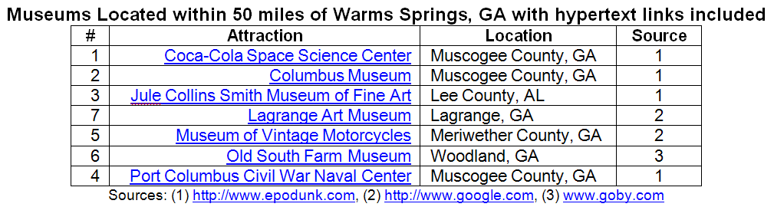

First Layer: Names & Locations

Slide 16
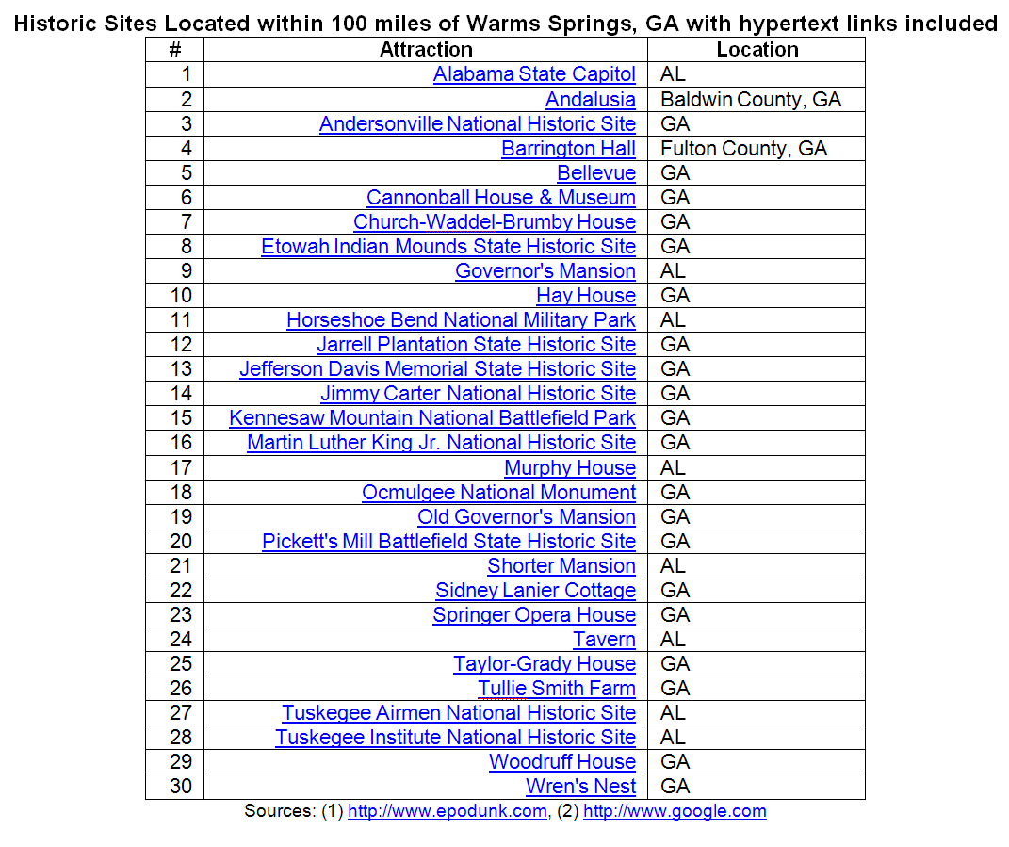
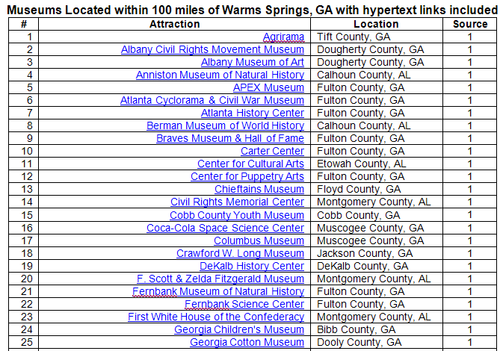

Slide 17
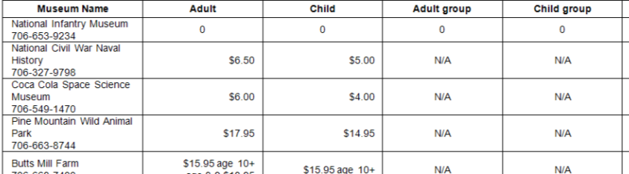
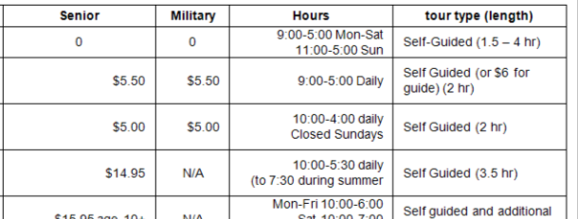
Second Layer: Costs and Details

Slide 18
Complementary Market-set
Same tools, different approach.
Define your reach
Define attributes of complementary partners
Explore and invent creative collaborations (e.g., consider translating the marketing practices you personally experience)
Use mapping tools, website search, events-postings,
What draws people to your community that is similar-enough to appeal to a common audience, but different-enough not to be ‘competition’?

