Slide 1
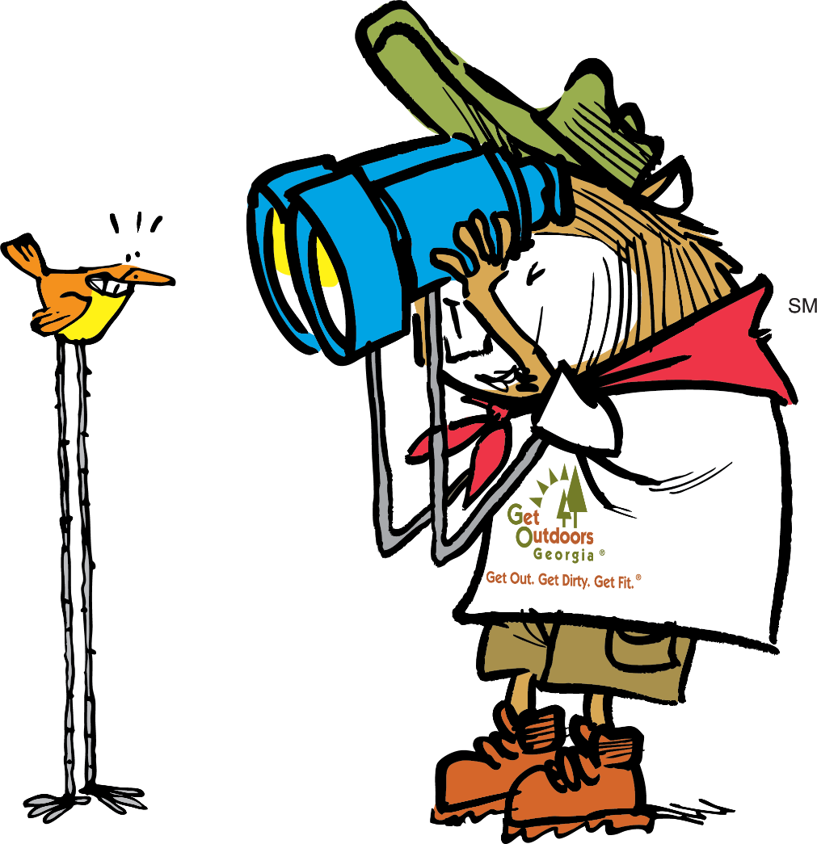


Posting
Events to GaStateParks.org

Slide 2
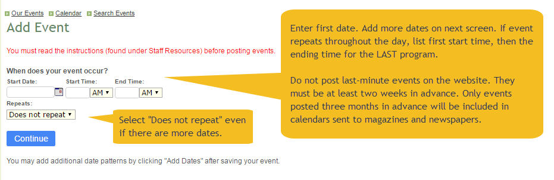
To begin, you must set up an account.
At the bottom of GaStateParks.org click “Staff Resources,” then click “Sign in or create an account.”
If you have a username and password, go ahead and sign in. If not, proceed to “Create an Account.”
Contact Amanda.Hrubesh@dnr.ga.gov to have your access level increased to “staff” and to change your password if you would like a new one. Once you receive a confirmation, you will be able to add events.
Once you are logged in, go to Explore.GaStateParks.org/Staff or click Staff Resources from bottom of GaStateParks.org. Click “Add Event” (on right side). Below is the next screen you’ll see.

Slide 3
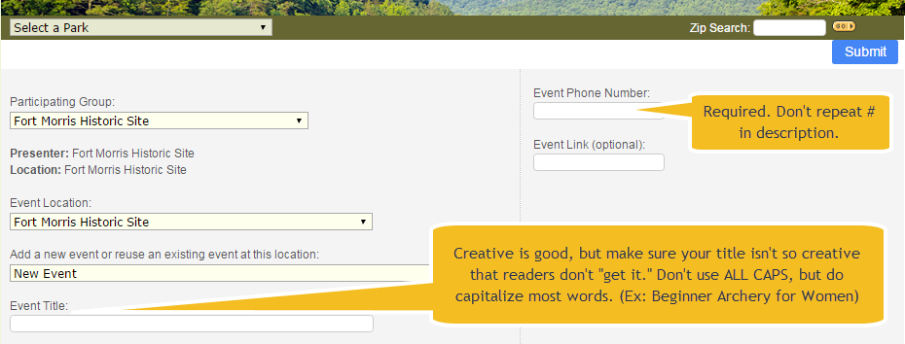
This is the top of the next screen.
Tip: If entering a statewide event (such as National Trails Day) give it a title specific to your event, not simply National Trails Day. This prevents duplication among all the parks. It’s okay to put National Trails Day AFTER the title (Avian Loop Hike: National Trails Day).

Slide 4
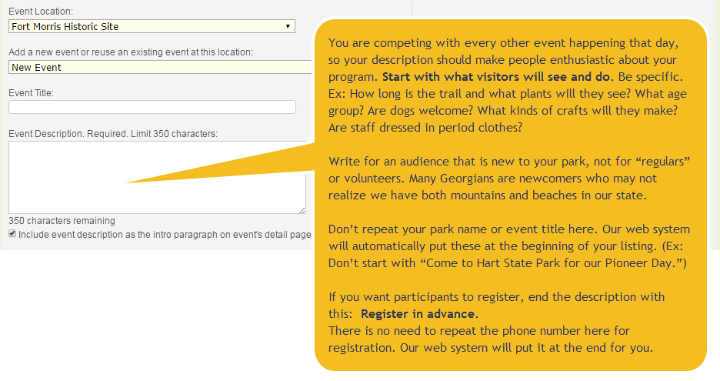
Writing an effective description (1 of 2)
Tip: This is the most important part of your listing. Please read this page and the next carefully.

Slide 5
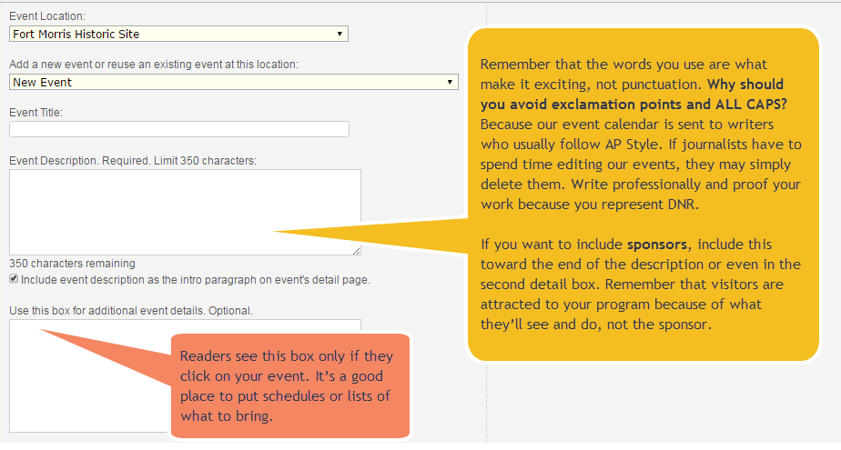
Writing an effective description (2 of 2)
Tip: Spell out “and” instead of using “&.” The less an editor has to change, the more likely they’ll include your event in their calendar.

Slide 6
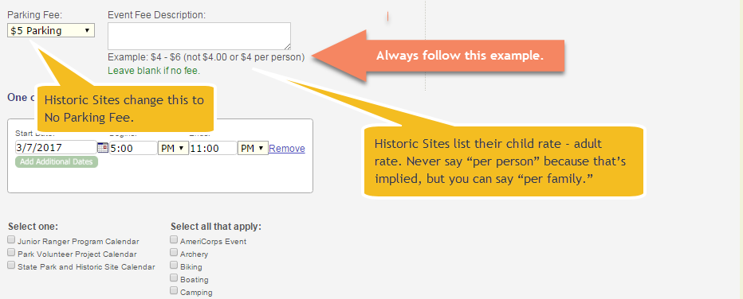
Fees.
Tip: All fees must be written in the same format for consistency throughout the calendar.
Do not say “regular admission charged” because the average reader does not know your fees.

Slide 7
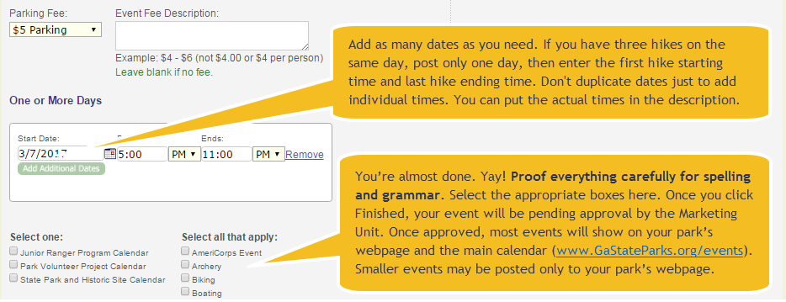
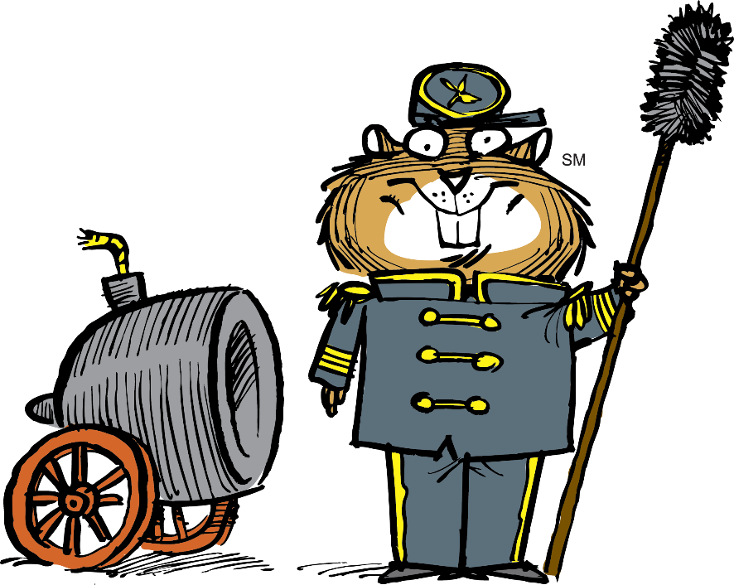
You’re almost done. Yay!
Tip: If your event spans numerous days (such as a temporary exhibit) it may be best to add it to your website copy rather than the calendar. Call the Marketing Unit at 770-389-7284 for advice.

