Slide 1
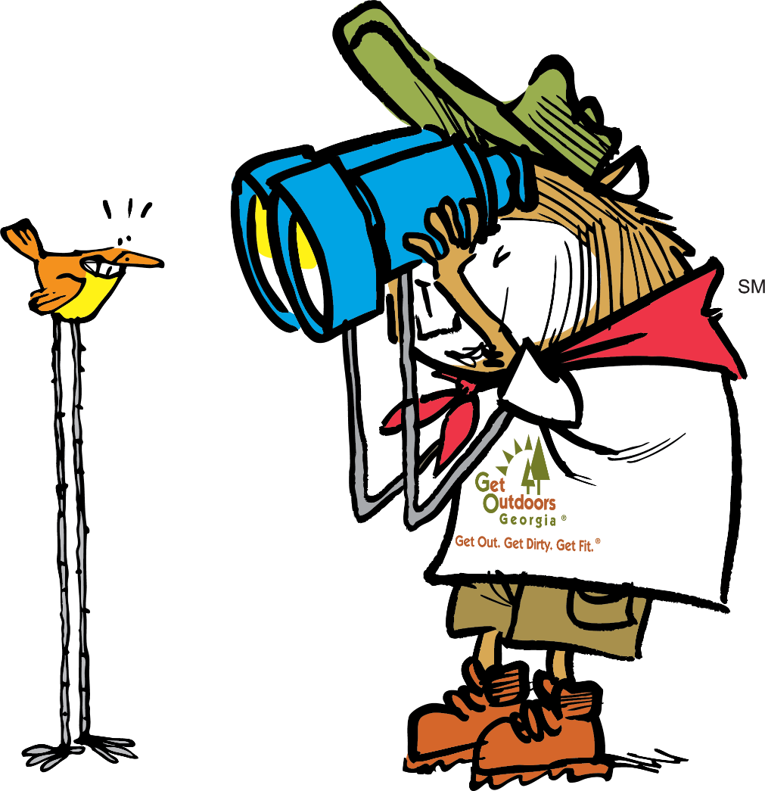


Posting
Events to GaStateParks.org

Slide 2
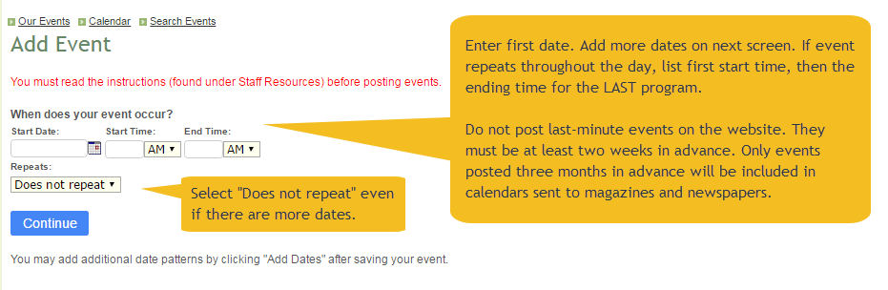
To begin, you must set up an account.
At the bottom of www.GeorgiaStateParks.org click “Sign In.”
Go to Create Account – Use your office address and e-mail. You will receive a User Name and Password via e-mail.
Contact Ben.Chambers@dnr.ga.gov to have your access level increased to “staff” and to change your password if you would like a new one. Once you receive a confirmation, you will be able to add events.
To add an event, click on ‘Staff Resources’ in the footer of the website. Click the large ‘Add Event’ button near the top right of the staff resources page. Below is the next screen you’ll see.

Slide 3
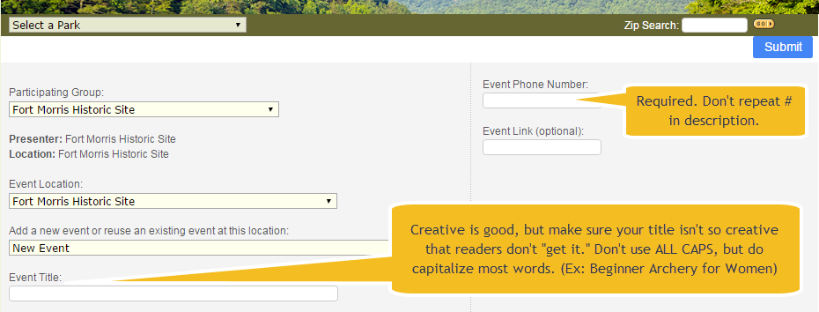
This is the top of the next screen.
Tip: If entering a statewide event such as National Trails Day, give it a title specific to YOUR event, not simply National Trails Day. This prevents duplication among all the parks. It’s okay to put National Trails Day AFTER the title. (Example -- Avian Loop Hike: National Trails Day)

Slide 4
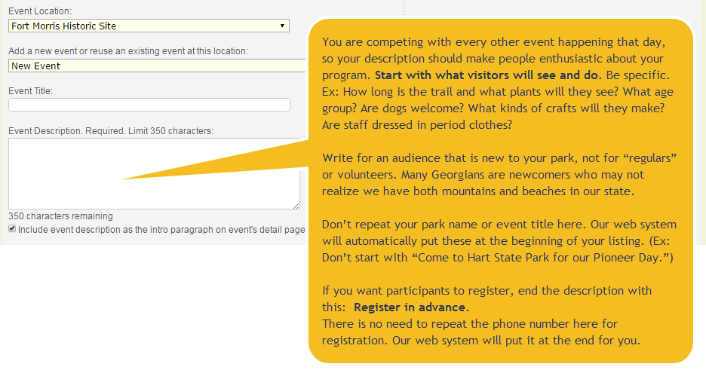
Writing an effective description (1 of 2)
Tip: Your listing is a reflection on the Georgia Department of Natural Resources, so be professional. Proof your work for spelling and grammar. Listings that don’t follow instructions may be deleted without notice.

Slide 5
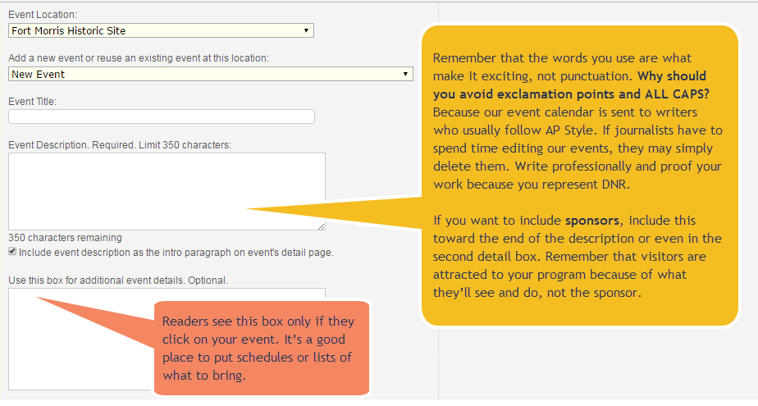
Writing an effective description (2 of 2)
Tips: Don’t click “enter” after each sentence. The description should be one paragraph. Don’t use exclamation points instead of periods. Spell out “and” instead of using “&.” The less an editor has to change, the more likely they’ll include your event in their calendar.

Slide 6
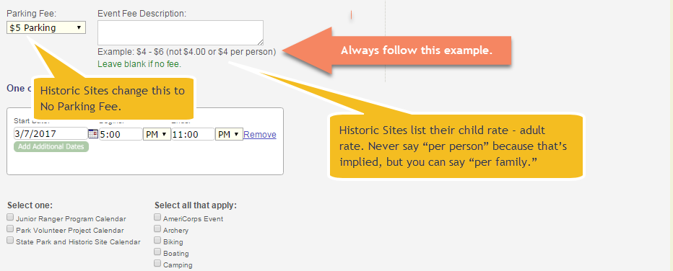
Fees.
Tip: All fees must be written in the same format for consistency throughout the calendar.
Do not say “regular admission charged” because the average reader does not know your fees.

Slide 7
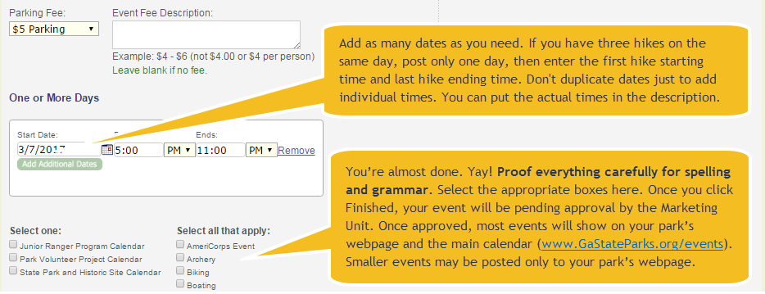
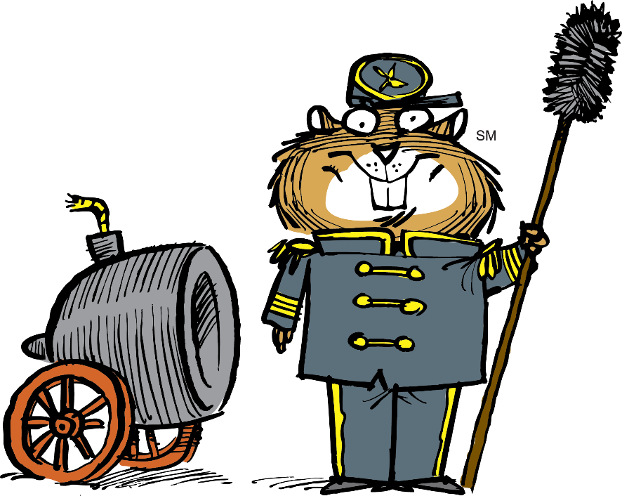
You’re almost done.
Tip: If your event spans numerous days (such as a temporary exhibit) it may be best to add it to your website text rather than the calendar. Call the Marketing Unit at 770-389-7284 for advice.

