Slide 1
Enhancing Fraud Detection via GNNs with Synthetic Fraud Node Generation and Integrated Structural Features
published in: International Conference on Artificial Neural Networks 2024, Springer

Slide 2
Problem
Description

Slide 3
Fraud detection
The problem: fraud detection in graphs using GNNs.
Binary classification (Fraudster ή Legitimate);
Additional difficulties:
"Camouflaged" fraud
Imbalanced classes

Slide 4
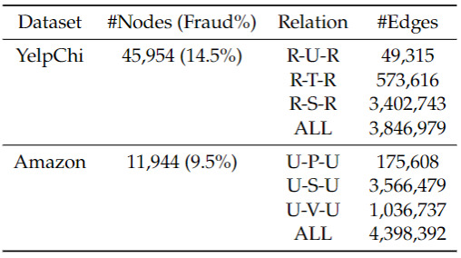
Fraud detection
Datasets
YelpChi: reviews on hotels and restaurants
Amazon: users posting reviews in the Musical Instruments category

Slide 5
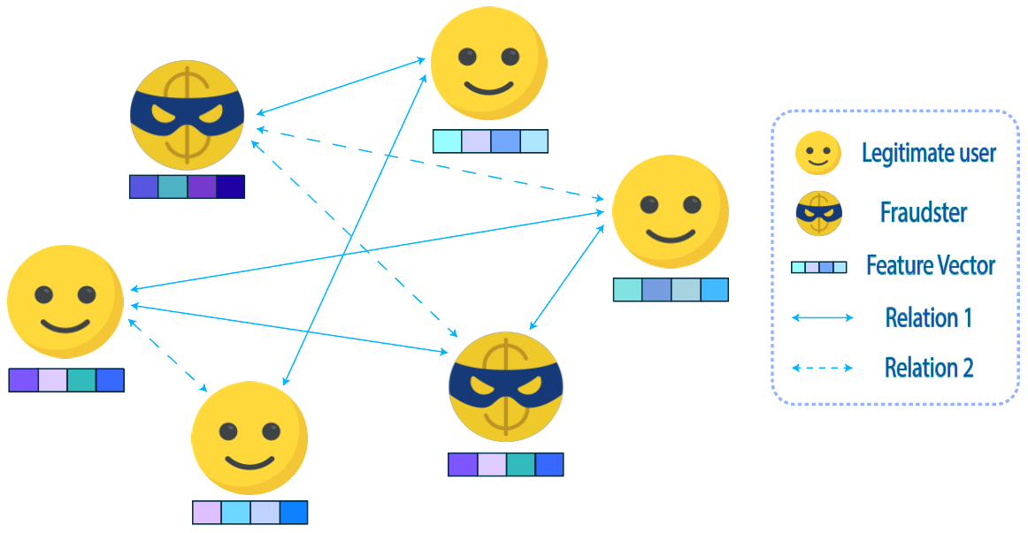
“Camouflaged” fraud
Types of camouflage
feature camouflage: concerns the feature vector of a user
structural inconsistency: concerns connections between users

Slide 6
Background

Slide 7
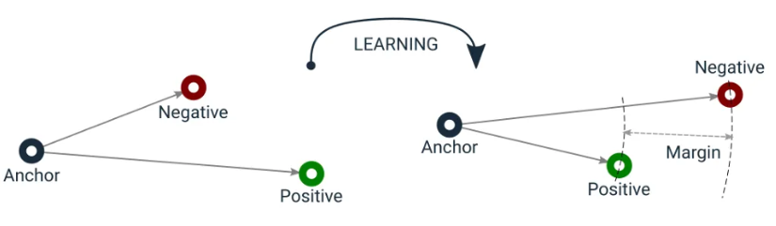
Contrastive Learning (CL)
Objective
Create an embedding space where:
similar samples have have come closer together,
dissimilar samples have distanced themselves from each other,
the samples are compared based on the category they belong to and not their feature values.
*anchor: the sample under consideration in the current iteration

Slide 8
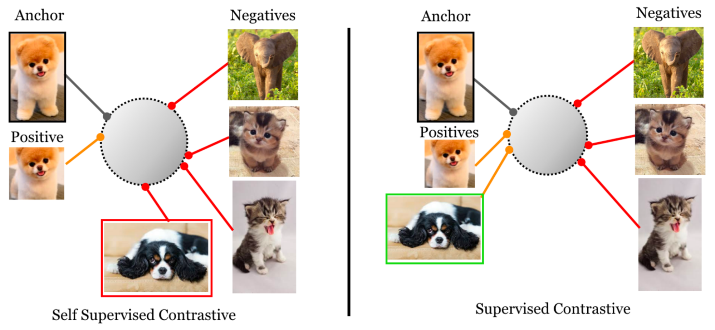
Types of Contrastive Learning
Two types of Contrastive Learning:
self-supervised
supervised (SCL), which was used in this paper.
SCL: considers as positives all the samples that belong in the same class as anchor.
Self-supervised CL: considers as positives only the augmentations of the anchor.
Source: Supervised contrastive learning, 2020, Khosla et al.

Slide 9
State-of-the-art

Slide 10
01
Applications with GNNs
CARE-GNN (2020)
Filter neighbors of a node using:
label-aware similarity measure
threshold for choosing the number of neighbors trained with reinforcement learning
02
PC-GNN (2021)
It works in two steps.
Pick step : training where minority class nodes are selected with higher probability.
Choose step: new neighbors of a node are the nodes whose GNN-generated embeddings are closest to that node's embedding

Slide 11
Applications with GNNs + SCL
03
CACO-GNN (2022)
It uses supervised contrastive learning (SCL) to combat feature camouflage thereby improving the sampling of neighbouring nodes.
04
IMINF (2023)
Like CACO-GNN, it uses supervised contrastive learning and adds an interactive learning framework

Slide 12
Contribution

Slide 13
BRIE
Boosted Representation with Integrated Structural Features and Synthetic Fraud GEneration
Dual approach:
augment dataset with additional structural features
improve the contrastive learning module by introducing synthetic nodes of the minority class

Slide 14
Additional structural features
Create new features for the entire dataset AND for the synthetic nodes
degree
second-order degree
opposite label count
preferential attachment
clustering coefficient
structural similarity

Slide 15
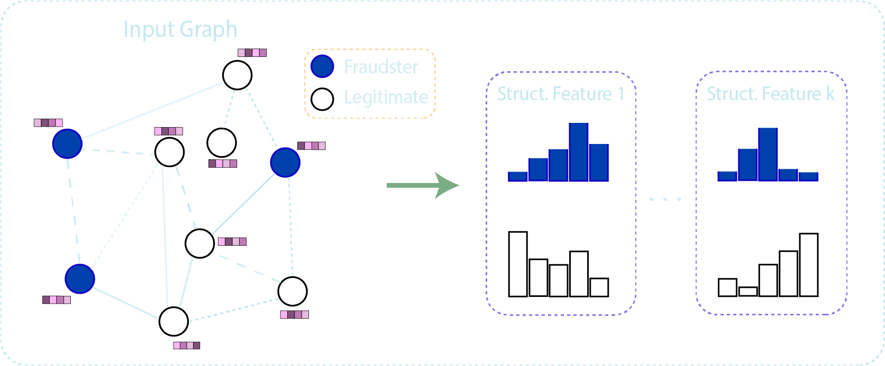
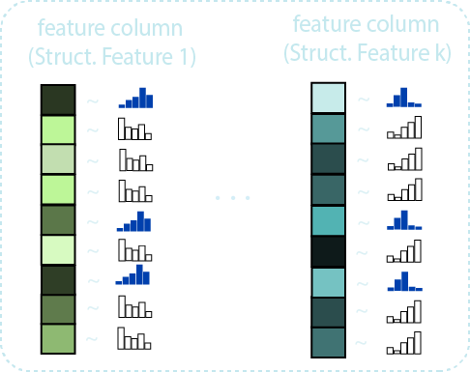
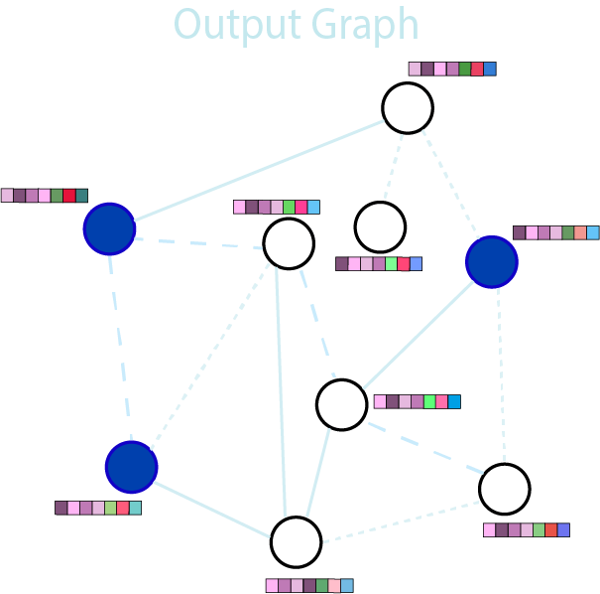
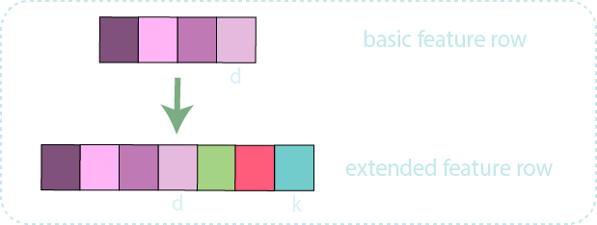
Process of integration of the structural features
Calculation of distributions
Generation of extra feature columns
Concatenation of extra feature values

Slide 16
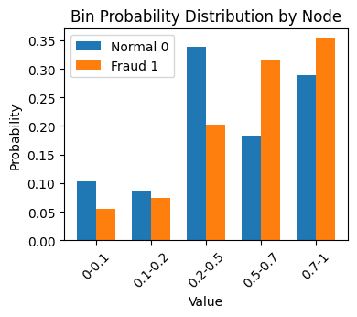
Creating synthetic fraud nodes
Need more positives in SCL module
For this reason, new fraud nodes are built (positives).
No new edges are created between already existing and synthetic nodes
Probability distributions of the 2 classes for feature18.

Slide 17
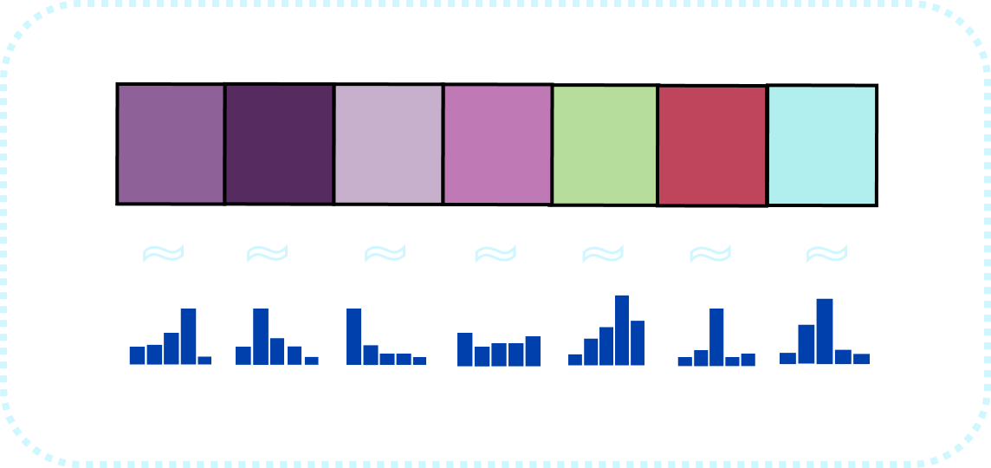
Creating synthetic fraud nodes
Synthetic nodes are created by following the probability distribution of fraudsters calculated for each feature.
Synthesizing of a fraud node

Slide 18
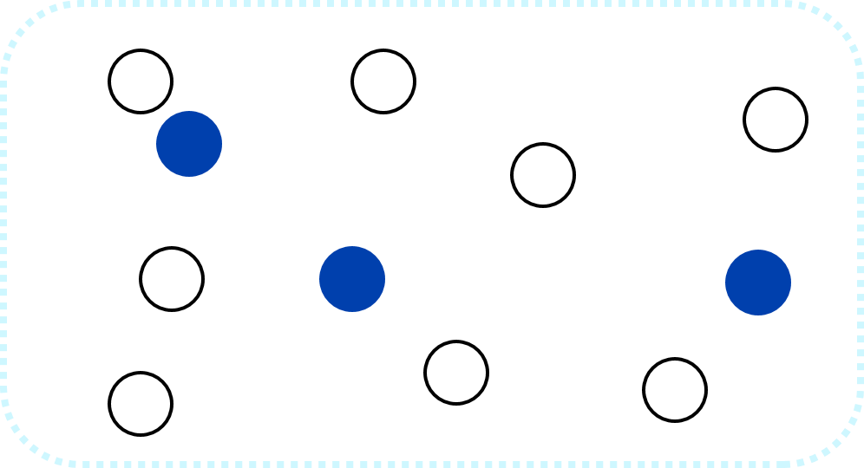
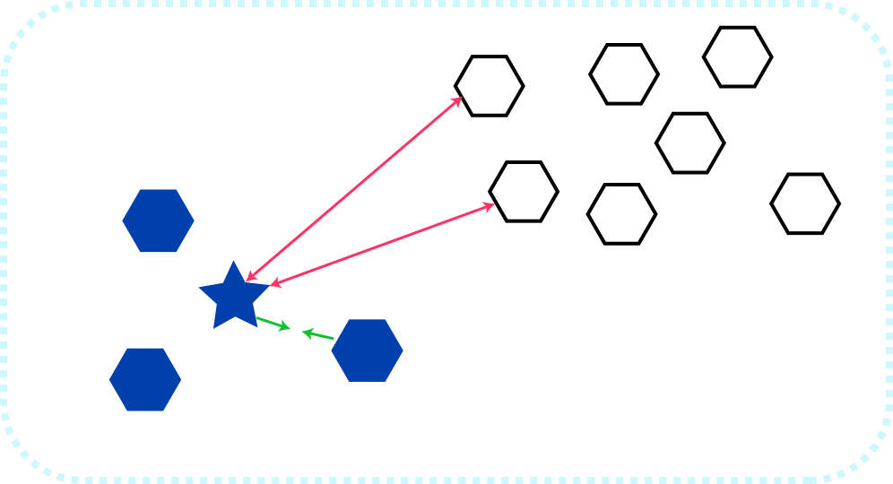
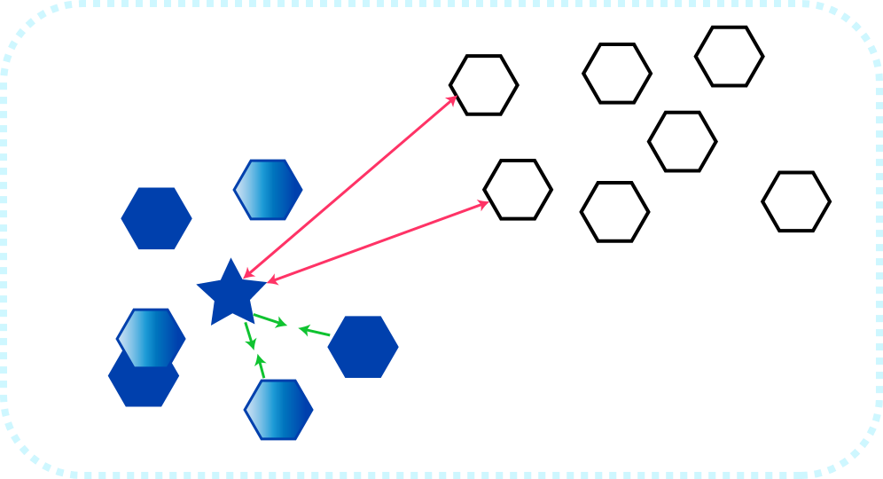
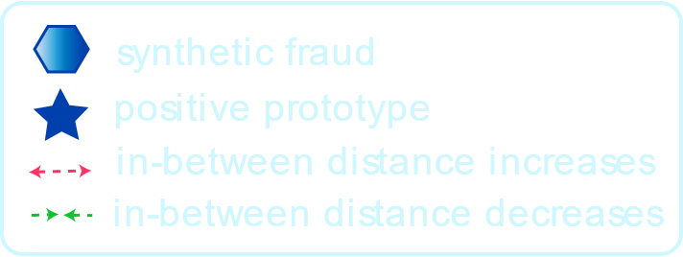
Effect of synthetic fraud nodes in the embedding space
Latent embedding space enhanced
Original feature space
Latent embedding space
Contrastive learning
+ embedding
Synthetic fraud generation
The representative ability of the positive (fraud) prototype is enhanced as it is compared with more positive data.

Slide 19
Results & Discussion

Slide 20
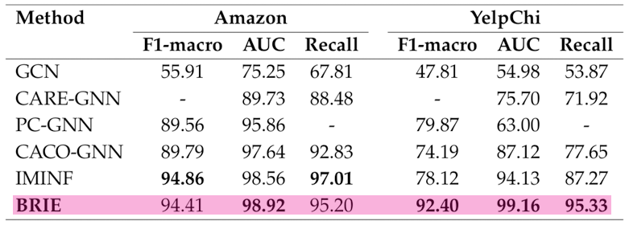
Results
YelpChi: BRIE outperforms all models, in every metric.
Amazon: BRIE is better than the other models except IMINF, with which it is very close.

Slide 21
Code in GitHub
GitHub - brie-user/brie-model

