Slide 1


Group Project
Team 5

Slide 2
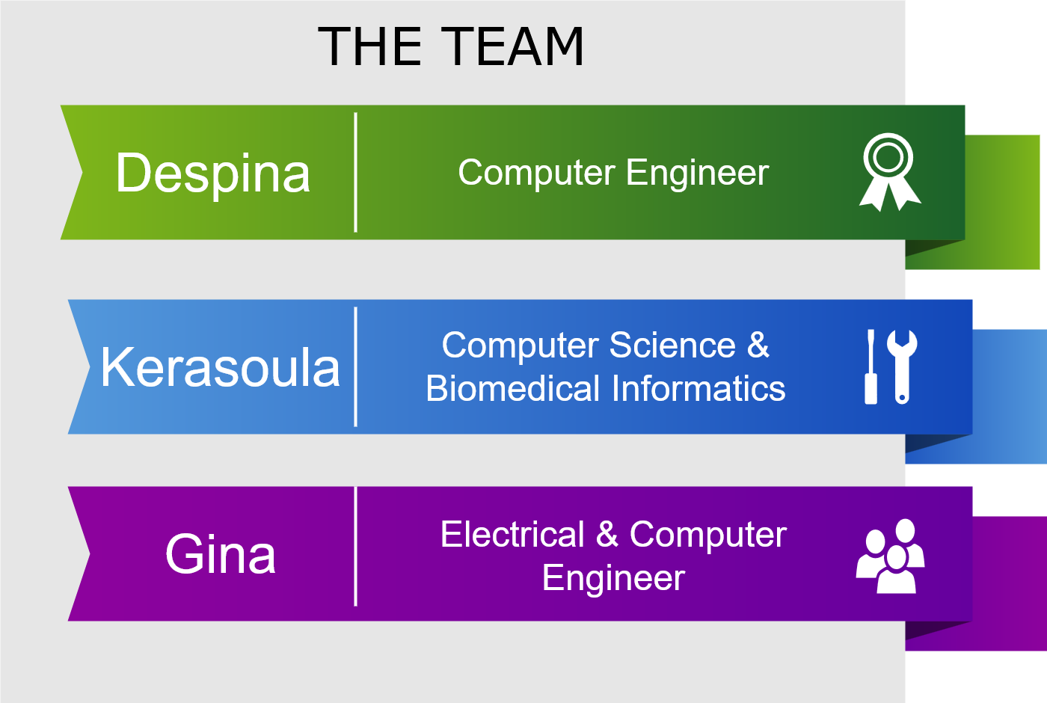
Team Members
Notes:
ALL : Γεια σας ειμαι η ταδε και σπουδασα εκει.

Slide 3
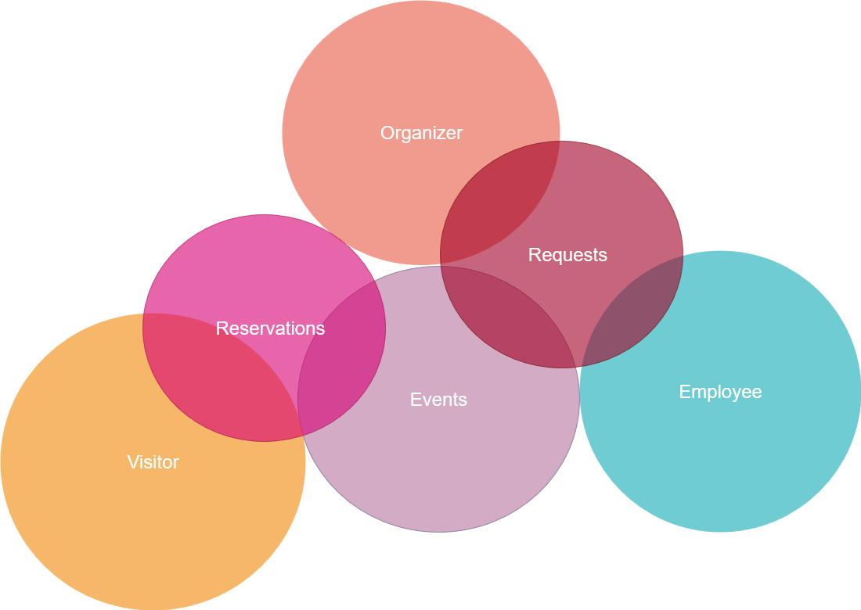
Project Info & Details
Event Management System
for the
Municipality of Thessaloniki
Notes:
TZINA

Slide 4
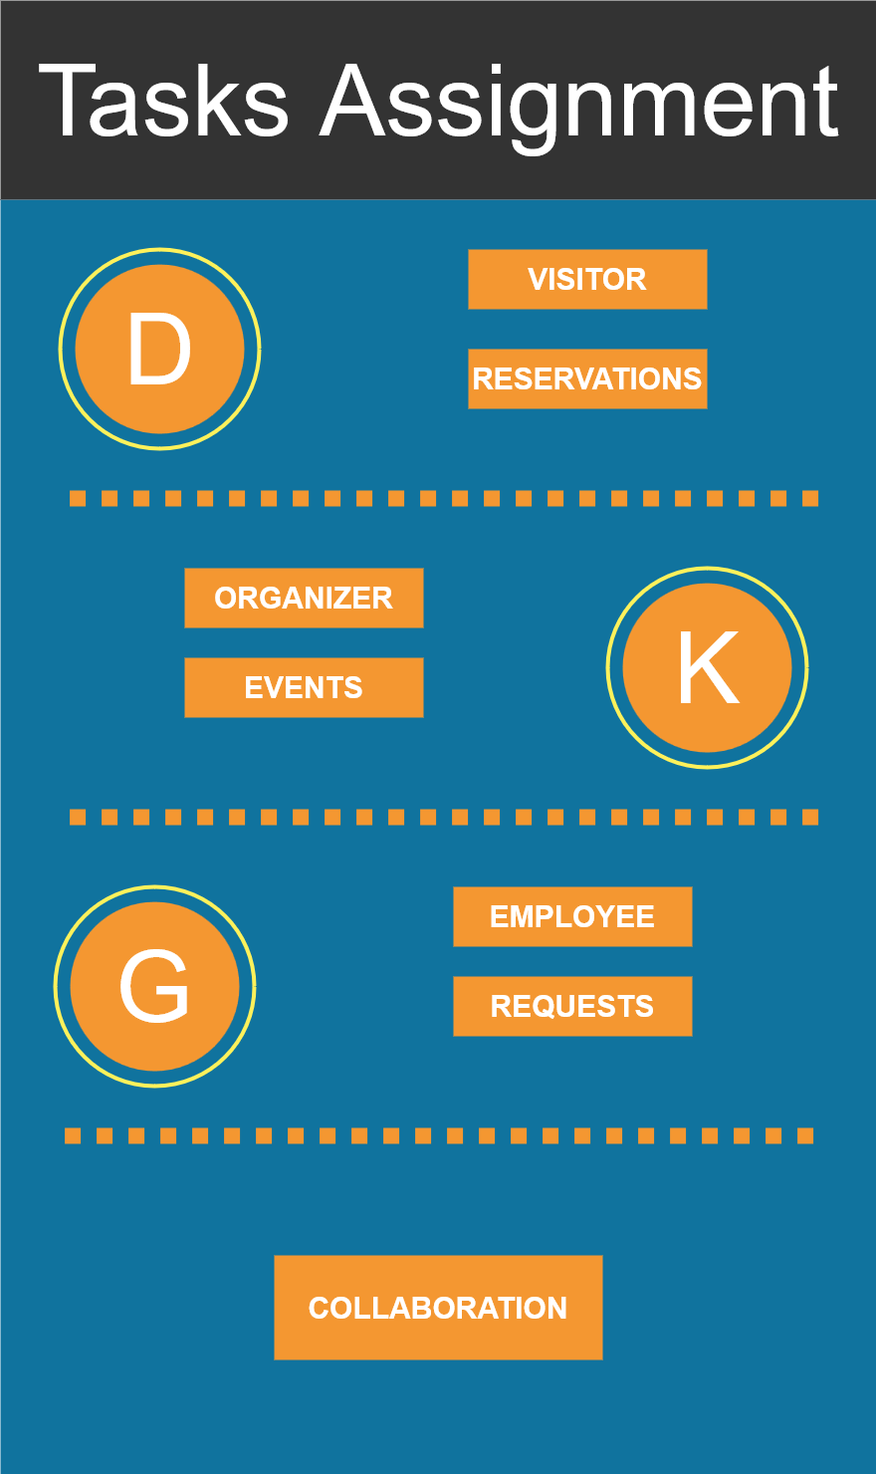
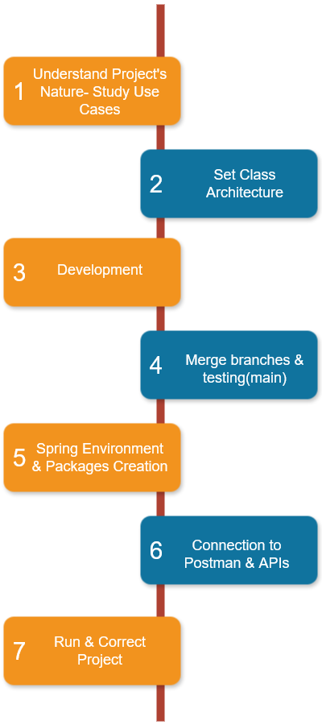
Notes:
ALL: 1 user & 1 complicated entity randomly

Slide 5
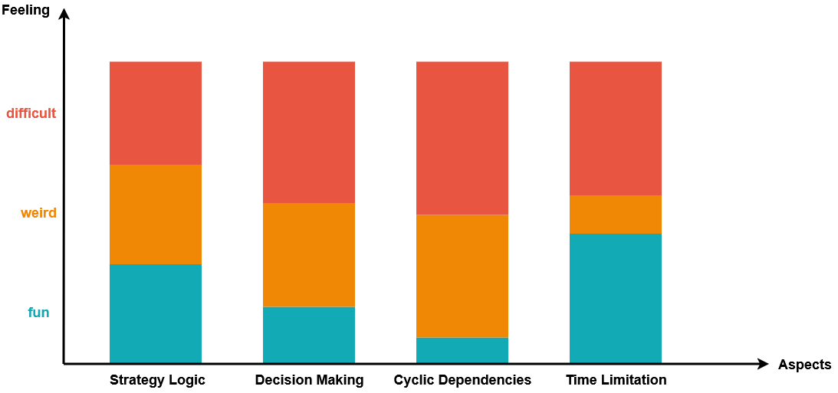
Feelings During the Process

Slide 6
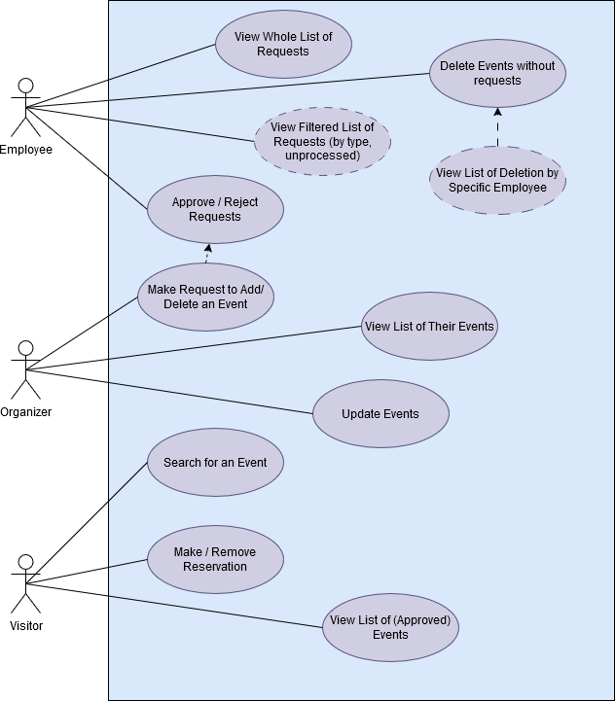
Use Case Diagram
photo
Notes:
GINA

Slide 7
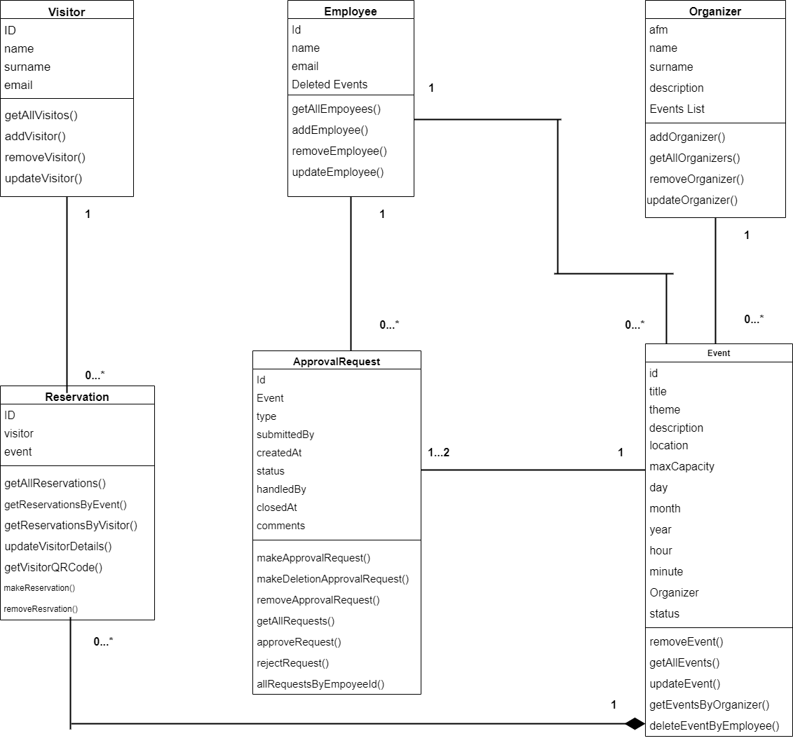
UML Class Diagram
Notes:
DESPINA

Slide 8
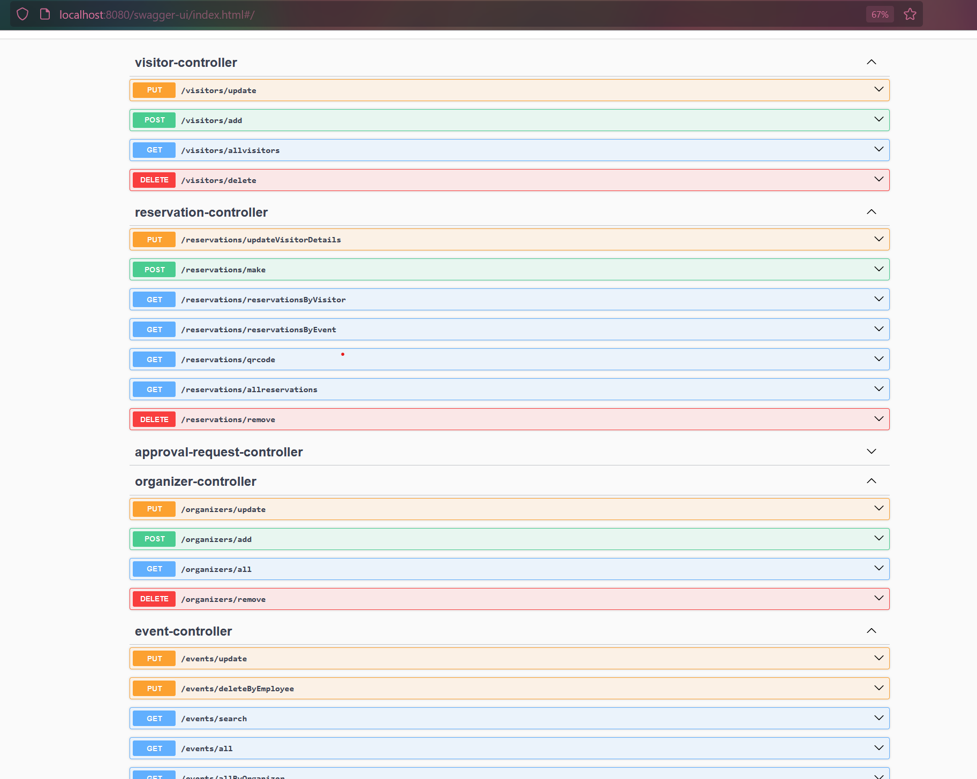
Service Documentation
http://localhost:8080/swagger-ui/index.html#/
Notes:
KERASOULA

Slide 9
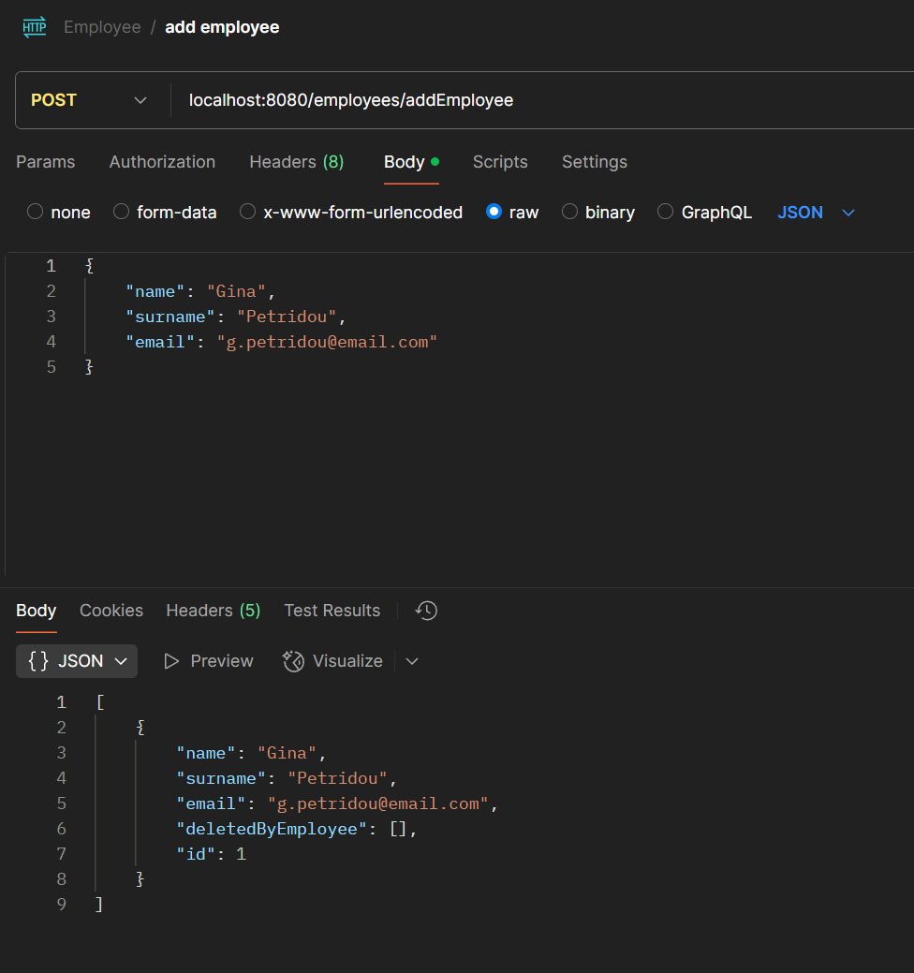

API Requests
Notes:
KERASOULA & ALL

Slide 10
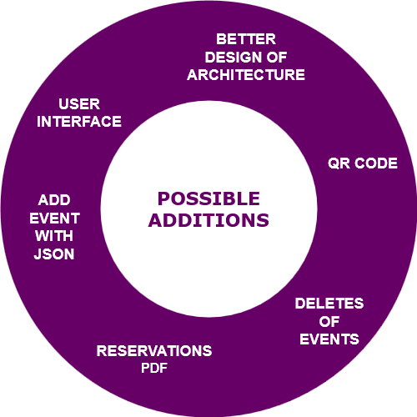

Slide 11
Thank you!

