Slide 1
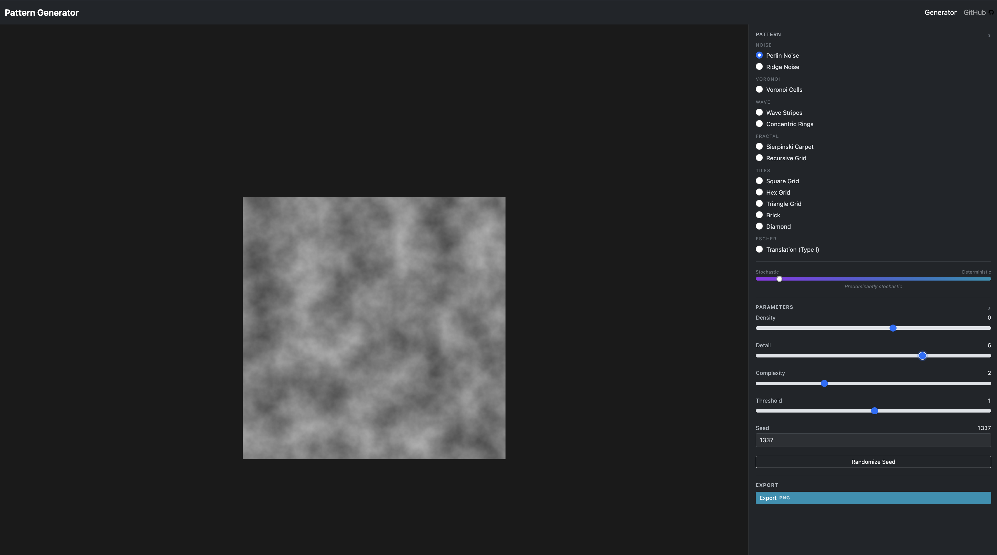
Prototype 1 - Algorithmic Pattern Generator (Perlin Noise)

Slide 2
Prototype 2 - Parameterised Algorithmic Pattern Generator

Slide 3
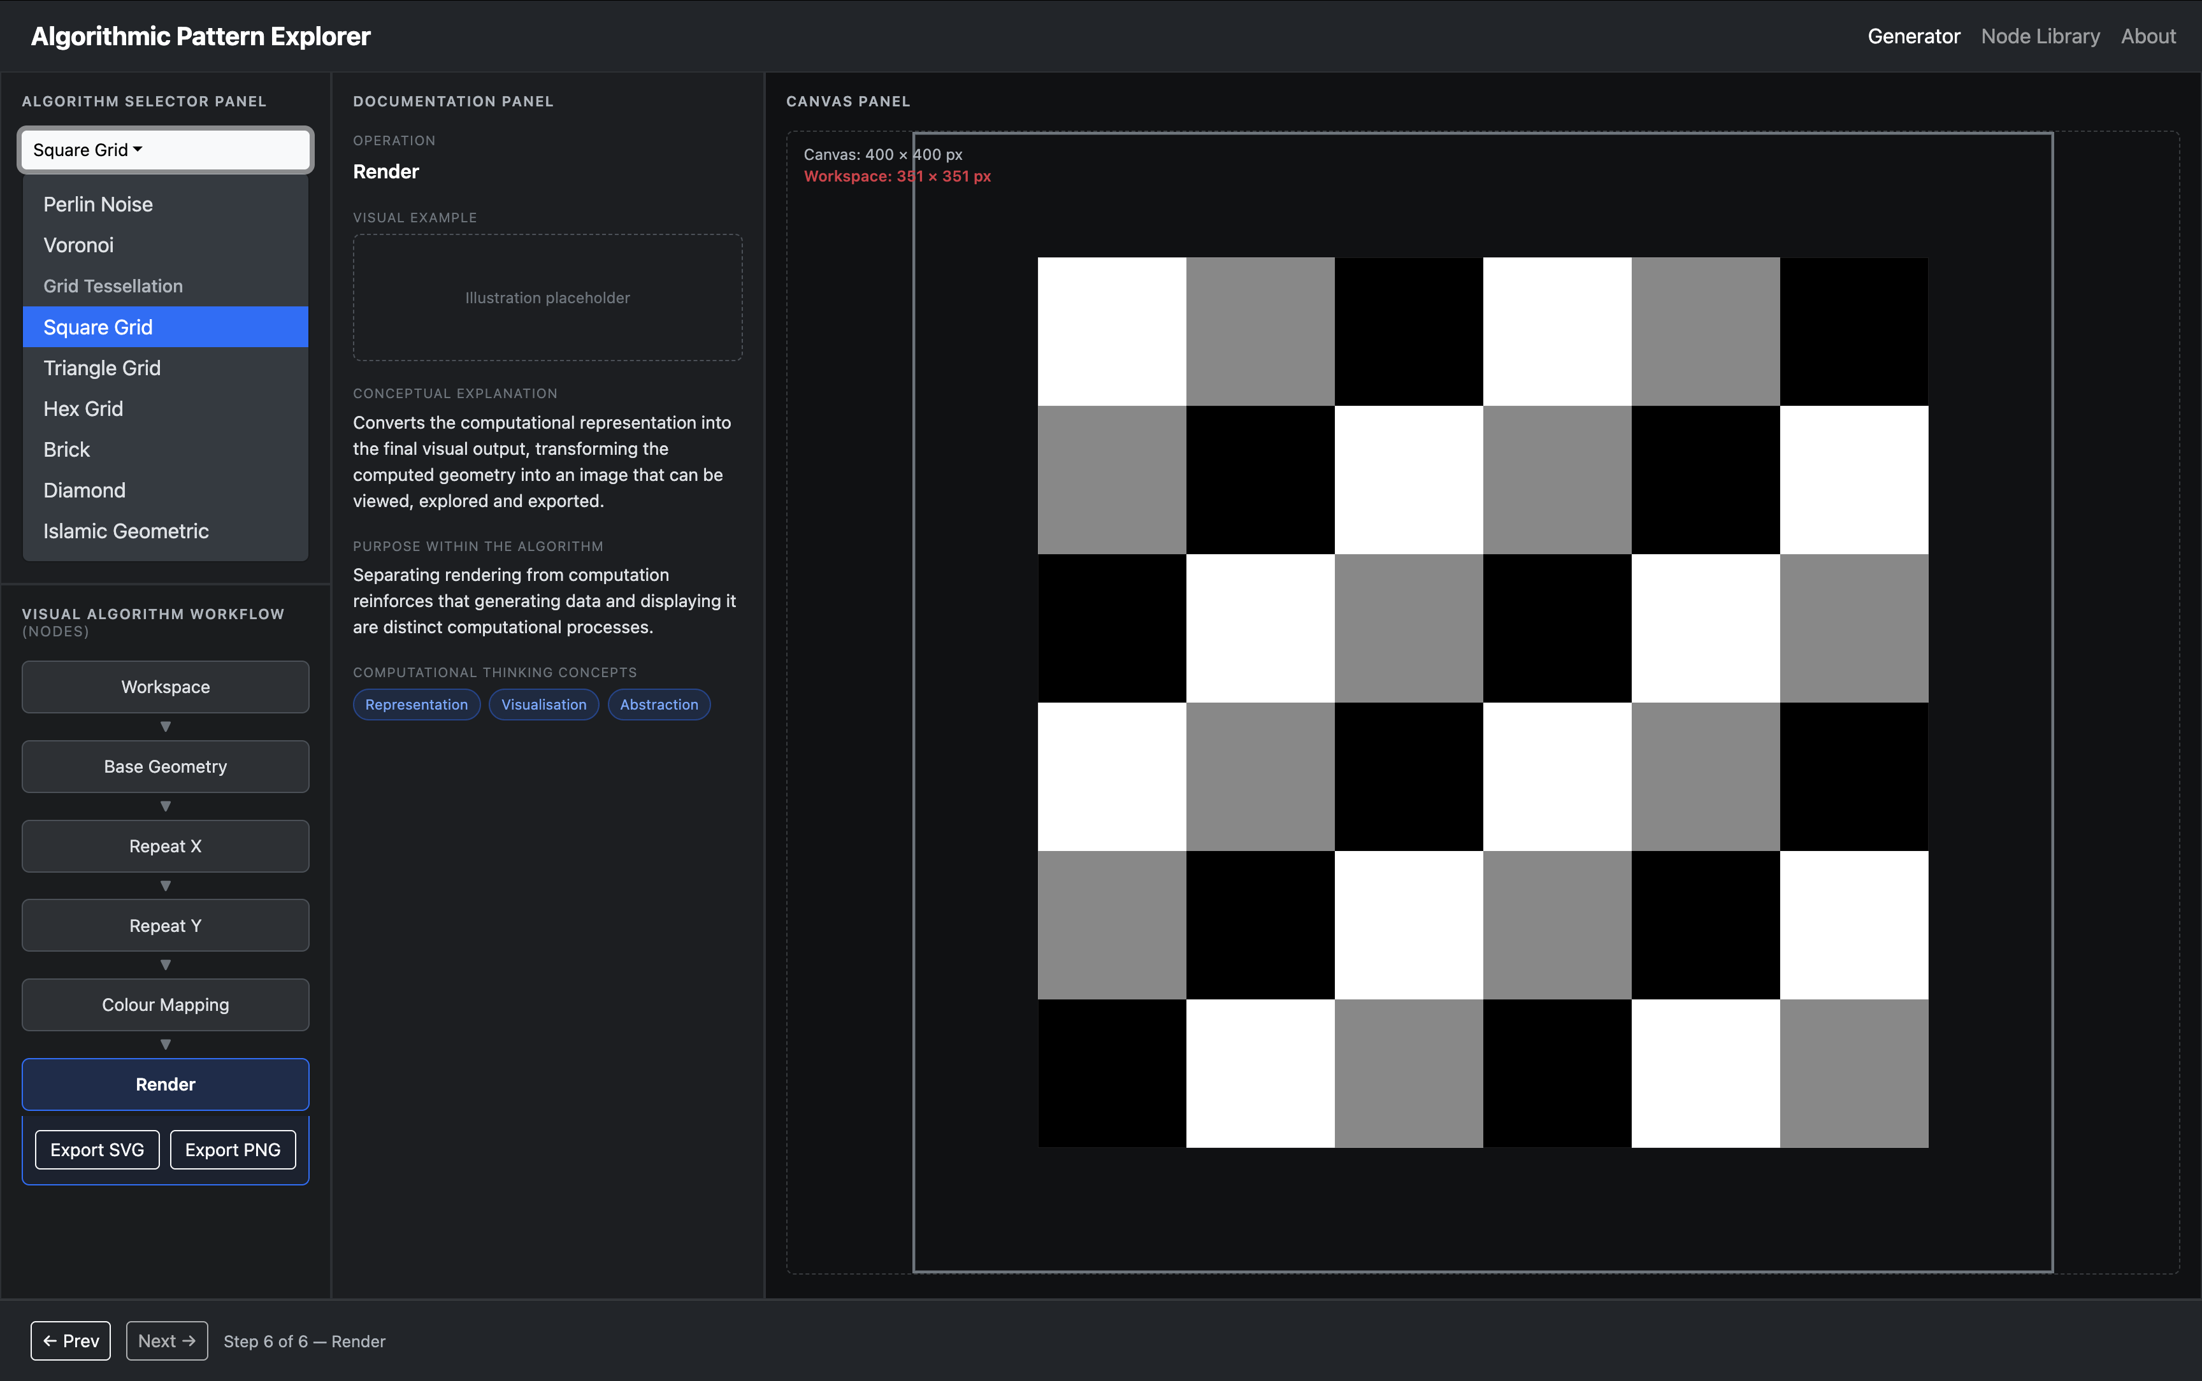
Prototype 3 (mockup) – Algorithmic Pattern Explorer

