Slide 1
Logos Similarity project
Ion Florentin Georgian
Master's Student – ETTI, UPB
ion.georgian2001@gmail.com
0724765658

Slide 2
Table of contents
The flow of the project
Step 1 – Data extraction
Step 2 – Preprocess extracted logos
Step 3 - Analyze & cluster the logos
Conclusions

Slide 3



The flow of the project
DATA EXTRACTION
PREPROCESS
THE DATA
ANALYZE & CLUSTER THE DATA
Resize & normalize
Convert formats
Filter unwanted logos
Extract embeddings (Generate feature vectors)
Cluster similar logos
Visualize results
Scrape website data
Identify logos
Store extracted logos

Slide 4

Step 1 – Data extraction
Goal: Collect logos from websites automatically.
What is the purpose? → We need to automatically extract logos from multiple websites.
How did we do it? → We used web scraping to find and download logos.
Challenges? → Not all logos are easy to detect, some websites hide them.
Key Technologies Used:
✔ Python (for automation)
✔ BeautifulSoup (for web scraping) ✔ Requests (for downloading images)

Slide 5
Data extraction workflow
Website
Parsing HTML
How the process works ?
Step 1: Access the website and extract HTML
Step 2: Locate images with potential logos
Step 3: Apply rules to filter the correct logo
Step 4: Download and store logos
Find image tags
Extract LOGO
Save image

Slide 6

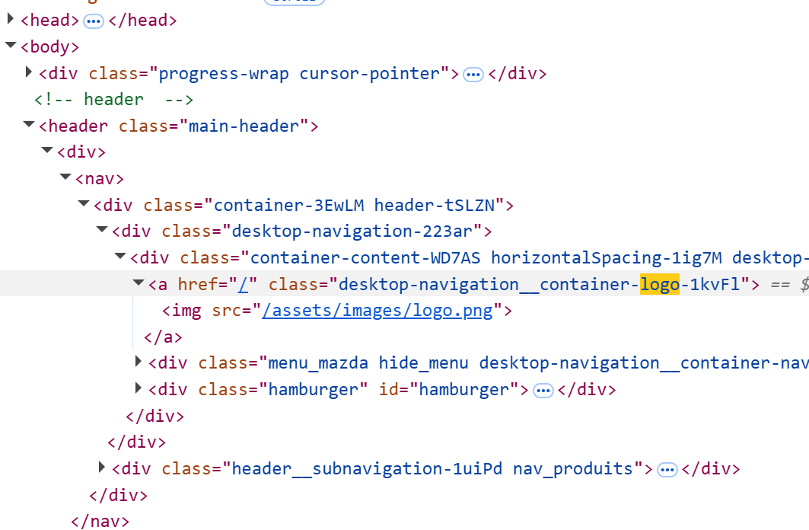
Finding logos in websites
How to identify logos?
Primary method: Look for <img> elements with "logo" in URL, alt, class, id, title, or aria-label.
Saves the first valid logo for each website
Fallback method: Use favicon when no clear logo is found.
Challenges: Some logos are stored in CSS backgrounds or lazy-loaded
Example for https://mazda-ma.com/ site

Slide 7
Extraction process – key components
Parallel Processing → Extracts multiple websites at the same time (concurrent.futures). Reduces total execution time significantly.
Web Scraping with BeautifulSoup → Finds logo images from <img> and <link> tags.
Logging System → Tracks progress and errors in a log file.
Stores extracted logos (URL and the name of site) in a parquet file → Saves results efficiently.

Slide 8
Statistics of the extracted logos
Success rate: 88.03%

Slide 9
Step 2: Preprocess the extracted logos
Why preprocessing is necessary?
Logos come in different formats and sizes
Some images are too small (favicons)
To improve clustering, we need standardization

Slide 10
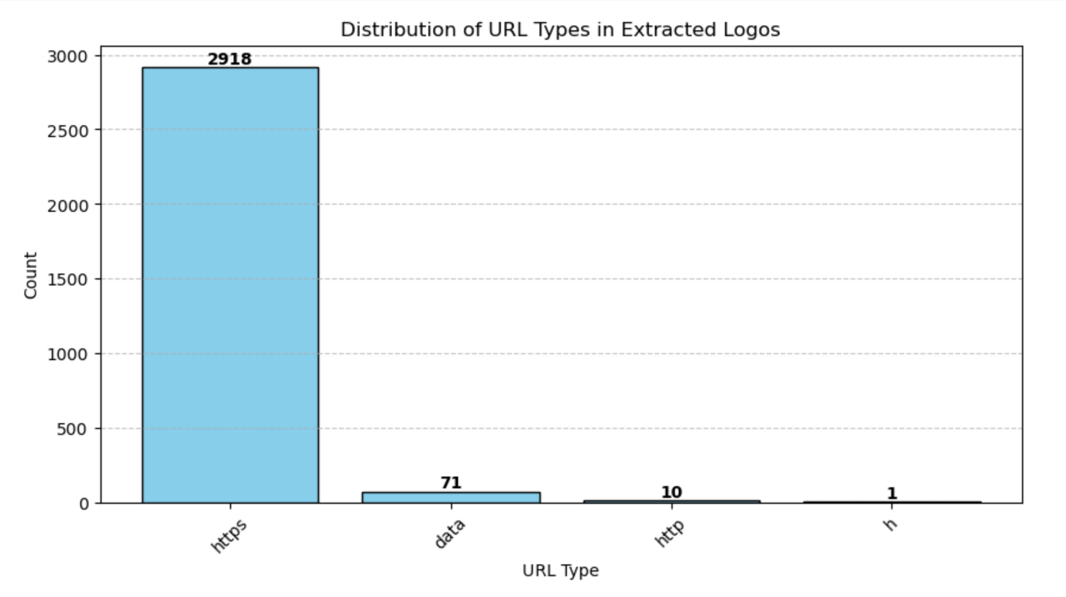
Verify the URL types

Slide 11
Preprocessing actions
What actions were taken?
Converted different image formats to PNG/JPG
Resized all images to the same size (224x224 pixels)
Normalized pixel values for consistency
Handled tiny images (favicons) by filtering or upscaling
Enhanced contrast using CLAHE filter

Slide 12

Handling different file formats
Problem: Logos were extracted in various file formats, requiring standardization before further processing.
Formats extracted & processed
Raster images: JPG, PNG, WEBP (pixel-based images) → Converted WebP to PNG/JPG for universal compatibility
Vector images: SVG (scalable graphics, requiring conversion) → Used CairoSVG
Skipped Format (Processing Issue) - XML-encoded logos (data:image/svg+xml) - Some logos were stored inside <svg> tags or Base64-encoded as data:image/svg+xml.Issue: These caused decoding errors and were skipped to avoid data corruption.

Slide 13
Standardizing logo sizes
Problem: Logos were different sizes (some very large, some very small). ➡ Solution:
Resized all images to 224x224 pixels
Used Cubic Interpolation for smooth resizing
If a logo was too small, it was upscaled to 224x224 pixels.
If a favicon was too low quality, it was removed.

Slide 14
Improving image contrast
Problem: Some logos had low contrast or light colors. ➡ Applied CLAHE (Contrast Limited Adaptive Histogram Equalization). ✔ CLAHE enhances contrast locally, rather than globally. ✔ Ensures bright areas don’t become too bright and dark areas don’t lose details. ✔ Prevents over-enhancement of noise, unlike traditional histogram equalization.

Slide 15
Storing processed logos
Instead of saving logos as separate files, they were stored in a database.
This allows faster access and better organization.
Statistics after preprocessing:
Total sites processed: 3000
Images successfully stored: 2291
Failed to process: 709
Success Rate: 76.37%

Slide 16
Step 3: Analyze & cluster the logos
Logos need to be grouped based on visual similarity. ➡ Manual sorting is inefficient → A model can extract useful features automatically. ➡ Solution: Use a Deep Learning model to create embeddings and group logos based on them.

Slide 17
Feature extraction & clustering
What is Feature Extraction? ✔ Converts an image into a compact numerical representation. ✔ Similar images will have closer feature representations in space. ✔ ResNet50 is used as the feature extractor.
What is Clustering? ✔ Groups similar objects based on extracted features. ✔ We use DBSCAN (Density-Based Clustering) to form groups. ✔ No need to specify the number of clusters → Algorithm determines structure automatically.

Slide 18
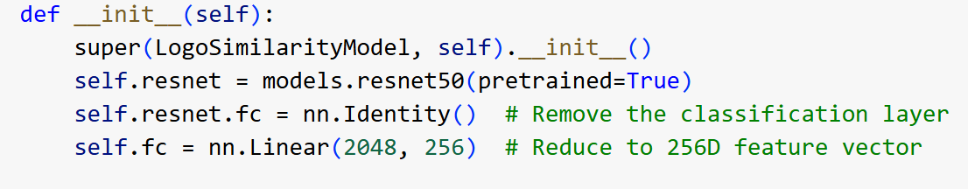
Model architecture
How the model works?
Base model: ResNet50 pretrained on ImageNet.
Modification: Removed the final classifier layer → Instead, a 256D feature vector is output.
This feature vector is used to compare logos & find similar ones.
Key layers used:

Slide 19
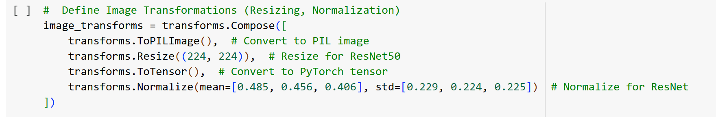
Data preprocessing for the model
How are the images prepared before training?
Resize to 224x224 pixels → Required by ResNet50.
Normalize pixel values → Ensures stable training.
Convert to tensors → Makes data compatible with PyTorch.
Transformation Pipeline Used:

Slide 20
Training & feature extraction
How do we extract features from images?
Feed images through ResNet50
Obtain a 256D feature vector for each logo
These vectors represent logos numerically for similarity comparison.
Example Feature Vector:
([0.12, -0.05, 0.78, ..., 0.22]) # 256-dimensional embedding

Slide 21
Clustering with DBSCAN
Why DBSCAN?
✅ Finds groups without requiring a fixed number of clusters. ✅ Can ignore outliers (logos with no similar matches). ✅ Works well for high-dimensional data (like our 256D feature vectors).
Key DBSCAN Settings:

Slide 22
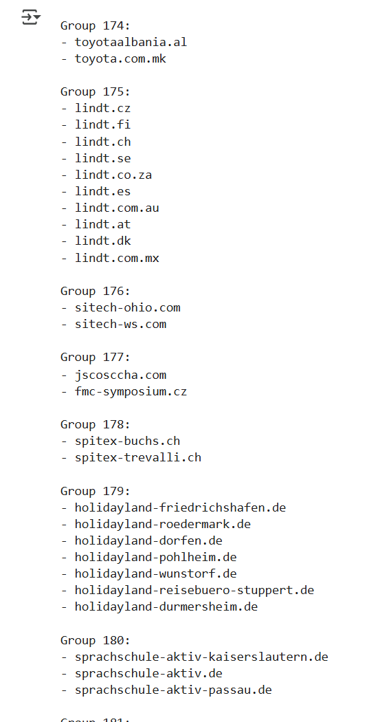
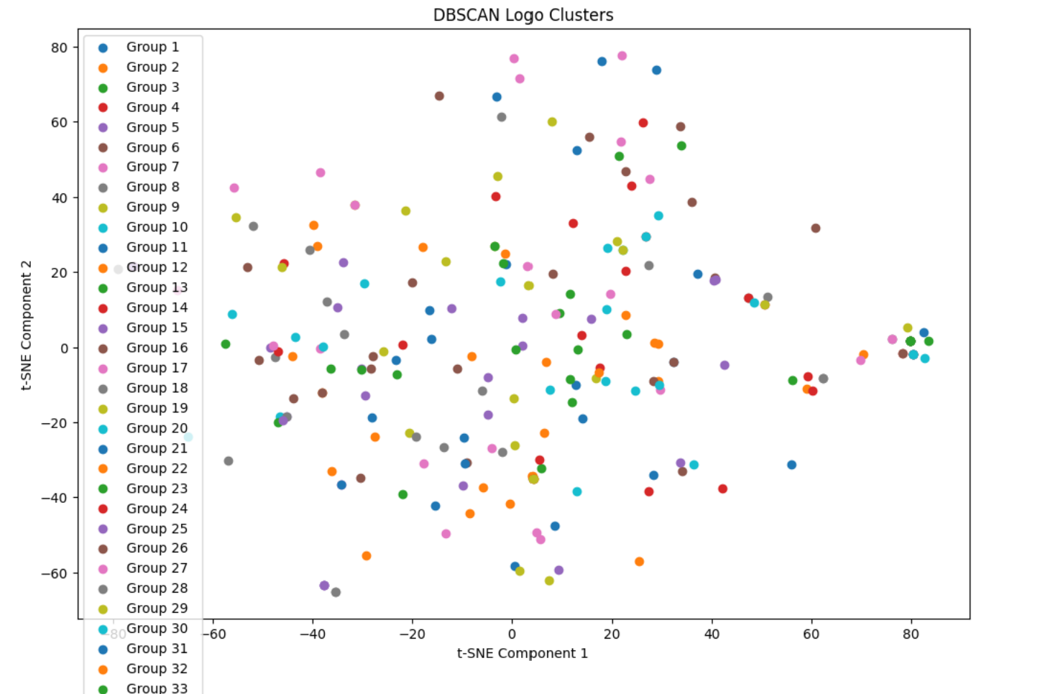
Results - grouped logos

Slide 23
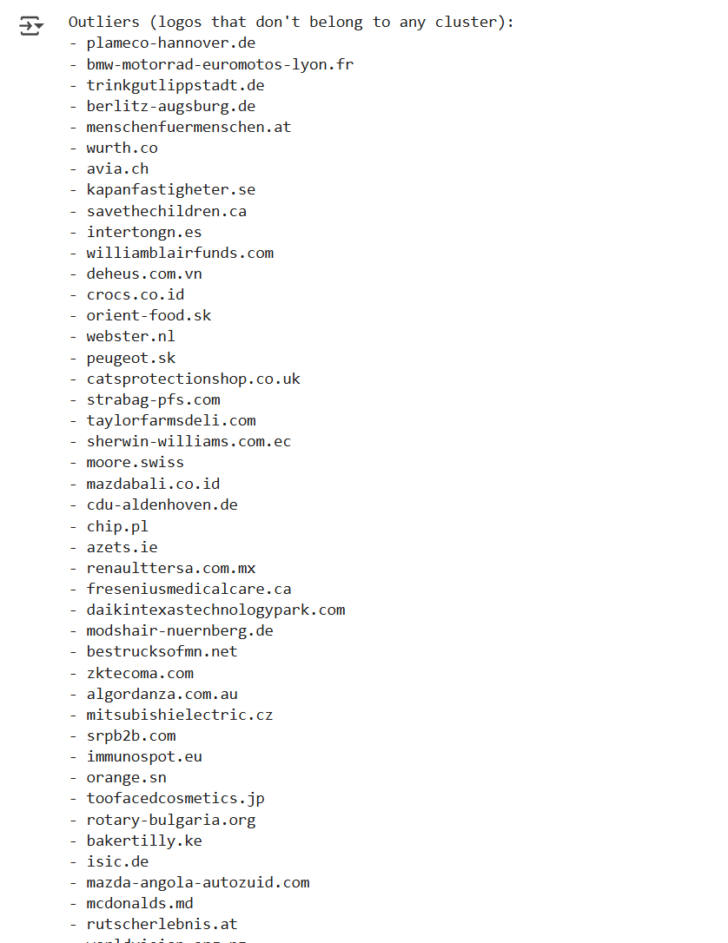
Outliers → logos that don’t belong to any cluster/ the group would consist only of itself

Slide 24
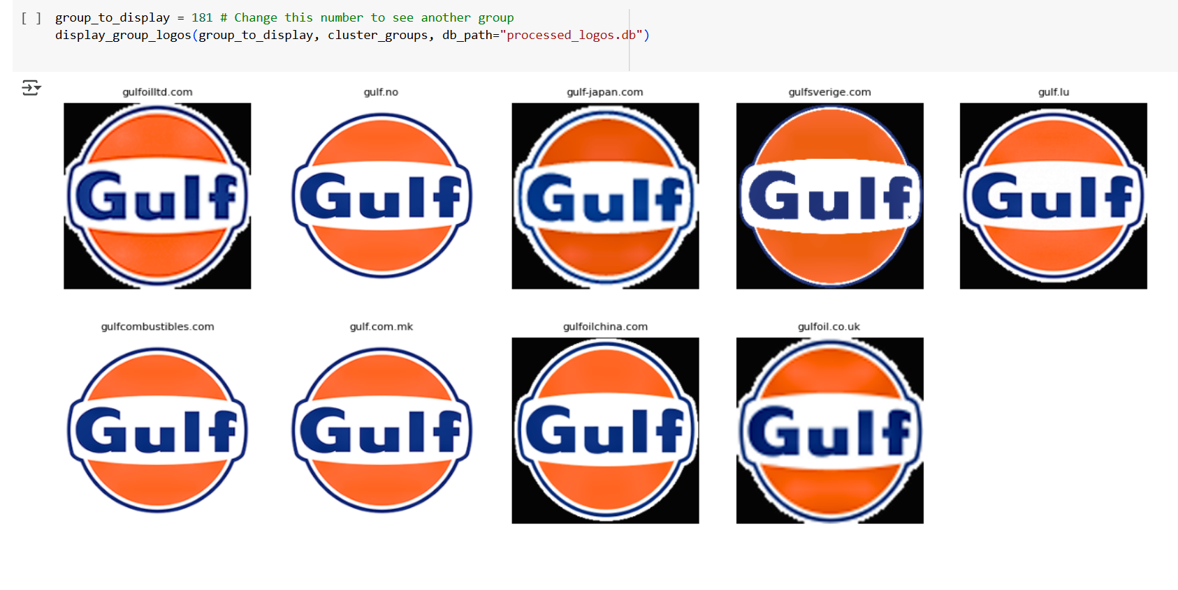
Group example displaying

Slide 25
Conclusions and key takeaways
Extracted logos from thousands of websites using automated web scraping.
Preprocessed the logos to ensure uniformity in size, format, and contrast.
Used a Deep Learning model (ResNet50) to extract meaningful features from logos.
Applied DBSCAN clustering to group similar logos without requiring a fixed number of clusters.
Successfully identified visually similar logos across different websites.

Slide 26
Key learnings and challenges
Handling different logo formats (SVG, PNG, WebP, etc.) → Required conversion and preprocessing.
Favicon vs. Logo distinction → Small favicons were upscaled & processed carefully.
Clustering logos without a predefined number of groups → DBSCAN proved effective for this.
Scaling up the pipeline for larger datasets → Optimized parallel processing helped.

Slide 27
Future improvements and next steps
Enhance Web Scraping – Improve extraction from dynamically loaded websites and handle missing logos more efficiently.
Refine Logo Detection – Increase accuracy by using better image processing and object detection techniques.
Optimize Clustering – Improve logo grouping by testing more adaptive and efficient clustering methods.
Speed Up Model Processing – Reduce feature size, optimize architecture, and enhance performance for large-scale datasets.

Slide 28
Thank you!

