Slide 1
Instrumental Variables

Slide 2
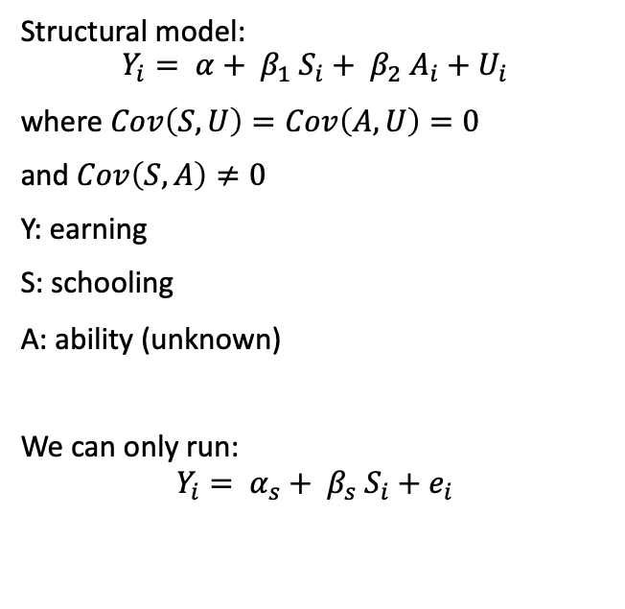
Why instrumental variables
Structural model:
$$Y_{i}= α+ β_{1} S_{i}+ β_{2} A_{i}+U_{i}$$
where $Cov\left(S, U\right)=Cov\left(A, U\right)=0$
and $Cov\left(S, A\right)≠0$
Y: earning
S: schooling
A: ability (unknown)
We can only run:
$$Y_{i}= α_{s}+ β_{s} S_{i}+e_{i}$$
S
Y
A
Notes:
Instrumental variables come from the classical question: what do we do if we can not use conditioning to separate out the causal effect. That is, what do we do if there are some unobservable variable that both effect the treatment and result.
Lets consider this question with a classical example, the result of schooling on earning.

Slide 3
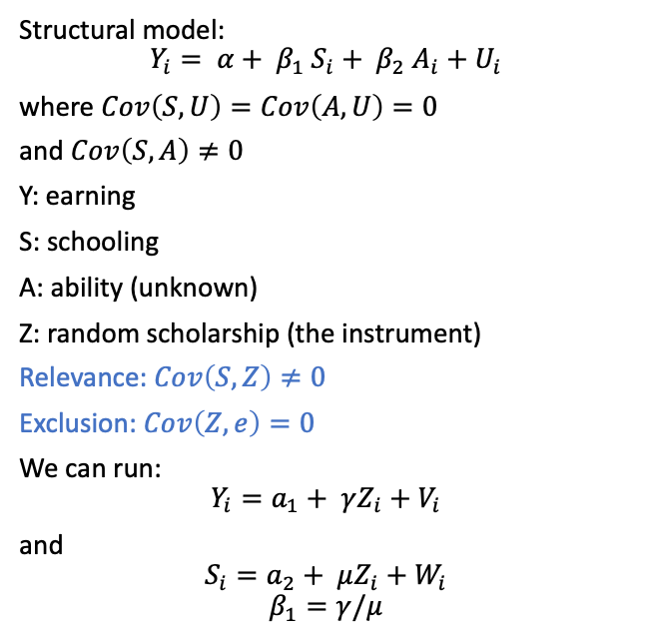
Why instrumental variables
Structural model:
$$Y_{i}= α+ β_{1} S_{i}+ β_{2} A_{i}+U_{i}$$
where $Cov\left(S, U\right)=Cov\left(A, U\right)=0$
and $Cov\left(S, A\right)≠0$
Y: earning
S: schooling
A: ability (unknown)
Z: random scholarship (the instrument)
Relevance: $Cov\left(S, Z\right)≠0$
Exclusion:$Cov\left(Z, e\right)=0$
We can run:
$$Y_{i}=a_{1}+ γZ_{i}+V_{i}$$
and
$$S_{i}=a_{2}+ μZ_{i}+W_{i}$$
$$β_{1}=γ/μ$$
Z
S
Y
A

Slide 4
Why does the math work
Notes:
Write on the board

Slide 5
A few more examples
D: some disease
F: measurable features (like obesity)
Z: genes that influence adulty weight
U: other variables
Z
F
D
U

Slide 6
A few more examples(Angrist and Krueger, 1991)
Students can drop out of schooling when they turn 16, but all start school at a fixed month.
Y: earnings
S: amount of schooling
M: month of birth
U: other variables
M
S
Y
U

Slide 7
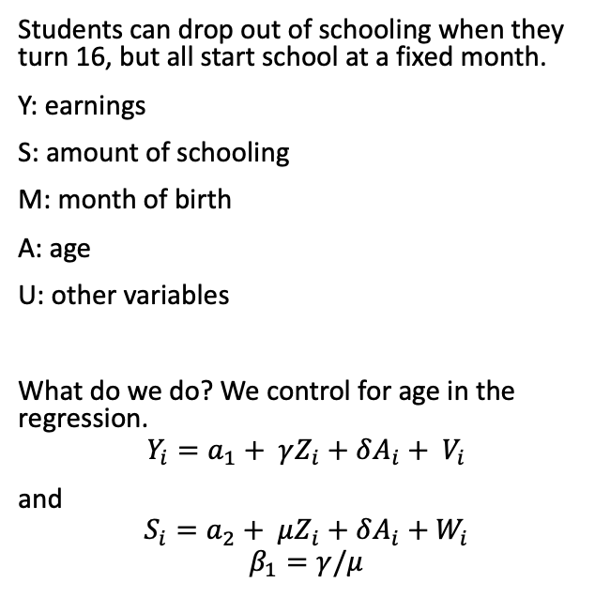
Other things to consider- covariates
A
Students can drop out of schooling when they turn 16, but all start school at a fixed month.
Y: earnings
S: amount of schooling
M: month of birth
A: age
U: other variables
What do we do? We control for age in the regression.
$$Y_{i}=a_{1}+ γZ_{i}+{δA_{i}+ V}_{i}$$
and
$$S_{i}=a_{2}+ μZ_{i}+δA_{i}+W_{i}$$
$$β_{1}=γ/μ$$
M
S
Y
U

Slide 8

Frisch-Waugh-Lovell
Let there be a regression:
$$Y=X_{1}^{′}β_{1}+X_{2}^{′}β_{2}+U$$
We can obtain$β_{1}$ by first residualizing $X_{1}$ on $X_{2}$, then regressing $Y$ on these residuals

Slide 9
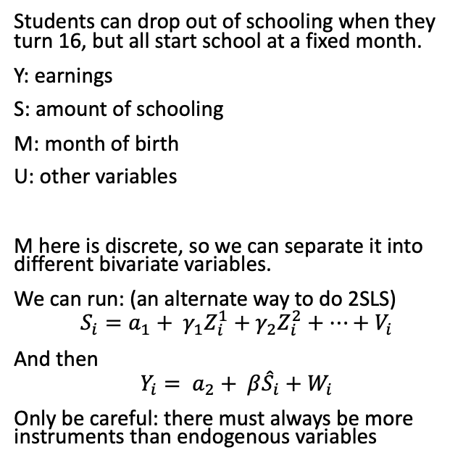
Other things to consider - multi instruments
M1
M2
Students can drop out of schooling when they turn 16, but all start school at a fixed month.
Y: earnings
S: amount of schooling
M: month of birth
U: other variables
M here is discrete, so we can separate it into different bivariate variables.
We can run: (an alternate way to do 2SLS)
$$S_{i}=a_{1}+ γ_{1}Z_{i}^{1}+γ_{2}Z_{i}^{2}+…+V_{i}$$
And then
$$Y_{i}= a_{2}+ β{\hat{S}}_{i}+W_{i}$$
Only be careful: there must always be more instruments than endogenous variables
S
M3
…
Y
U

Slide 10
Other things to consider- week instruments
Students can drop out of schooling when they turn 16, but all start school at a fixed month.
Y: earnings
S: amount of schooling
M: month of birth
U: other variables
Problem: only a small amount of variation of amount of schooling can be explained by month of birth
What is the problem of two many weak instruments: it increases the bias of the 2SLS estimator.
M
S
Y
U

Slide 11
Other things to consider – heterogenous effects
Students can drop out of schooling when they turn 16, but all start school at a fixed month.
Y: earnings
S: amount of schooling
M: month of birth
U: other variables
The question: is the treatment effect of education the same for those predicted by the instrument vs those who do not?
M
S
Y
U

Slide 12
Let’s read papers
Read the following papers (only the section on the instrument needed) and consider the following questions:
What is the treatment? The outcome? The instrument?
Why does the instrument work? How does the paper justify relevance? Exclusion? Does these explanations make sense?
Does the paper use additional controls? Why or why not?
How is the outcome of the instrument different from a straightforward linear regression? Is the effect smaller or bigger? Why?
How does the paper deal the question of weak instruments?
How does the paper deal with the question of heterogenous effects? Do you think there is a complier effect? Why or why not?
Can you think of other good instruments for this question? Why is instrumental variables so useful for economics?

Slide 13
Here’s a few papers with IV
“Income and Democracy” Daron Acemoglu, Simon Johnson, James A. Robinson, and Pierre Yared (2008) p822-5
Does Compulsory School Attendance Affect Schooling and Earnings? By Angrist and Krueger, 1991
Lifetime Earnings and the Vietnam Era Draft Lottery: Evidence from Social Security Administrative Records. 1990 by Angrist, Joshua
The Old Boys' Club: Schmoozing and the Gender Gap 2021 by Zoë Cullen, Ricardo Perez-Truglia

