Slide 1
Recognition of Usual Similar Activities of Dementia Patients via Smartwatches Using Supervised Learning
Sergio Staab
18.12.2021

Slide 2
Introduction
Overview
Motivation and Background
Structure of the Project
Movements and Data Analysis
Results
Outlook

Slide 3
Motivation
People with Dementia
Dementia is one of the most dangerous diseases in the world
Worldwide: 46.8 million cases
More than 7.7 million new cases every year
74.7 million cases until 2030, 131 million cases until 2050
Caregiver shortage: over 66,000 skilled workers will be missing in 15 years
Loss of value added of 35 billion euros by 2030

Slide 4
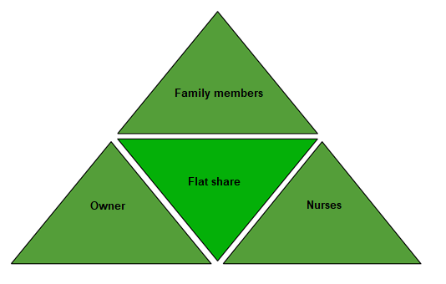
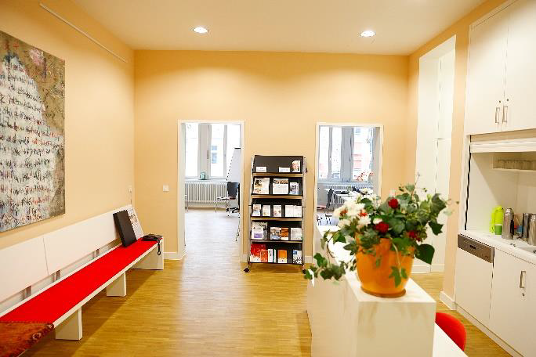
Background
Cooperation With Two Dementia Residential Communities
Transparency
Documentation
Communication
Coordination Processes
Notes:
The problem is that the residential communities are cared for by different nurses and all the patients activities have to be documented. This is a very big effort.

Slide 5
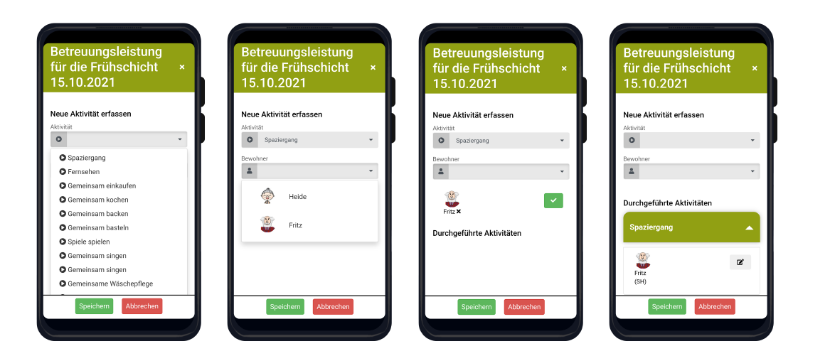
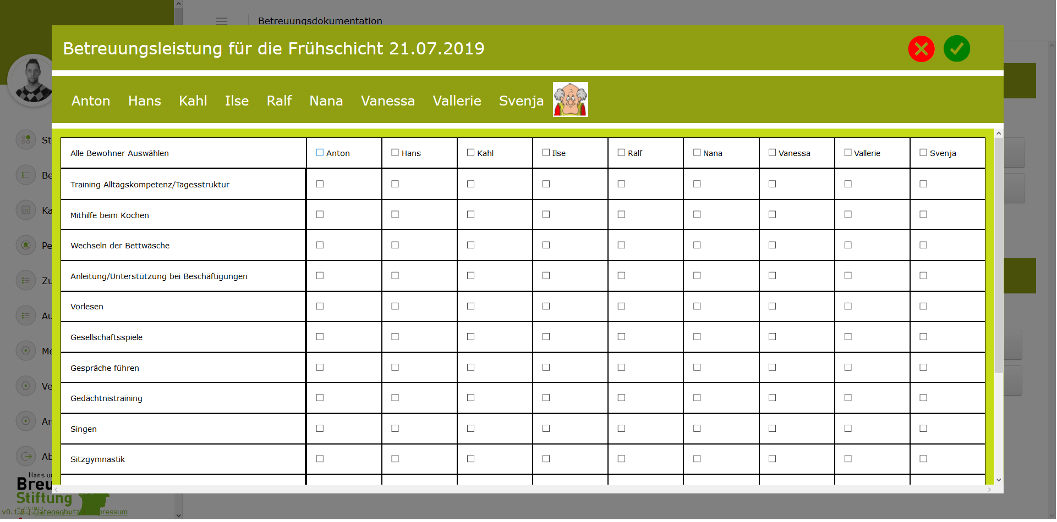
Background
Cooperation With Two Dementia Residential Communities
We developed INFODOQ
Web Communication
Three documentations per patient per day
High effort for documentation
Difficult to track changes due to illness
Predictions not possible
Notes:
The Digitisation of the documentation has reduced the effort but a lot of time is still lost for documentation.

Slide 6
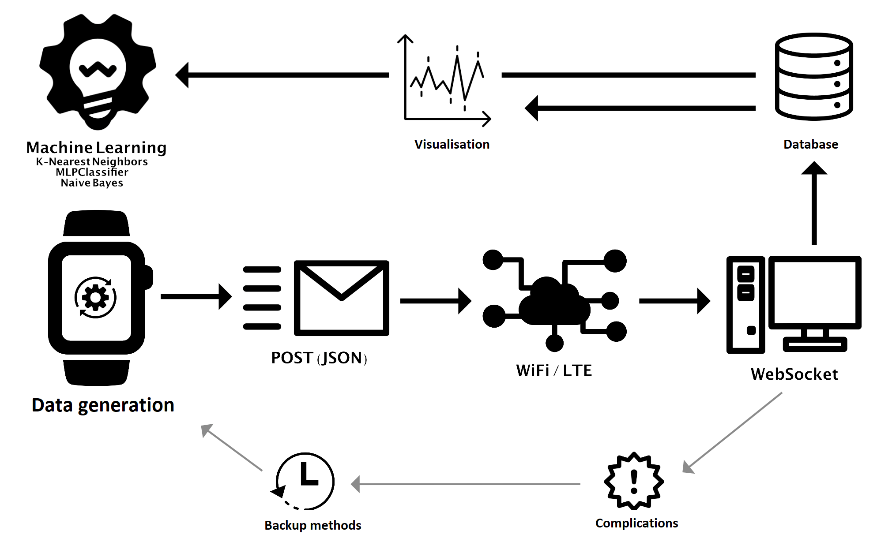
Structure of the project
Overview
Tracking
Accelerometer
Gyroscope
Attitude
Gravity
Hertz Frequency
WebSocket
NodeJs
Mysql
c sharp

Slide 7
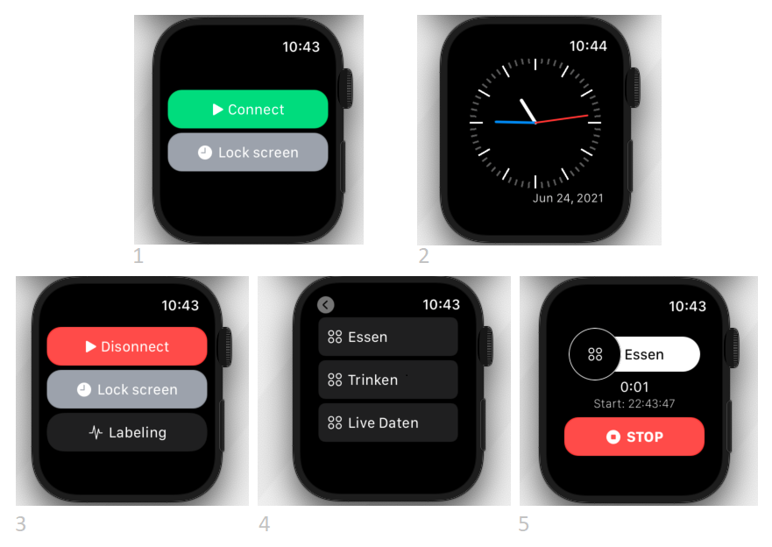
Structure of the project
Watch
Login to the server
Control of the clock via server
Labelling via server and via the clock
Standard state no confirmation
Communication with 20 Hertz/s

Slide 8
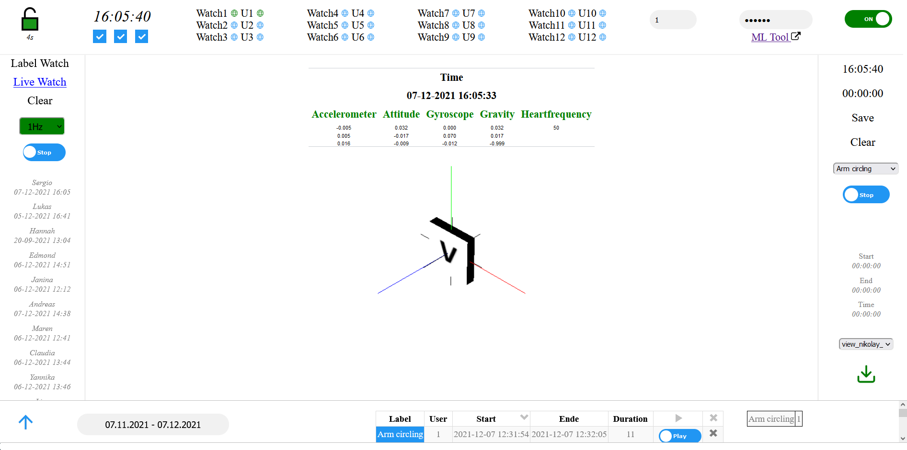
Structure of the project
WebSocket
Overview page
Watches can be registered
User can be registered
Watch live data
Create labels
Label management

Slide 9
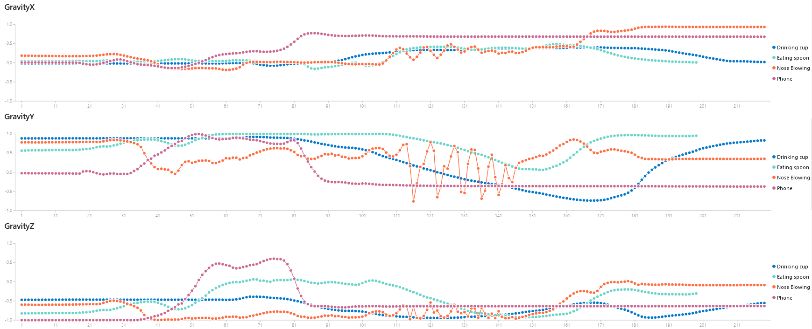
Structure of the project
Machine Learning Tool – Plotting
Vizualisation
of the labels
Comparison
of the labels
Comparison
of movements
Comparison
of sensor systems

Slide 10
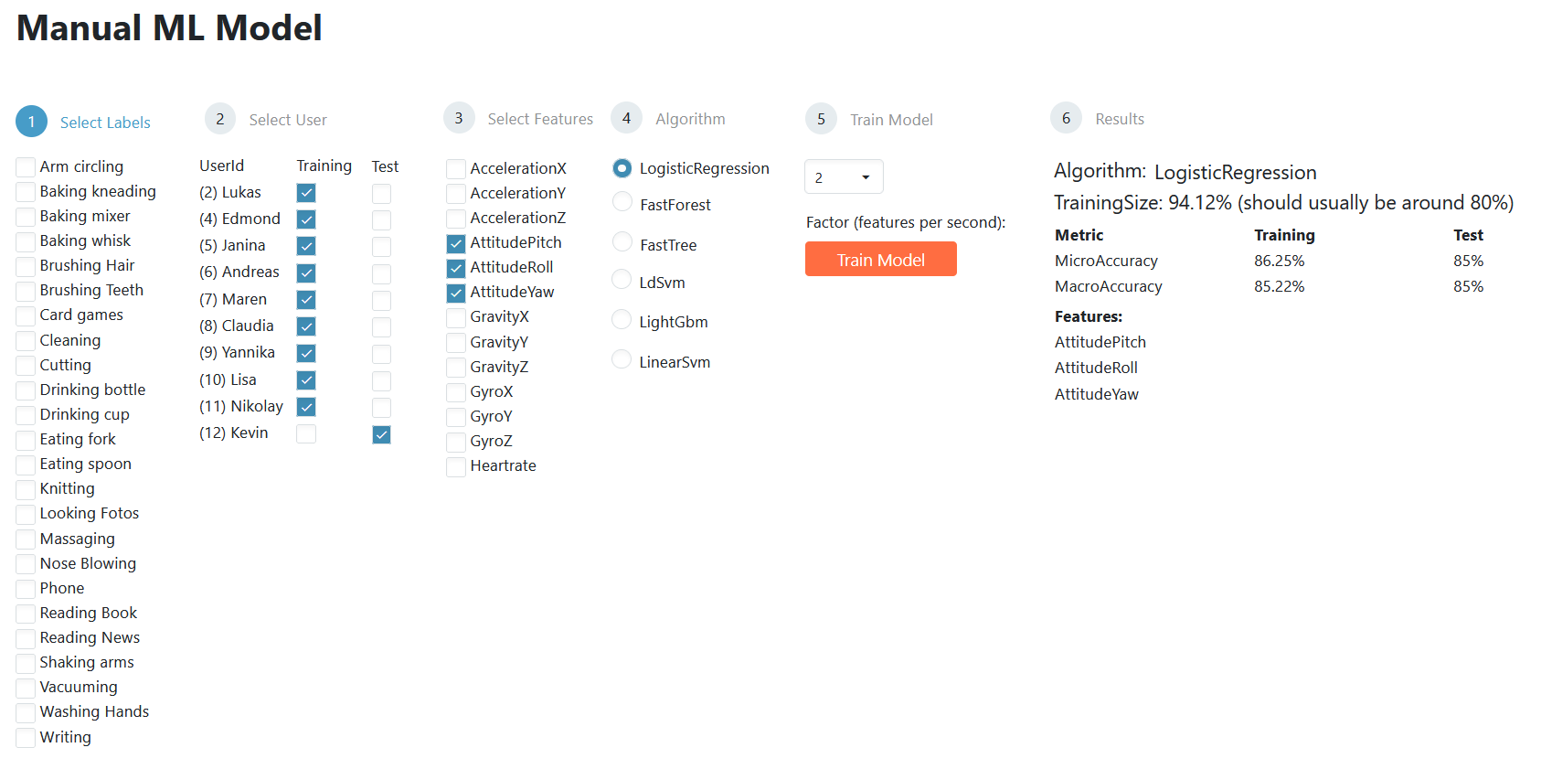
Structure of the project
Machine Learning Tool – Training Models

Slide 11
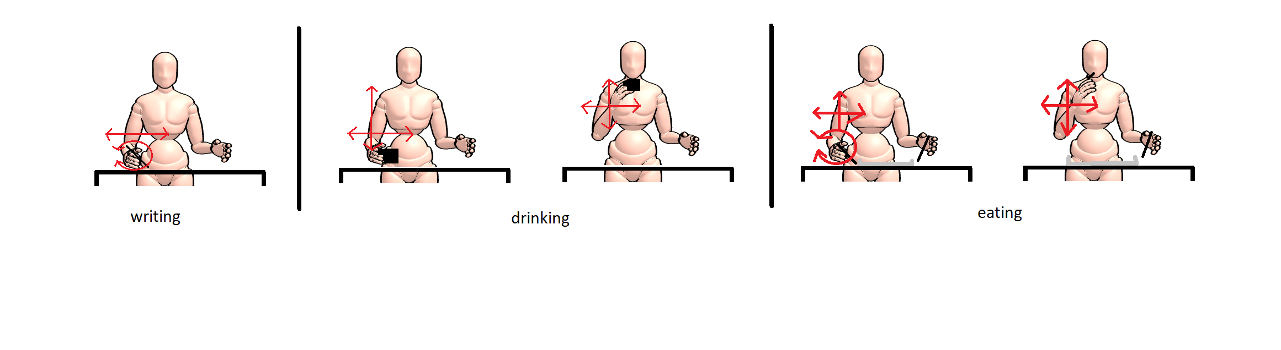
Movements
Three very similar movements

Slide 12
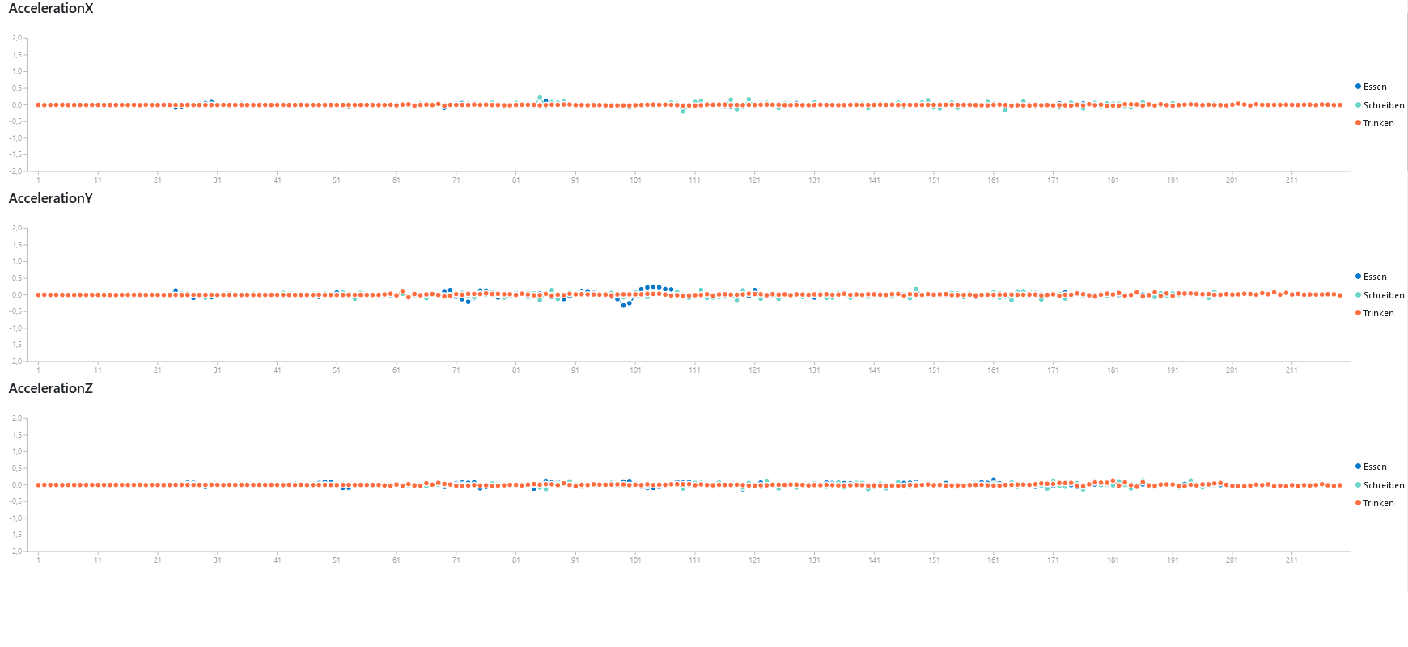
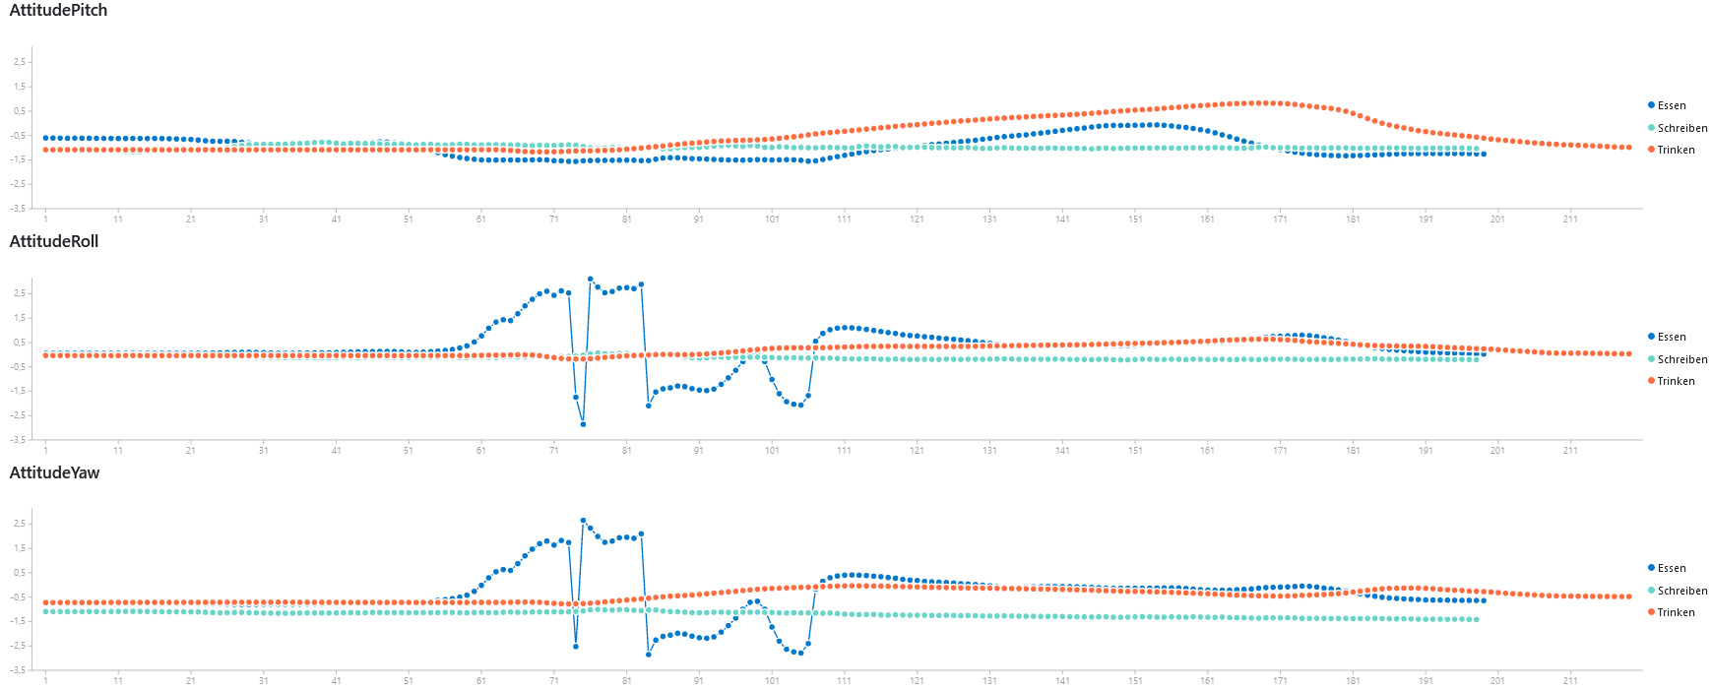
Movements
Acceleration Attitude
Measuring hand movement is much more important than measuring arm movement

Slide 13
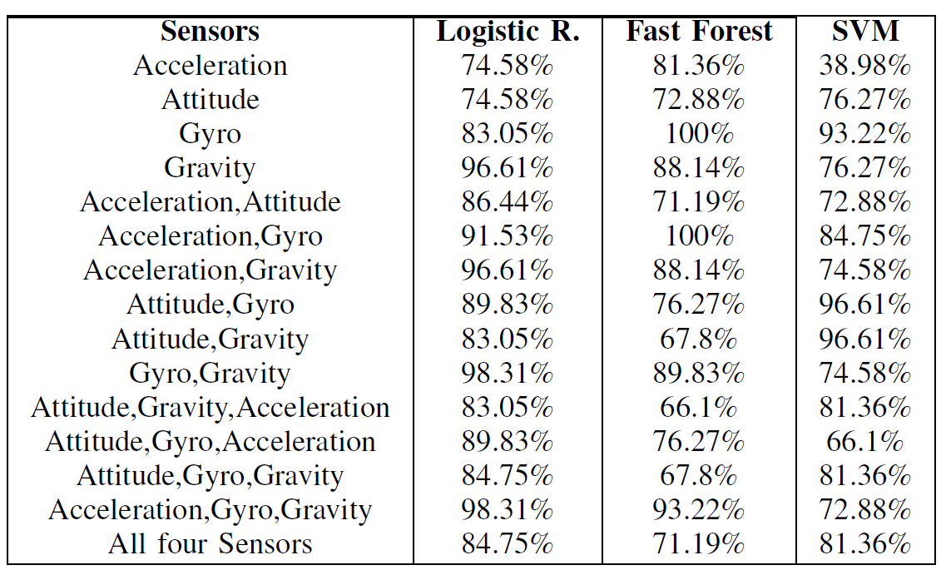
Results
Three classifications
12 features (4 sensors * x, y, z)
Labels with 10 seconds of data
20 Hertz/s
5 subjects
10 * 5 * 60 * 20 = 60,000 data

Slide 14
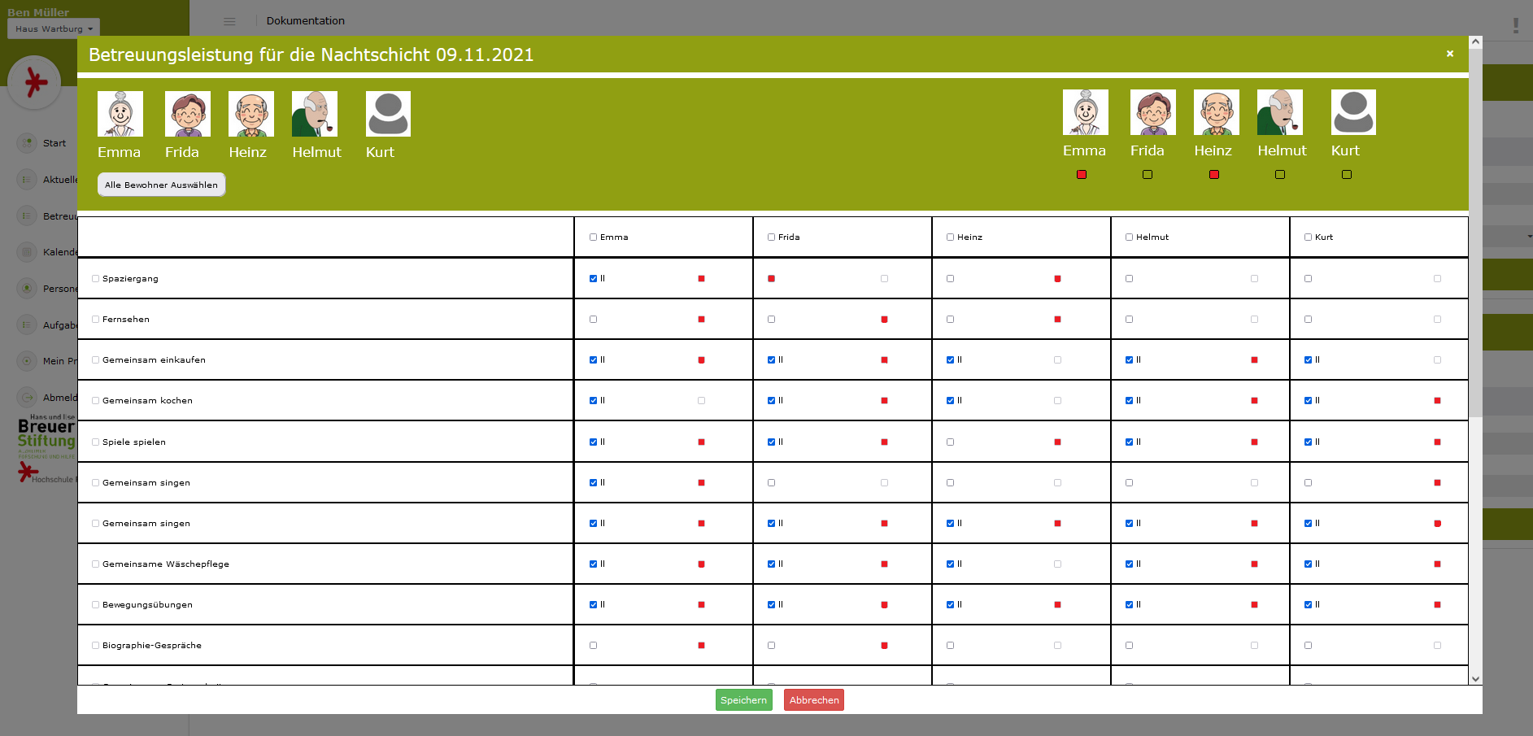
Outlook
Applied to the software INFODOQ
Support for the caregivers
Prediction of activities
Options are coloured in red

