Slide 1

Python Chess Application
A Complete Chess Engine & GUI Built from Scratch
Georgios Giosmas
Electrical & Computer Engineering Graduate

Slide 2
Project Overview
A fully functional chess application built entirely in Python, featuring a rules-compliant engine and a graphical interface built with tkinter.
4
Core Files
150
Pytest Tests
The project demonstrates strong object-oriented design, algorithmic problem-solving, GUI development, and test automation with pytest — all implemented independently as a portfolio piece.
1500+
Lines of Code
Tech Stack
Python 3
tkinter
pytest
OOP

Slide 3
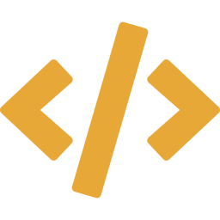
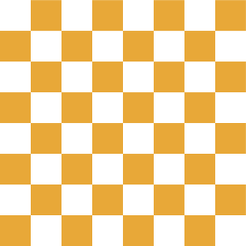


Architecture
piece.py
board.py
Base Piece class + 6 subclasses
(King, Queen, Rook, Bishop, Knight, Pawn)
Each implements piece_get_valid_moves()
Board & Square classes
Move generation, legal move filtering
Check detection via ray-casting
gui.py
main_game.py
ChessGameGUI class (tkinter Canvas)
Click-to-move interaction
Sprite rendering & highlighting
Entry point
Creates Board + GUI
Launches tkinter mainloop

Slide 4
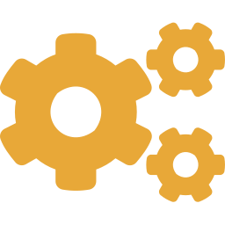

Chess Engine
Two-Pass Move Generation
Special Rules Implemented
Pass 1
Castling
King/queenside, path & attack validation
All non-King pieces compute valid moves.
Check flags set when a piece sees the opponent King.
En Passant
History-aware, immediate response only
Pass 2
Kings compute moves using is_square_attacked_by().
Castling eligibility checked with full attack info.
Pawn Promotion
GUI dialog for Q/R/B/N selection
Legal Move Filtering
Check Detection
Ray-casting from King position
For every candidate move: simulate it, check if own King
is still in check via is_king_in_check_raw(), then undo.
Only moves that don't leave the King exposed survive.
Checkmate / Stalemate
Exhaustive legal move enumeration
Pin Awareness
filter_legal_moves catches all pins

Slide 5
Graphical Interface
Programmatic Board Drawing
Canvas rectangles with lichess color palette. Rank/file labels rendered via create_text() for perfect alignment.
Sprite Sheet Rendering
GIF sprite sheet (480x160) sliced into 12 piece images at 80x80 pixels using PhotoImage subimage extraction.
Click-to-Move Interaction
Two-click selection system: first click selects piece and shows legal moves, second click executes the move.
Turn Enforcement
Only the current player's pieces are selectable. Turn alternates automatically after each valid move.
Selected Piece
Valid Move
Event-Driven Architecture
Replaced blocking while-loop with tkinter event handlers. Each click triggers state update and board refresh.
King in Check
Checkmate
Modal Promotion Dialog
Toplevel popup with piece images as buttons. Uses wait_window() for synchronous selection.
Draw

Slide 6

Testing & Validation
150
test cases passing
150 pytest tests across 9 categories: openings, piece movement, check detection, checkmate patterns, stalemate, castling, en passant, pins, and tactical patterns. Full pytest integration with fixtures, markers, and selective test execution.

Slide 7
Key Design Decisions
Mathematical State Over Tracked State
Square colors computed via (rank + file) % 2 instead of storing highlight state. Eliminates an entire class of state management bugs.
Two-Pass Move Generation
Non-King pieces computed first, then Kings. Ensures check flags are fully set before castling eligibility is evaluated.
Canvas.delete('all') + Full Redraw
Each move wipes the canvas and redraws everything. Prevents ghost images from castling, en passant, and captures.
Separate Highlight Functions
Selected-square highlighting and valid-move highlighting are independent systems. Avoids tangling two different visual concerns.
Event-Driven Over Blocking Loop
Replaced main_game.py's while-loop with GUI click handler as the game loop. Each click = one atomic game action.

Slide 8
Skills Demonstrated
Object-Oriented Design
Inheritance hierarchy (Piece base class, 6 subclasses), Encapsulation, Polymorphism via piece_get_valid_moves()
Algorithmic Thinking
Ray-casting for sliding pieces, Simulate-and-undo for legal move filtering, L-shape offsets for knight movement
GUI Development
tkinter Canvas drawing, Sprite sheet extraction, Event binding, Modal dialogs, Coordinate system mapping
Software Architecture
Clean separation of engine and GUI, Event-driven design replacing procedural loops, State management across components
Testing & QA
150 pytest tests with fixtures, markers, and selective execution. Edge case identification, regression testing

Slide 9
Future Roadmap
Phase 1
AI Opponent
Minimax algorithm with alpha-beta pruning. Material + positional evaluation. Configurable search depth.
Phase 2
Drag & Drop
B1-Motion event handling for piece dragging. Snap-back animation on invalid moves.
Phase 3
Board Flipping
Play as black with reversed board orientation. Dynamic coordinate remapping.
Phase 4
Custom Piece Sprites
AI-generated 80x80 pixel art chess pieces replacing the current sprite sheet. Unique visual identity.

Slide 10
Thank You
Georgios Giosmas
github.com/GeorgiosGiosmas
Electrical & Computer Engineering Graduate

