Slide 1
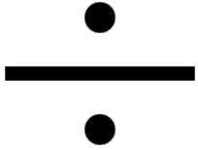
Analysis and Implementation of Common Division Algorithms

Slide 2
Problem statement
Let n be the dividend and d the divisor both unsigned real integers.
How can we find the quotient q and the remainder r?
Can this procedure be optimized?

Slide 3
Why Unsigned Real Integers
Unsigned = positive
Negative numbers are a special case of positive numbers.
For negative numbers just put the minus sing in front of the quotient.
Real = no complex part
Complex numbers are an algebraic combination and manipulation of real numbers.
Most real-life applications and tasks use real numbers.
Integers = no fractional part
Fast algorithms do not bother with the fractional part as this makes them slower.

Slide 4
Applications and Importance of Division Algorithms
Complexity of the floating-point unit (FPU) – Standalone or Integrated
High performance 3D graphics rendering systems (CAD)
Image processing
QR decomposition

Slide 5
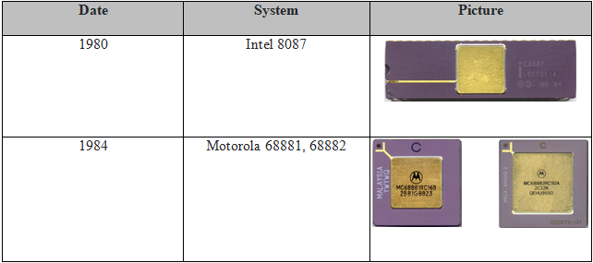
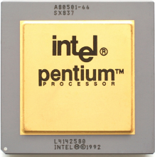
DIVISION NEEDED IN FPU AND CPU
FPU
FPU
CPU

Slide 6
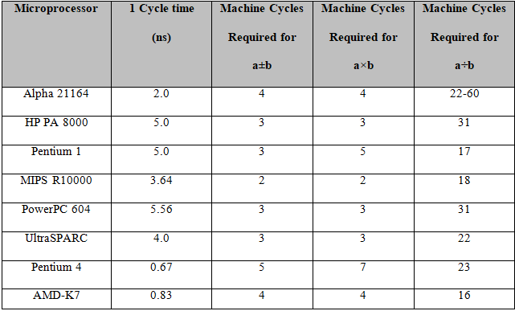
The Need to Optimize Division

Slide 7
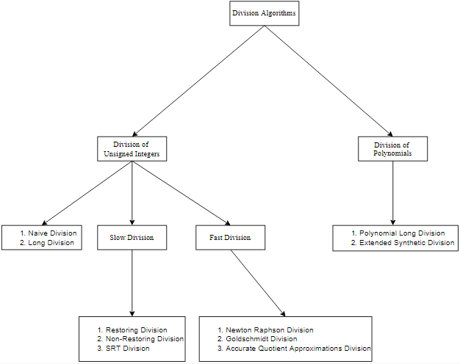
Common Division Algorithms

Slide 8
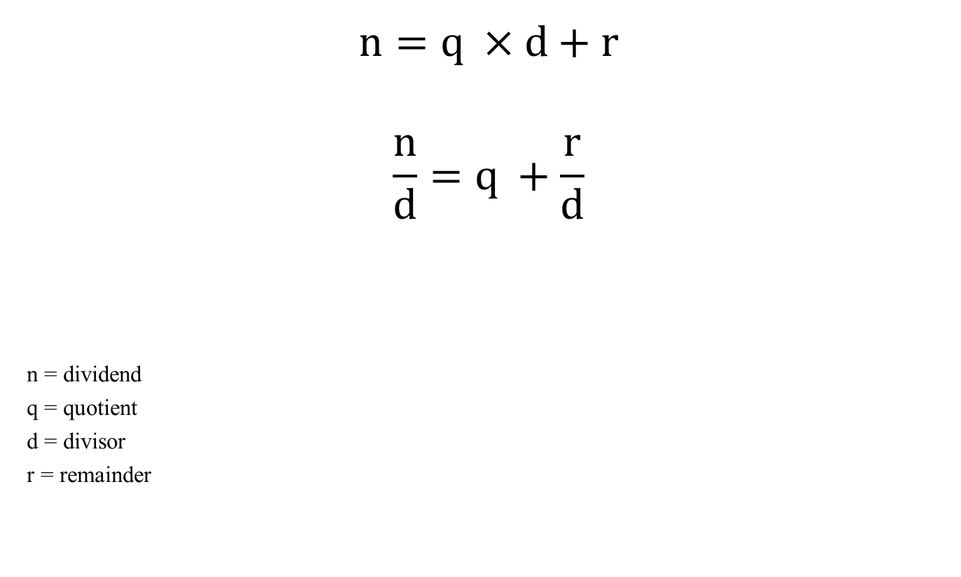
Euclid’s Division Lemma
$$n=q ×d+r$$
$$\frac{n}{d}=q +\frac{r}{d}$$
n = dividend
q = quotient
d = divisor
r = remainder

Slide 9

Conditions on Remainder
$$r<d ×ulp$$
$$0≤r<d$$

Slide 10
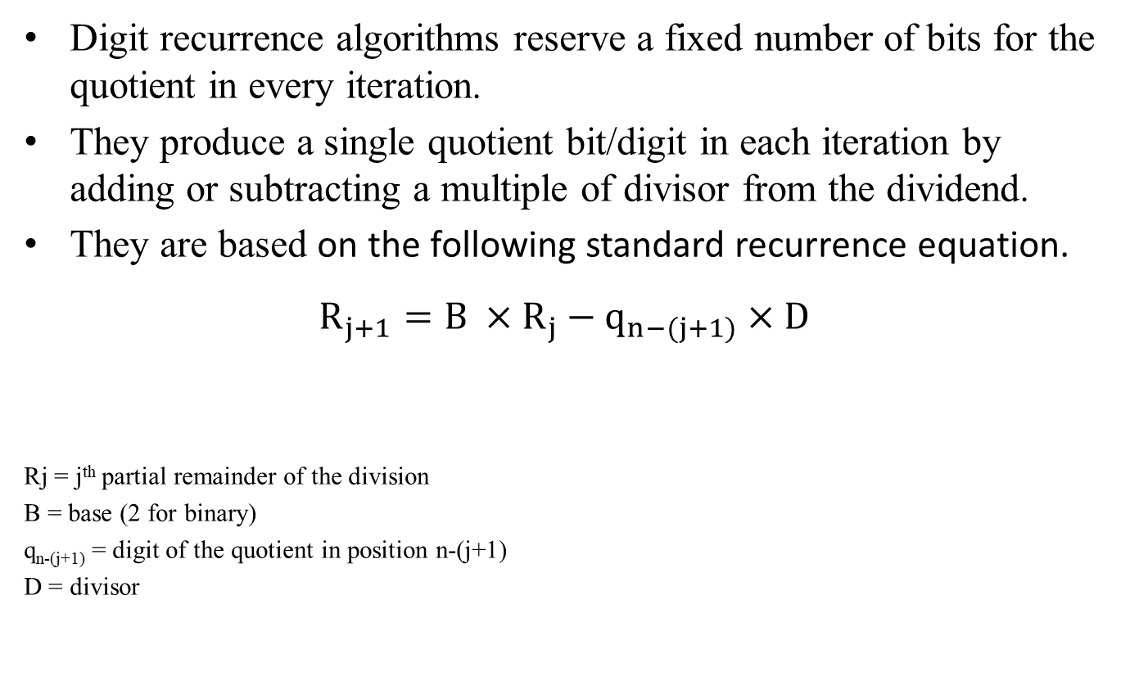
Slow Division/ Digit recurrence Algorithms
Digit recurrence algorithms reserve a fixed number of bits for the quotient in every iteration.
They produce a single quotient bit/digit in each iteration by adding or subtracting a multiple of divisor from the dividend.
They are based on the following standard recurrence equation.
$$R_{j+1}=B ×R_{j}−q_{n−(j+1)}×D$$
Rj = j^{th} partial remainder of the division
B = base (2 for binary)
q_{n-(j+1)} = digit of the quotient in position n-(j+1)
D = divisor

Slide 11
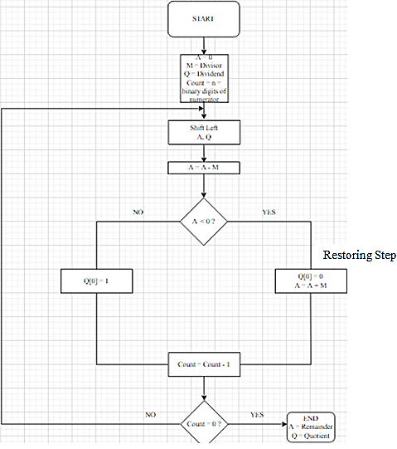
Restoring Division Algorithm
Restoring division algorithm got its name from the fact that it restores the value of A in each iteration.
This algorithm works on the binary level using only 0 and 1.
The digits of the quotient are from the set [0, 1].

Slide 12
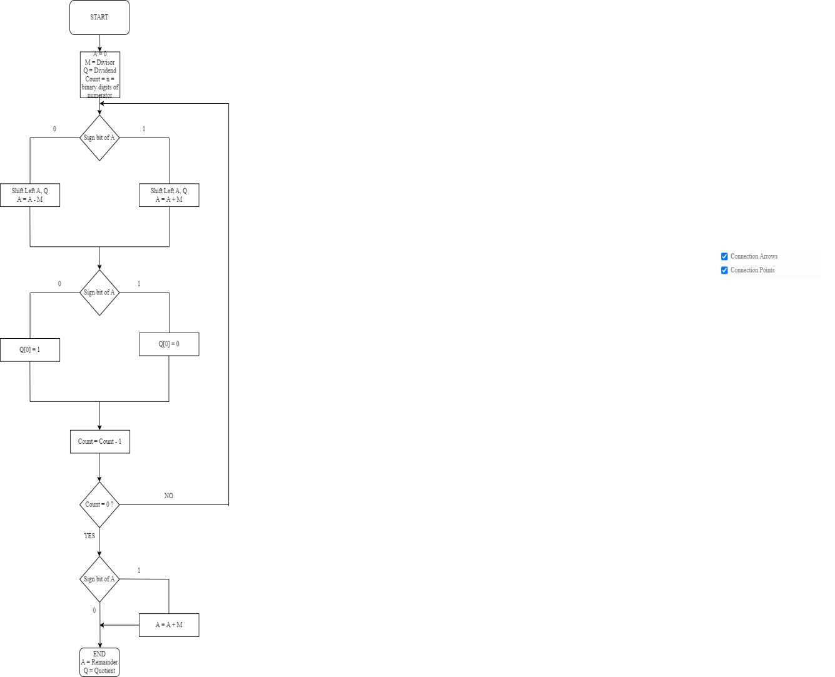
Non-Restoring Division Algorithm
More complex than Restoring Division Algorithm.
However, it avoids the Restoring Step.

Slide 13
SRT Division Algorithm
Application: General-purpose CPU
The Intel Pentium processor (slide 5) uses a base 4 SRT division algorithm where the quotient digits are from the set [-2, -1, 0, 1, 2].
SRT is a special case of the non-restoring division algorithm.
Generates a fixed number of quotient bits at every iteration.
Uses subtraction as the fundamental operator to calculate a quotient bit/digit in each iteration.
Main Idea: Guess the quotient digit based on the most significant bits of the divisor and the partial remainder.
Next, find an answer close enough to the correct answer and then use redundant quotient bits/digits to correct subsequent steps.

Slide 14
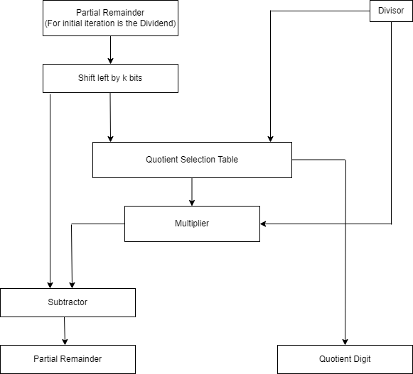
SRT Division Algorithm
Step 1: The partial remained is multiplied by the base n that is used. This is done by left bit shifting by k bits.
Step 2: The result given to the quotient selection table and the subtractor.
Step 3: The divisor provides the second input for the quotient selection table.
Step 4: Based on few of the most significant bits of the divisor and the partial remainder, the quotient digit for the next iteration is calculated. This is known as the multiplier.
Step 5: The multiplier becomes the second input of the subtractor.
Step 6: The subtractor generates the next partial remainder.
Step 7: Repeat process until all the quotient bits/digits are revealed

Slide 15
Fast Division/ Functional Iterative/ Multiplicative Algorithms
Give more than one quotient digit in each iteration.
They are based on multiplication. Eliminate addition and subtraction as much as possible.
Multiplication can be done using bit shifting.
Bit shifting is faster than addition and subtraction.
They give only the quotient. Do not bother with the remainder.

Slide 16
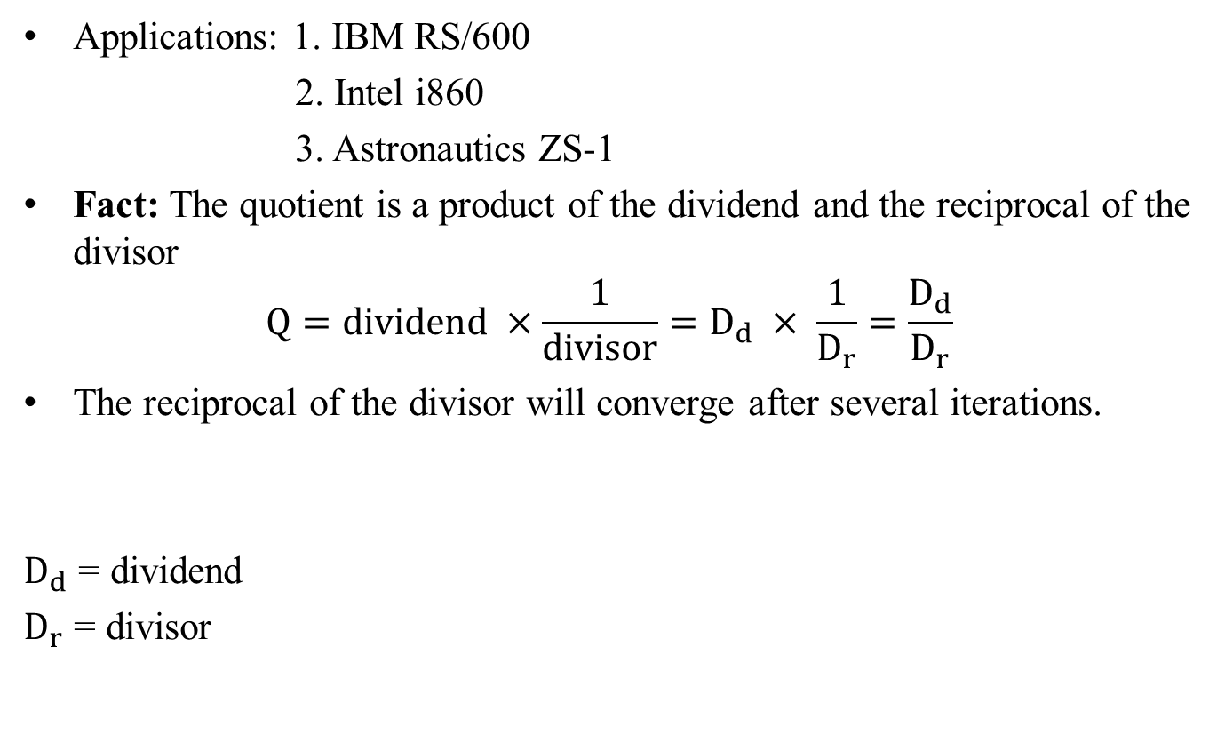
Newton Raphson Division Algorithm
Applications: 1. IBM RS/600
2. Intel i860
3. Astronautics ZS-1
Fact: The quotient is a product of the dividend and the reciprocal of the divisor
$$Q=dividend ×\frac{1}{divisor}=D_{d} × \frac{1}{D_{r}}=\frac{D_{d}}{D_{r}}$$
The reciprocal of the divisor will converge after several iterations.
$D_{d}$ = dividend
$D_{r}$ = divisor

Slide 17

Newton Raphson Division Algorithm
The Newton Raphson Division Algorithm is divided into three processes.
Process 1:
Find the initial estimation of the divisor’s reciprocal using a priming function that has a root at the divisor’s reciprocal.
$F\left(X\right)=\frac{1}{X}−D_{r}=0$, F(X) = Priming function

Slide 18
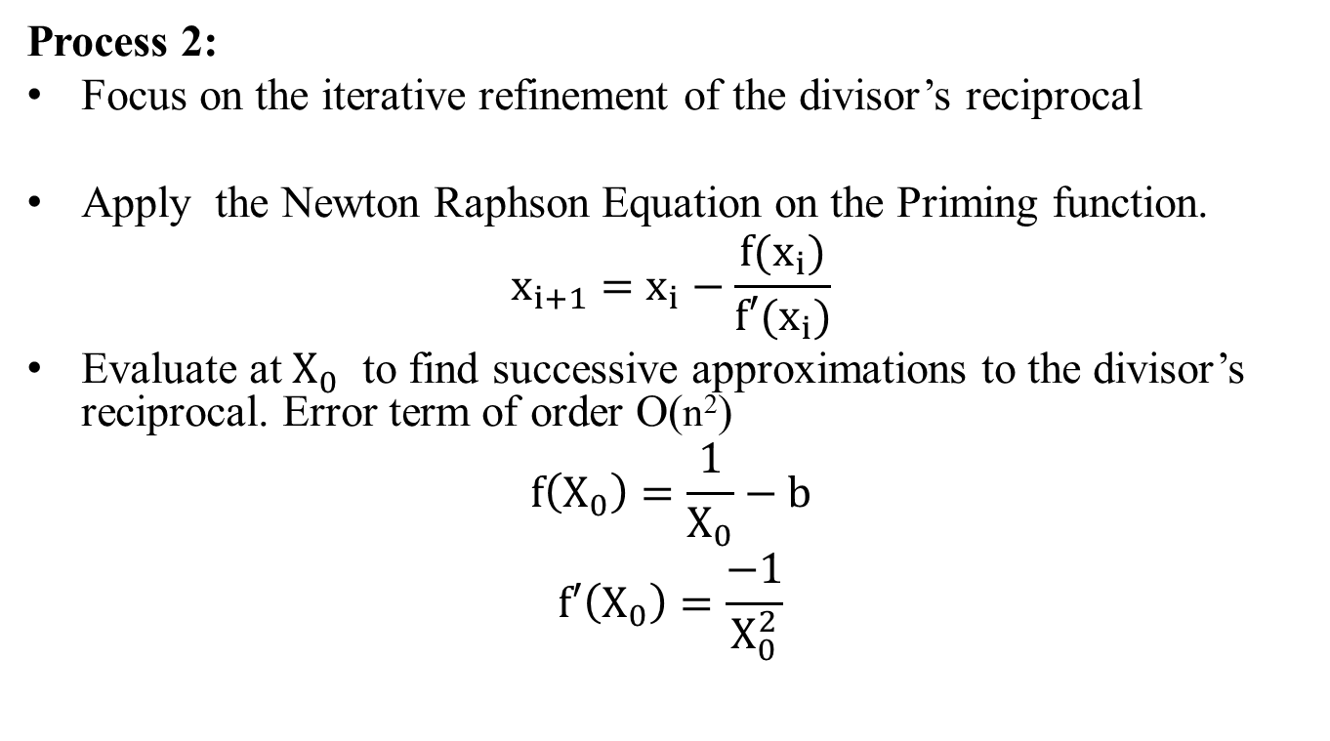
Newton Raphson Division Algorithm…
Process 2:
Focus on the iterative refinement of the divisor’s reciprocal
Apply the Newton Raphson Equation on the Priming function.
$$x_{i+1}=x_{i}−\frac{f(x_{i})}{f′(x_{i})}$$
Evaluate at $X_{0}^{}$ to find successive approximations to the divisor’s reciprocal. Error term of order O(n²)
$$f\left(X_{0}\right)=\frac{1}{X_{0}}−b$$
$$f′\left(X_{0}\right)=\frac{−1}{X_{0}^{2}}$$

Slide 19

Newton Raphson Division Algorithm…
Successive approximations to the divisor’s reciprocal until it converges.
$$X_{1}=X_{0}−\frac{f(X_{0})}{f′(X_{0})}$$
$$X_{1}=X_{0}+\frac{(\frac{1}{X_{0}}−b)}{(\frac{1}{X_{0}^{2}})}$$
$$X_{1}=X_{0}×(2−b×X_{0})$$
$$X_{i+1}=X_{i}×(2−b×X_{i})$$

Slide 20

Newton Raphson Division Algorithm…
Process 3:
Multiply the dividend and the final convergent divisor reciprocal found in the previous step using the fact mentioned before.
$$Q=dividend ×\frac{1}{divisor}=D_{d} × \frac{1}{D_{r}}=\frac{D_{d}}{D_{r}}$$

Slide 21
Goldschmidt Division Algorithm
Applications: 1. General-purpose CPU
2. IBM 360/91
3. TMS390C602A Sparc FPU
Main Idea: The iterative parallel multiplication of the dividend and the divisor by multiplicative factors until the final divisor will be one or close to one

Slide 22
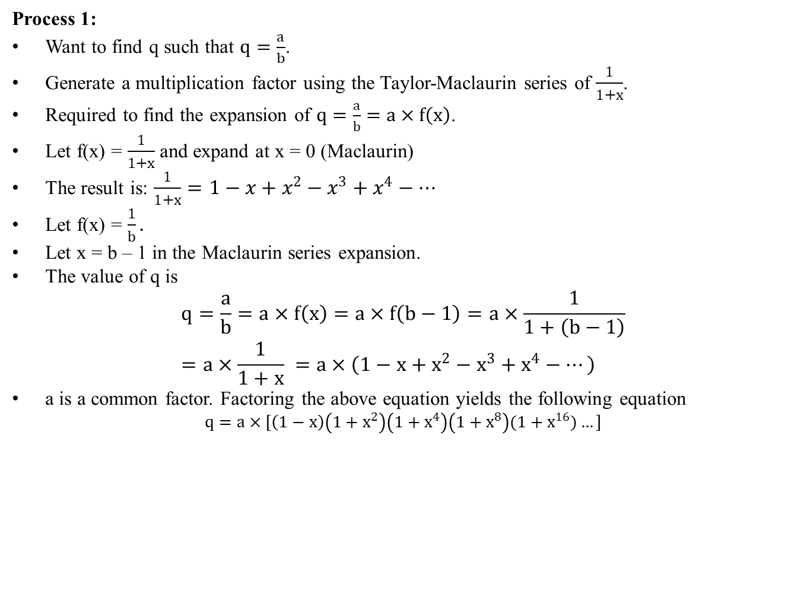
Goldschmidt Division Algorithm…
Process 1:
Want to find q such that $q=\frac{a}{b}$.
Generate a multiplication factor using the Taylor-Maclaurin series of $\frac{1}{1+x}$.
Required to find the expansion of $q=\frac{a}{b}=a×f\left(x\right)$.
Let f(x) = $\frac{1}{1+x}$ and expand at x = 0 (Maclaurin)
The result is: $\frac{1}{1+x}=1−x+x^{2}−x^{3}+x^{4}−…$
Let f(x) = $\frac{1}{b}.$
Let x = b – 1 in the Maclaurin series expansion.
The value of q is
$$q=\frac{a}{b}=a×f\left(x\right)=a×f\left(b−1\right)=a×\frac{1}{1+\left(b−1\right)}=a×\frac{1}{1+x} =a×\left(1−x+x^{2}−x^{3}+x^{4}−…\right)$$
a is a common factor. Factoring the above equation yields the following equation
$$q=a×[\left(1−x\right)\left(1+x^{2}\right)\left(1+x^{4}\right)\left(1+x^{8}\right)(1+x^{16})…]$$

Slide 23
Comparison of Common Division Algorithms
We will compare all division algorithms with respect to:
1. The number of digits that they can handle
2. The time they need to execute
The tests were done in the Python programming language with a machine having an AMD 3020e CPU and the following machine environment.
The tests were stopped at 30 minutes.

Slide 24
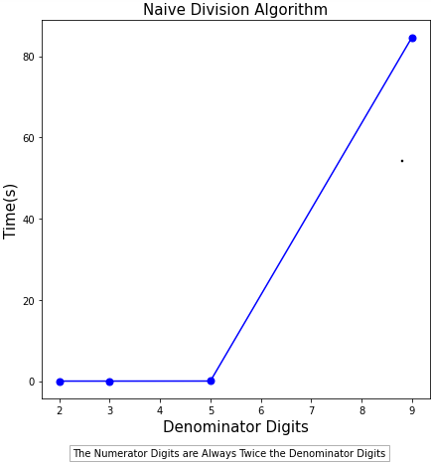
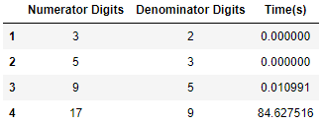
Naive Division Algorithm

Slide 25
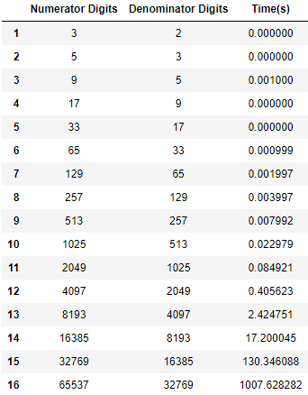
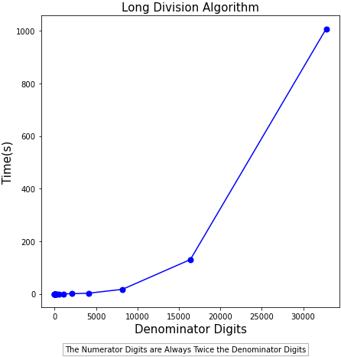
Long Division Algorithm

Slide 26
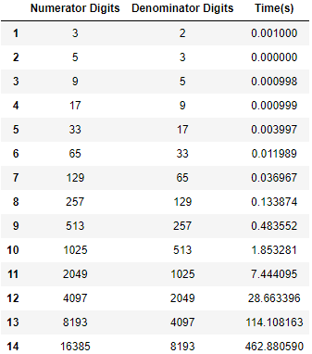
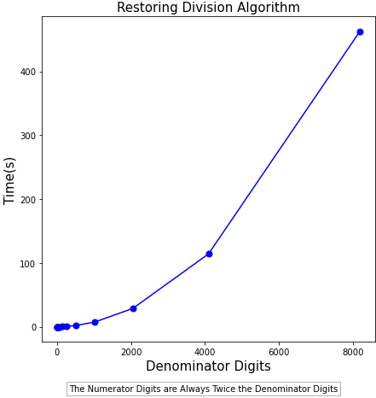
Restoring Division Algorithm

Slide 27
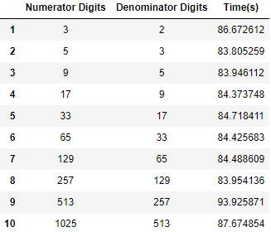
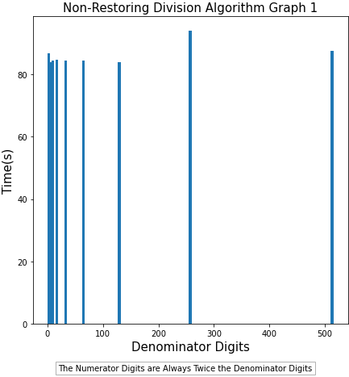
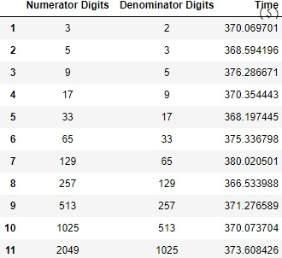
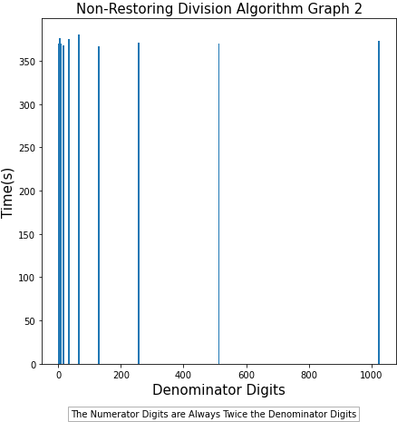
Non-Restoring Division Algorithm

Slide 28
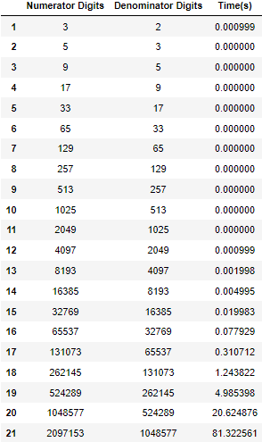
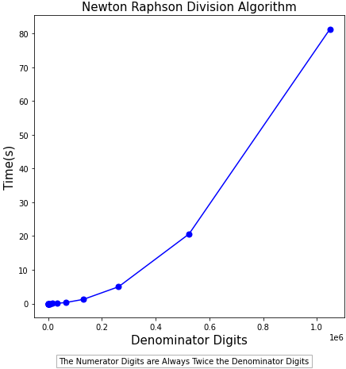
Newton Raphson Division Algorithm

Slide 29
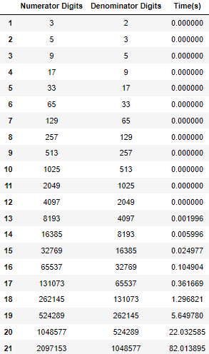
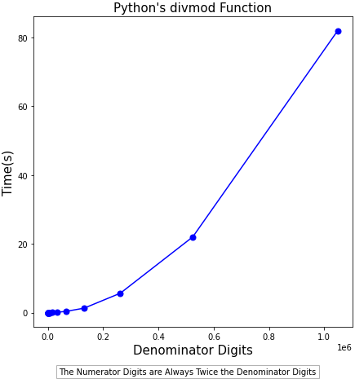
Python’s divmod Function

Slide 30
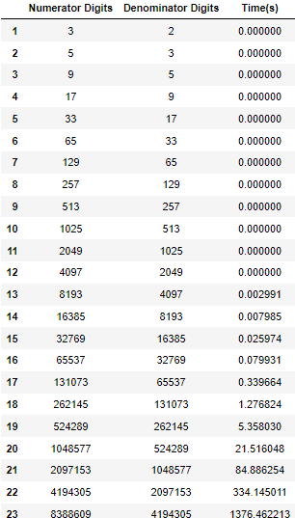
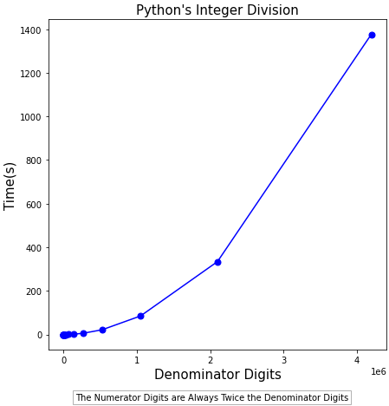
Python’s Integer Division

Slide 31
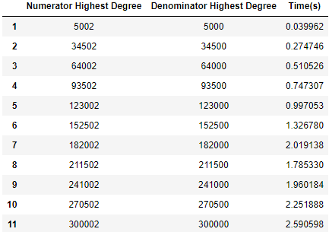
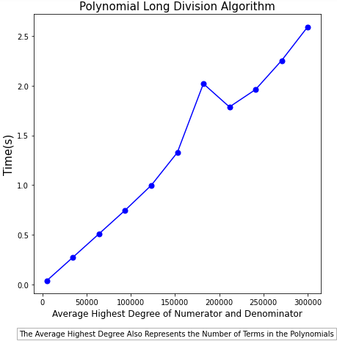
Polynomial Long Division Algorithm

Slide 32
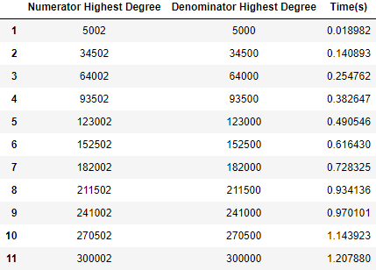
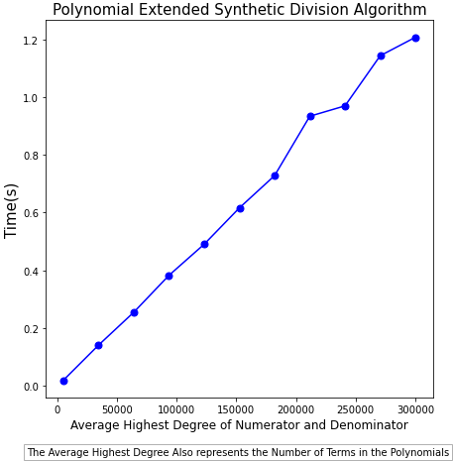
Polynomial Extended Synthetic Division Algorithm

Slide 33
Conclusion
Number of atoms in the universe = 10⁷⁸ to 10⁸²
Newton Raphson division algorithm = 2,097,153 digits (able to carry the most complex tasks)
Polynomial extended synthetic division algorithm = 300,002nd degree polynomials
Newton Raphson division algorithm is the fastest and faster than Python’s built-in functions
None of the division algorithms is considered as the “best”.
There is a trade-off in choosing what division algorithm to use and it depends on the task needed to be done.

Slide 34
QUESTIONS

