Slide 1
AI IN GENOMICS - FINAL PROJECT
Interpretable Features vs.
Protein Language Models
Comparing handcrafted features and ESM-2 embeddings for missense variant pathogenicity classification
Georgios Ioannou
gi2100
Vedant Jagtap
vsj7589
Team 19 | May 2026

Slide 2
ACT 1 - THE WORLD
Setting the scene
A patient walks into a clinic.
Their DNA is sequenced. The lab finds hundreds of differences from the reference human genome.
Most are harmless. A few might cause disease. The doctor needs to know which is which.
Today, roughly 40% are reported as 'uncertain' - no answer, no action.
THE BOTTLENECK
~40%
of clinically reported variants are 'variants of uncertain significance'
That's the gap we want AI to close.

Slide 3
ACT 1 - THE PROBLEM
Zooming in
Which letter changes break the protein?
We focus on missense variants - changes that swap one amino acid in a protein for another.
Some break the protein (pathogenic).
Others are tolerated (benign).
Telling them apart from sequence alone is the open problem.
...K-L-V-A-G-T-R-N...
Reference
...K-L-V-C-G-T-R-N...
Pathogenic - protein breaks
...K-L-V-I-G-T-R-N...
Benign - protein still works

Slide 4
ACT 1 - THE QUEST
What we set out to answer
Two questions
Q1
How much signal lives in simple, interpretable features?
Identity of the amino acids, substitution score, local composition, position. 62 dimensions.
Q2
Does ESM-2 actually help when tested on new genes?
Evaluated on entire genes held out from training - the clinically realistic setting.
The tradeoff: interpretability vs. compute vs. performance vs. generalization.

Slide 5
OUR APPROACH
Bridge to methods
What we built, and what makes it different
WHAT WE BUILT
WHY IT'S DIFFERENT
Four classifiers
trained on 193K labelled variants - then compared head-to-head against AlphaMissense and CADD on the same held-out test set.
1
Strict gene-disjoint test - no variant from a training gene appears at test time.
2
Feature-family ablation directly quantifies the interpretability-vs-performance tradeoff.
3
We empirically test the UR50 pretraining contamination concern - not just flag it.

Slide 6
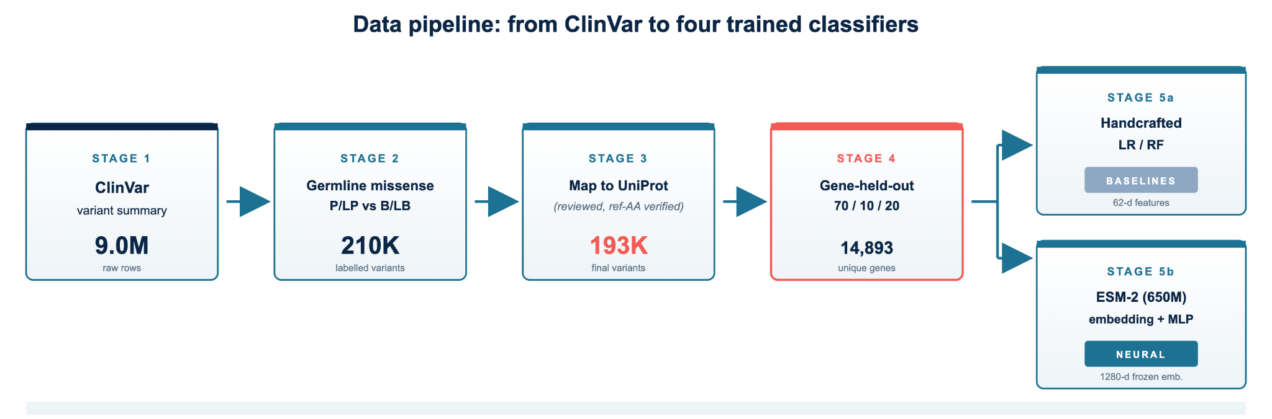
ACT 2 - THE SETUP
Step 1: assembling clean data
From 9 million rows to 193K usable variants

Slide 7
ACT 2 - THE SETUP
Step 2: building a fair test
We hold out entire genes, not just variants
Train 70%
Val 10%
Test 20%
Train
Val
Test
135,418
19,539
38,526
10,425 genes
1,489 genes
2,979 genes
Why it matters: if any gene appears in both train and test, the model can cheat by memorizing gene-specific patterns. By splitting on whole genes, we force every test gene to be brand new.

Slide 8
ACT 2 - THE SETUP
Step 3: lining up the contestants
Four of ours, two outside references
MODEL
INPUT
ARCHITECTURE
Logistic regression
62-d handcrafted
L2 LR, class-balanced
BASELINE
Random forest
62-d handcrafted
500 trees, tuned
BASELINE
ESM-2 head
1280-d frozen emb.
MLP, AdamW
NEURAL
Combined head
1342-d (concat)
MLP, wider input
NEURAL
Outside references: AlphaMissense and CADD - we score them on the same test variants to know where the field stands.

Slide 9
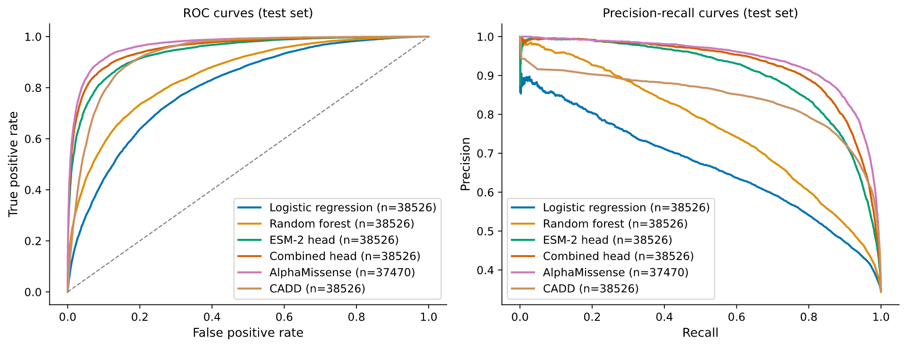
ACT 3 - FINDING 1
Headline result
ESM-2 closes most of the gap to AlphaMissense

Slide 10
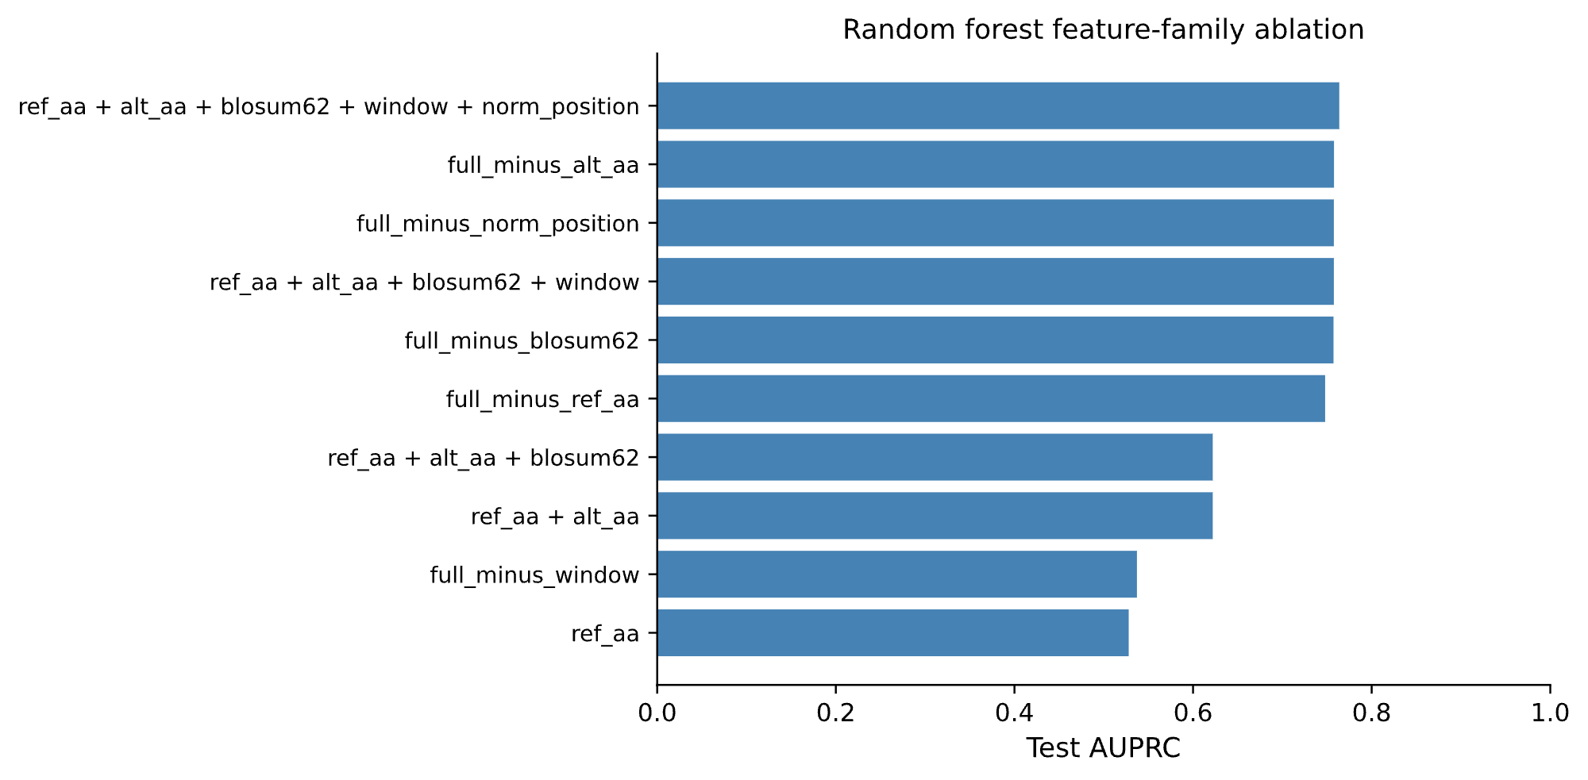
ACT 3 - FINDING 2
Answering Q1
Simple features get you 81% of the way there

Slide 11
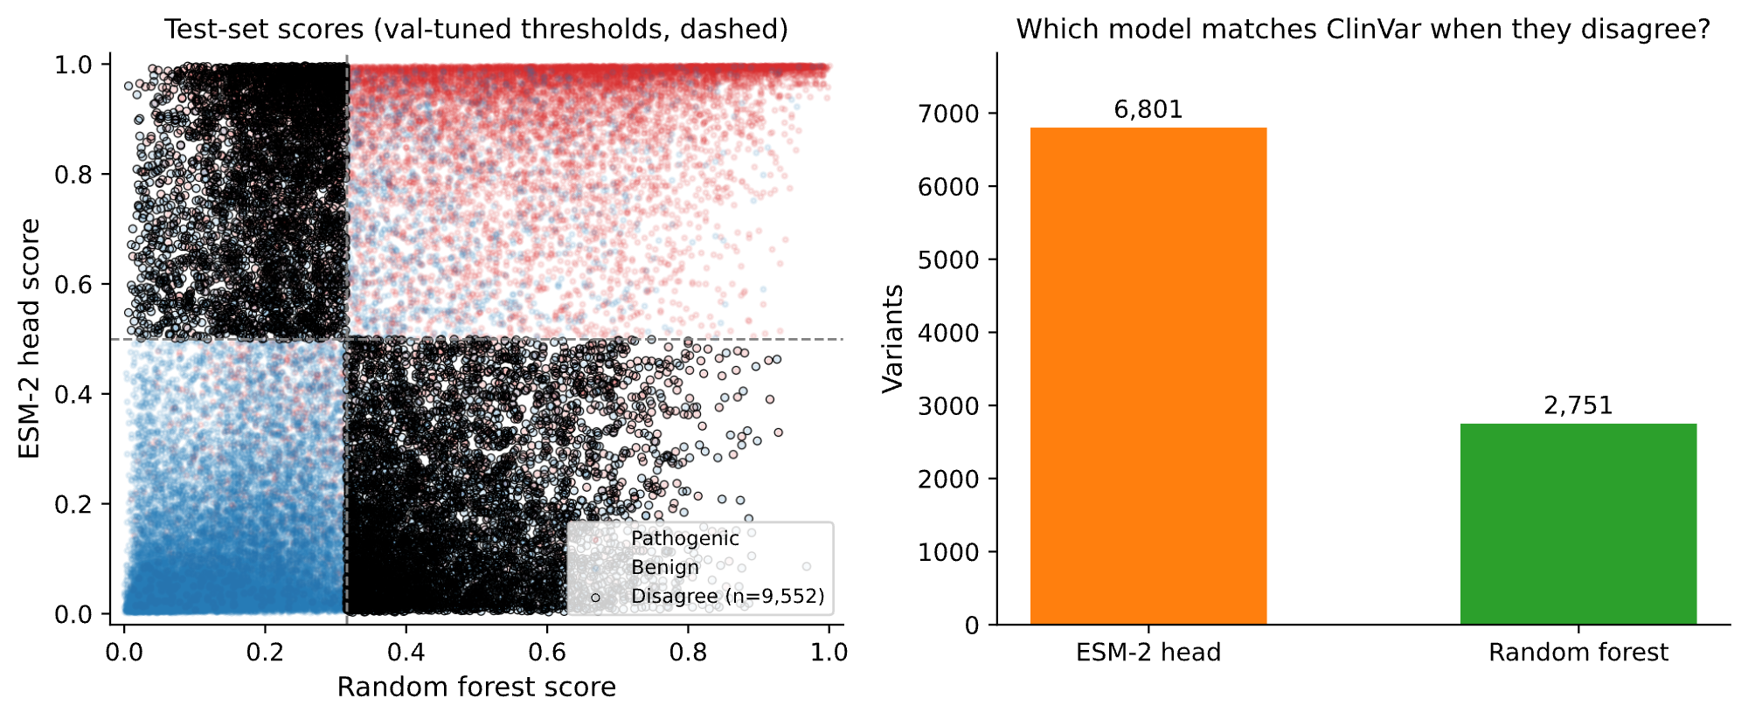
ACT 3 - FINDING 3
Looking inside the gap
When RF and ESM-2 conflict, ESM-2 wins more often

Slide 12
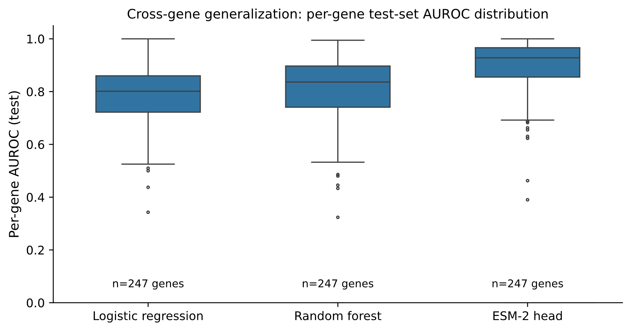
ACT 3 - FINDING 4
Answering Q2
ESM-2 generalizes evenly across genes

Slide 13
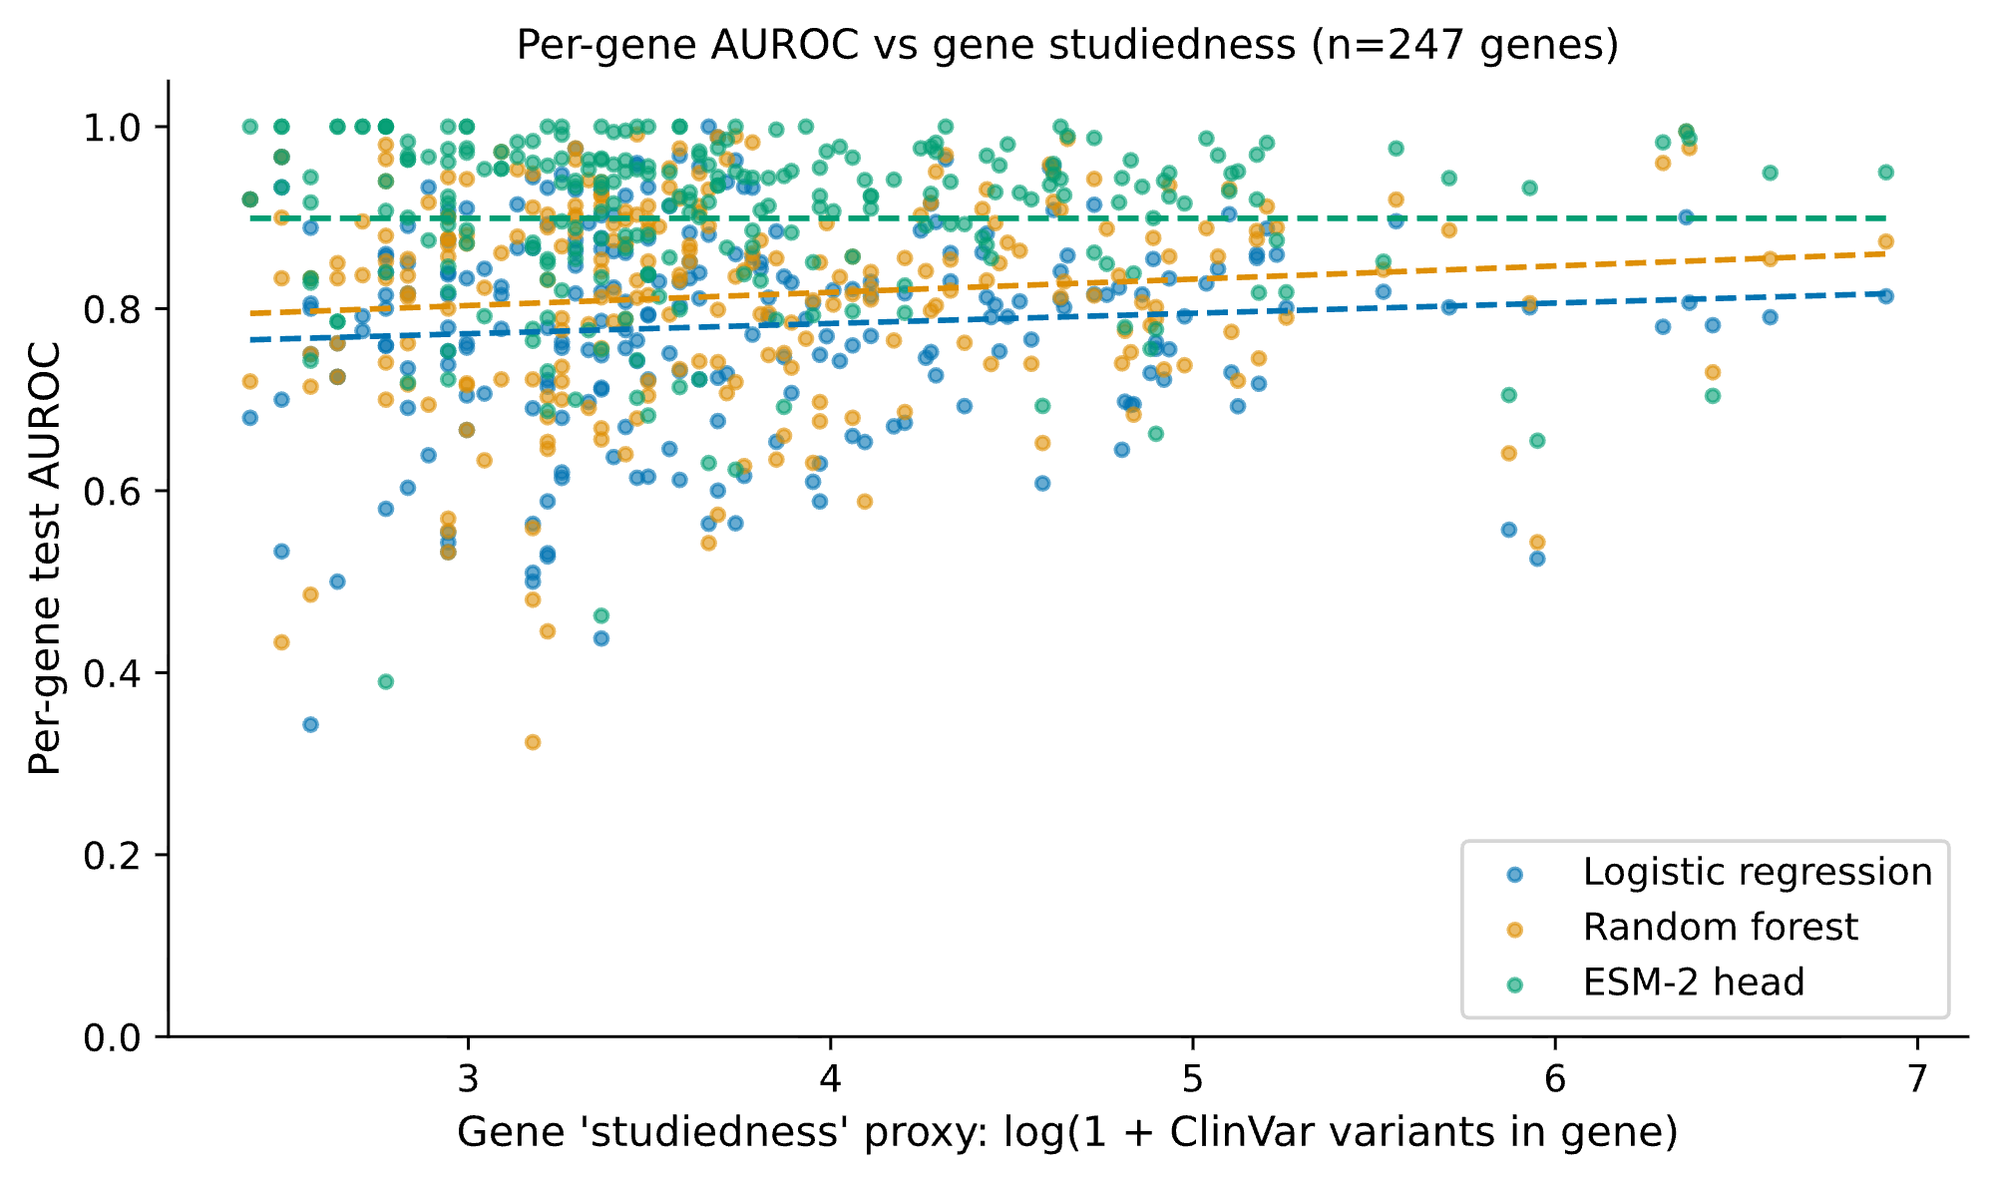
ACT 3 - THE CONTAMINATION CHECK
But wait...
Is ESM-2 just winning on well-studied genes?

Slide 14
ACT 4 - WRAPPING UP
Three things we learned, plus what's next
Simple features carry real signal. A 62-d handcrafted vector reaches AUROC 0.850 - and just three of those features get you to 81% of that.
1
ESM-2 truly generalizes. +0.089 AUROC over the random forest on held-out genes (p < 0.001). The advantage isn't from UR50 contamination.
2
Combining is best. Concatenating handcrafted features with ESM-2 embeddings gives another +0.015 - they carry complementary information.
3
LIMITS ClinVar bias, optimistic references
NEXT Fine-tune ESM-2 end-to-end on ClinVar

Slide 15
Thank You!

