Slide 1


Slide 2
Data Description & Hypothesis
Our Dataset provides information about shark attacks incidents globally, and based on this information we are going to explore these hypothesis:
Higher number of shark attacks based on the location - in which locations we notice higher number of incidents.
We expect higher number of shark attacks in summer months - to test this hypothesis whether is true.
How the type of activity can predict the possibility for a fatal incident - the correlation between activity and number of fatal incidents.
If there is correlation between the type of species with the number of fatal cases - exploring whether the type of the shark can predict the fatality of the incident.

Slide 3
Data Cleaning & Techniques
Whole Dataset:
Dropping irrelevant columns
Stripping the columns names & keeping first letter in uppercase
Yorgos: Country, State, Activity
Removed non-alphanumeric characters, Removed Extra Spaces, using Regex and strip() Spaces, Converted text to uppercase.
Replaced NaN with ‘Unknown’.
Using fuzz.ratio to identify similar values in the column & corrected with replace function.
For activity: Contains function to replace values based on pattern Key words
Vera: Age, Injury, Fatal
Added a new column with the category according to the age number. (e.g. : baby - age<=2 years, child - age<=12 years, senior -age>60 years)
To achieve that a function was created to extract the number from column Age.
For injury: a function to locate the most common word and replace them with a single category. (e.g minor/ moderate/severe and fatal injuries)
A new column added to group Fatality to Y or N.
Iryna: Sex, Date, Location
I was responsible for cleaning 'Sex', 'Date' and 'Location columns, to be able to reach the correct conclusions from our dataset.
- I've replaced empty or whitespace-only strings in 'Sex', 'Date', and 'Location' with NaN.
- Standardized 'Sex' and 'Date' columns: trimmed whitespace, converted entries to uppercase, and retained only 'M' or 'F', setting others to NaN.
In 'Date' column converted entries to datetime objects, coercing invalid formats to NaT.
- Cleaned 'Location' column: trimmed whitespace, standardized to title case, and removed entries with excessive length or non-alphabetic characters.
- And finished with removing duplicates: dropped duplicate rows based on 'Sex', 'Date', and 'Location'.
Ngoc: Year, Type, Species
Year: Convert values to integers, replace NaN with Zero, remove commas and decimals.
Type: replace function to create standardized categories to describe the Type, and lstrip() spaces.
Species: Replace function to replace values based on keywords.

Slide 4
Challenges in Data Cleaning
(Yorgos): To implement correctly fuzz.ratio & in a way that doesn’t not result in exact matches. Reversing the mapping result for easy replacement of values.
(Vera):Identify the most frequent words and consolidate all diverse data inputs into common categories
(Ngoc): My main challenge was to clean the Species column. First, because I didn't see the space after the word. Second, there were a lot of unique counts. And finally, I have to deal with frustration because the column 'Species' contains almost 50% of blank cells. We cannot analyze and establish the bond between Species and Fatal accidents
(Iryna): My main challenge was to identify which data cleaning techniques to apply, to convert inconsistent data and text formats, and to make it work hahahaha.

Slide 5
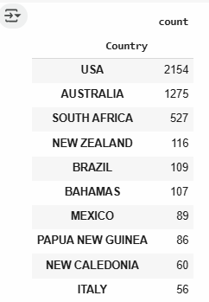
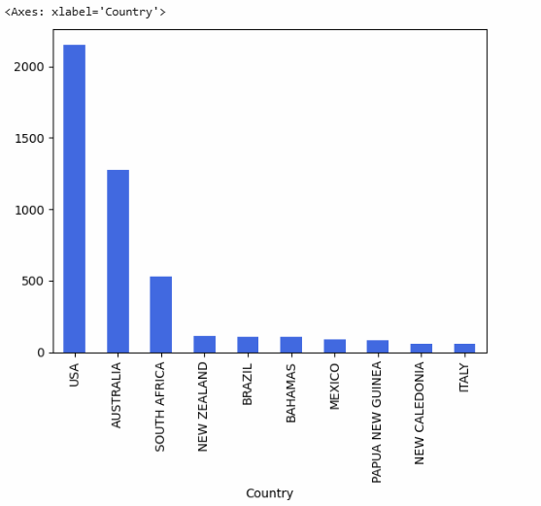
Exploratory Data Analysis & Results
Yorgos: Hypothesis 1 - Higher number of shark attacks based on the location - in which locations we notice higher number of incidents
Data Analysis - We grouped the number of ‘FatalGroup Y/N’ per Country, and created a plot to show the results
Conclusions:
The United States has the highest number of shark attacks by far, followed by Australia, with South Africa ranking third.

Slide 6
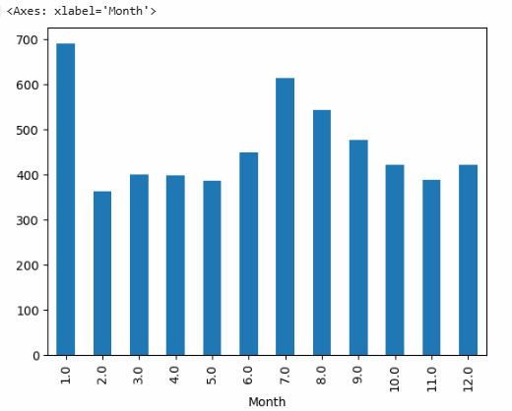
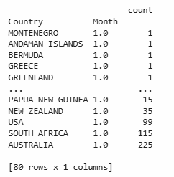
Exploratory Data Analysis & Results
Vera: Hypothesis 2 - We expect higher number of fatal shark attacks in summer months - to test this hypothesis whether is true
Data Analysis - We grouped the number of ‘FatalGroup Y/N’ per month, and created a plot to show the results. *extracted the month from the Date column shark_attacks['Month'] = shark_attacks['Date'].dt.month
Conclusions:
As expected, we observe a higher number of cases during the summer months. However, we also notice that January has the highest number of cases. To explore this further, we incorporated location into our analysis. The high numbers in January are primarily due to cases in Australia, South Africa, and the United States, where it is summer during that time.

Slide 7
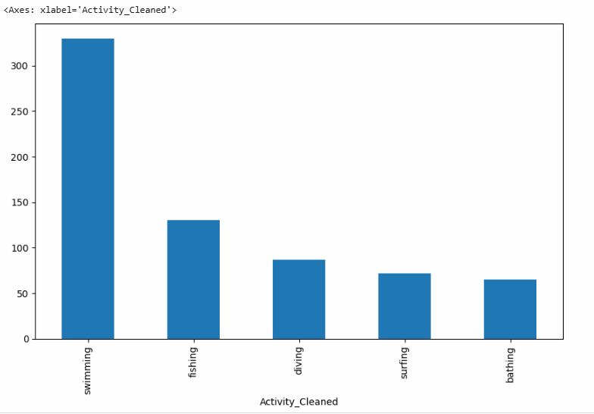
Exploratory Data Analysis & Results
Iryna: Hypothesis 3 - How the type of activity can predict the possibility for a fatal incident - the correlation between activity and number of fatal incidents
Data Analysis - Pivoted our data based on the “Activity_Cleaned” and the number of fatal cases,(shark_attacks['FatalGroup Y/N'] == 'Y']. And created to a plot to show the 5 Activities with the highest number of fatal incidents.
Conclusions:
Swimming is by far the most common activity associated with shark attacks, significantly surpassing all other activities.

Slide 8
Exploratory Data Analysis & Results
Ngoc: Hypothesis 4 - If there is correlation between the type of species with the number of fatal cases - exploring whether the type of the shark can predict the fatality of the incident.
Conclusion: Unable to find a correlation between the numbers of cases and the Shark species because of too many blank values in the Species column associated with Fatal cases (blank cells counts = 3 142 on 6 992 total cells).
Our lovely code: https://colab.research.google.com/drive/1RVfo3N8ofcH9Fle6k9idmBWGGe6AWpp4#scrollTo=e5VMdgwpLyZv

Slide 9

THANK YOU!
Shark Attacks JAWS Team: Iryna, Ngoc, Vera, Yorgos

