Slide 1


Georgios Kyritsis
Personality Insights from a Joint
Text and Image Model
Supervisors:
Prof. Boi Faltings
Dr. Claudiu Musat
Lausanne, 12.12.2017

Slide 2
Personality Insights from a Joint Text and Image Model
Introduction
Emotion Detection from Images
Implement the latest methods to detect and categorize the base emotional state of the people in an image.
8 Basic emotions:
Neutral, Happy, Angry, Sad, Fear, Surprise, Disgust, Contempt
Georgios Kyritsis
12.12.2017

Slide 3


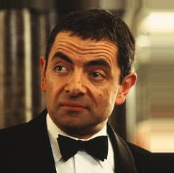
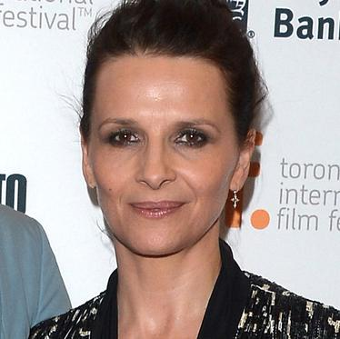


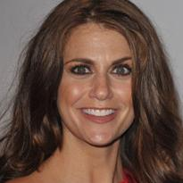
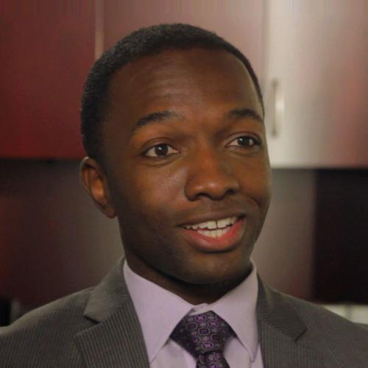
Personality Insights from a Joint Text and Image Model
Datasets
35K+ images annotated with 8 emotions:
Neutral, Happy, Angry, Sad, Fear, Surprise, Disgust, Contempt
IMDB - WIKI - 500K+ images annotated with gender and age:
Georgios Kyritsis
12.12.2017

Slide 4
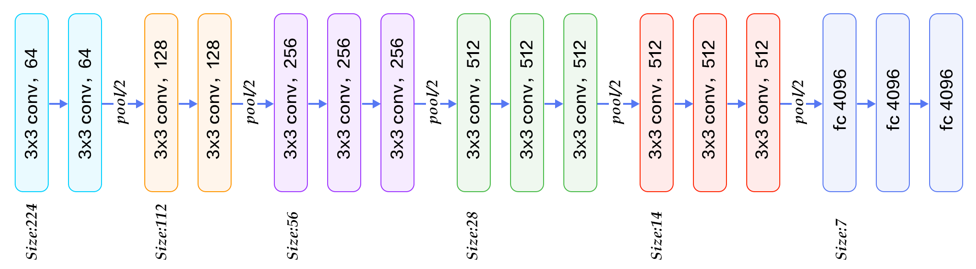
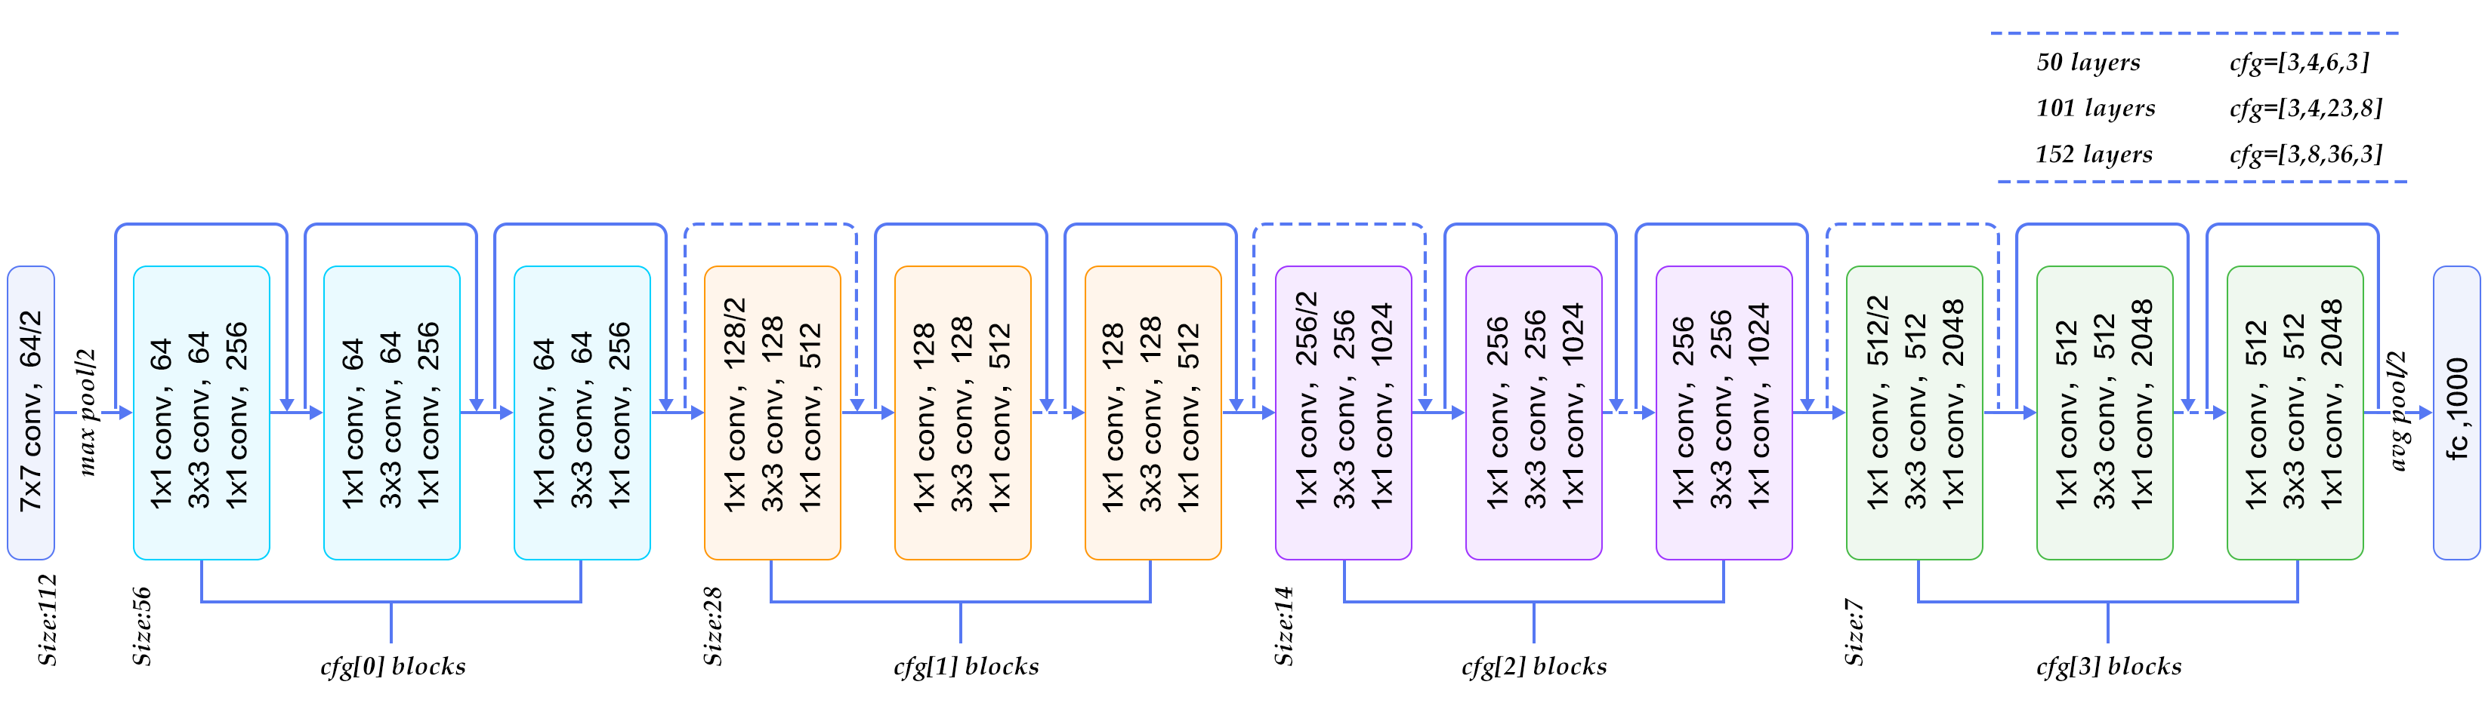
Personality Insights from a Joint Text and Image Model
CNN Architectures
Georgios Kyritsis
12.12.2017

Slide 5
Personality Insights from a Joint Text and Image Model
Architecture with state-of-the-art accuracy
8 emotions
Probabilities
Softmax
FC 1024
Dropout 0.25
FC 8
Max Pooling 2
Conv3, 128
Conv3, 256
Max Pooling 2
Conv3, 64
Conv3, 256
Conv3, 256
Conv3, 64
Conv3, 128
Conv3, 256
Dropout 0.25
Dropout 0.25
Dropout 0.25
Max Pooling 2
Conv3, 256
Conv3, 256
Image 64,64,1
Max Pooling 2
Dropout 0.5
Dropout 0.5
FC 1024
Georgios Kyritsis
12.12.2017

Slide 6
Personality Insights from a Joint Text and Image Model
Multi-task learning
Age
Image
Gender
Emotion
Shared Layers
Task-specific layers
Georgios Kyritsis
12.12.2017

Slide 7
Personality Insights from a Joint Text and Image Model
Architecture with better accuracy
Dropout 0.25
Max Pooling 2
Emotion Probabilities
Max Pooling 2
Max Pooling 2
2X Conv3, 64
Image 64,64,1
2X Conv3, 128
FC 1024
Dropout 0.25
Dropout 0.25
Dropout 0.25
3X Conv3, 256
FC 1024
Softmax
3X Conv3, 256
FC 8
Max Pooling 2
Dropout 0.5
Dropout 0.5
FC 1024
Dropout 0.5
FC 1024
Dropout 0.5
FC 2
Gender
Prob
Softmax
Dropout 0.25
3X Conv3, 512
Dropout 0.25
Max Pooling 2
Max Pooling 2
3X Conv3, 512
FC 1024
Dropout 0.5
FC 1024
Dropout 0.5
FC 1
Age
Georgios Kyritsis
12.12.2017

Slide 8
Personality Insights from a Joint Text and Image Model
Next steps
Increase the accuracy for emotion detection by using different architectures and datasets
Experiment with CapsNets
Build a personality mining system from Joint Text and Image data
Georgios Kyritsis
12.12.2017

Slide 9

Personality Insights from a Joint Text and Image Model
Georgios Kyritsis
12.12.2017

